Slide 1
BIOLOGY 2E
Chapter 16 GENE EXPRESSION
PowerPoint Image Slideshow
This work is licensed under a Creative Commons Attribution-NonCommercial-ShareAlike 4.0 International License.

Slide 2
HOW DOES REGULATION BENEFIT ORGANISMS?
Each somatic cell contains the full genome of an organism
All genes do not need to be expressed simultaneously in each cell (in fact, that would be detrimental to the organism)
Regulation maintains efficiency
Energy – expressing all genes would require a massive amount of energy
Space – cells are kept to a manageable size
Time – genes can be expressed as needed and more rapidly.

Slide 3
DIFFERENT CELL TYPES EXHIBIT DIFFERENTIAL GENE EXPRESSION
The genetic content of each somatic cell in an organism is the same, but not all genes are expressed in every cell. The control of which genes are expressed dictates whether a cell is (a) an eye cell or (b) a liver cell. It is the differential gene expression patterns that arise in different cells that give rise to (c) a complete organism.

Slide 4
GENERAL MODEL OF TRANSCRIPTION AND TRANSLATION IN PROKARYOTIC ORGANISMS
Transcription and translation occur simultaneously in the cytoplasm.
Regulation occurs at the
transcriptional level.
Notes:
Prokaryotic transcription and translation occur simultaneously in the cytoplasm, and regulation occurs at the transcriptional level. Eukaryotic gene expression is regulated during transcription and RNA processing, which take place in the nucleus, and during protein translation, which takes place in the cytoplasm. Further regulation may occur through post-translational modifications of proteins.

Slide 5
GENERAL MODEL OF TRANSCRIPTION AND TRANSLATION IN EUKARYOTIC ORGANISMS
Eukaryotic transcription and RNA processing occurs in the nucleus
Translation takes place in the cytoplasm
Gene expression is regulated during:
Transcription
Translation
Post-translational modification of proteins

Slide 6
GENE EXPRESSION REGULATION DIFFERENCES
Prokaryotic organisms | Eukaryotic organisms
Lack nucleus | Contain nucleus
DNA is found in the cytoplasm | DNA is confined to the nuclear compartment
RNA transcription and protein formation occur almost simultaneously | RNA transcription occurs prior to protein formation, and it takes place in the nucleus. Translation of RNA to protein occurs in the cytoplasm.
Gene expression is regulated primarily at the transcriptional level | Gene expression is regulated at many levels (epigenetic, transcriptional, nuclear shuttling, post-transcriptional, translational, and post-translational)
Refer back to this table as you review the subsequent sections in this chapter

Slide 7
PROKARYOTIC GENE REGULATION
Prokaryotic DNA is organized into a
circular chromosome located in nucleoid region of cytoplasm
Proteins with similar function or in the same
biochemical pathway are organized in blocks
called operons
Operons are regulated by three molecule types:
Repressors – suppress transcription
Activators – increase transcription
Inducers – may suppress or activate transcription depending upon the needs of the cell

Slide 8
THE trp OPERON: A REPRESSOR OPERON
When tryptophan is plentiful
two tryptophan molecules bind the repressor protein at the operator sequence
The complex physically blocks the RNA polymerase from transcribing the tryptophan genes by binding to operator

Slide 9
THE trp OPERON: A REPRESSOR OPERON
When tryptophan is absent
the repressor protein does not bind to the operator
The RNA polymerase can access the operator and the genes are transcribed
Negative Regulators: Proteins that bind to the operator silence trp expression.

Slide 10
CATABOLITE ACTIVATOR PROTEIN (CAP): AN ACTIVATOR REGULATOR
When glucose levels fall,
E. coli may use other sugars
for fuel but must transcribe
new genes to do so.
Positive Regulators: Proteins that bind the promoter in order to activate gene expression
Glucose supplies become limited in cell
cAMP levels increase
cAMP binds to the CAP protein (a positive regulator)
CAMP/CAP protein complex binds to an operator region upstream of the genes required to use other sugar sources

Slide 11
THE lac OPERON: AN INDUCER OPERON
Inducible operons:
Proteins that activate or repress transcription
Activation/repression depends on the local environment and the needs of the cell.
Notes:
Transcription of the lac operon is carefully regulated so that its expression only occurs when glucose is limited and lactose is present to serve as an alternative fuel source.

Slide 12
THE lac OPERON: AN INDUCER OPERON
Notes:
Transcription of the lac operon is carefully regulated so that its expression only occurs when glucose is limited and lactose is present to serve as an alternative fuel source.

Slide 13
EUKARYOTIC EPIGENETIC GENE REGULATION
Eukaryotic gene expression is more complex than in prokaryotes:
Transcription and translation are physically separated.
Regulation can occur at many levels.
1st level begins with control of access to the DNA – epigenetic regulation – and occurs before transcription begins.
Transcription factors are proteins that control the transcripton of genetic information from DNA to RNA

Slide 14
EPIGENETIC CONTROL: REGULATING ACCESS TO GENES WITHIN THE CHROMOSOME
Organization of human genome
20,000 genes
23 chromosomes (thousands of genes/chromosome)
DNA is wound/compacted tightly with proteins (histones)
Expressed genes must be unwound and made available to polymerases

Slide 15
ORGANIZATION OF DNA AND PROTEINS
DNA is folded around histone proteins to create (a) nucleosome complexes.
These nucleosomes control the access of proteins to the underlying DNA.
When viewed through an electron microscope (b), the nucleosomes look like beads on a string. (credit “micrograph”: modification of work by Chris Woodcock)

Slide 16
NUCLEOSOMES CONTROL ACCESS TO DNA
When nucleosomes are spaced closely together (top), transcription factors cannot bind and gene expression is turned off.
When the nucleosomes are spaced far apart (bottom), the DNA is exposed.
With the DNA exposed, transcription factors can bind to it, allowing gene expression to occur.

Slide 17
CHEMICAL MODIFICATIONS OF HISTONES AND DNA AFFECT GENE EXPRESSION
Chemical tags are added to histones and DNA
Phosphate, methyl, acetyl groups serve as tags
Tags are not permanent – can be added or removed
Acts as signals to tell histones if region of chromosome should be open or closed
Epigenetic regulation – “around genetics” temporary changes to nuclear proteins and DNA that do not alter nucleotide sequence but do alter gene expression

Slide 18
HISTONE PROTEINS AND DNA NUCLEOTIDES CAN BE MODIFIED CHEMICALLY
Unwinding and opening of DNA allows transcription factors to bind promoters and other upstream regions and initiate transcription
Modifications affect nucleosome spacing and gene expression.
(credit: modification of work by NIH)

Slide 19
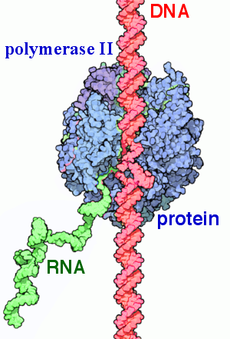
EUKARYOTIC TRANSCRIPTION GENE REGULATION
Gene transcription in Eukaryotes requires RNA polymerases.
These RNA polymerases require transcription factors (specialized proteins) to initiate transcription.
These factors bind the promoter sequence and other DNA regulatory sequences.
Eukaryotic RNA polymerases require transcription factors in order to initiate transcription
RNA polymerase II interacting with DNA (red) and producing new RNA (green).
Credit: Protein Data Bank, Public Domain

Slide 20
EXAMPLE OF TRANSCRIPTION REGULATION
https://www.youtube.com/watch?v=vi-zWoobt_Q

Slide 21
PROMOTER AND TRANSCRIPTION MACHINERY
Promoter – Region of DNA upstream of coding sequence (a few nucleotide to 100’s of nucleotides long)
TATA box – a series of thymine and adenine dinucleotides within the promoter just upstream of the transcriptional start site

Slide 22
PROMOTER AND TRANSCRIPTION MACHINERY
Transcription factor TFIID binds the TATA box
This recruits additional transcription factors to form a complex at TATA box
RNA polymerase can bind to upstream sequence
RNA polymerase is then phosphorylated and part of protein is released from DNA
RNA polymerase is in proper orientation for transcription

Slide 23
PROMOTER AND TRANSCRIPTION MACHINERY
Enhancer - a DNA sequence that promotes transcription.
Each enhancer is made up of short DNA sequences called distal control elements.
Activators bind to the distal control elements and interact with mediator proteins and transcription factors.
Note: Two different genes may have the same promoter but different distal control elements, enabling differential gene expression.
DNA bending protein changes the shape of DNA and properly orients enhancer region.

Slide 24
EUKARYOTIC POST TRANSCRIPTIONAL GENE REGULATION
RNA transcripts must be processed into final form before translation can begin-post transcriptional modification
This step can be regulated to control gene expression

Slide 25
RNA SPLICING, THE FIRST STAGE OF POST-TRANSCRIPTIONAL CONTROL
Pre-mRNA can be alternatively spliced to create different proteins. This process occurs in the nucleus.

Slide 26
FIVE BASIC MODES OF ALTERNATIVE SPLICING

Slide 27
HOW COULD ALTERNATIVE SPLICING HAVE EVOLVED?
Splicing requires proper identification of introns.
Errors in this process could lead to splicing out of an intervening exon.
Usually would be deleterious to organism…
But it could produce a protein variant without loss of original protein.
New variant might have had an adaptive advantage.

Slide 28
CONTROL OF RNA STABILITY
5’ cap methylated guanosine triphosphate molecule (GTP)prevents degradation of transcript.
Poly-A tail prevents degradation of transcript.
The protein-coding region of mRNA is flanked by 5' and 3' untranslated regions (UTRs).
RNA-binding proteins at these UTRs influences the RNA stability:
Can increase or decrease the length of time mRNA is present in the cytoplasm.
They also regulate mRNA localization and protein translation.

Slide 29
RNA STABILITY AND microRNAS
microRNAs (miRNAs) – short RNA molecules (21-24 nucleotides) that recognize s specific sequence of mRNA.
They associate with ribonucleoprotein complex called RNA-induced silencing complex (RISC).
RISC/miRNA bind to and degrade the mRNA.
Muhonen P, Holthofer H - (2009)

Slide 30
THE INITIATION COMPLEX AND TRANSLATION RATE
Translation controlled by proteins that bind and initiate process (formation of initiation complex).
Eukaryotic initiation factor-2 (eIF-2) – first protein to bind and form complex.
GTP binds to eIF-2 and this complex binds to 40S ribosomal subunit.
Methionine initiator tRNA brings mRNA and binds the eIF-2/GTP/40S complex
GTP is converted to GDP and energy is released.
Phosphate and eIF-2 are released and 60S binds and translation occurs.

Slide 31
GENE EXPRESSION CAN BE CONTROLLED BY FACTORS THAT BIND THE TRANSLATION INITIATION COMPLEX
When eIF-2 is phosphorylated, a conformation change occurs
GTP cannot bind eIF-2: Translation cannot occur
Notes:
Gene expression can be controlled by factors that bind the translation initiation complex.

Slide 32
CHEMICAL MODIFICATIONS AFFECT PROTEIN ACTIVITY
Proteins can be chemically modified – chemicals added or removed
These chemical changes regulate protein activity or length of time they exist in cell.
These changes can alter epigenetic accessibility, transcription, mRNA stability, or translation—all resulting in changes in expression of various genes.
For example, proteins with ubiquitin tags are marked for degradation.
Notes:
Proteins with ubiquitin tags are marked for degradation within the proteasome.

Slide 33
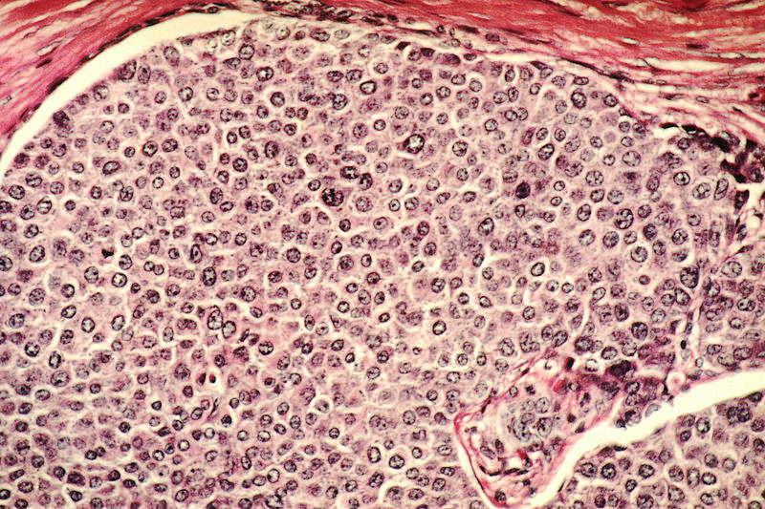
CANCER: DISEASE OF ALTERED GENE EXPRESSION
Breast Cancer Cells
Cancer is not a single disease but many diseases.
Mutations modify cell-cycle control and cells don’t stop growing as they normally would.
Credit: National Cancer Institute
Breast cancer invades normal tissues and establishes new centers of growth. Note that the duct on inside of breast is completely filled with tumor cells. This histological slide is stained with H&E stain and magnified to 100x.

Slide 34
CANCER: DISEASE OF ALTERED GENE EXPRESSION
Expression of genes not normally expressed in a cell can be due to:
Gene mutation
Gene regulation
Epigenetic
Transcription
Post-transcription
Translation
Post-Translation

Slide 35
TUMOR SUPPRESSOR GENES AND CANCER
Tumor Suppressor Genes – function to prevent excess, inappropriate cell growth
Tumor suppressor gene p53 – mutated in over 50% of all cancer types
p53 functions as a transcription factor

Slide 36
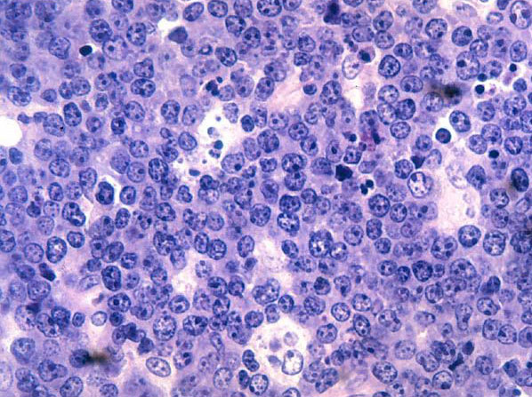
ONCOGENES AND CANCER
Proto-oncogenes - positive cell-cycle regulators
Histology slide Burkitt's lymphoma
Cause cancer when mutated
Alter transcriptional activity of a gene that control cell growth
Ex. Myc – transcription factor that is activated in Burkett’s Lymphoma
National Cancer Institute (NCI); Author: Louis M. Staudt
Malignant B-cell lymphocytes seen in Burkitt's lymphoma, stained with hematoxylin and eosin (H&E) stain

Slide 37
OTHER CANCERS AFFECTED BY GENE REGULATION
Mutations that activate transcription factors
Overexpression of the epidermal growth factor receptor (EGFR) in a subset of breast cancers
Leads to activation of protein kinases
Leads to overexpression of transcription factors that control genes involved in cell cycle
Drugs that prevent activation of EGFR may be useful in treating this type of cancer.

Slide 38
This PowerPoint file is copyright Rice University. All Rights Reserved.
Modified by the Biology faculty at Valdosta State University.
Updated for Biology 2e by OpenStax.

