Slide 1
BIOLOGY 2E
Chapter 20 PHYLOGENIES AND THE HISTORY OF LIFE
PowerPoint Image Slideshow
This work is licensed under a Creative Commons Attribution-NonCommercial-ShareAlike 4.0 International License.

Slide 2
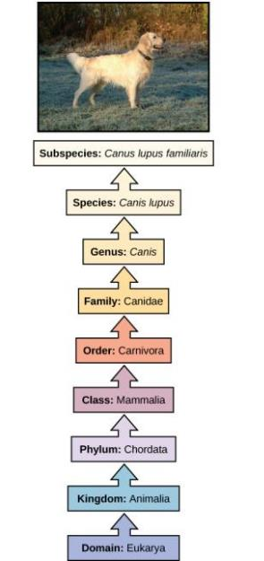
TRADITIONAL CLASSIFICATION
Taxonomy = science of classifying organisms into taxa
Also called the Linnaean system
Uses a hierarchical model where groups become more specific from the point of origin until one branch ends as a single species
Each level is a taxon
At each taxon, organisms become more similar in appearance
Largest groups are domains: Bacteria, Archaea, and Eukarya
Download for free at http://cnx.org/contents/185cbf87-c72e-48f5-b51e-f14f21b5eabd@10.61

Slide 3
TRADITIONAL CLASSIFICATION
Binomial nomenclature of species
Species name = genus + species ‘epithet’
Rules:
Genus is capitalized and entire species name is italicized
Example: Homo sapiens or Homo sapiens
Higher taxonomic names are capitalized only
Example: Hominidae
Download for free at http://cnx.org/contents/185cbf87-c72e-48f5-b51e-f14f21b5eabd@10.61

Slide 4
TRADITIONAL CLASSIFICATION
Historically, taxonomy did not reflect descent
Organisms grouped solely by physical characteristics rather than evolutionary relationships
Example: Reptilia

Slide 5
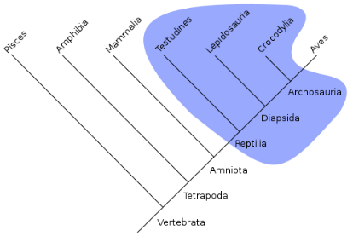
Jacek FH
https://commons.wikimedia.org
Jacek FH
https://commons.wikimedia.org

Slide 6
SYSTEMATICS
The reconstruction and study of evolutionary relationships from a common ancestor
Produces a phylogeny
The evolutionary history and relationship of an organism or group of organisms
Does not rely on taxonomy

Slide 7
SYSTEMATICS
The outcome is depicted as a phylogenetic tree or cladogram
A diagram used to reflect evolutionary relationships
Hypothesis about past and present relationships among taxonomic groups that is tested against multiple data sets
Download for free at http://cnx.org/contents/67322fde-a447-4caa-94f6-2c072d3bda66@7

Slide 8
TYPES OF PHYLOGENETIC TREES
Rooted: single lineage (at base) represents common ancestor
Unrooted: show relationships but not a common ancestor
Download for free at http://cnx.org/contents/67322fde-a447-4caa-94f6-2c072d3bda66@7

Slide 9
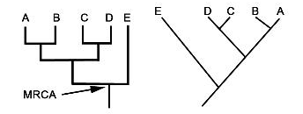
PARTS OF PHYLOGENETIC TREES
Clade = any branch or lineage (lines in cladogram)
Branch point (node) = a splitting that represents a single lineage evolving into two clades
Nodes represent the most recent common ancestor (MRCA) of the clades descending from that branch point
Taxa descending from a node share a common ancestor but they did not “evolve from each other”
Rotation at branch points does not change the relationships

Slide 10
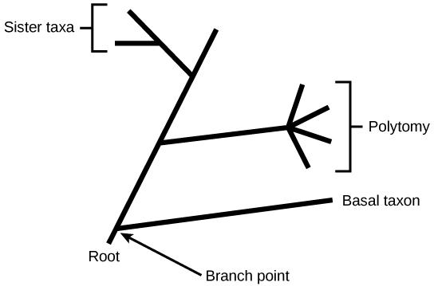
PARTS OF PHYLOGENETIC TREES
Basal taxon = a lineage that evolved early from the root that remains unbranched
Sister taxa = two lineages stemming from the same branch point
Polytomy = a branch with more than two lineages
Relationships between lineages are unknown

Slide 11
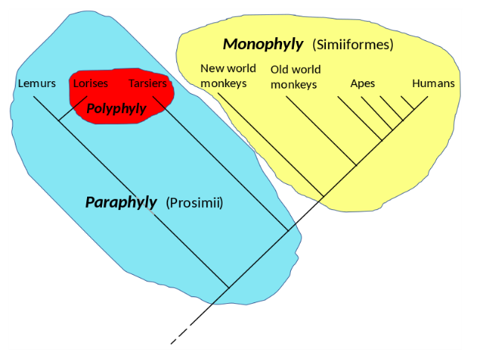
MONOPHYLY, POLYPHYLY, AND PARAPHYLY
Chiswick Chap
https://commons.wikimedia.org
Cladogram of the primates, showing a monophyly (the simians, in yellow), a paraphyly (the prosimians, in blue, including the red patch), and a polyphyly (the night-active primates, in red).
Notes:
A polyphyletic group is a set of organisms, or other evolving elements, that have been grouped together but do not share an immediate common ancestor
A group is paraphyletic if it consists of the group's last common ancestor and all descendants of that ancestor excluding a few—typically only one or two—monophyletic subgroups
A monophyletic group is a group of organisms that consists of all the descendants of a common ancestor.

Slide 12
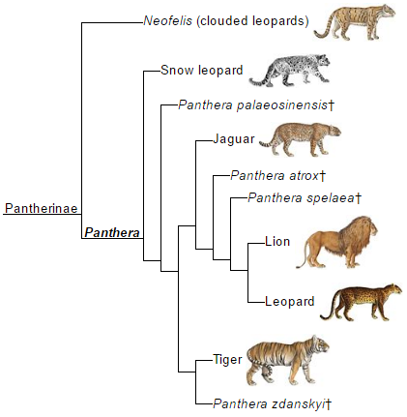
LABEL THE FOLLOWING…
E.
What kind of group are “leopards”?
A
B
C or D
Notes:
A = basal taxon, B = sister taxa, C/D = branch point/most recent common ancestor, E = polyphyletic

Slide 13
LIMITATIONS OF PHYLOGENETIC TREES
Often, closely related taxa look similar, but not always
If they evolved under different circumstances, the taxa may look very different
Example: lizards and rabbits are more closely related yet lizards and frogs look more similar
Download for free at http://cnx.org/contents/185cbf87-c72e-48f5-b51e-f14f21b5eabd@10.61

Slide 14
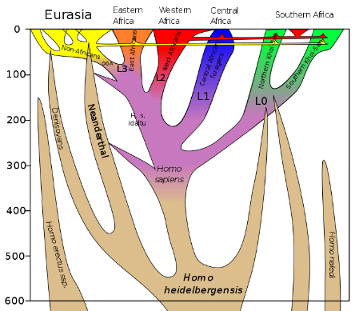
LIMITATIONS OF PHYLOGENETIC TREES
Dbachmann
https://commons.wikimedia.org
Length of a branch does not generally indicate amount of time passed since the split
Download for free at http://cnx.org/contents/185cbf87-c72e-48f5-b51e-f14f21b5eabd@10.61

Slide 15
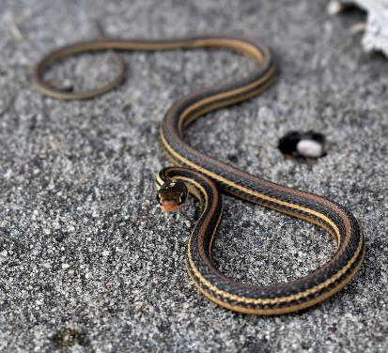
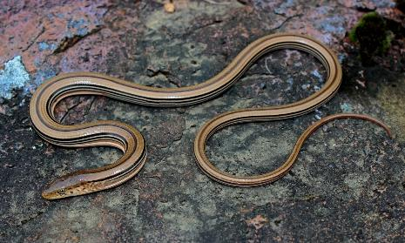
LIMITATIONS OF PHYLOGENETIC TREES
Groups that are not closely related but evolve under similar conditions may appear more similar to each other than to a close relative
Download for free at http://cnx.org/contents/185cbf87-c72e-48f5-b51e-f14f21b5eabd@10.61
Notes:
Legless lizard (left) and garter snake (right)

Slide 16
GROUP DISCUSSION
List the different levels of the taxonomic classification system.
Compare systematics, taxonomy, and phylogeny.
Discuss a phylogenetic tree's components and purpose.
Discuss the limitations of phylogenetic trees.

Slide 17
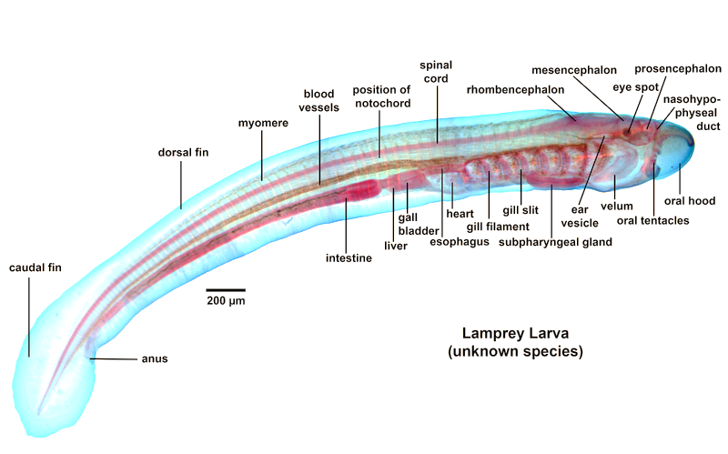
DETERMINING EVOLUTIONARY RELATIONSHIPS
Phylogenies are built from two types of evidence:
DNA/RNA sequences
Morphological
Embryological development
Fossil records
Morphology
Physiology
Behavior
Tracyanne
https://commons.wikimedia.org

Slide 18
TWO OPTIONS FOR SIMILARITIES BETWEEN SPECIES
Homologous characters
Features that overlap both morphologically (in form) and genetically
Similar due to evolutionary origin (same ancestral source)
More complex the character, the more likely it’s of same origin
Caption: The principle of homology (c) Волков Владислав Петрович , Public domain

Slide 19
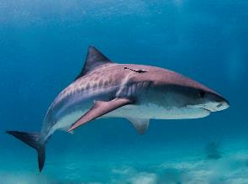
TWO OPTIONS FOR SIMILARITIES BETWEEN SPECIES
Analogous characters (or homoplasies)
Similar due to functional or ecological constraints rather than common ancestry
Convergence occurs in unrelated (or distantly-related) taxa when characters are shaped by similar ecological or evolutionary constraints
Caption: Bird Wing Feather and Bones (c) L Shyamal, Public domain
Caption: Anisoptera (c) RA Nonenmacher, Public domain

Slide 20
MOLECULAR SYSTEMATICS
Molecular comparisons
Using nucleotide sequences (DNA, RNA) as characters
Sophisticated computer algorithms are used to discern true evolutionary relationships (hypotheses)
But they do have limitations
With only four different nucleotides, sequences may appear homologous when they are not
Insertions/deletions that shift sequences can give appearance of being unrelated even when they are

Slide 21
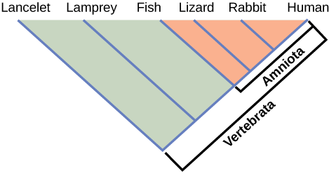
BUILDING PHYLOGENETIC TREES
Cladistics
Process to arrange taxa by homologous characters into clades
Monophyletic group
Goal is to produce cladograms where all clades are monophyletic
Download for free at http://cnx.org/contents/185cbf87-c72e-48f5-b51e-f14f21b5eabd@10.61

Slide 22
SHARED CHARACTERISTICS
Shared ancestral character
Found in common ancestor and all members of the clade
Some may have secondarily lost it
Download for free at http://cnx.org/contents/185cbf87-c72e-48f5-b51e-f14f21b5eabd@10.61

Slide 23
SHARED CHARACTERISTICS
Shared derived character (aka synapomorphy)
Distinguishes those that share it from those that do not…
Used to identify branch points (nodes) within the larger clade

Slide 24
CHOOSING THE RIGHT RELATIONSHIPS
Using many characters to develop an accurate cladogram often results in many possible trees
How do you decide which is most likely?
Rule of maximum parsimony: choose the simplest cladogram with the fewest steps or events
Why?
Mutations that generate new traits are random
It takes many, many mutations to lead to new trait
Most mutations are either neutral or harmful
Exercise: using parsimony to build a cladogram http://evolution.berkeley.edu/evolibrary/article/usingparsimony_01

Slide 25
CHOOSING THE RIGHT RELATIONSHIPS
1: trait A
2: trait A, B, C
3: trait A, B, D
1: trait A
2: trait A, B, C
3: trait A, B, D
B, C
B, D
C
D
B
A
A
Less parsimonious (trait B evolved twice)
More parsimonious (trait B evolved once)
Using many characters (you should) to develop an accurate cladogram (phylogenetic hypothesis) often results in many possible trees
Rule of parsimony – choose the simplest cladogram with the most obvious, fewest steps or events
Exercise: using parsimony to build a cladogram http://evolution.berkeley.edu/evolibrary/article/usingparsimony_01

Slide 26
GROUP DISCUSSION
Compare homologous and analogous traits.
Discuss the purpose of cladistics.
Describe maximum parsimony and why scientists use it to determine the best tree.

Slide 27
PERSPECTIVES ON THE PHYLOGENETIC TREE
The concept of phylogenetic trees started with Charles Darwin
“Classic” model
A single trunk representing a common ancestor, with the branches representing the divergence of species from this ancestor
Evidence DNA sequence analysis and newly developed computer algorithms has caused skepticism about the classic model's validity
Download for free at http://cnx.org/contents/185cbf87-c72e-48f5-b51e-f14f21b5eabd@10.61

Slide 28
LIMITATION TO THE CLASSIC MODEL
Mendelian inheritance assumes…
Vertical gene transfer: genes are transferred from parent to offspring
Mutations are the primary sources of new genetic information
This is not the complete story in prokaryotes, and even some eukaryotes
Horizontal gene transfer: transfer of genetic material between unrelated species

Slide 29
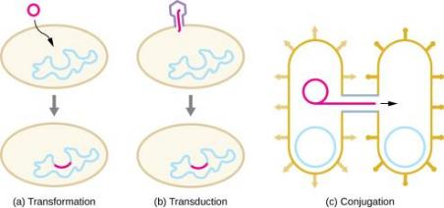
HORIZONTAL GENE TRANSFER
Four primary modes of HGT in prokaryotes:
Transformation – naked DNA uptake by bacteria
Transduction – genes transferred by virus
Conjugation – genes transferred between to bacteria via a hollow tube
Gene transfer agents (GTAs) - most likely bacteriophages that cannot reproduce on their own and carry random DNA pieces from one species to another
HGT is important source of genetic variation
Download for free at http://cnx.org/contents/185cbf87-c72e-48f5-b51e-f14f21b5eabd@10.61

Slide 30
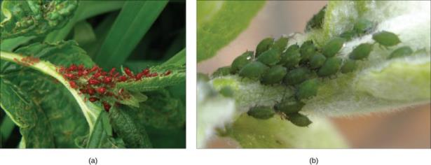
HGT IN EUKARYOTES
Much rarer in eukaryotes than prokaryotes
Cells are not exposed directly to their environment
Transposons (jumping genes) transfer genes between rice and millet plant species
Fungi uptake of Taxol gene from yew tree
Ability to make carotenoids transferred from fungi to aphid
Notes:
(a) Red aphids get their color from red carotenoid pigment. Genes necessary to make this pigment are present in certain fungi, and scientists speculate that aphids acquired these genes through HGT after consuming fungi for food. If mutation inactivates the genes for making carotenoids, the aphids revert back to (b) their green color. Red coloration makes the aphids considerably more conspicuous to predators, but evidence suggests that red aphids are more resistant to insecticides than green ones. Thus, red aphids may be more fit to survive in some environments than green ones.

Slide 31
GENOME FUSION AND THE EVOLUTION OF EUKARYOTES
The ultimate HGT is genome fusion
One species is taken inside another species' cytoplasm, which ultimately results in a genome consisting of genes from both the endosymbiont and the host
Two symbiotic organisms become endosymbiotic
Part of the Endosymbiont Theory

Slide 32
GENOME FUSION AND THE EVOLUTION OF EUKARYOTES
Endosymbiont Theory
Mitochondria, chloroplasts, and flagellates originated as free-living prokaryotes that became established as permanent symbionts in the cytoplasm
Engulfment of a prokaryotic cell by a ‘protoeukaryotic’ cell
Download for free at http://cnx.org/contents/185cbf87-c72e-48f5-b51e-f14f21b5eabd@10.61

Slide 33
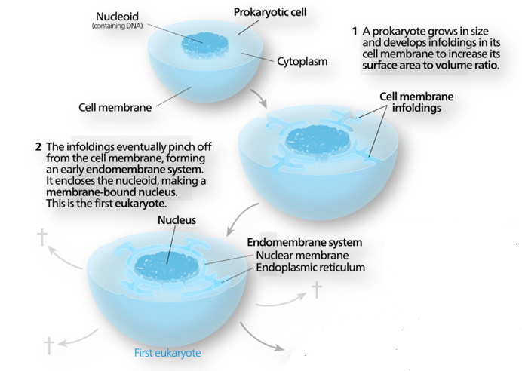
Caption: Great Board of Biology (c) Kelvin13, Public domain

Slide 34
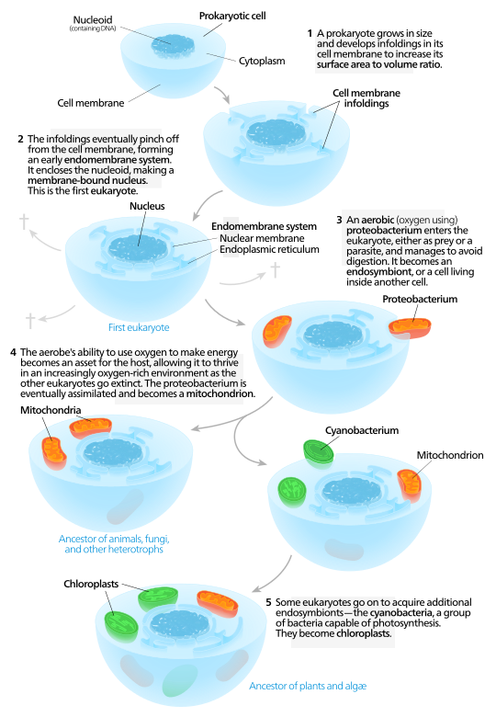

Slide 35
GENOME FUSION AND THE EVOLUTION OF EUKARYOTES
Other possible examples of genome fusion:
Formation of gram-negative bacteria
Endosymbiotic fusion between Archaea and gram-positive bacteria
Explains their two lipid bilayer membranes
The endosymbiont picked up the second membrane from the host as it was engulfed

Slide 36
GENOME FUSION AND THE EVOLUTION OF EUKARYOTES
Other possible examples of genome fusion
Formation of eukaryotes
Endosymbiotic fusion of prokaryotes
Mitochondrial DNA derived from bacteria's circular genomes
Nuclear DNA derived from ancient prokaryotic cells that engulfed the bacteria
Possibly between Archaea and Bacteria
Explains why some eukaryotic genes resemble those of Archaea whereas others resemble those from Bacteria

Slide 37
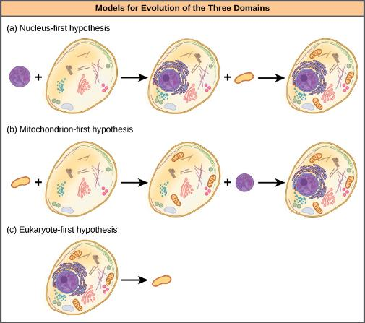
WHAT HAPPENED FIRST?
Nucleus-first hypothesis
Nucleus evolved in prokaryotes first followed by a later fusion of the new eukaryote with bacteria that became mitochondria
Mitochondria-first hypothesis
Mitochondria were first established in a prokaryotic host which subsequently acquired a nucleus by fusion to become the first eukaryotic cell
Eukaryote-first hypothesis
Prokaryotes evolved from eukaryotes by losing genes and complexity

Slide 38
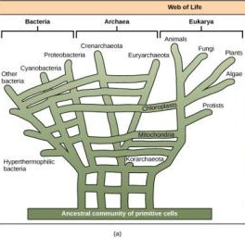
WEB MODELS
“Web of Life” model may be more appropriate than classic “tree of life”
Eukaryotes evolved from a pool of prokaryote species sharing genes via HGT

Slide 39
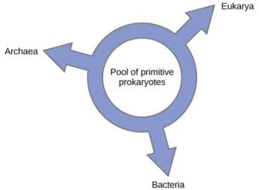
RING OF LIFE MODELS
Another alternative is the “Ring of Life” model
All three domains evolved from a pool of primitive prokaryotes swapping genes via HGT
This may help explain how certain eukaryotic genes resemble those of bacteria while others resemble Archaea
Download for free at http://cnx.org/contents/185cbf87-c72e-48f5-b51e-f14f21b5eabd@10.61

Slide 40
GROUP DISCUSSION
Describe horizontal gene transfer and the different ways it can occur.
Describe how mitochondria and chloroplasts are believed to have evolved.
Describe the different hypotheses for eukaryote evolution.
Describe the web and ring models of phylogenetic relationships.
Describe how the web and ring models differ from the classic tree of life model.

