Slide 1
BIOLOGY 2E
Chapter 21 VIRUSES
PowerPoint Image Slideshow
This work is licensed under a Creative Commons Attribution-NonCommercial-ShareAlike 4.0 International License.

Slide 2
VIRUSES ARE DIFFERENT FROM LIVING CELLS, YET THEY MAKE A LARGE IMPACT ON CELLS
They are “acellular” (not cells).
They have no metabolism and cannot grow.
They depend on host cells to make copies of themselves.
They are the ultimate parasite; cannot replicate unless they are in host cell using that cell’s machinery
Their origin is uncertain.
They seem to have collected pieces of nucleic acid from various sources.
They can infect nearly all lifeforms.
They are not only species specific but tissue specific (as far as what they will infect)

Slide 3
VIRUSES WERE KNOWN TO EXIST BEFORE THEY WERE SEEN
In 1892, tobacco mosaic disease was transmitted via plant extracts. Filtration removed the bacteria… but they knew something even smaller was transmitting the disease.
Download for free at http://cnx.org/contents/185cbf87-c72e-48f5-b51e-f14f21b5eabd@10.61

Slide 4
SEEING VIRUSES
In the 1930s, a new technology made viruses visible by microscopy
Download for free at http://cnx.org/contents/185cbf87-c72e-48f5-b51e-f14f21b5eabd@10.61

Slide 5
VIRUS SIZE AND IMAGING
Almost all viruses are too small to be seen with light microscopes.
A single virus particle (a “virion”) may be only 20 nm across.
Electron microscopes can magnify 500,000x.
The image clarity is due to good resolution (0.05 nm).
The invention of electron microscopes led to the discovery of many types of viruses in many types of organisms.

Slide 6
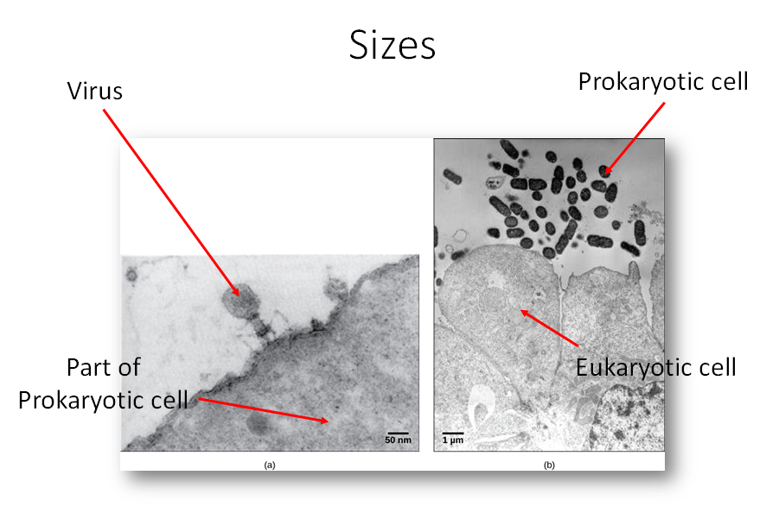
SIZES

Slide 7
VIRUS EVOLUTION
Did they “devolve” from free-living cells?
Did nucleic acid molecules “escape” from cells?
Did they begin as self-replicating molecules?
No one is sure.
Download for free at http://cnx.org/contents/185cbf87-c72e-48f5-b51e-f14f21b5eabd@10.61

Slide 8
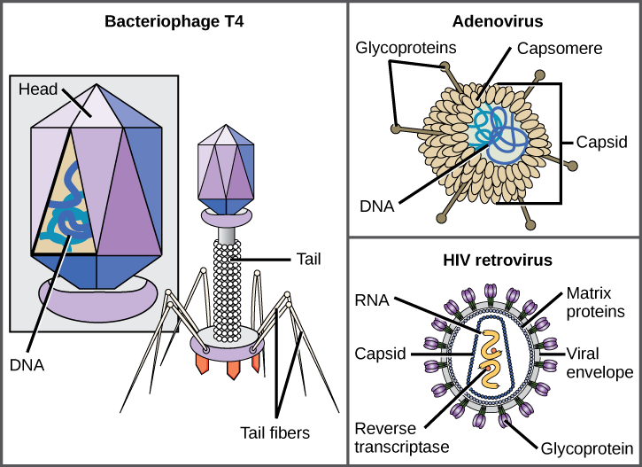
VIRUS MORPHOLOGY
Each virion has:
Nucleic acid: might be DNA or RNA, double stranded or single stranded
Protein capsid
Some virions also have an “envelope” that is similar to a cell membrane.
Download for free at http://cnx.org/contents/185cbf87-c72e-48f5-b51e-f14f21b5eabd@10.61

Slide 9
FOUR VIRUS SHAPES

Slide 10
BACTERIOPHAGE T4
Bacteriophages infect bacteria
Infects the bacterium, Escherichia coli
Has a DNA genome
Has been studied extensively
Download for free at http://cnx.org/contents/185cbf87-c72e-48f5-b51e-f14f21b5eabd@10.61

Slide 11
ADENOVIRUS
Infects the human respiratory tract
Is non-enveloped
Other non-enveloped viruses include poliovirus, human papillomavirus, and hepatitis A virus.
Download for free at http://cnx.org/contents/185cbf87-c72e-48f5-b51e-f14f21b5eabd@10.61

Slide 12
HIV RETROVIRUS
Causes AIDS (acquired immunodeficiency syndrome)
Is enveloped
Is a retrovirus (can reverse transcribe its RNA genome into DNA form.)
Download for free at http://cnx.org/contents/185cbf87-c72e-48f5-b51e-f14f21b5eabd@10.61

Slide 13
VIRUSES HAVE GENOMES
The virus core contains nucleic acid.
either DNA or RNA (but not both)
may be single-stranded or double-stranded
may be circular or linear
may be in one piece or in multiple segments
The genome is much smaller than a cell’s genome.
DNA directs the host cell to make new virus copies.
RNA may be directly transcribed, or replicated first.
RNA viruses use enzymes that make more errors
RNA viruses mutate more frequently

Slide 14
SEVERAL WAYS TO CLASSIFY VIRUSES
According to nucleic acid type and function
According to capsid structure
Enveloped/non-enveloped
Genome structure

Slide 15
VIRUS CLASSIFICATION BY GENOME STRUCTURE AND CORE
Core Classifications | Examples
DNA RNA | Rabies virus, retroviruses Herpesviruses, smallpox virus
Single-stranded Double-stranded | Rabies virus, retroviruses Herpesviruses, smallpox virus
Linear Circular | Rabies virus, retroviruses Herpesviruses, smallpox virus Papillomaviruses, many bacteriophages
Non-segmented Segmented | Parainfluenza viruses Influenza viruses

Slide 16
VIRUS CLASSIFICATION
Download for free at http://cnx.org/contents/185cbf87-c72e-48f5-b51e-f14f21b5eabd@10.61

Slide 17
BALTIMORE CLASSIFICATION
Download for free at http://cnx.org/contents/185cbf87-c72e-48f5-b51e-f14f21b5eabd@10.61

Slide 18
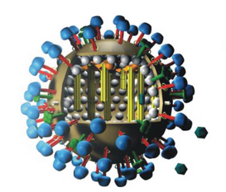
FLU ATTACK! HOW A VIRUS INVADES YOUR BODY
Video Link
Download for free at http://cnx.org/contents/185cbf87-c72e-48f5-b51e-f14f21b5eabd@10.61

Slide 19
CYTOPATHIC EFFECTS
These cell damaging changes can occur when a virus replicates in a host cell:
lysis (the cell ruptures or bursts open)*
apoptosis (programmed self-destruction)
widespread symptoms due to the body’s immune response
*In some cases, replicated viruses can leave the cell by “budding”, which does not immediately kill the cell.

Slide 20
STEPS OF VIRUS INFECTIONS
Attachment
Entry
Replication and Assembly
Egress (Release)

Slide 21
Attachment
Receptors on the surface of the host cell bind to virus capsid proteins or virus envelope glycoproteins.
Viruses can attach only to cells that have the right receptor molecules.
Therefore, viruses can be very specific about what species or cell type they can infect.

Slide 22
Entry
Bacteriophage DNA enters the host cell “naked”.
Viruses may enter eukaryotic cells by endocytosis or, if enveloped, by fusion with the cell’s membrane.

Slide 23
Replication and Assembly
Virus Genome | Steps
DNA | transcribe mRNA 🡪 make viral proteins duplicate DNA to make new viral genomes
RNA | make complementary RNA if necessary transcribe mRNA 🡪 make viral proteins copy RNA to make new viral genomes
RNA retrovirus | reverse transcribe RNA to make DNA, using reverse transcriptase DNA incorporates into host genome DNA directs synthesis and assembly of new viruses
The viral genes then direct the assembly of the new proteins and genomes to make new viruses.

Slide 24
Egress (Release)
May involve lysis and death of the host cell.
May involve budding, which does not directly kill the host cell.

Slide 25
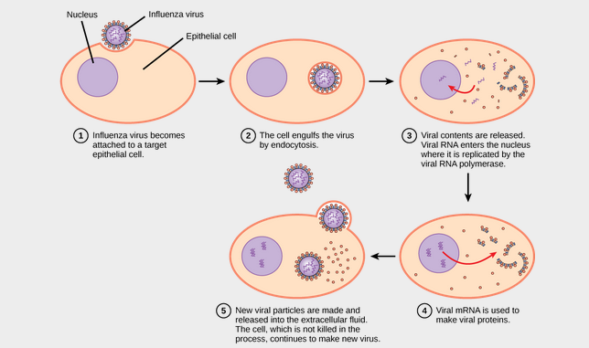
INFECTION
In influenza virus infection, glycoproteins attach to a host epithelial cell. As a result, the virus is engulfed. RNA and proteins are made and assembled into new virions.
Download for free at http://cnx.org/contents/185cbf87-c72e-48f5-b51e-f14f21b5eabd@10.61

Slide 26
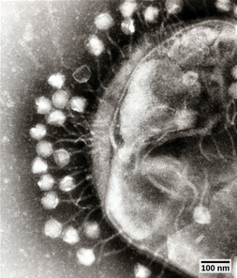
BACTERIOPHAGES
Viruses that infect bacteria
Download for free at http://cnx.org/contents/185cbf87-c72e-48f5-b51e-f14f21b5eabd@10.61

Slide 27
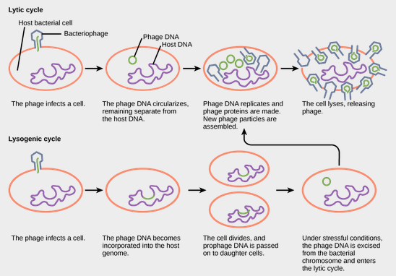
VIRUS CYCLES
Download for free at http://cnx.org/contents/185cbf87-c72e-48f5-b51e-f14f21b5eabd@10.61

Slide 28
ANIMAL VIRUSES
May cause:
Acute disease (colds, influenza)
Chronic infection (hepatitis C)
Latency and intermittent symptoms (herpes simplex)
remains in nerve tissue for life
reactivation causes active replication and cell lysis
Asymptomatic infection (other human herpesviruses)
Oncogenesis (hepatitis B and C, human papillomavirus [HPV])

Slide 29
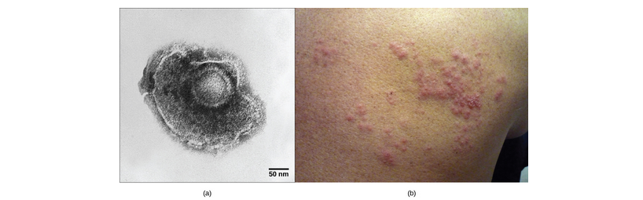
VARICELLA-ZOSTER (CHICKENPOX VIRUS)
Childhood chickenpox 🡪 viral latency 🡪 possible reactivation in later life results in shingles
(a) Varicella-zoster, the virus that causes chickenpox, has an enveloped icosahedral capsid visible in this transmission electron micrograph. Its double-stranded DNA genome becomes incorporated in the host DNA and can reactivate after latency in the form of (b) shingles, often exhibiting a rash. (credit a: modification of work by Dr. Erskine Palmer, B. G. Martin. CDC; credit b: modification of work by “rosmary”/Flickr; scale-bar data from Matt Russell)
Download for free at http://cnx.org/contents/185cbf87-c72e-48f5-b51e-f14f21b5eabd@10.61

Slide 30
HPV
HPV, or humans papillomavirus, has a naked icosahedral capsid visible in this transmission electron micrograph and a double-stranded DNA genome that is incorporated Into the host DNA. The virus, which is sexually transmitted, is oncogenic and can lead to cervical cancer. (credit: modification of work by NCI, NIH; scale bar data from Matt Russell)
Download for free at http://cnx.org/contents/185cbf87-c72e-48f5-b51e-f14f21b5eabd@10.61

Slide 31
PLANT VIRUSES
Horizontal transmission
virus typically enters by way of damaged plant tissue
may come from pollen, another plant, or vectors such as insect bites
Vertical transmission
virus is transmitted from the parent plant
May cause hypoplasia (decreased growth and vigor)
May cause necrosis of the plant or plant tissue

Slide 32
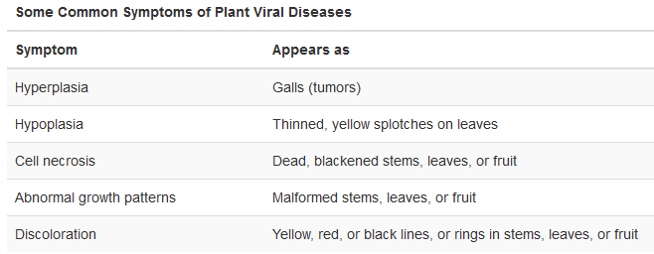
PLANT VIRUSES
Download for free at http://cnx.org/content/col11448/latest/

Slide 33
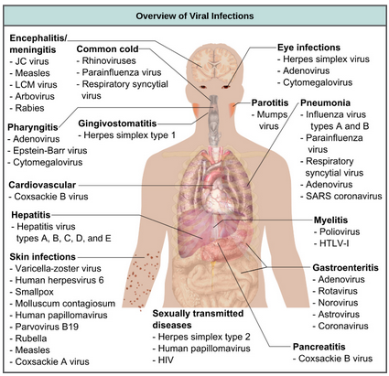
IMPACTS ON HUMANS

Slide 34
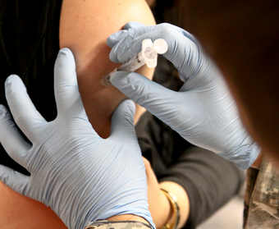
VACCINES TO PREVENT VIRAL INFECTIONS
Trigger immune protection
Prepared using:
Attenuated “live” virus*
“killed” virus
molecular subunits
*very small risk of infection
credit: USACE Europe District
Download for free at http://cnx.org/content/col11448/latest/

Slide 35
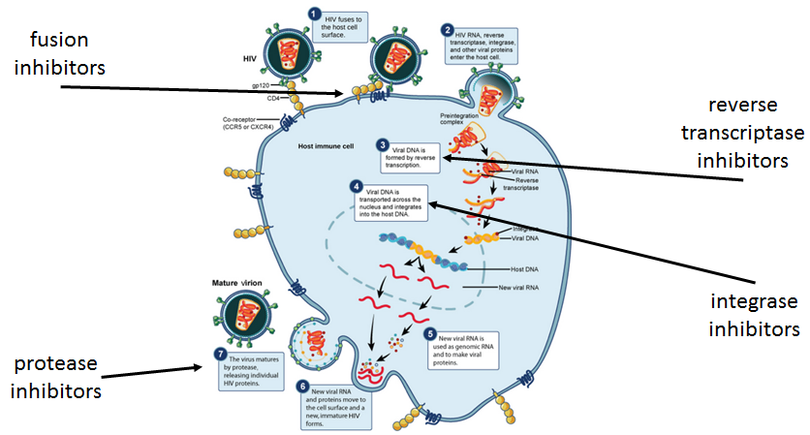
HIV, an enveloped, icosahedral virus, attaches to the CD4 receptor of an immune cell and fuses with the cell membrane. Viral contents are released into the cell, where viral enzymes convert the single-strandd RNA genome into DNA and incorporate it into the host genome. (credit: NIAID, NIH)
Download for free at http://cnx.org/content/col11448/latest/

Slide 36
PRIONS: PROTEINACEOUS INFECTIOUS PARTICLES
Very small
Contain no nucleic acid
Cause fatal neurodegenerative diseases
Mad cow disease (BSE, bovine spongiform encephalopathy)
(v)Creutzfeldt-Jakob disease (in humans)
Kuru (in humans, spread by cannibalism)
Scrapie (in sheep)
Chronic wasting disease (in deer, moose, elk)
Prions are not destroyed by cooking.

Slide 37
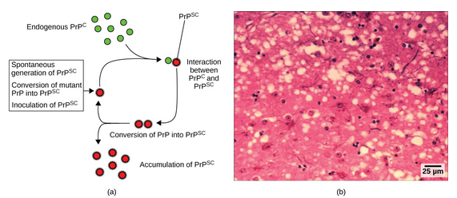
Abnormal Prp converts normal Prp into abnormal Prp.
Download for free at http://cnx.org/content/col11448/latest/

Slide 38
VIROIDS: SMALL CIRCLES OF RNA
Only known to infect plants
Can replicate within cells
Do not manufacture any proteins
Can cause crop failures

