Slide 1


BIOLOGY 2e
Chapter 42 THE IMMUNE SYSTEM
PowerPoint Image Slideshow
This work is licensed under a Creative Commons Attribution-NonCommercial-ShareAlike 4.0 International License.

Slide 2
Introduction
As long lived multicellular organisms, we need protection against pathogenic organisms and altered self (tumor) cells.
  Only a small percentage of microbes are pathogenic.
  However, those that are pathogenic are very good at invading our tissues when getting past certain barriers.
  Our immune system has the ability to fight:
    Viruses
    Bacteria
    Protozoans (i.e. malaria, amoebas)
    Fungi
    Parasitic animals (i.e. tapeworms, flukes)
    Tumor cells

Slide 3
Two Immune Systems:
Innate Immune System
  Innate immune components found throughout all of the animal kingdom and even in the plant kingdom.
  Always present
  Nonspecific
  No memory
Adaptive Immune System
  Found only in vertebrate animals
  Must be induced, not present at birth
  Highly specific
  Has memory (gives us the ability to recover from an infection and then have faster, stronger protection when exposed to same pathogen)

Slide 4
Innate Immune System
Physical and Chemical Barriers
  Skin
  Normal microbiota found on skin
  Mucous membrane and cilia in respiratory tract
  Low pH of stomach
  Antimicrobial peptides

Slide 5
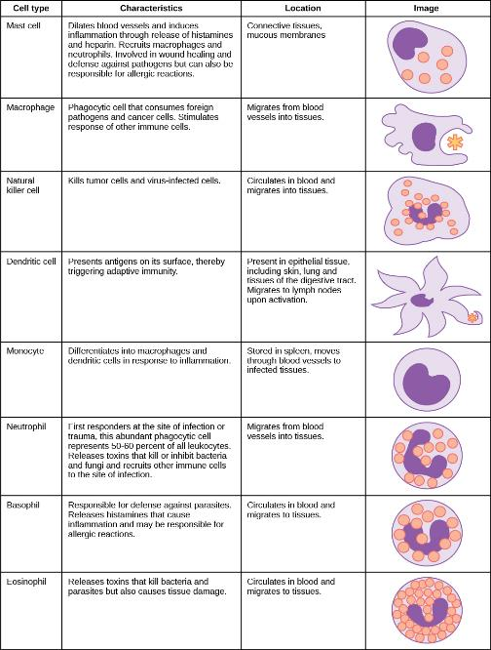
Innate Immune
System
Cells involved are leukocytes (white blood cells: WBC)
Credit: Modification of work by NIH

Slide 6
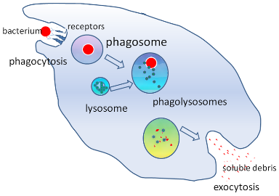
Innate Immune System
Pathogen Recognition
  Microbes have distinct cell surface
  signatures compared to our cells.
  Anything that is foreign is called an antigen.
  Our cells will recognize these foreign, pathogen associated molecular patterns (PAMPs) and phagocytize in a nonspecific fashion.
  We will see later that cells of the adaptive immune response can recognize one bacterial species from another.
Phagocytosis Video
Source: PloS Pathogens http://pathogens.plosjournals.org/perlserv/?request=get-document&doi=10.1371/journal.ppat.0030013
Simplified illustration of the stages of phagocytosis (c) Graham Colm, Public Domain

Slide 7
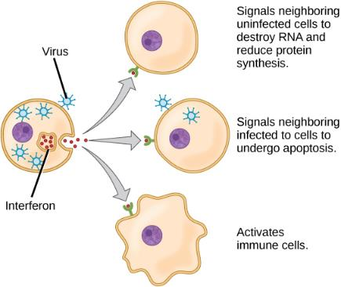
Innate immune system
Recognition of PAMPs causes the release of cytokines which are chemical messengers that regulate the actions of the cells of the innate immune system.
Interferons are a type of cytokine that are released by a cell infected with a virus. Response of neighboring cells to interferon helps stem the infection.

Slide 8
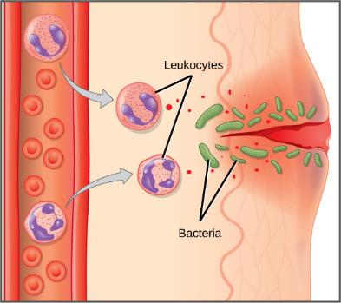
Innate Immune System
Inflammatory Response
  Induced by cytokines
  Pain
  Heat – body raises temp in attempt to slow growth of pathogenic bacteria
  Redness
  Swelling (edema)
    Redness and swelling are due to increased vascular permeability to allow WBCs to leave capillaries and enter tissues
Download for free at https://cnx.org/contents/GFy_h8cu@10.96:XaEKhjEp@6/Innate-Immune-Response

Slide 9
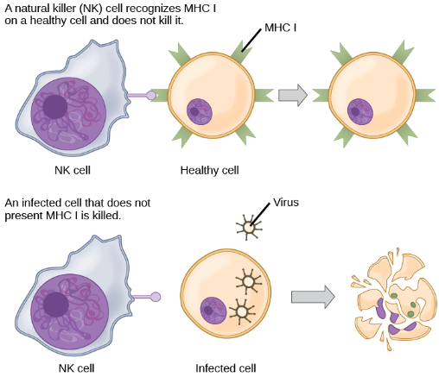
Innate Immune System
Natural Killer Cells
  Kill virus infected or altered self cells (tumor cells)
  Recognize a modified expression of major histocompatibility class I molecules which distinguish self vs non self (or altered self) cells
Download for free at https://cnx.org/contents/GFy_h8cu@10.96:etZobsU-@6/Adaptive-Immune-Response

Slide 10
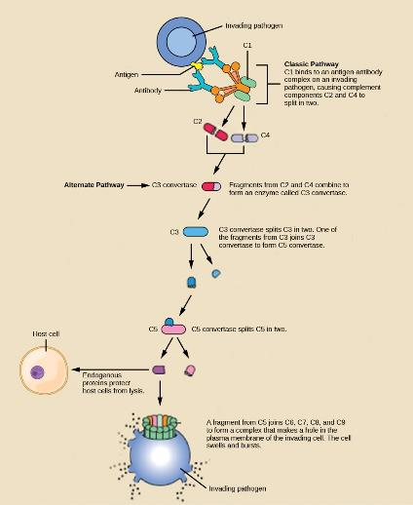
Innate Immune System
Complement
  Complex series of proteins that destroy extracellular pathogens
  Serves to complement the antibody response of the adaptive immune response
  Attracts WBC
  Open pores in cellular membrane to kill targets

Slide 11
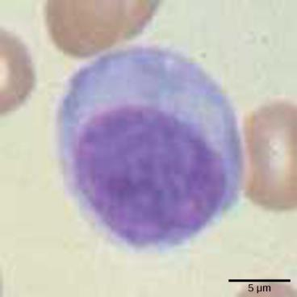
Adaptive Immune Response
Characteristics:
    Lymphocytes: B cells and T cells
    Must be induced
    Antigen-presenting cells (APCs) processes antigen and inform B-cells and T-cells of an infection
    Can take days/weeks to become upregulated
        We’ll talk about primary and secondary response later
        Remember the innate immune system is immediate

Slide 12
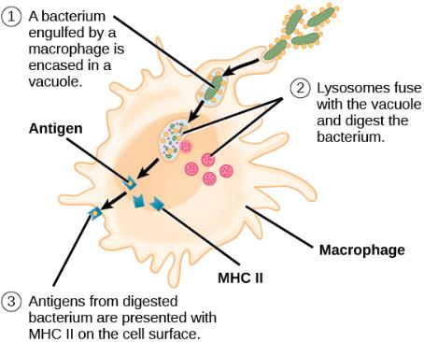
Adaptive Immune System
Major Histocompatibility Complex (MHC)
  Antigen presenting molecules
  MHC Class I
    Found on all of our nucleated cells
  MHC Class II
    Found on Antigen Presenting
    Cells (APCs)
      B cells
      Dendritic cells
      Macrophages
How an antigen presenting cell (APC) processes antigen to be presented on the MHC to a T cell
Download for free at https://cnx.org/contents/GFy_h8cu@10.96:etZobsU-@6/Adaptive-Immune-Response

Slide 13

Adaptive Immune System
Major Histocompatibility Complex (MHC)
  Antigen presenting molecules
Natural killer (NK) cells recognize the MHC I receptor on healthy cells. If MHC I is absent, the cell is lysed.

Slide 14
Adaptive Immune Response
Characteristics:
    Highly specific
    Antibodies (Abs) made by B cells and T cell Receptors (TCRs) made by T cells
        Innate immune system nonspecifically recognizes PAMPs found on wide variety of microbes
        B cells and T cells can distinguish between different specific motifs (epitopes) found on an individual microbe
    Has memory so subsequent response to the same antigen occurs sooner and at a higher magnitude

Slide 15
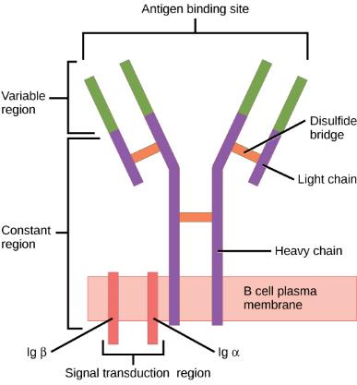
Adaptive Immune System – Humoral Response
B cells
  Mature in the bone marrow
  Make antibodies (Abs)
  Each B cell produces antibodies with a specific variable region that recognizes a specific epitope, part of an antigen
  Can be secreted or membrane-bound on the
  B cell
  B-cells that are secreting Abs are identified as a plasma cell
Download for free at https://cnx.org/contents/GFy_h8cu@10.96:etZobsU-@6/Adaptive-Immune-Response

Slide 16
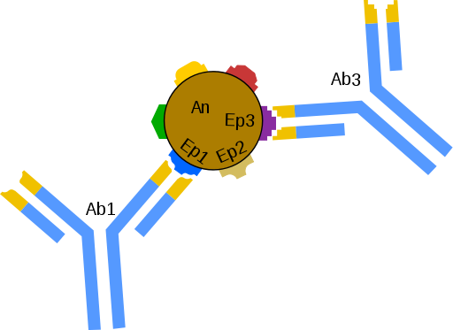
Adaptive Immune System – Humoral Response
Each B cell secretes antibodies with a specific variable region that recognizes a specific epitope
Title: Schemat łączenia się przeciwciał (Ab) z epitopami (Ep) znajdującymi się na powierzchni antygenu., (c) Schorschski, Public Domain

Slide 17
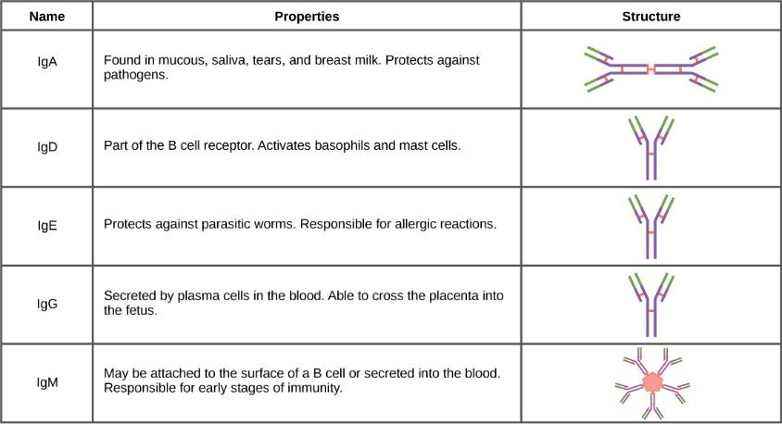
Adaptive Immune System – Humoral Response
Download for free at https://cnx.org/contents/GFy_h8cu@10.96:Ab5hWIaf@6/Antibodies

Slide 18
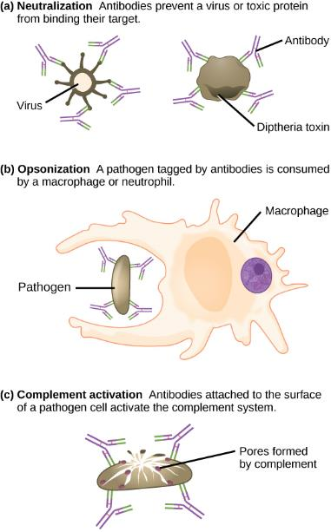
Adaptive Immune System – Humoral Response
Antibody Function

Slide 19
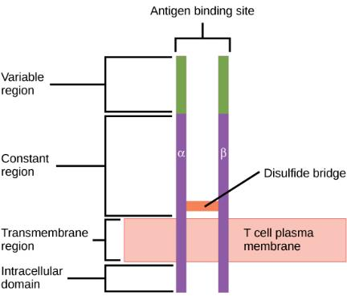
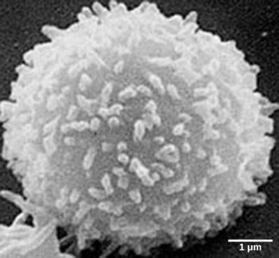
Adaptive Immune System – Cell-Mediated Response
T cells
  Mature in the thymus
  Produce the T cell receptor (TCR)
  that is membrane bound
    Recognized specific antigens
    presented in MHC molecules
  3 populations of T cells
    T_{H} – helper T cells – CD4 markers
    T_{C} – cytotoxic T cell – CD8 markers
    T regulatory cells – inhibit stimulatory
    immune factors
(credit: modification of work by NCI; scale-bar data from Matt Russell)

Slide 20

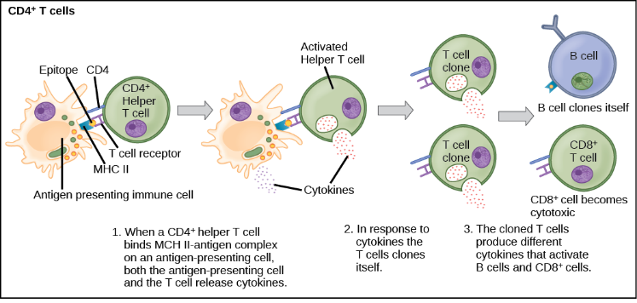
Adaptive Immune System – Cell-Mediated Response
Helper T cells will then release cytokines to upregulate B cells, other immune cells, will go through mitosis to make clones of itself
Download for free at https://cnx.org/contents/GFy_h8cu@10.96:etZobsU-@6/Adaptive-Immune-Response

Slide 21

Adaptive Immune System – Cell-Mediated Response
Cytotoxic T cells will kill infected self cells or altered (tumor) self cells
For instance, if a cell is infected with a virus, it will present some of that virus on it’s MHC Class I, the Tc cell will then force that self cell to go through apoptosis
Download for free at https://cnx.org/contents/GFy_h8cu@10.96:etZobsU-@6/Adaptive-Immune-Response

Slide 22
Adaptive Immune Response
How does the variable region of a specific antibody secreted by one B cell differ from another B cell?
How does the variable region of a specific T cell receptor (TCR) of one T cell differ from another T cell?
  Process called gene rearrangement which results in high diversity
  During B and T cell development, the region of the DNA that codes for the variable region “rearranges” – this results in each B and T cell having unique variable region

Slide 23
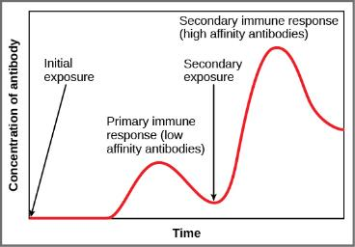
Adaptive Immune Response
Primary Response
  Initial exposure to antigen/pathogen
  Takes days to weeks for B and
  T cells to upregulate and mount a full response
  After recovery, memory B and
  T cells that are specific to that antigen/pathogen will remain and circulate (up to decades)
Secondary Response
  Second exposure to same antigen/pathogen
  Memory cells will respond faster and to a higher magnitude
  Results in an individual either not getting sick or being able to recover faster
Download for free at https://cnx.org/contents/GFy_h8cu@10.96:etZobsU-@6/Adaptive-Immune-Response

Slide 24
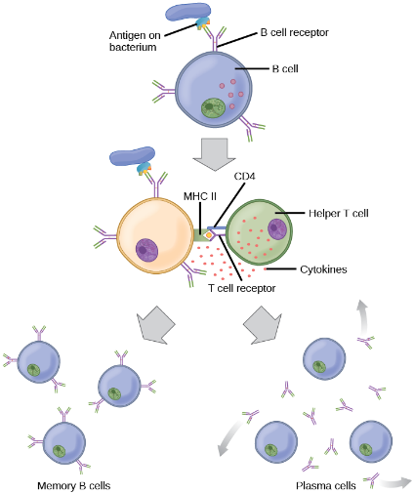
Adaptive Immune Response
Vaccination initiates a primary immune response
  The body is given time to mount a primary response against a pathogen and make memory B and T cells against that pathogen without risking the illness
  When person is exposed to pathogen later, a secondary response will hopefully prevent sickness

Slide 25
Lymphatic System
Contains cells/factors of the immune system
The leukocytes have the ability of migrating into the tissues
Lymphatic vessels pick up fluid (plasma) that has escaped from blood vessels to the surrounding tissue
Lymph is that watery fluid which then travels through our lymph vessels to be dumped back into circulation
Along the way, the lymph will travel through lymph nodes.
  A congregation of B, T and other white blood cells are there.
  If there is something foreign that made it past the skin or mucosal membranes into the tissues, hopefully it will be detected in the lymph nodes, clones of T and B cells specific for the antigen will be released into circulation to find more of that same antigen

Slide 26
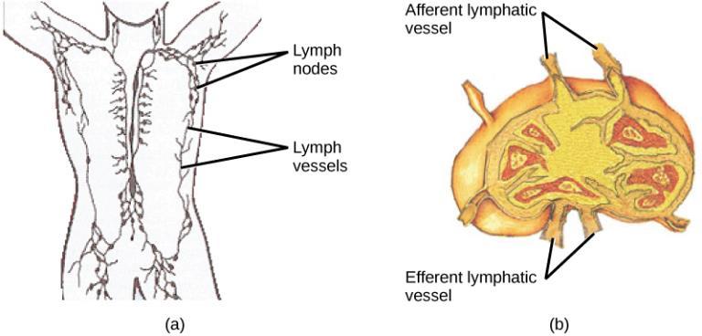
Lymphatic System
(a) Lymphatic vessels carry a clear fluid called lymph throughout the body. The liquid enters (b) lymph nodes through afferent vessels. Lymph nodes are filled with lymphocytes that purge infecting cells. The lymph then exits through efferent vessels. (credit: modification of work by NIH, NCI)

Slide 27
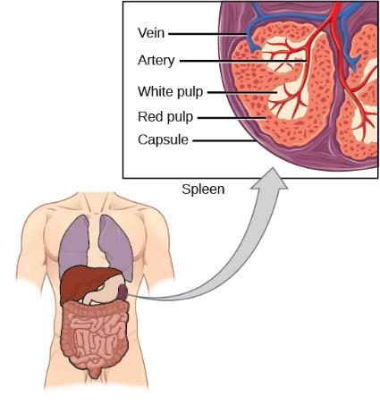
Lymphatic System
The spleen is similar to a lymph node but is much larger and filters blood instead of lymph. The spleen contains two types of tissue: red pulp and white pulp. Red pulp store blood and damaged red blood cells are removed and replaced by new ones. White pulp is rich in lymphocytes that remove antibody-coated bacteria from the blood. (credit: modification of work by NCI)

Slide 28
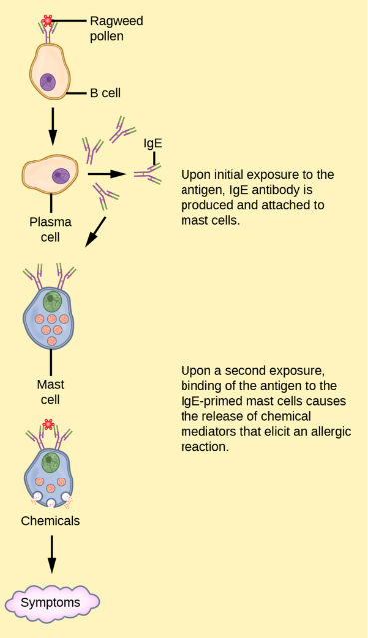
Things that can go wrong:
Chronic inflammation
  Can cause damage to tissues
Allergies
  Immune system’s over-reaction to antigen
  Mediated by IgE antibody
  20% of US population
  Release of cytokines, including histamine, result in symptoms

Slide 29
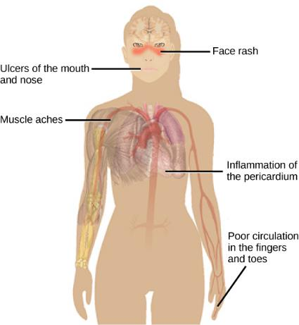
Things that can go wrong:
Autoimmunity
  The immune system can mistakenly recognize self antigen as being foreign – results in tissue/organ damage
    Systemic lupus erythematosus
    Multiple sclerosis
    Grave’s disease
    Rheumatoid arthritis

Slide 30
Things that can go wrong:
Immunodeficiency
  Primary – genetic/developmental defect results in individual lacking in some component of the immune system
    SCID
    Inability to make certain antibody class
    Lack of thymus
  Acquired – later in life (i.e. AIDS as a result of HIV infection)

