Slide 1



BIOLOGY 2E
Chapter 7 CELLULAR RESPIRATION
PowerPoint Image Slideshow
This work is licensed under a Creative Commons Attribution-NonCommercial-ShareAlike 4.0 International License.

Slide 2
OVERVIEW: CELLULAR RESPIRATION
Cells extract energy from food to generate ATP in a process called glucose catabolism or cellular respiration.
As we work through the metabolic pathways involved, notice the close link between the transfer of energy and the movement of electrons (electrons have high energy levels).
This incremental transfer of electrons allows the cell to transfer food energy in small packages that can be captured in the phosphate bonds of ATP.

Slide 3
7.1 ENERGY IN LIVING SYSTEMS – ELECTRONS AND ENERGY
Oxidation reductions (redox) reactions are chemical reactions where electrons are transferred from one molecule to another.
Molecules that can donate electron(s) in a redox reaction are reducing agents, and those that can accept electrons are oxidizing agents.
Molecules that gain electron(s) after the reaction are reduced, and those that lose electron(s) are oxidized.
AH
(Reducing Agent)
X⁺
(Oxidizing agent)
A⁺
(oxidized)
XH
(reduced)
+ 🡪 +

Slide 4
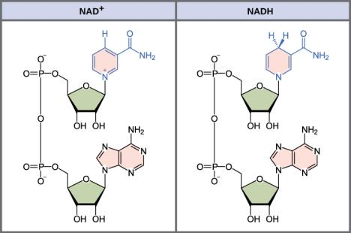
7.1 ENERGY IN LIVING SYSTEMS – ELECTRON CARRIERS
Molecules like nicotineamide adenine dinucleotide (NAD) can occur in an oxidized state (NAD+) or a reduced state (NADH).
  NADH carries 2e- and 1H+ more than NAD
NAD is called an electron carrier because NAD+ accepts electrons from redox reactions while NADH donates them.
Electron carriers are very important molecules in cellular respiration and photosynthesis.
They shuttle electrons to electron transport chains where ATP is produced.
Other electron carriers include:
FAD⁺, (oxidized)/ FADH₂ (reduced)
NADP⁺(oxidized)/ NADPH (reduced)

Slide 5
7.1 ENERGY IN LIVING SYSTEMS – ELECTRON CARRIERS
NAD+ (oxidized)/ NADH (reduced)

Slide 6
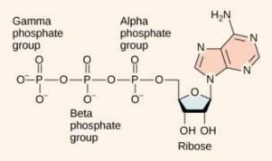
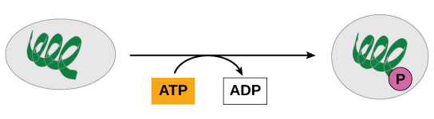
7.1 ENERGY IN LIVING SYSTEMS - ATP
The hydrolysis of ATP 🡪 ADP + Pi is exergonic and can provide energy for a coupled endergonic reaction.
The loss of a phosphate group from a molecule is called dephosphorylation.
Phosphorylation is the process of adding a phosphate group is to a molecule.
Phosphorylated molecules tend to be less stable and more likely to react.

Slide 7
7.1 ENERGY IN LIVING SYSTEMS - ATP
Adenosine triphosphate (ATP)

Slide 8
7.1 ENERGY IN LIVING SYSTEMS - ATP
ATP is generated by an endergonic reaction where ADP undergoes phosphorylation, ADP + Pi 🡪 ATP.
The energy required for this reaction can come from:
  Substrate-level phosphorylation - a coupled exergonic reaction
  Chemiosmosis- a process which uses energy from a concentration gradient and requires the enzyme ATP synthase.
    90% of ATP is produced by chemiosmosis.
    Occurs in mitochondria, chloroplasts, and plasma membrane of aerobic prokaryotes.

Slide 9
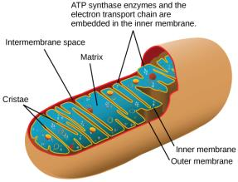
7.1 ENERGY IN LIVING SYSTEMS - ATP
Mitochondrion Structure

Slide 10
OVERVIEW: CELLULAR RESPIRATION
C₆H₁₂O₆ + 6 O₂ 🡪 6 CO₂ + 6 H₂O + ~36 ATP
The metabolic pathways involved are:
Glycolysis
Oxidation of Pyruvate and Citric Acid Cycle
Oxidative Phosphorylation

Slide 11
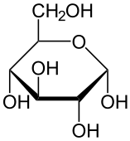
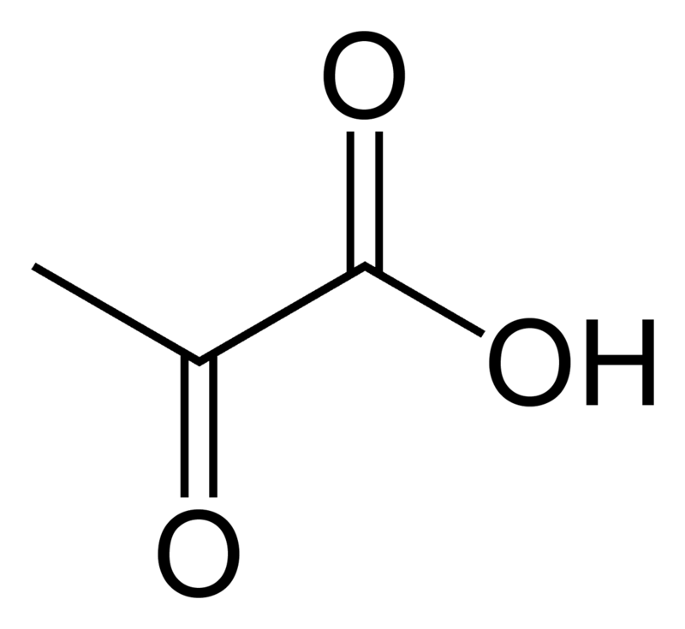
7.2 GLYCOLYSIS
Glycolysis is the first metabolic pathway of cellular respiration and includes 10 enzymatic reactions.
Nearly all organisms perform glycolysis
  occurs in the cytoplasm
  O₂ is not required
Inputs: 1 Glucose, 2 NAD⁺, 2 ATP, 4 ADP
Outputs: 2 Pyruvate, 2 NADH, 4 ATP, 2 ADP
🡪 🡪 🡪 🡪 🡪 🡪 🡪 🡪 🡪 🡪
-
-
10 reactions
+
Glucose
Pyruvate

Slide 12
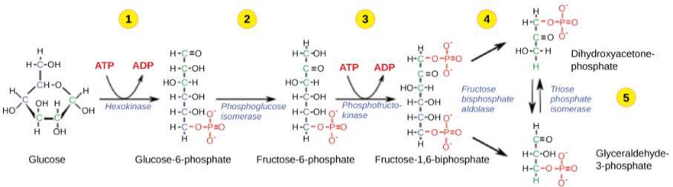
7.2 GLYCOLYSIS – ENERGY-REQUIRING STEPS
The first half of glycolysis involves 5 enzymes and uses two ATP molecules.
Glucose is phosphorylated twice and then split into two three-carbon molecules, called glyceraldehyde-3-phosphate (G3P).

Slide 13
7.2 GLYCOLYSIS – ENERGY-REQUIRING STEPS

Slide 14
7.2 GLYCOLYSIS – ENERGY-REQUIRING STEPS

Slide 15
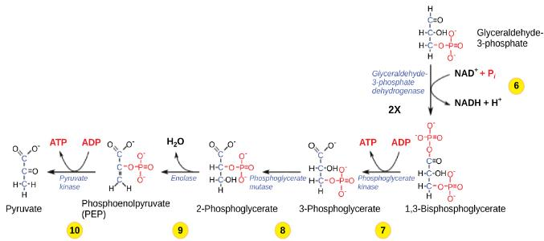
7.2 GLYCOLYSIS – ENERGY-RELEASING STEPS
The second half of glycolysis involves phosphorylation without ATP investment (step 6) and produces two NADH and four ATP molecules to generate 2 pyruvate molecules.
Net ATP production of glycolysis is 2 ATP.
These are the only ATP produced in glucose
catabolism by anaerobic cells.

Slide 16

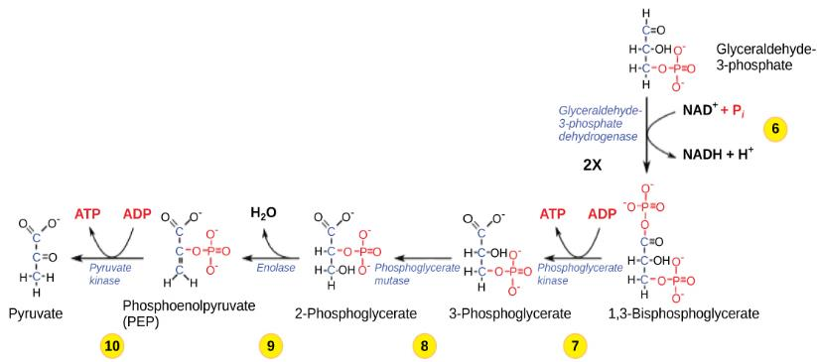
7.2 GLYCOLYSIS – ENERGY-RELEASING STEPS

Slide 17
7.2 GLYCOLYSIS – ENERGY-RELEASING STEPS

Slide 18
7.2 GLYCOLYSIS – ENERGY-RELEASING STEPS

Slide 19
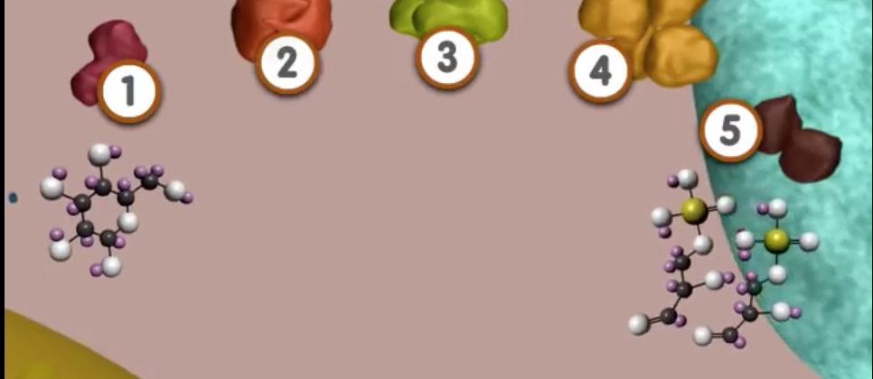
7.2 GLYCOLYSIS
https://www.youtube.com/watch?v=8Kn6BVGqKd8

Slide 20
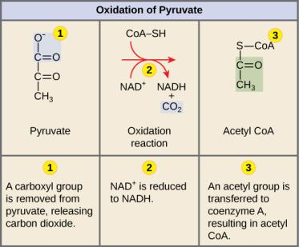
7.3 OXIDATION OF PYRUVATE
In eukaryotic cells, if oxygen is present, the 2 pyruvate molecules enter mitochondria where each is converted to Acetyl CoA before entering the CAC:
  CO2 is released
  It is oxidized, transferring e- to NADH
  coenzyme A is attached
Inputs:
2 pyruvate, 2 NAD+
2 coenzyme A
Outputs:
2 CO2, 2 NADH, 2 acetyl CoA

Slide 21
7.3 OXIDATION OF PYRUVATE

Slide 22
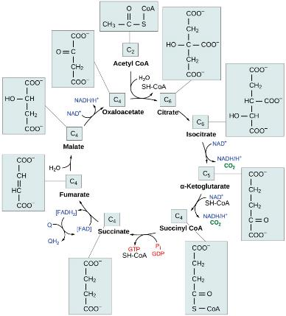
7.3 CITRIC ACID CYCLE
Occurs in the mitochondrial matrix.
Step 1 - the acetyl group from acetyl CoA is transferred to oxaloacetate to form citrate.
Through a cycle of reactions
  citrate is oxidized (3 NADH & 1 FADH₂ made)
  2 CO₂ released
  1 GTP or ATP produced
The final product of the citric acid cycle is oxaloacetate.

Slide 23
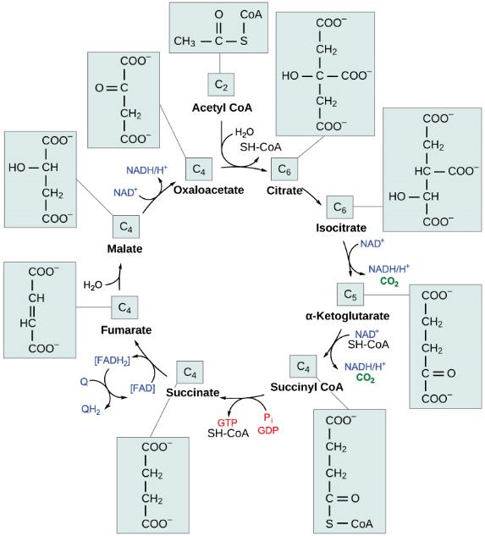

Slide 24
OVERVIEW: CELLULAR RESPIRATION
Outputs: Glycolysis, Pyruvate Oxidation and the Citric Acid Cycle
4 ATP (2 from glycolysis, 2 from CAC)
6 CO2 (2 from oxidation of pyruvate, 4 from CAC)
10 NADH (2 from glycolysis, 2 from oxidation of pyruvate, 6 from CAC)
2 FADH₂ (from CAC)
Glucose is completely oxidized at the end of CAC.
  All possible electrons have been removed.
Question: Is most of the energy from glucose stored in the ATP, the CO₂, or the electron carrier molecules?

Slide 25

7.4 OXIDATIVE PHOSPHORYLATION
Most of the ATP produced during cellular respiration occurs in the last pathway, oxidative phosphorylation.
This is the only pathway where O₂ is an input.
The pathway consists of an electron transport chain and chemiosmosis, which generates ATP.
A H⁺ concentration gradient created by the ETC, provides the energy to power chemiosmosis.

Slide 26
7.4 OXIDATIVE PHOSPHORYLATION
Mitochondrion Structure

Slide 27
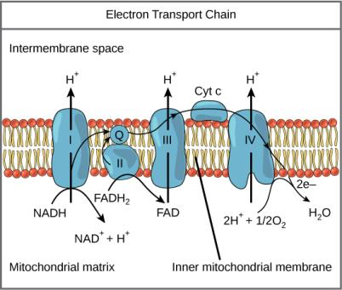
7.4 OXIDATIVE PHOSPHORYLATION- ELECTRON TRANSPORT CHAIN (ETC)
https://www.youtube.com/watch?v=xbJ0nbzt5Kw
The ETC is a series of electron transporters embedded in the inner mitochondrial membrane.
They shuttle electrons from NADH and FADH₂ to O₂.
In the process, protons (H⁺) are pumped from the mitochondrial matrix to the intermembrane space, and O₂ is reduced to form H₂O.

Slide 28
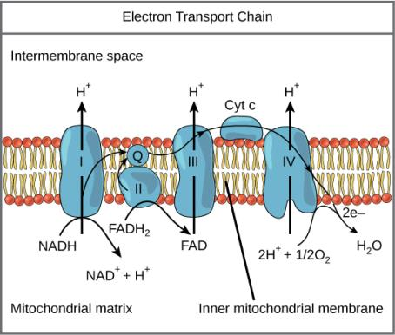
7.4 OXIDATIVE PHOSPHORYLATION- ELECTRON TRANSPORT CHAIN (ETC)
Each component of the ETC is more electronegative than the previous.
e- from NADH are transferred to complex I of ETC
  Includes NADH dehydrogenase, a B-vitamin derived molecule, & an Fe-S containing protein

Slide 29
7.4 OXIDATIVE PHOSPHORYLATION- ELECTRON TRANSPORT CHAIN (ETC)
e- from FADH₂ enter the ETC at complex II.
Ubiquinone (Q) carries e- from complexes I and II to complex III
Complex III is called cytochrome oxidoreductase.
  Includes transmembrane cytochrome B and peripheral protein cytochrome C
Cytochrome C carries each e- to complex IV
  Oxygen is reduced at complex IV (the final e- acceptor)

Slide 30
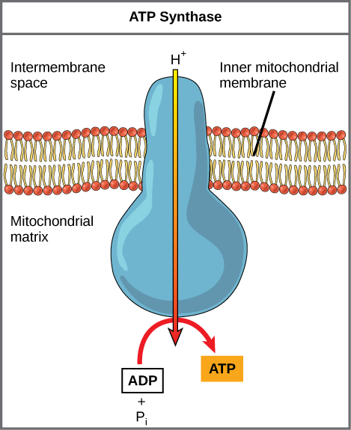
7.4 OXIDATIVE PHOSPHORYLATION – CHEMIOSMOSIS
Chemiosmosis uses kinetic energy from protons falling down its gradient to form ATP from ADP + Pi. The complex, integral protein ATP synthase mediates this reaction.
www.youtube.com/watch?v=3y1dO4nNaKY
(Credit: modification of work by Klaus Hoffmeier)

Slide 31
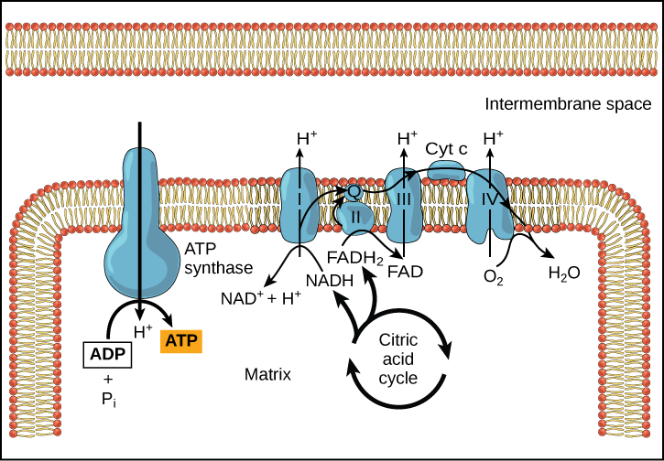
7.4 OXIDATIVE PHOSPHORYLATION

Slide 32
7.4 OXIDATIVE PHOSPHORYLATION
ATP Yield
The number of ATP generated by cellular respiration is 30-36 per glucose
  Varies by species and how efficiently NADH from glycolysis enters mitochondria
Cellular respiration in total stores ~ 34% of the energy from glucose in ATP

Slide 33
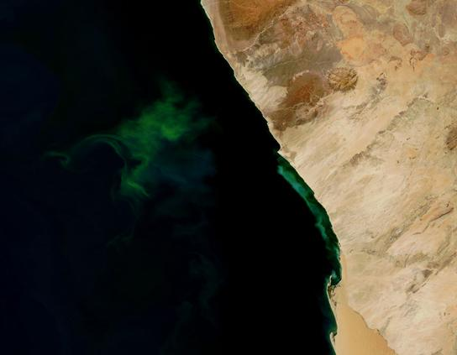
7.5 METABOLISM WITHOUT OXYGEN – ANAEROBIC RESPIRATION
Prokaryotic cells (Domains Bacteria and Archaea)
Use a terminal electron acceptor other than oxygen in the electron transport chain.
Figure 7.13 The green color seen in these coastal waters is from an eruption of hydrogen sulfide–producing bacteria. These anaerobic, sulfate-reducing bacteria release hydrogen sulfide gas as they decompose algae in the water.
(credit: modification of work by NASA/Jeff Schmaltz, MODIS Land Rapid Response Team at NASA GSFC, Visible Earth Catalog of NASA images)

Slide 34
7.5 METABOLISM WITHOUT OXYGEN - FERMENTATION
Glycolysis occurs in aerobic and anaerobic environments.
NAD⁺ is an input of glycolysis; regenerated during oxidative phosphorylation when O₂ is present.
When O₂ is lacking, fermentation regenerates NAD⁺; otherwise, glycolysis would halt.
There are two common types of fermentation
  Lactic acid fermentation
  Alcohol fermentation

Slide 35
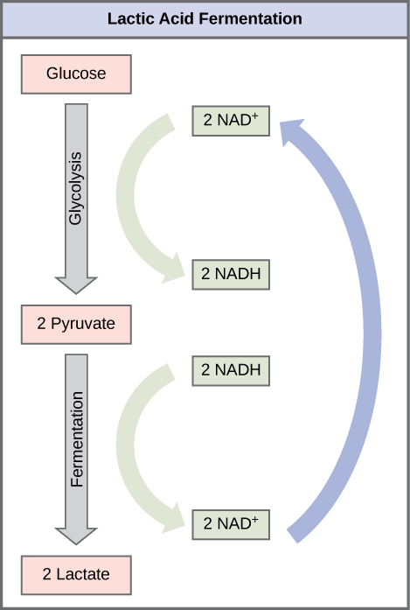
7.5 METABOLISM WITHOUT OXYGEN - FERMENTATION
  Lactic Acid Fermentation
  Occurs in muscle cells when O₂ is limited, mammalian red blood cells, & some bacteria, ex. those in yogurt
Lactate dehydrogenase catalyzes this reaction.
Pyruvate + NADH 🡨🡪 lactate + NAD⁺

Slide 36
7.5 METABOLISM WITHOUT OXYGEN - FERMENTATION
Lactic Acid Fermentation

Slide 37
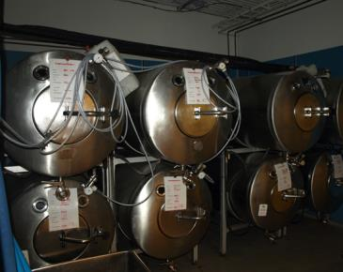
7.5 METABOLISM WITHOUT OXYGEN - FERMENTATION
  Alcoholic Fermentation
  anaerobic yeast species
Involves two reactions
  First, catalyzed by pyruvate decarboxylase
  Second, by alcohol dehydrogenase
Fermentation tanks have valves so that the pressure inside the tanks created by the CO² produced can be released.
Pyruvate 🡪 CO₂ + acetylaldehide
acetylaldehide + NADH🡪 ethanol + NAD⁺

Slide 38
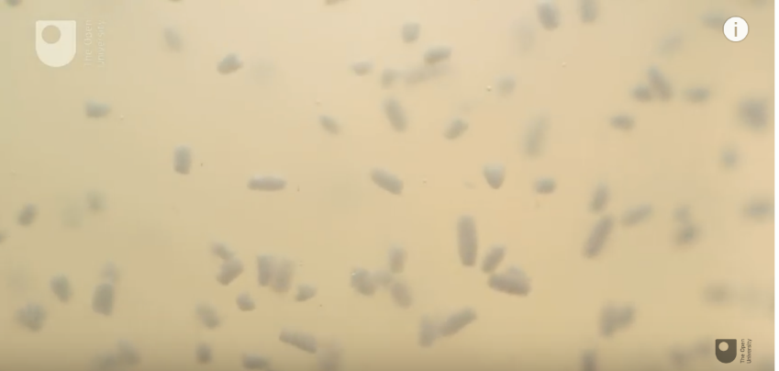
7.5 METABOLISM WITHOUT OXYGEN - FERMENTATION
Measuring Respiration in Yeast
https://www.youtube.com/watch?v=Cngt2HmJuSo

Slide 39
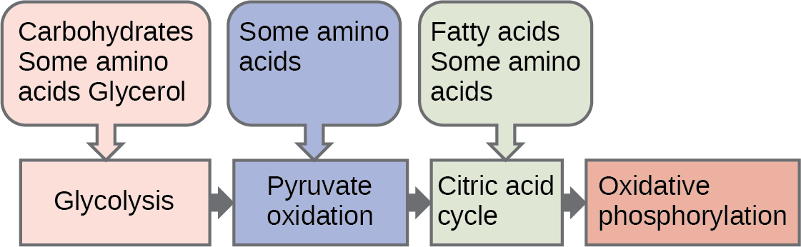
7.6 CONNECTIONS OF CARBOHYDRATE, PROTEIN AND LIPID METABOLIC PATHWAYS
Catabolic pathways for carbohydrates, lipids, and proteins eventually connect to glycolysis or the CAC pathways.

Slide 40
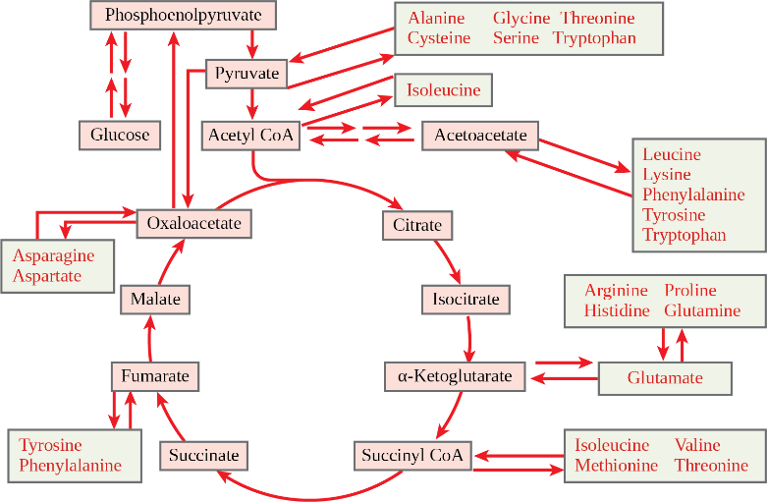
7.6 CONNECTIONS OF CARBOHYDRATE, PROTEIN AND LIPID METABOLIC PATHWAYS
Amino Acids that enter the Citric Acid Cycle do so at different locations, depending on the AA.

Slide 41
7.7 REGULATION OF CELLULAR RESPIRATION
Cellular respiration is regulated by many mechanisms, including:
Hormonal control of glucose entry into the cell
Enzyme reversibility (functioning to substrate product equilibrium) or irreversibility (able to exceed equilibrium)
Enzyme sensitivity to pH changes due to lactic acid build-up
Feedback controls

Slide 42
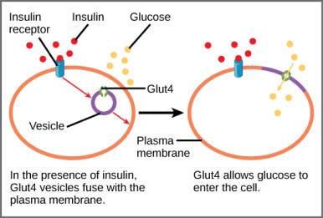
7.7 REGULATION OF CELLULAR RESPIRATION

Slide 43
7.7 REGULATION OF CELLULAR RESPIRATION
Pathway | Enzyme affected | Elevated levels of effector | Effect on pathway activity
glycolysis | Hexokinase | Glucose-6-phosphate | decrease
 | Phosphofructokinase | Fructose-6-phosphate | increase
 |  | Citrate, acidic pH | decrease
Pyruvate to acetyl coA | Pyruvate dehydrogenase | ADP, pyruvate | increase
 |  | Acetyl coA, ATP, NADH | decrease
CAC | Isocitrate dehydrogenase | ADP | increase
 |  | ATP, NADH | decrease
 | Ketoglutarate dehydrogenase | Calcium ions, ADP | increase
 |  | ATP, NADH, succinyl coA | decrease
ETC |  | ADP | Increase
 |  | ATP | decrease

