Slide 1


BIOLOGY 2e
Chapter 9 CELL COMMUNICATION
PowerPoint Image Slideshow
This work is licensed under a Creative Commons Attribution-NonCommercial-ShareAlike 4.0 International License.

Slide 2
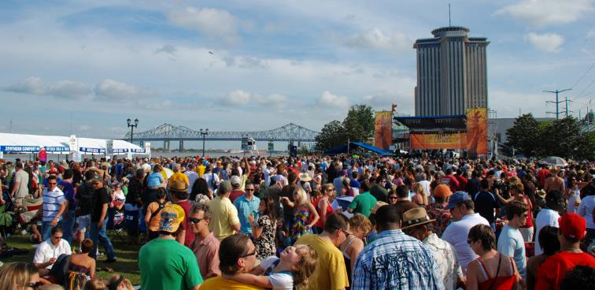
Communication
As with people, it is vital for individual cells to be able to interact with their environment. In order to properly respond to externals stimuli, cells have developed complex mechanisms of communication that can receive a message, transfer the information across the plasma membrane, and produce changes within the cell in response to the message. The ability of cells to communicate through chemical signals originated in single cells and was essential for the evolution of multicellular organisms. (credit: modification of work by Vincent and Bella Productions)

Slide 3
Communication
Intercellular signaling: communication between cells
Intracellular signaling: communication within a cell
Ligands are signaling molecules which interact with proteins (receptors) in target cells.
The four forms of signaling are distinguished by the distance that the signal travels

Slide 4
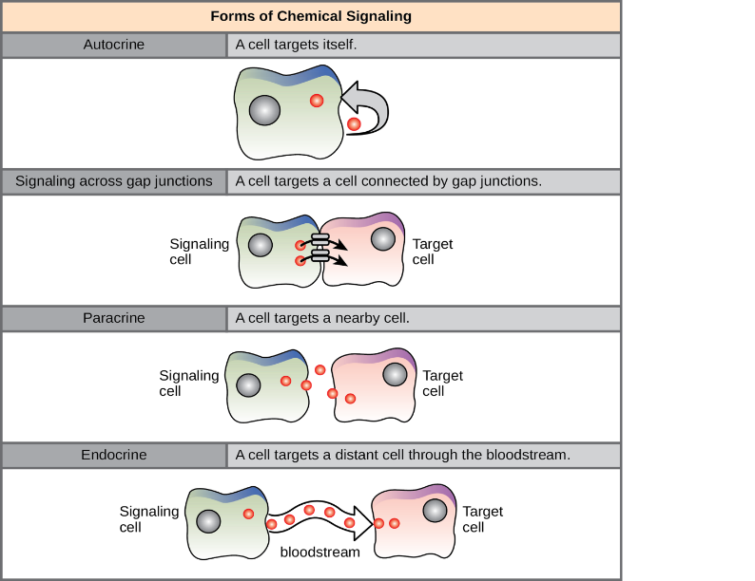
Forms of signaling
Paracrine signaling: move by diffusion through extracellular matrix, examples include synaptic signals and neurotransmitters
Endocrine signaling: signals from distant cells, typically produce a slower response with a long-lasting effect (e.g., hormones)

Slide 5
Forms of signaling
Autocrine signaling: signaling cells that can also bind to the ligand that is released, such that signal and target cell can be the same or similar to each other (cell death signaling)
Direct signaling across gap junctions: intracellular mediators that allow small signaling molecules to move between cells

Slide 6
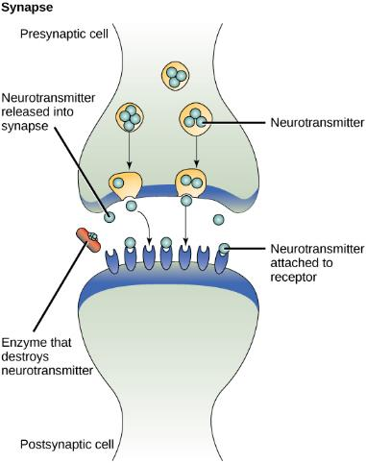
Paracrine Signaling Example
The distance between the presynaptic cell and the postsynaptic cell—called the synaptic gap—is very small and allows for rapid diffusion of the neurotransmitter. Enzymes in the synaptic cleft degrade some types of neurotransmitters to terminate the signal.

Slide 7
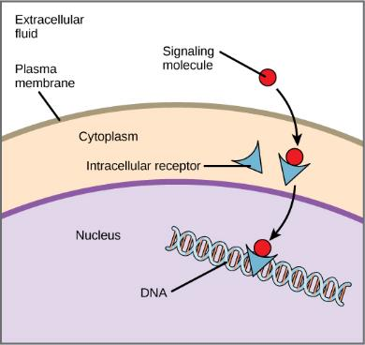
Types of receptors - internal
Intracellular
Hydrophobic signaling molecules typically diffuse across the plasma membrane and interact with intracellular receptors in the cytoplasm. Many intracellular receptors are transcription factors that interact with DNA in the nucleus and regulate gene expression.

Slide 8
Types of receptors – cell surface
Ion channel-linked
G-protein-linked
Enzyme-linked
Evolution Connection on p. 256 – these receptors are used by viruses to infect a host cell

Slide 9
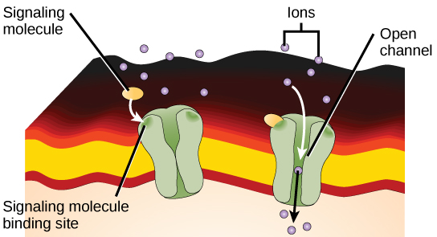
Cell-Surface Receptors: Ion Channel-Linked
Gated ion channels form a pore through the plasma membrane that opens when the signaling molecule binds. The open pore then allows ions to flow into or out of the cell.

Slide 10
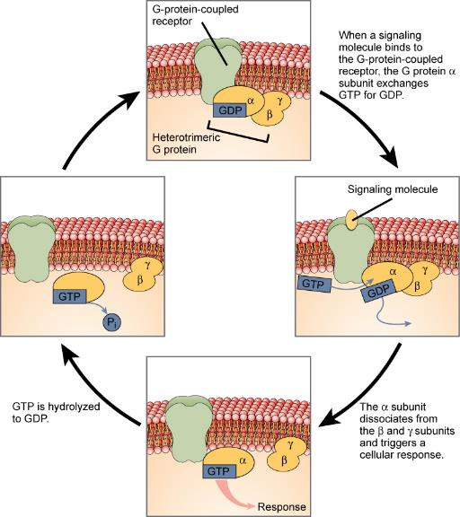
Cell-Surface Receptors: G-Protein-linked

Slide 11
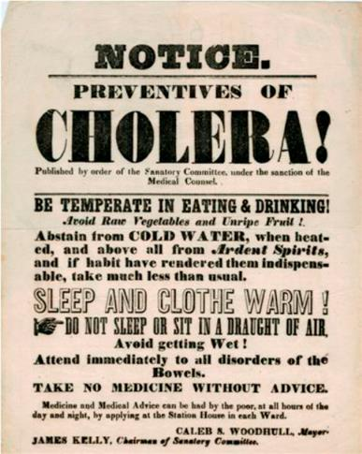
G-protein-linked receptor: Figure 9.7
Transmitted primarily through contaminated drinking water, cholera is a major cause of death in the developing world and in areas where natural disasters interrupt the availability of clean water. The cholera bacterium, Vibrio cholerae, creates a toxin that modifies G-protein-mediated cell signaling pathways in the intestines. Modern sanitation eliminates the threat of cholera outbreaks, such as the one that swept through New York City in 1866. This poster from that era shows how, at that time, the way that the disease was transmitted was not understood. (credit: New York City Sanitary Commission)

Slide 12
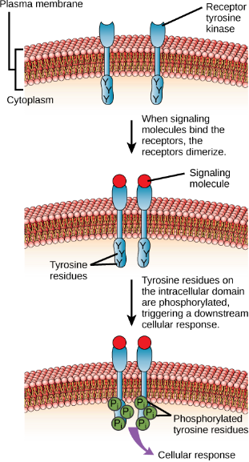
Cell-Surface Receptors: Enzyme-linked
A receptor tyrosine kinase is an enzyme-linked receptor with a single transmembrane region, and extracellular and intracellular domains. Binding of a signaling molecule to the extracellular domain causes the receptor to dimerize. Tyrosine residues on the intracellular domain are then autophosphorylated, triggering a downstream cellular response. The signal is terminated by a phosphatase that removes the phosphates from the phosphotyrosine residues.

Slide 13
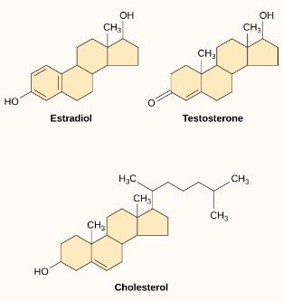
Signaling Molecules
Small hydrophobic ligands
  Can diffuse directly across the plasma membrane into the cell, where they interact with internal receptors.
  Steroid hormones including estradiol, testosterone, thyroid hormones and vitamin D
Water soluble ligands
  Hydrophilic so cannot pass through the plasma membrane
  Typically bind to cell-surface receptors
Gas ligands (e.g., nitric oxide)

Slide 14
Propagation of the Signal
Signal transduction: when a ligand binds to a receptor and the signal is transmitted through the cell membrane and into the cytoplasm continuing the signal
Dimerization: in some cases binding of the ligand causes two receptors bind to each other to form a stable complex
Signaling pathway: chain of events including second messengers, enzymes and activated proteins that follow ligand binding to a receptor. Notice how complex these can be on the following slide.
Signal integration: signals from two or more different cell-surface receptors merge to activate the same response in the cell – more complexity!

Slide 15
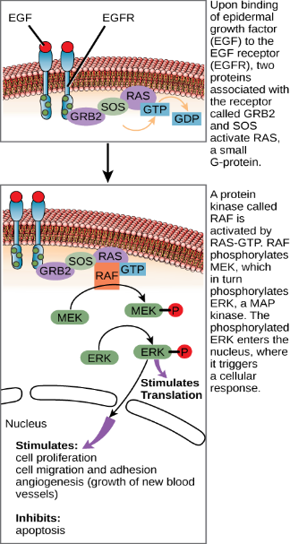
signaling pathway: EGFR (Note the complexity!)
The epidermal growth factor (EGF) receptor (EGFR) is a receptor tyrosine kinase involved in the regulation of cell growth, wound healing, and tissue repair.
When EGF binds to the EGFR, a cascade of downstream events causes the cell to grow and divide.
If EGFR is activated at inappropriate times, uncontrolled cell growth (cancer) may occur.

Slide 16
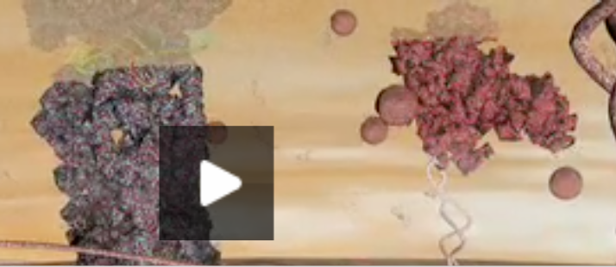
Cell Signaling
https://www.dnalc.org/resources/3d/cellsignals.html

Slide 17
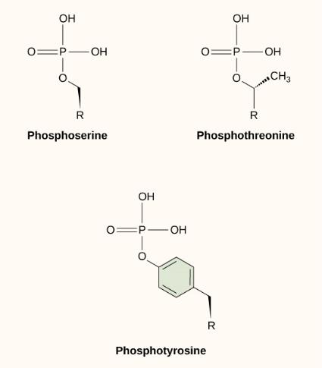
Methods of Intracellular Signaling
Phosphorylation
  Phosphate group (PO₄⁻³ ) is added to residues of the amino acids serine, threonine, and tyrosine.
  Kinases catalyze the transfer of the phosphate group

Slide 18
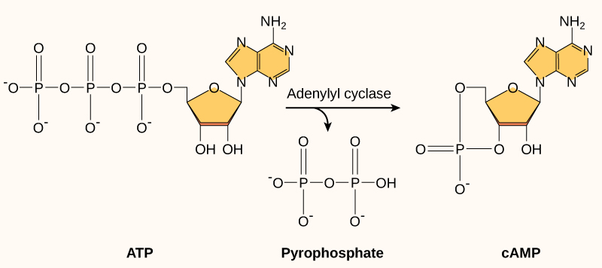
Methods of Intracellular Signaling
Second messenger
  Small molecule that propagates a signal after it has been initiated by the binding of the signaling molecule to the receptor
Example of a second messenger: This diagram shows the mechanism for the formation of cyclic AMP (cAMP). cAMP serves as a second messenger to activate or inactivate proteins within the cell. Termination of the signal occurs when an enzyme called phosphodiesterase converts cAMP into AMP.

Slide 19
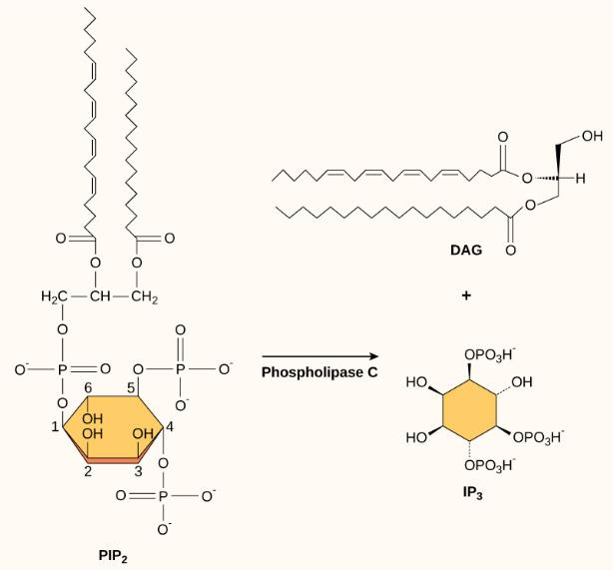
Methods of Intracellular Signaling
Second messenger
The enzyme phospholipase C breaks down PIP₂ into IP₃ and DAG, both of which serve as second messengers.

Slide 20
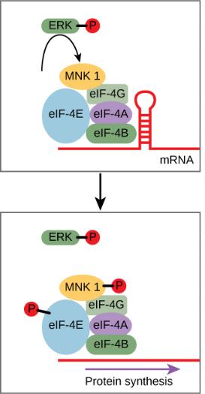
Response to the signal: Gene Expression
Gene expression as a response to cell signaling
  ERK is a MAP kinase that activates translation when it is phosphorylated.
  ERK phosphorylates MNK1, which in turn phosphorylates eIF-4E.
  When eIF-4E becomes phosphorylated, the mRNA unfolds, allowing protein synthesis in the nucleus to begin.

Slide 21
Response to the signal: cellular metabolism
Increase in cellular metabolism in muscle cells
  Adrenaline activates β-adrenergic receptors
  These increase cyclic AMP (cAMP), which activates PKA.
  PKA phosphorylates two enzymes, which lead to a ready supply of glucose and an increase in metabolism which is needed for the “fight or flight” response.

Slide 22
Response to the signal: cell growth
Cell growth
  Growth factors bind to tyrosine kinases
  These initiate a pathway (including a G-protein called RAS) which activates MAP kinase pathway
  MAP kinase stimulates protein expression that eventually leads to cell division
  See Career Connection on p. 267 – RAS and cancer

Slide 23
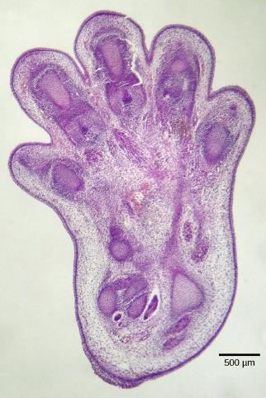
Response to the signal: Cell Death (apoptosis)
Cell death
  When a cell is damaged, unnecessary, or potentially dangerous to an organism, then the cell can initiate a mechanism to trigger its death.
  Elimination of self-reactive T-lymphocytes
  Embryonic development
  This process can fail and lead to cancer
Example of cell-signal induced apoptosis: The histological section of a foot of a 15-day-old mouse embryo, reveals areas of tissue between the toes, which apoptosis will eliminate before the mouse reaches its full gestational age at 27 days. (credit: modification of work by Michal Mañas)

Slide 24
Response to the signal: Termination of the signal
Termination of the signal cascade
  Cell signals are terminated by degradation of ligands or by other signals: Ex. phosphatases: enzymes that remove the phosphate group attached to proteins by kinases
  May fail in tumor cells

Slide 25
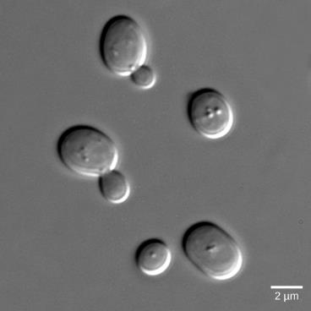
signaling in single-celled organisms: Yeast
Yeast cells can communicate by releasing a signaling molecule called mating factor.
Mating factor binds to cell-surface receptors in nearby yeast cells.
They stop their normal growth cycles and initiate a cell signaling cascade that includes protein kinases and GTP-binding proteins that are similar to G-proteins.

Slide 26
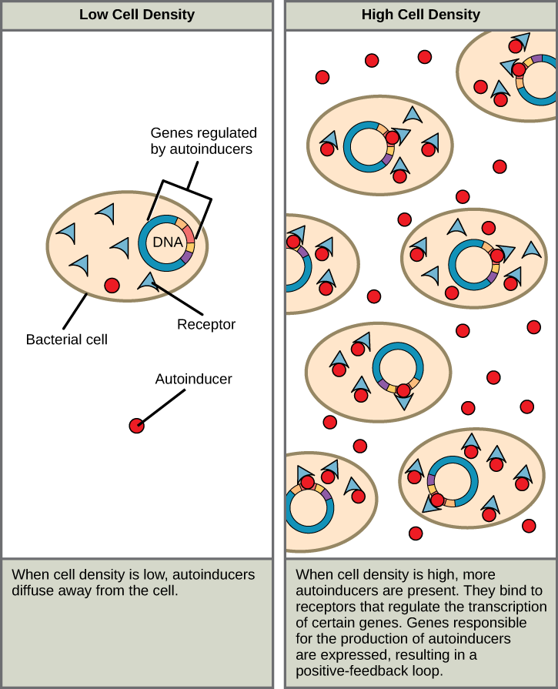
signaling in single-celled organisms: Bacteria
In bacteria, population density is often the key factor for signaling.
Bacterial signaling is thus call quorum sensing.
  Autoinducers
  Biofilms, which are responsible for over 70% of infections, use signaling to coordinate release of toxins. Also to form on indwelling medical devices

Slide 27
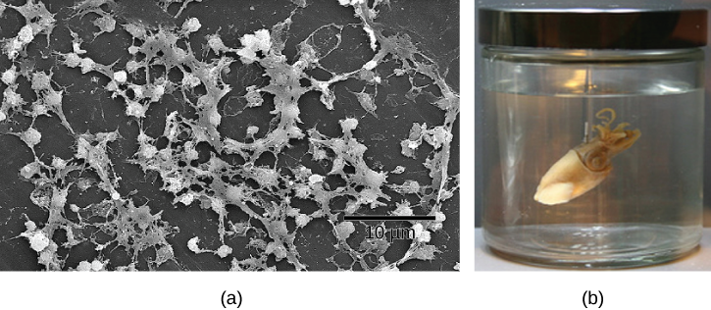
Signaling in Bacteria: Figure 9.18
Cell-cell communication enables these (a) Staphylococcus aureus bacteria to work together to form a biofilm inside a hospital patient’s catheter, seen here via scanning electron microscopy. S. aureus is the main cause of hospital-acquired infections. (b) Hawaiian bobtail squid have a symbiotic relationship with the bioluminescent bacteria Vibrio fischeri. The luminescence makes it difficult to see the squid from below because it effectively eliminates its shadow. In return for camouflage, the squid provides food for the bacteria. Free-living V. fischeri do not produce luciferase, the enzyme responsible for luminescence, but V. fischeri living in a symbiotic relationship with the squid do. Quorum sensing determines whether the bacteria should produce the luciferase enzyme. (credit a: modifications of work by CDC/Janice Carr; credit b: modifications of work by Cliff1066/Flickr)

