Slide 1
BIOLOGY 2E
Chapter 11 MEIOSIS AND SEXUAL REPRODUCTION
PowerPoint Image Slideshow
This work is licensed under a Creative Commons Attribution-NonCommercial-ShareAlike 4.0 International License.

Slide 2
11.1 THE PROCESS OF MEIOSIS
Reproduction
Asexual reproduction
Produces genetically identical clones
Sexual reproduction
combines cells (gametes) from two individuals (parents) through fertilization
genetic diversity is increased

Slide 3
11.1 THE PROCESS OF MEIOSIS
Sexual reproduction
The cells that make up the bodies of most plants and animals have two sets of chromosomes
One set from each parent, contributed through gametes
Diploid (2n)
Meiosis reduces the number of chromosomes in gametes to avoid doubling in every generation
Occurs in reproductive tissues
Haploid (n)

Slide 4
11.1 THE PROCESS OF MEIOSIS
Meiosis reduces the number of chromosomes by ½ to produce haploid (n) cells
The process resembles mitosis includes two rounds of division: Meiosis I and Meiosis II

Slide 5
11.1 THE PROCESS OF MEIOSIS

Slide 6
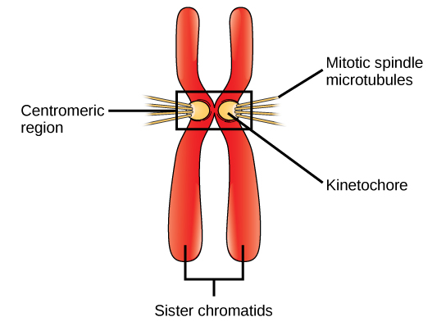
11.1 THE PROCESS OF MEIOSIS
Meiosis I
Meiosis is preceded by interphase (G₁, S, G₂)
Chromosome replication in S phase produces identical sister chromatids

Slide 7
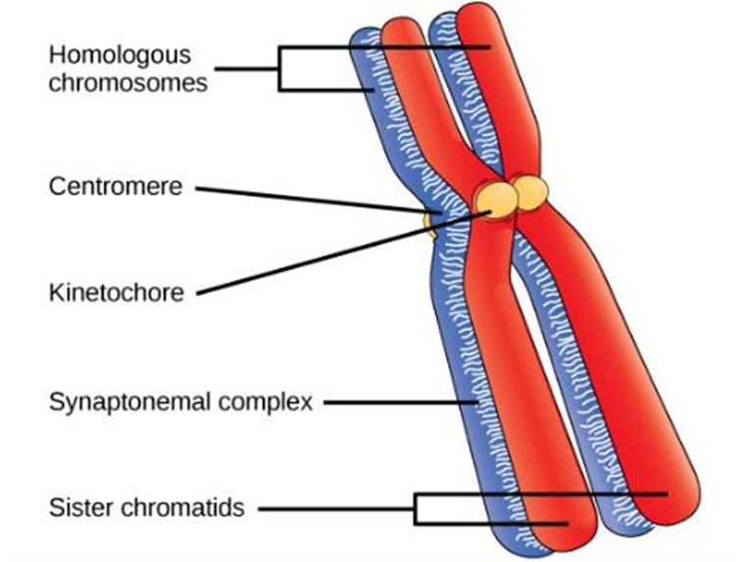
11.1 THE PROCESS OF MEIOSIS
Prophase I
Homologous chromosomes pair and the synaptonemal complex holds them close together in synapsis
Segments of chromosomes can be exchanged through crossing over
Visible structures at cross over points are called chiasmata
The four chromatids held together are called a tetrad

Slide 8
11.1 THE PROCESS OF MEIOSIS

Slide 9
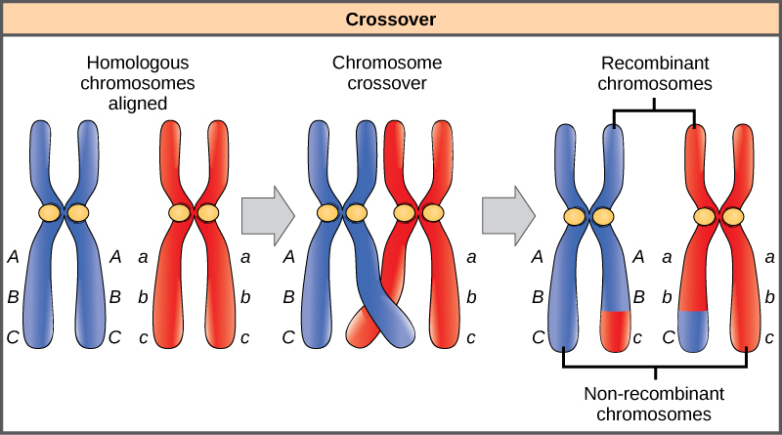
11.1 THE PROCESS OF MEIOSIS
Crossing Over

Slide 10
11.1 THE PROCESS OF MEIOSIS
Prometaphase I
Spindle fiber microtubules attach to the kinetochore proteins at the centromeres
Homologous chromosomes are still held together
Nuclear envelope is completely broken down

Slide 11
11.1 THE PROCESS OF MEIOSIS
Metaphase I
Homologous chromosomes are arranged at the cell equator with kinetochores facing opposite poles
Maternal and paternal chromatids orient randomly and are mixed when they migrate to the poles (Independent Assortment)
Increases genetic variation among daughter cells

Slide 12
11.1 THE PROCESS OF MEIOSIS
Anaphase I
The microtubules pull tetrads apart
Chiasmata are broken
Sister chromatids remain attached at centromere

Slide 13
11.1 THE PROCESS OF MEIOSIS
Telophase I and Cytokinesis
Separated chromosomes arrive at opposite poles
Cytokinesis separates the cytoplasm into daughter cells

Slide 14
11.1 THE PROCESS OF MEIOSIS
https://www.cellsalive.com/meiosis_js.htm

Slide 15
11.1 THE PROCESS OF MEIOSIS

Slide 16
11.1 THE PROCESS OF MEIOSIS
Prophase II
Events depend on species-specific differences
If chromosomes decondensed in telophase I, they recondense now
If centrosomes were duplicated, they migrate to opposite poles and new spindles form

Slide 17
11.1 THE PROCESS OF MEIOSIS
Prometaphase II
Nuclear envelopes completely disappear
Spindle is fully formed
Each sister chromatid forms a kinetochore and attaches to microtubules from opposite poles

Slide 18
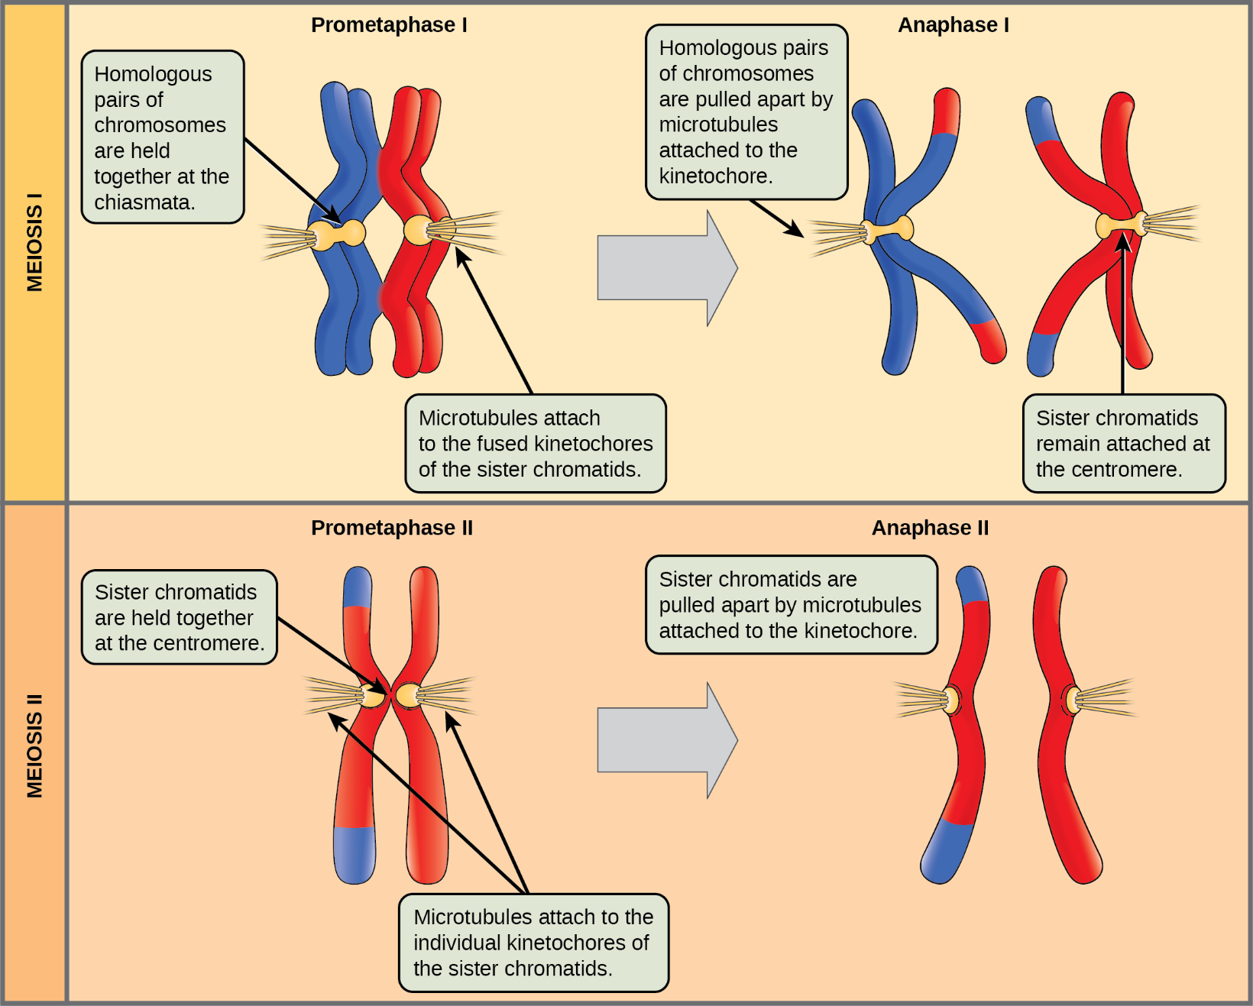
11.1 THE PROCESS OF MEIOSIS

Slide 19
11.1 THE PROCESS OF MEIOSIS
Metaphase II and Anaphase II
Events proceed as in mitosis as chromosomes line up at the cell equator and sister chromatids separate and move toward opposite poles

Slide 20
11.1 THE PROCESS OF MEIOSIS
Telophase II and Cytokinesis
The chromosomes arrive at opposite poles and decondense
Nuclear envelopes form around chromosomes
Cytokinesis separates the two cells into four unique haploid cells

Slide 21
11.1 THE PROCESS OF MEIOSIS
Comparing Meiosis and Mitosis
Both processes divide the nucleus in eukaryotic cells
Mitosis is a single division; meiosis is two successive divisions
Homologous chromosomes pair to form tetrads in meiosis but not in mitosis
In meiosis, crossing over between sister chromatids and independent assortment of chromosomes in anaphase I create genetic variation. Mitosis produces genetically identical clones.
Meiosis reduces the number of chromosome (ploidy: 2n → 1n), mitosis does not

Slide 23
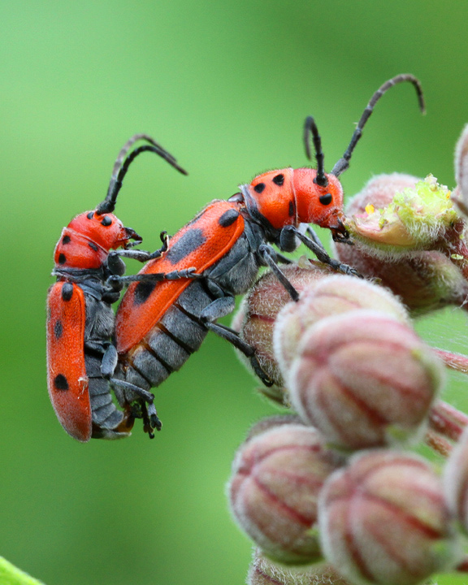
11.2 Sexual Reproduction
https://naturallycuriouswithmaryholland.files.wordpress.com/2011/07/7-12-11-milkweed-longhorn-beetles-mating-img_8816.jpg?w=590

Slide 24
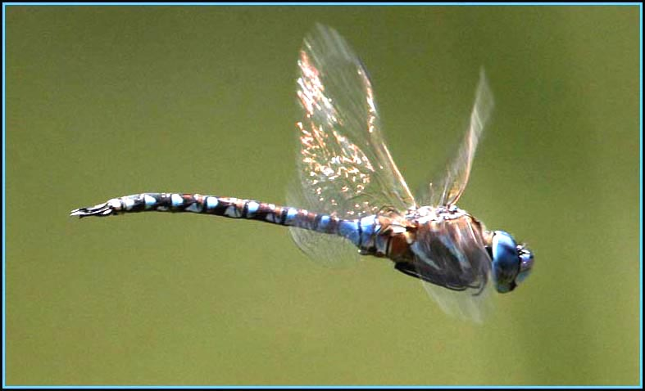
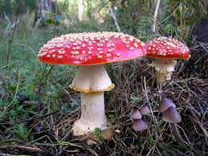
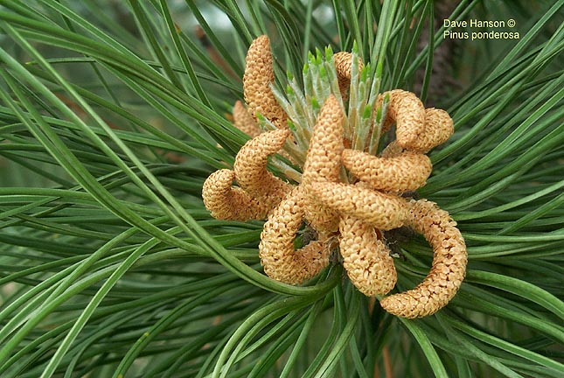
11.2 Sexual Reproduction
Life Cycles
There are 3 main categories of life cycles in multicellular organisms
Diploid-dominant
Haploid-dominant
Alternation of generations

Slide 25
11.2 Sexual Reproduction
Diploid-Dominant Life Cycle
Most animals have a diploid-dominant life-cycle strategy: the only haploid cells produced are the gametes
Germ cells produced by gonads (testes and ovaries) use mitosis to perpetuate the cell line and meiosis to produce gametes
There is no multicellular haploid life stage
Fertilization occurs when two gametes fuse to restore the diploid state

Slide 26
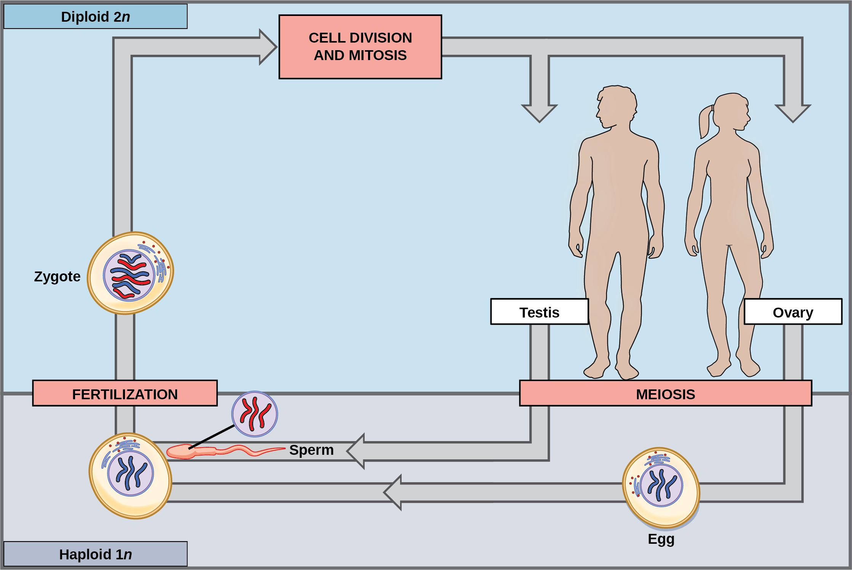
Diploid-Dominant Life Cycle

Slide 27
11.2 Sexual Reproduction
Haploid-Dominant Life Cycle
In most fungi and algae the “body” of the organism, the ecologically important part of the life cycle, is haploid
During sexual reproduction, specialized haploid cells from two individuals, designated the (+) and (−) mating types, join to form a diploid zygote which immediately undergoes meiosis to form 4 haploid spores
Although haploid like the “parents,” these spores contain a new genetic combination from two parents.
The spores form multicellular haploid structures by many rounds of mitosis

Slide 28
Haploid-Dominant Life Cycle

Slide 29
11.2 Sexual Reproduction
Alternation of Generations
Seen in some algae and all plants
The haploid multicellular plants are called gametophytes, because they produce gametes from specialized cell
Meiosis is not directly involved in the production of gametes because the organism that produces the gametes is already a haploid
Fertilization between the gametes forms a diploid zygote
Zygotes undergo many rounds of mitosis and give rise to a diploid multicellular plant called a sporophyte
Specialized cells of the sporophyte undergo meiosis to produce haploid spores which subsequently develop into the gametophytes

Slide 30
Alternation of Generations

