Slide 1
BIOLOGY 2E
Chapter 18 EVOLUTION AND THE ORIGIN OF SPECIES
PowerPoint Image Slideshow
This work is licensed under a Creative Commons Attribution-NonCommercial-ShareAlike 4.0 International License.

Slide 2
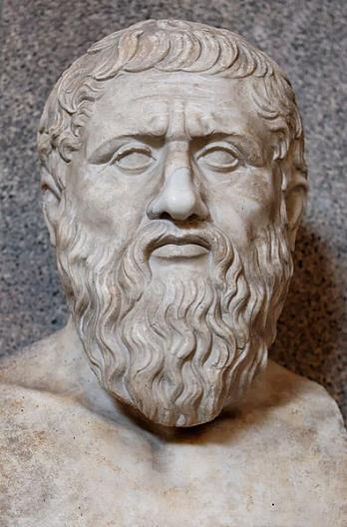
DO SPECIES CHANGE?
Greek philosopher Plato emphasized that species were static and unchanging
Founded first institution of higher learning in the Western world
Founder of Western political philosophy, religion, and spirituality
Taught by Socrates
Teacher of Aristotle

Slide 3
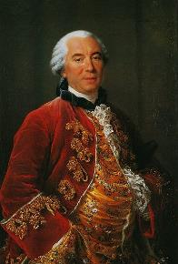
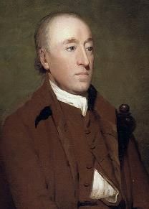
DO SPECIES CHANGE?
1700s:
Georges-Louis Leclerc Comte de Buffon
Reintroduced the idea of evolution
Geographic regions have different plant and animal populations, even when the environments are similar
James Hutton
Geological changes occur gradually by accumulating small changes (not catastrophic processes)

Slide 4
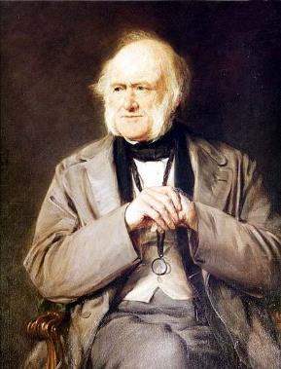
DO SPECIES CHANGE?
1800s: Charles Lyell
Geologic processes from the past still operating today and at the same rate
Therefore the Earth must be VERY old
This gives more time for gradual changes in species

Slide 5
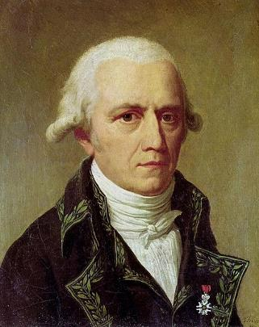
DO SPECIES CHANGE?
1800s: Jean-Baptiste Lamarck
Provided a mechanism for evolutionary change
Inheritance of acquired characteristics
Individual use or disuse of a structure causes a change that can be passed to the offspring
Not supported by data

Slide 6
DARWIN, WALLACE, AND NATURAL SELECTION
Charles Darwin and Alfred Russel Wallace independently conceived and described the actual mechanism for evolution
Both went on expeditions to the tropics that explored several island chains
From 1831 to 1836, Darwin traveled to South America, Australia, and the southern tip of Africa
From 1848 to 1862, Wallace traveled to the Amazon rainforest and the Malay Archipelago

Slide 7
ISLAND OBSERVATIONS
Species of organisms on different islands were clearly similar, yet had distinct differences
Galapagos finches have a graded series of beak sizes and shapes that help the birds acquire specific types of food
Island species resemble the mainland species
Galapagos Island species might have been modified from one of the South American mainland species

Slide 8
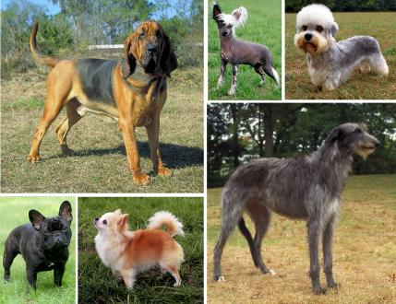
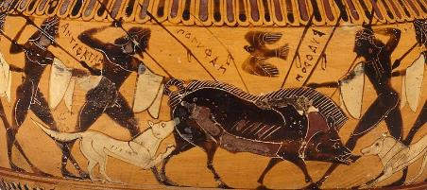
BASED ON ARTIFICIAL SELECTION
Humans have been selectively breeding for thousands of years
Crops
Domesticated animals
Mary Bloom
https://commons.wikimedia.org

Slide 9
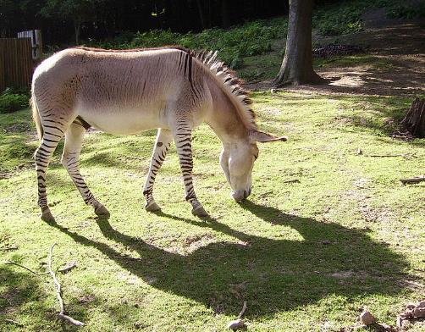
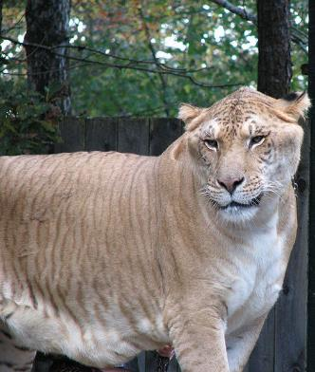
DESCENT WITH MODIFICATION
Natural selection is the outcome of three principles
Most characteristics of organisms are inherited from parent to offspring
Ali West
https://commons.wikimedia.org

Slide 10
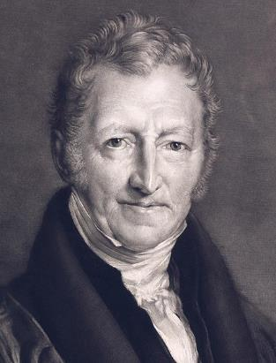
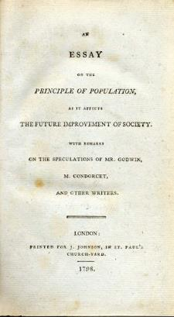
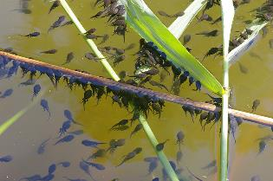
DESCENT WITH MODIFICATION
Natural selection is the outcome of three principles
More offspring are produced than are able to survive
Thomas Malthus: because too many are born, there is competition for resources in each generation
Christian Fischer
https://commons.wikimedia.org

Slide 11
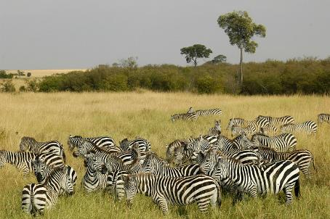
DESCENT WITH MODIFICATION
Natural selection is the outcome of three principles
Offspring vary in heritable characteristics
Offspring with inherited characteristics which allow them to best compete for limited resources will survive and have more offspring than those individuals with variations that are less able to compete
Alexander Leisser
https://commons.wikimedia.org

Slide 12
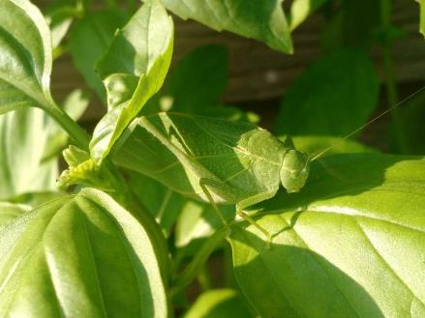
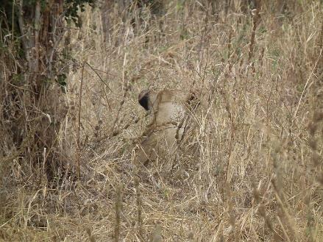
DESCENT WITH MODIFICATION
Natural selection is the only mechanism of adaptive evolution
Adaptation of the population to its local environment
The “best” traits accumulate in the population over time
Jeff Kwapil
https://commons.wikimedia.org
Nevit Dilmen
https://commons.wikimedia.org

Slide 13
VARIATION AND ADAPTATION
Natural selection can only take place if there is variation among individuals in a population
Variation must be genetic
Genetic diversity in a population comes from two main mechanisms
Mutation = the ultimate source of new alleles
May help fitness, hurt fitness, or have no effect (neutral)
Sexual reproduction
When two parents reproduce, unique combinations of alleles assemble to produce the unique genotypes in each offspring

Slide 14
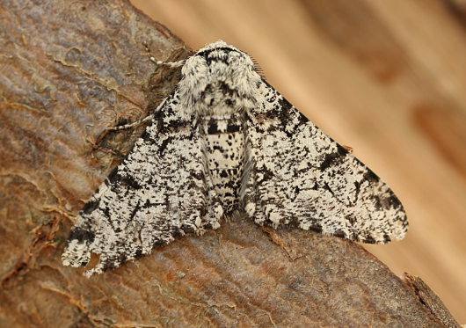
VARIATION AND ADAPTATION
A heritable trait that helps an organism's survival and reproduction in its present environment is an adaptation
Whether or not a trait is favorable depends on the current environmental conditions
Example: Peppered moth
Nick Goodrum
https://commons.wikimedia.org

Slide 15
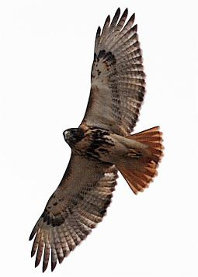
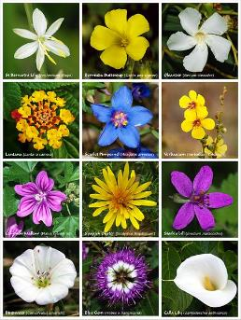
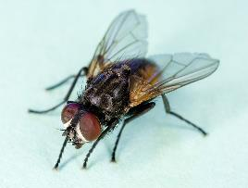
CONVERGENT VS. DIVERGENT EVOLUTION
A common ancestor can give rise to multiple species tremendously different from each other
Divergent evolution
In other cases, similar phenotypes evolve independently in species without a common ancestor
Convergent evolution
U.S. Air Force/Airman 1st Class Zachary Wolf
https://www.jble.af.mil/News/Article-Display/Article/259759/bird-counting/
Alvesgaspar
https://commons.wikimedia.org
USDAgov
https://www.flickr.com/photos/usdagov/8674435033/sizes/o/in/photostream/

Slide 16
OVERVIEW: EVIDENCE OF EVOLUTION
Fossil record
Anatomy
Embryology
Biogeography
Molecular Biology

Slide 17
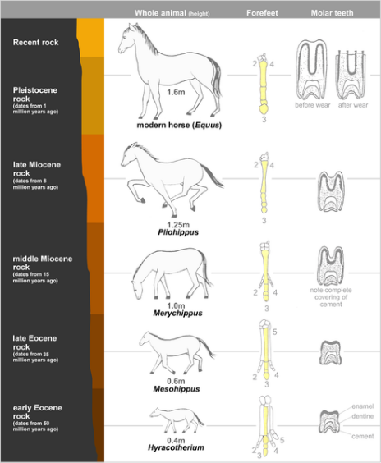
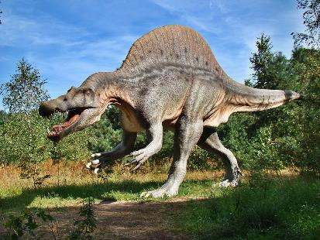
EVIDENCE OF EVOLUTION
Fossil record
Organisms from the past are different
Progression of form
Mcy Jerry
https://commons.wikimedia.org

Slide 18
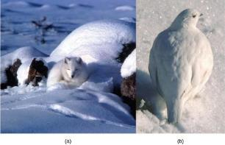
EVIDENCE OF EVOLUTION
Anatomy
Homologous structures
Vestigial structures
Convergence of form
Keith Morehouse

Slide 19
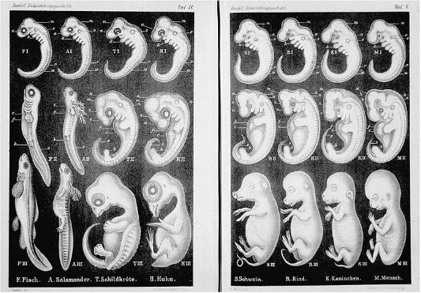
EVIDENCE OF EVOLUTION
Embryology
The study of the anatomy of an organism's development to its adult form
Embryo formation tends to be preserved

Slide 20
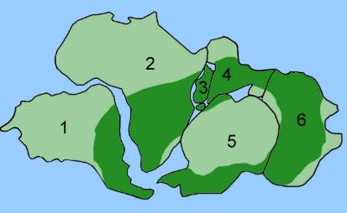
EVIDENCE OF EVOLUTION
Biogeography
Before and after the break-up of Pangaea
Groups that evolved before Pangea broke up are distributed worldwide
Groups that developed after the breakup appear only in certain regions/continents
e.g. Australian marsupials and Madagascar lemurs
Island vs. mainland species
Notes:
Glossopteris fossil distribution

Slide 21
EVIDENCE OF EVOLUTION
Molecular biology
Common ancestor for all life supported by similarities in ribosome components, membrane structures, and the universality of DNA
Differences in the genetic code, DNA replication, and expression cause the major structural differences between different forms of life

Slide 22
COMMON MISCONCEPTIONS OF EVOLUTION
Evolution is just a theory
Individuals evolve
Evolution explains the origin of life
Organisms evolved on purpose

Slide 23
GROUP DISCUSSION
Describe how Darwin and Wallace developed the present-day theory of evolution.
Define adaptation and give an example.
Explain the difference between convergent and divergent evolution.
Describe homologous and vestigial structures and give examples.
Discuss misconceptions about the theory of evolution.

Slide 24
WHAT IS A SPECIES?
Biological definition: A group of organisms that can interbreed and produce viable, fertile offspring in nature
Share external/internal characteristics that develop because of high degree of genetic similarity
Similar physical characteristics and behavior lead to successful reproduction
Populations of a species share a gene pool
A collection of all the variants of genes in a species
Includes genes found only in egg and sperm
Only these genes are passed to the next generation and can be sorted by natural selection
Hybrid: a cross between two species
Usually infertile (reinforcing the parent species)
Different species have different sets of embryonic directions for development

Slide 25
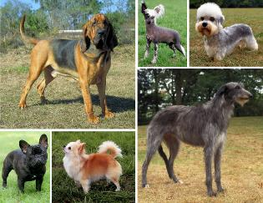
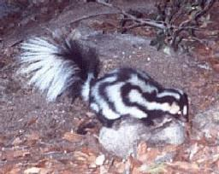
PHYSICAL APPEARANCE IS MISLEADING
Physical appearance alone is unreliable in determining ability to mate
Mary Bloom
https://commons.wikimedia.org
Notes:
Dogs look very different but produce healthy offspring
Eastern and western (right) spotted skunks look very similar but don’t interbreed
African fish eagle (left) and bald eagle (right) cannot breed

Slide 26
SPECIATION
The formation of two species from one original species
For it to occur, populations must be prevented from interbreeding
Allopatric
Sympatric

Slide 27
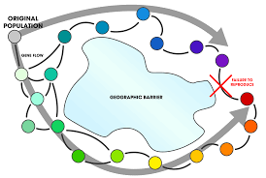
ALLOPATRIC SPECIATION
A geographically continuous population experiences free gene flow, creating similar allele frequencies across the range
Movement of alleles across a species' range
If a geographic barrier arises, gene flow is reduced
Allele frequencies become increasingly different as a result of mutation and natural selection
Changes lead to the groups no longer being reproductively compatible
Two mechanisms
Dispersal
Vicariance
Andrew Z. Colvin
https://commons.wikimedia.org
Notes:
Dispersal is when a few members of a species move to a new geographical area,
Vicariance is when a natural situation arises to physically divide organisms.

Slide 28
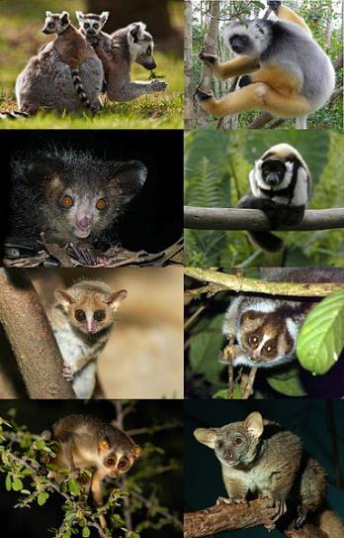
VICARIANCE VS. DISPERSAL
(credit “northern spotted owl”: modification of work by John and Karen Hollingsworth; credit “Mexican spotted owl”: modification of work by Bill Radke)
Maky
https://commons.wikimedia.org
Notes:
Lemurs are endemic to Madagascar. (dispersal)

Slide 29
SYMPATRIC SPECIATION
Occurs in the same geographical area without physical barriers to gene flow
Caused by chromosomal errors in cell division in mainly plants
Aneuploidy
Autopolyploidy
Allopolyploidy

Slide 30
ANEUPLOIDY
Gametes have too few or too many individual chromosomes
Caused by nondisjunction during meiosis

Slide 31
AUTOPOLYPLOIDY
“Self”: complete extra set of chromosomes from the same species
Results when mitosis is not followed by cytokinesis
Individuals can self pollinate or mate with other, similar plants if they have an even number of chromosome sets

Slide 32
ALLOPLOIDY
“Other”: extra set of chromosomes from a different species
Individuals can self pollinate or mate with other, similar plants if they have an even number of chromosome sets

Slide 33
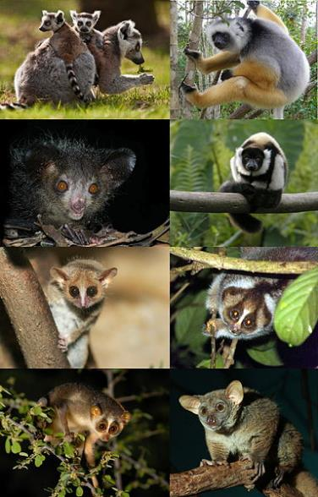
ADAPTIVE RADIATION
In some cases, a species can spread throughout an area and each population find a distinct niche
Over time, the varied demands of the different niches lead to multiple speciation events
Maky
https://commons.wikimedia.org

Slide 34
REPRODUCTIVE ISOLATION
Given enough time, the genetic and phenotypic changes in the two populations will lead to reproductive isolation
The inability to interbreed
This is the point the populations are different species
Reproductive isolation is maintained by reproductive barriers
Any feature of a species that keeps it reproductively isolated from other species
Prezygotic barriers
Prevent fertilization
Postzygotic barriers
After fertilization

Slide 35
PREZYGOTIC BARRIERS TO REPRODUCTION
Temporal:
(a) Rana aurora breeds earlier in the year than (b) Rana boylii.
(credit a: modification of work by Mark R. Jennings, USFWS; credit b: modification of work by Alessandro Catenazzi)

Slide 36
PREZYGOTIC BARRIERS TO REPRODUCTION
Habitat:
Species can live in close proximity, but because of their different habitat preferences, they became genetically isolated.
The cricket (a) Gryllus pennsylvanicus prefers sandy soil, and the cricket (b) Gryllus firmus prefers loamy soil.

Slide 37
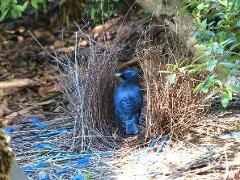
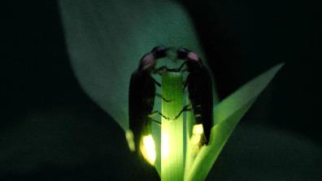
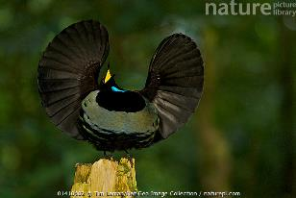
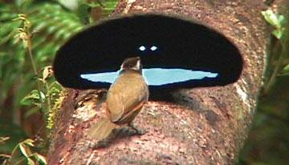
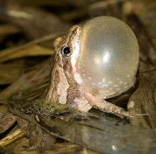
PREZYGOTIC BARRIERS TO REPRODUCTION
www.nationalgeographic.com
www.birds.cornell.edu
Behavioral:
Courtship rituals are required to initiate mating.

Slide 38
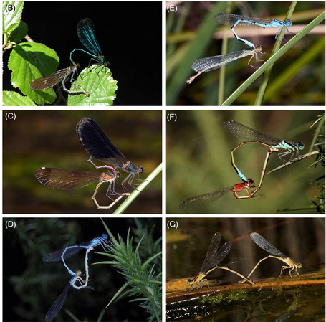
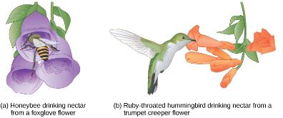
PREZYGOTIC BARRIERS TO REPRODUCTION
Mechanical:
Reproductive organs must have compatible shapes
The shape of the male reproductive organ varies among male damselfly species
Wellenreuther, M., & R. Sánchez Guillén. (2015). Non-adaptive radiation in damselflies. Evolutionary Applications. 9.

Slide 39
PREZYGOTIC BARRIERS TO REPRODUCTION
Salimfadhley
https://commons.wikimedia.org
Gametic:
Receptors on the sperm do not match receptors on the egg, preventing fertilization

Slide 40
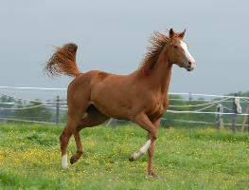
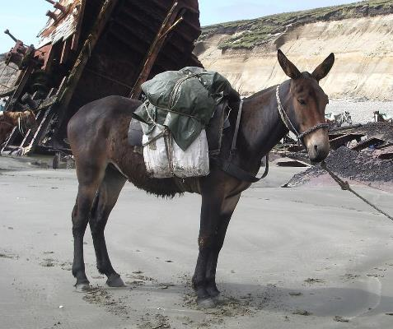
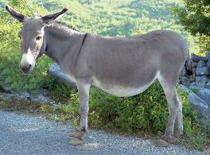
POSTZYGOTIC BARRIERS TO REPRODUCTION
Hybrid inviability: an embryo is produced, but cannot survive development
Hybrid sterility: offspring are born but cannot reproduce
www.britannica.com

Slide 41
GROUP DISCUSSION
Define species and discuss the challenges in identifying a species.
Describe how speciation can occur.
Describe several prezygotic and postzygotic reproductive barriers.

Slide 42
RECONNECTION
After speciation, two species may recombine or even continue interacting indefinitely
Hybrid zones: area where two closely related species interact and interbreed

Slide 43
HOW QUICKLY DOES SPECIATION OCCUR?
Gradual speciation: species diverge gradually through time with small steps
Punctuated equilibrium: species exhibit a large change in a relatively short period of time followed by long periods of stasis

