Slide 1
BIOLOGY 2E
Chapter 19 THE EVOLUTION OF POPULATIONS
PowerPoint Image Slideshow
This work is licensed under a Creative Commons Attribution-NonCommercial-ShareAlike 4.0 International License.

Slide 2
POPULATION GENETICS
Microevolution = evolutionary change in a population over time
Population genetics is the study of what changes allele frequencies in populations through time
Allele frequency = frequency of a single allele in the gene pool of a population
The sum of all the alleles in a population
Example: allele frequency for cystic fibrosis in Caucasians in the United States is 1.8%
Population genetics became formally incorporated into the Theory of Evolution in the 1940s after the Modern Synthesis
Evolutionary processes affect a population’s genetic makeup which results in the gradual change of populations and species

Slide 3
HARDY-WEINBERG PRINCIPLE OF EQUILIBRIUM
Allele frequencies can be used to determine the genotype frequencies
Genotype frequencies of a population = its genetic structure
The Hardy-Weinberg principle gives a mathematical baseline of a non-evolving population to which an evolving population can be compared
If a population is in equilibrium, the gene pool and genetic structure will never change
If allele or genotype frequencies deviate from the expected values, the population is evolving
Can then infer what evolutionary forces might be present

Slide 4
HARDY-WEINBERG PRINCIPLE OF EQUILIBRIUM
A population’s allele and genotype frequencies are inherently stable unless some kind of evolutionary force is acting upon the population
Assumptions:
No mutations
No migration or emigration (gene flow)
No natural selection
An infinite population size
Random mating
Do real populations meet these assumptions?

Slide 5
HARDY-WEINBERG EQUATIONS
p + q = 1
Alleles must be either dominant or recessive. The dominant allele is p while the recessive allele is q. Since no other option is possible, the % of p alleles and % of q alleles must add up to 100%.
p² + 2pq + q² = 1
Individuals can have only one of three genotypes. Homozygous dominant individuals are p² . Heterozygotes have one dominant and one recessive allele and are therefore 2pq. Homozygous recessive individuals are q². Since no other genotype is possible, the % of the three genotypes added together must equal 100%.
If you know one of these terms, you can find the other terms through algebra.

Slide 6
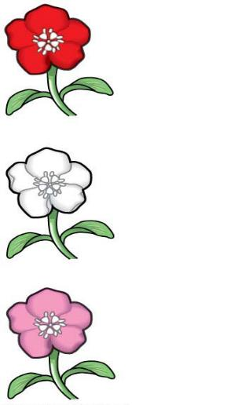
EXAMPLE 1
Incomplete dominance in a population of wildflowers
320 red flowers (C^{R}C^{R})
160 pink flowers (C^{R}C^{W})
20 white flowers (C^{W}C^{W})
Find the allele frequencies in the gene pool.
Use the allele frequencies to find the genotype frequencies.
Can you think of another way to find the genotype frequencies?
C^{R}C^{R}
C^{W}C^{W}
C^{R}C^{W}

Slide 7
EXAMPLE 2
A greenhouse contains 455 pea plants with yellow seeds and 45 pea plants with green seeds. Yellow is dominant over recessive.
What are the yellow and green allele frequencies?
What are the genotype frequencies?

Slide 8
GROUP DISCUSSION
Five male birds and five female birds (all unrelated to each other) settle on an uninhabited island. All 10 of the original birds had large beaks, and 2 were heterozygous. Large beaks is dominant to small beaks. Which of these is closest to the allele frequency in the founding population?
A) 0.1 a, 0.9 A
B) 0.2 a, 0.8 A
C) 0.5 a, 0.5 A
D) 0.8 a, 0.2 A
E) 0.4 a, 0.6 A

Slide 9
GROUP DISCUSSION
If one assumes that Hardy-Weinberg equilibrium applies to the population of birds, about how many will have small beaks when the island’s population reaches 10,000?
A) 100
B) 400
C) 800
D) 1,000
E) 10,000

Slide 10
GROUP DISCUSSION
In peas, a gene controls flower color such that R = purple and r = white. In an isolated pea patch, there are 36 purple-flowering plants and 64 white-flowering plants. Assuming Hardy-Weinberg equilibrium, what is the value of q for this population?
A) 0.36
B) 0.64
C) 0.75
D) 0.80

Slide 11
POPULATION VARIATION
Genetic variance = the diversity of alleles and genotypes within a population
High genetic variation associated with high population variation
Population variation = the various phenotypes present in a population
Evolutionary forces can only act on heritable variation
Heritability = the fraction of population variation caused by genetic differences among individuals
The greater the heritability of a population’s variation, the more susceptible it is to evolutionary forces

Slide 12
EVOLUTIONARY FORCES THAT CAUSE CHANGE IN POPULATIONS
Natural selection
Genetic drift
Gene flow
Mutation
Nonrandom mating
Environmental variances

Slide 13
EVOLUTIONARY FORCES THAT CAUSE CHANGE IN POPULATIONS
Natural selection
Detrimental alleles are eliminated and beneficial alleles increase in frequency
Selection pressure = driving selective force acting on a population
Depends on the current environmental conditions

Slide 14
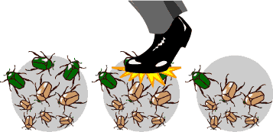
EVOLUTIONARY FORCES THAT CAUSE CHANGE IN POPULATIONS
Genetic drift
By chance, some individuals will have more offspring than others
Right place at the right time (a receptive female walks by)
Wrong place at the wrong time (a predator walks by)
Allele frequencies within a population change randomly with no advantage to the population
Susceptibility depends on population’s size
https://evolution.berkeley.edu/evolibrary/article/0_0_0/evo_24

Slide 15
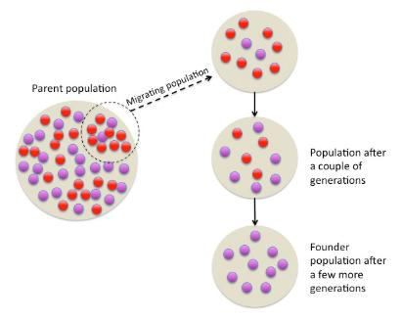
RAPID GENETIC DRIFT
Bottleneck
A chance event or catastrophe that drastically reduces the genetic variability within a population
Founder Effect
Random changes in allele frequencies (usually loss of alleles) due to a colonization event
Tsaneda
https://commons.wikimedia.org

Slide 16
EVOLUTIONARY FORCES THAT CAUSE CHANGE IN POPULATIONS
Gene flow
The flow of alleles in and out of a population due to the migration of individuals or gametes
Immigration brings in new genetic variation
Emigration can result in loss of genetic variation
Andrew Z. Colvin
https://commons.wikimedia.org

Slide 17
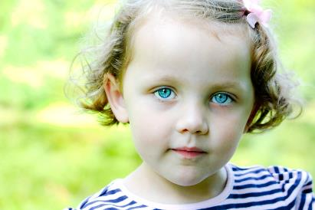
EVOLUTIONARY FORCES THAT CAUSE CHANGE IN POPULATIONS
Mutation
Changes to an organism’s DNA
Most common way to introduce novel genotypic and phenotypic variance.
Some are unfavorable or harmful and are quickly eliminated from the population by natural selection.
Some are beneficial and will spread
Some do not do anything and can linger, unaffected by natural selection

Slide 18
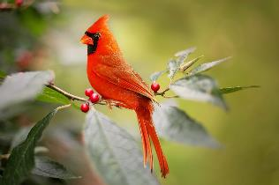
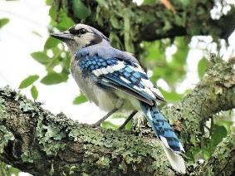
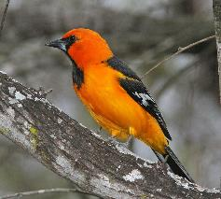
EVOLUTIONARY FORCES THAT CAUSE CHANGE IN POPULATIONS
Nonrandom mating
Mate choice
Natural selection picks traits that lead to more matings for an individual
Assortative mating = individual’s preference to mate with partners who look the same
Physical location
In large populations spread over vast geographic distances, not all individuals will have equal access to one another
Notes:
The cardinal, blue jay, and oriole all share a habitat, including the backyard bird feeder, in the Midwest. However, mate choice keeps the individuals from interbreeding.

Slide 19
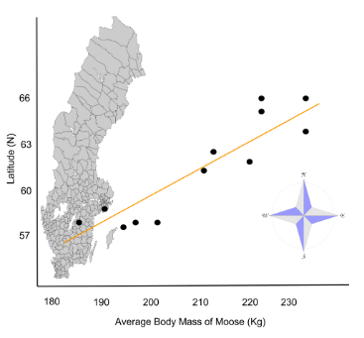
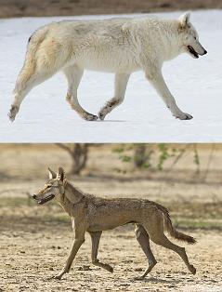
EVOLUTIONARY FORCES THAT CAUSE CHANGE IN POPULATIONS
Environmental variance
Human skin color
Temperature-dependent sex determination in reptiles
Geographical variation in environmental conditions
Can produce clines
Phenotype of a species' populations varies gradually across an ecological gradient (ie. Bergmann’s Rule)
Nmccarthy16
https://commons.wikimedia.org
Notes:
Bergmann's rule is an ecogeographical rule that states that within a broadly distributed taxonomic clade, populations and species of larger size are found in colder environments, and species of smaller size are found in warmer regions

Slide 20
GROUP DISCUSSION
Describe the different types of variation in a population.
Explain why only natural selection can act upon heritable variation.
Explain how each evolutionary force can influence a population's allele frequencies.
Describe the founder effect and the bottleneck effect.

Slide 21
ADAPTIVE EVOLUTION
Adaptive evolution = increase in the frequency of beneficial alleles in a population due to natural selection
Natural selection selects for individuals that contribute beneficial alleles to the next generation
Evolutionary (Darwinian) fitness = an individual’s absolute contribution to the gene pool of the next generation
BUT an individual's absolute fitness doesn’t count
Relative fitness = the contribution of an individual relative to others in the population
REMEMBER, NATURAL SELECTION ACTS ON INDIVIDUALS TO AFFECT CHANGE IN A POPULATION. INDIVIDUALS DO NOT EVOLVE. POPULATIONS EVOLVE.

Slide 22
ADAPTIVE EVOLUTION
Ways natural selection can affect population variation
Stabilizing selection
Directional selection
Diversifying selection
Frequency-dependent selection

Slide 24
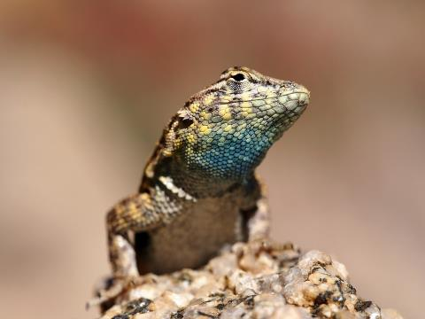
FREQUENCY DEPENDENT SELECTION
A yellow-throated side-blotched lizard is smaller than either the blue-throated or orange-throated males, allowing it to sneak copulations.
Populations of side-blotched lizards cycle in the distribution of these phenotypes.
In one generation, orange might predominate, and then yellow males will begin to rise in frequency. Once yellow males are the most common, blue males will be selected. When blue males become common, orange males once again will be favored.

Slide 25
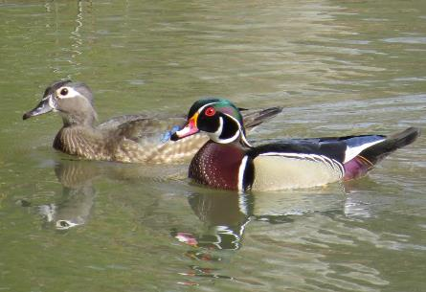
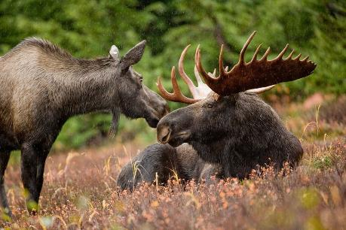
SEXUAL SELECTION
Typically males have more variance in reproductive success than females
Only a few males get most of the matings
This generates a strong selection pressure among males to obtain matings, resulting in a physical appearance different from females
= sexual dimorphism
Jeff Finn
www.flickr.com

Slide 26
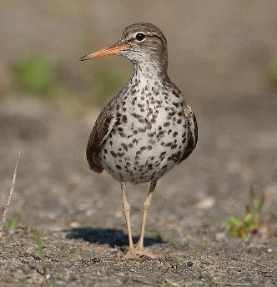
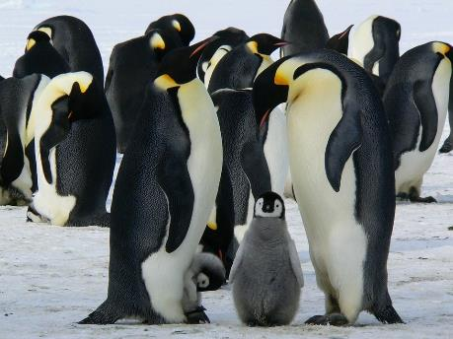
SEXUAL SELECTION
Sexual dimorphism is associated with the amount of parental care given to the offspring
In species whose sex-role are reversed, females have bigger body size and elaborate traits
Factumquintus
https://commons.wikimedia.org
Notes:
The strange part is that spotted sandpipers have done an almost complete role reversal. The females arrive first on the breeding grounds and establish and defend their territories in bloody disputes. The males form sub-territories within the female’s territory and are the primary caregivers from egg-laying until the chicks fledge. And unlike most birds, the female is larger than the male and is more visual attractive with more spotting on the white breast. The female performs the courtship rituals and females even experience a sevenfold increase in testosterone levels during breeding season.

Slide 27
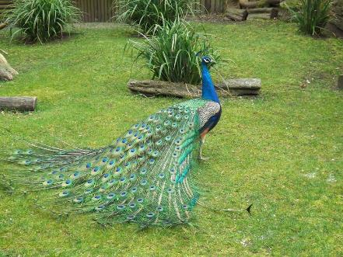
SEXUAL SELECTION
Sexual selection = the selection pressures on males and females to obtain matings
Selects for secondary sexual characteristics that often do not benefit the individual’s survival and may even be detrimental
Handicap principle: only the most fit male can afford the risk associated with significant adornments
Good genes hypothesis: the most impressive male traits indicate genetic superiority which will then pass on to their offspring
Choosy females produce fewer, healthier offspring rather than many, weaker offspring

Slide 28
NO PERFECT ORGANISM!!!
Natural selection…
Can only select from existing variation in the population
It cannot create variation
Is limited by existing structures
Works at the individual, not allele, level
Any given individual may carry some beneficial and some unfavorable alleles
Good alleles can be lost if individuals who carry them also have several overwhelmingly bad alleles and vice versa

Slide 29
NO PERFECT ORGANISM!!!
Not all evolution is adaptive
Genetic drift and gene flow can introduce deleterious alleles
Adaptations are compromises
Evolution has no purpose
Simply the sum of the various forces described in this chapter

Slide 30
GROUP DISCUSSION
Explain the different ways natural selection can shape populations.
Explain the difference between natural selection and sexual selection.

