Slide 1
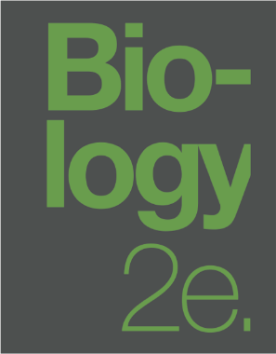
BIOLOGY 2E
INTRODUCTION TO ANIMAL DIVERSITY
This work is licensed under a Creative Commons Attribution-NonCommercial-ShareAlike 4.0 International License.

Slide 2
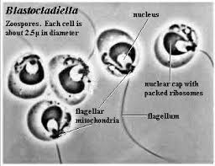
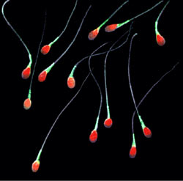
FEATURES OF THE ANIMAL KINGDOM
Two groups within Eukaryota have produced complex multicellular organisms
Archaeplastida (gave rise to plants)
Opisthokonta (gave rise to fungi and animals)
All have a single posterior flagellum in flagellated cells
Gilberto Santa Rosa
https://commons.wikimedia.org
Notes:
chytrid fungi zoospores and human spermatozoa

Slide 3
FEATURES OF THE ANIMAL KINGDOM
Multicellular
Heterotrophic
Obtain energy and organic molecules by ingesting other organisms
Active movement
Complex tissue structure
Differentiated and specialized tissues
Diplontic life cycle
Diploid state is multicellular whereas the haploid state is gametic

Slide 4
FEATURES OF THE ANIMAL KINGDOM
Most exhibit sexual reproduction
Offspring pass through developmental stages
Determined/fixed body plan = morphology of animal determined by developmental cues
Download for free at http://cnx.org/contents/d09cbd3e-a293-4aab-9ae6-e1a46e9e1da9@8.

Slide 5
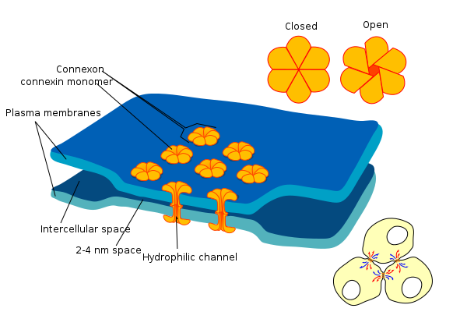
COMPLEX TISSUE STRUCTURE
Lack cell walls
Unique intracellular communication (gap junctions)

Slide 6
COMPLEX TISSUE STRUCTURE
Many of the specialized tissues of animals are associated with seeking and processing food
Connective tissues
Cells embedded in an extracellular matrix (ex: bone, cartilage)
Epithelial tissues
Covers, lines, protects and secretes
Nervous tissue
Coordinates movement
Sensory structures
Muscle tissue
Powers movement

Slide 8
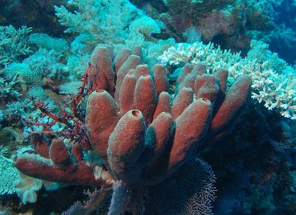
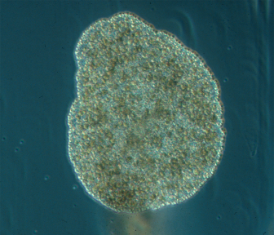
ORGANIZATION OF THE ANIMAL KINGDOM
Currently five monophyletic clades:
Simplest do not have specialized tissues derived from germ layers of the embryo
Possess specialized cell types that act functionally like tissues
Porifera (sponges)
Placozoa (tiny, flat creatures that resemble multicellular amoebae)
Bernd Schierwater
https://commons.wikimedia.org

Slide 9
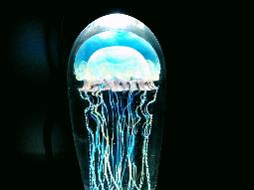
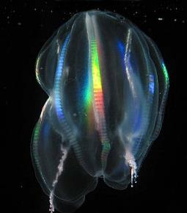
ORGANIZATION OF THE ANIMAL KINGDOM
Currently five monophyletic clades:
Others have specialized tissues derived from the germ layers of embryo
Cnidaria (jellyfish and their relatives)
Ctenophora (the comb jellies)
Bilateria (all other animals)
"true animals“
Most animals

Slide 10
FORMS OF ANIMAL REPRODUCTION
Asexual
Budding
Fragmentation
Common in stationary aquatic animals
Potential buildup of deleterious mutations
Lifetrance
https://commons.wikimedia.org

Slide 11
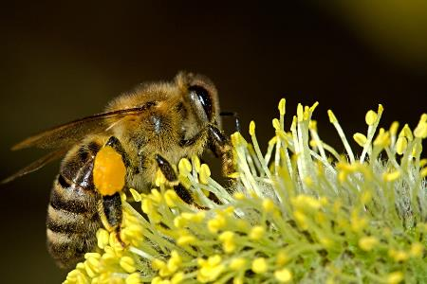
FORMS OF ANIMAL REPRODUCTION
Parthenogenesis
Progeny develop from a gamete without fertilization
Only occurs in females because of the nutrients stored in eggs
Can result in haploploidy
Females are diploid and males are haploid
Ensures genetic propagation when access to mates is limited

Slide 12
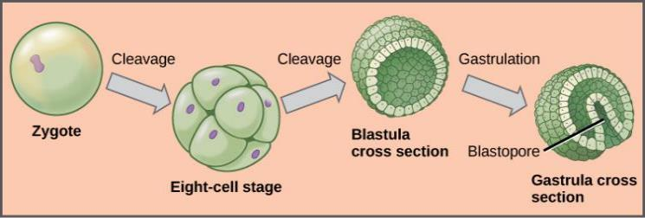
ANIMAL REPRODUCTION AND DEVELOPMENT
Cleavage (cell divisions without growth)
Cells are blastomeres
Further cell division and rearrangement of existing cells form a solid morula
Blastula
Hollow ball of cells
Blastocoel is internal cavity

Slide 13
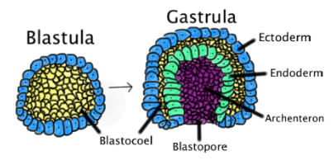
ANIMAL REPRODUCTION AND DEVELOPMENT
Gastrulation
Formation of the primitive gut (archenteron)
Formation of the embryonic germ layers
Diploblastic organisms have two: endoderm and ectoderm
Triploblastic organisms have three: endoderm, ectoderm, and mesoderm

Slide 14
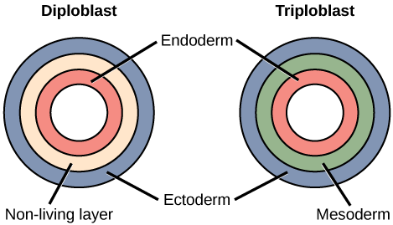
ANIMAL REPRODUCTION AND DEVELOPMENT
Organogenesis
Development of germ layers into certain tissue types, organs, and organ systems
Endoderm 🡪 inner lining of most digestive tract organs, trachea, lungs
Mesoderm 🡪 all muscle, bone, cartilage, blood, most other visceral organs
Ectoderm 🡪 outer epithelium of body surface, central nervous system

Slide 15
ANIMAL REPRODUCTION AND DEVELOPMENT
Some animals have larval forms different from adult
Complete metamorphosis
Embryo develops into one or more larval stages that may differ greatly from the adult form
Limits competition for food between adults and larva
Incomplete metamorphosis
Young resemble wingless adults

Slide 16
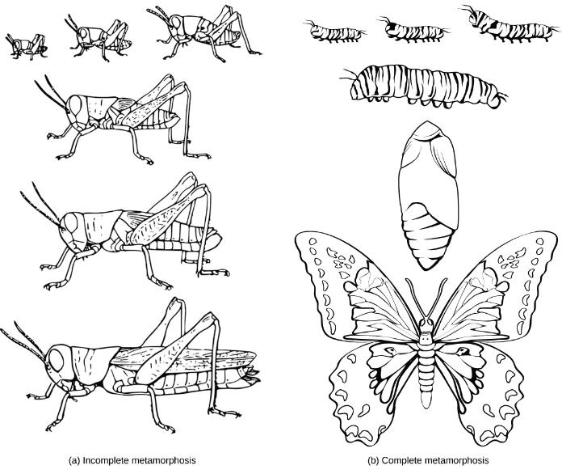
ANIMAL REPRODUCTION AND DEVELOPMENT

Slide 17
THE ROLE OF HOMEOBOX (HOX) GENES
Homeotic genes determine animal structure
Contain DNA sequences called homeoboxes
Encode transcription factors
Most important are Hox genes
Serve as “master control genes” that can turn on or off large numbers of other genes
General body plan
Number and placement of appendages
Head-tail directionality

Slide 18
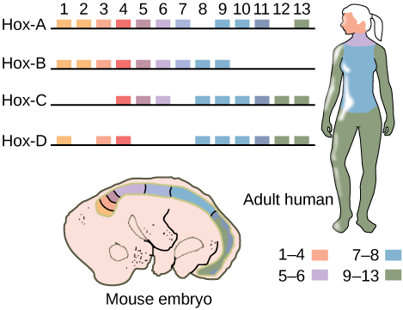
THE ROLE OF HOMEOBOX (HOX) GENES
Hox genes serve as “master control genes” that turn on/off large numbers of other genes
Homologous across the animal kingdom
Responsible for the increase in animal body complexity
Have undergone 2-4 duplication events during animal evolution

Slide 19
GROUP DISCUSSION
List the features that distinguish the kingdom Animalia from other kingdoms.
Describe the various ways animals reproduce.
Describe the steps of embryonic development.
Describe the roles that Hox genes play in development.

Slide 20
FEATURES USED TO CLASSIFY ANIMALS
Animals are classified according to body plan and developmental characteristics
Symmetry
Number of tissue layers
Origin of mouth and anus
Body cavity
Larval types
Molting
Download for free at http://cnx.org/contents/ca189282-29f0-459b-840f-c8853c66ede0@2.

Slide 21
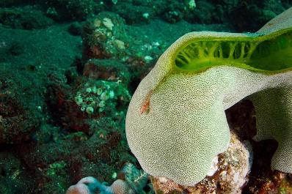
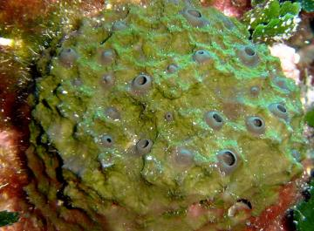
ANIMAL CHARACTERIZATION BASED ON BODY SYMMETRY
Asymmetrical
Lack of symmetry
Porifera (sponges)
Paul Kli
https://commons.wikimedia.org
Elapied
https://commons.wikimedia.org

Slide 22
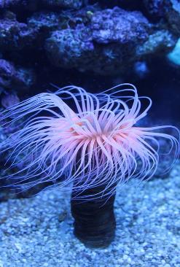
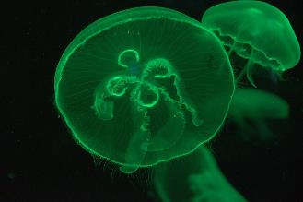
ANIMAL CHARACTERIZATION BASED ON BODY SYMMETRY
Radial symmetry
Parts radiate outward around central axis
Only oral (with mouth) vs aboral (without mouth) sides
Encounter environment equally from any direction … good for stationary or planktonic lifestyle
Cnidarians
Download for free at http://cnx.org/contents/ca189282-29f0-459b-840f-c8853c66ede0@2.

Slide 23
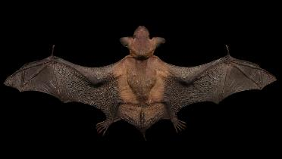
ANIMAL CHARACTERIZATION BASED ON BODY SYMMETRY
Matt Reinbold
www.flickr.com
Bilateral symmetry
Divides body along sagittal plane 🡪 right & left halves
Allows for cephalization (anterior vs. posterior)
Collection of sense organs in head
Suited for directional motion
All other animals
Download for free at http://cnx.org/contents/ca189282-29f0-459b-840f-c8853c66ede0@2.

Slide 24
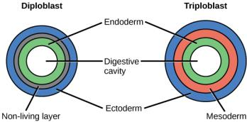
ANIMAL CHARACTERIZATION BASED ON FEATURES OF EMBRYOLOGICAL DEVELOPMENT
Animals with radial symmetry develop two germ layers = diploblasts
Endoderm
Ectoderm
Nonliving middle layer between the layers

Slide 25
ANIMAL CHARACTERIZATION BASED ON FEATURES OF EMBRYOLOGICAL DEVELOPMENT
Animals with bilateral symmetry) develop three germ layers = triploblasts
Endoderm
Ectoderm
Mesoderm
Download for free at http://cnx.org/contents/ca189282-29f0-459b-840f-c8853c66ede0@2.

Slide 26
ANIMAL CHARACTERIZATION BASED ON FEATURES OF EMBRYOLOGICAL DEVELOPMENT
Triploblasts are classified by presence/absence of a coelom
Body cavity derived from mesoderm
Lies between body wall and visceral organs and filled with fluid
Evolutionary advantages
Cushioning and shock absorption
Organs can grow and move freely, which promotes optimal organ development and placement
Improved flexibility and mobility
Space for the diffusion of gases and nutrients

Slide 27
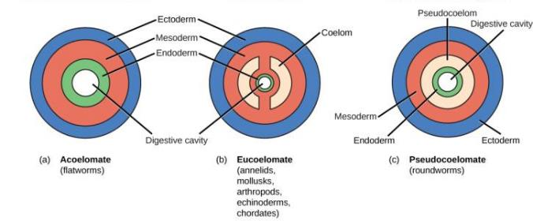
ANIMAL CHARACTERIZATION BASED ON FEATURES OF EMBRYOLOGICAL DEVELOPMENT
Acoelomates – lack body cavity
Mesoderm is filled with tissue
Platyhelminthes (flatworms)
Download for free at http://cnx.org/contents/ca189282-29f0-459b-840f-c8853c66ede0@2.

Slide 28
ANIMAL CHARACTERIZATION BASED ON FEATURES OF EMBRYOLOGICAL DEVELOPMENT
Pseudocoelomates
“False” body cavity
Derived from both endoderm and mesoderm
Still functional – hydrostatic skeleton
Nematodes (roundworms)
Download for free at http://cnx.org/contents/d09cbd3e-a293-4aab-9ae6-e1a46e9e1da9@8.

Slide 29
ANIMAL CHARACTERIZATION BASED ON FEATURES OF EMBRYOLOGICAL DEVELOPMENT
Coelomates (“eucoelomates”)
Arises completely within mesoderm
Body cavity & internal organs lined with epithelial tissue from mesoderm
Tissue holds organs in place, allowing motion
Most other animals
Download for free at http://cnx.org/contents/d09cbd3e-a293-4aab-9ae6-e1a46e9e1da9@8.

Slide 30
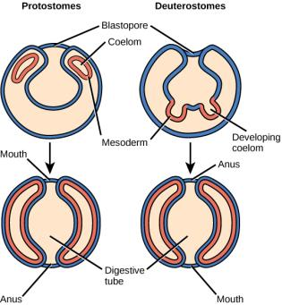
ANIMAL CHARACTERIZATION BASED ON FEATURES OF EMBRYOLOGICAL DEVELOPMENT
Bilateral, tribloblastic eucoelomates can be further divided based on the origin of the mouth
The blastopore of the gastrula may become a mouth or an anus
Protostomes form a mouth
Deuterostomes form an anus

Slide 31
PUTTING IT ALL TOGETHER…

Slide 32
MORE ABOUT PROTOSTOMES VS DEUTEROSTOMES
Method of coelom formation
Protostomes form coelom through schizocoely
Blastomeres form two clumps of mesoderm
Cavities form in each clump and then merge together
Deuterostomes form coelom through enterocoely
Pouches pinch off from endoderm
Pouches eventually fuse and expand to fill the space between the gut and the body wall
Download for free at http://cnx.org/contents/ca189282-29f0-459b-840f-c8853c66ede0@2.

Slide 33
MORE ABOUT PROTOSTOMES VS DEUTEROSTOMES
Cleavage patterns
Protostomes
Spiral cleavage
The cells of one pole of the embryo are rotated, and thus misaligned, with respect to the cells of the opposite pole
Determinate cleavage
A given cell does not have the ability to develop into any cell type other than its original destination
Removal of a blastomere from the embryo can result in missing structures

Slide 34
MORE ABOUT PROTOSTOMES VS DEUTEROSTOMES
Cleavage patterns
Deuterostomes
Radial cleavage
Cell division at right angles causing the cells to have parallel alignment
Indeterminate cleavage
Cells are not fully committed to specific cell types
Removal of individual blastomeres does not result in the loss of embryonic structures

Slide 35
GROUP DISCUSSION
Describe the three types of symmetry and name a group of animals that has that type.
Describe the differences between the Parazoa and Eumetazoa.
Describe the differences between acoelomates, pseudocoelomates, and eucoelomates.
Discuss the differences in the embryonic development of protostomes and deuterostomes.

Slide 36
ANIMAL PHYLOGENY
The study of phylogeny (the branching sequence of evolution) aims to determine evolutionary relationships
Phylogenetic trees serve as hypotheses about which species evolved from which ancestors
Traditionally, phylogenetic trees were created using morphological characters

Slide 37
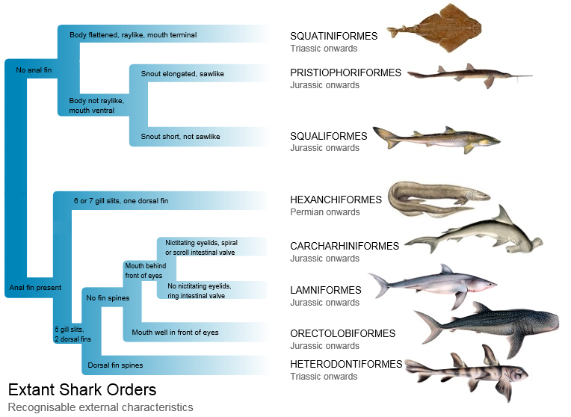
AN EXAMPLE OF A TREE BUILT FROM MORPHOLOGY

Slide 38
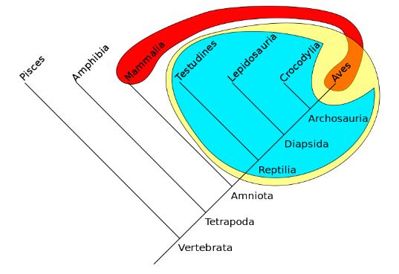
ANIMAL PHYLOGENY
Morphology can be misleading
Similar structures can evolve independently (analogous structures from convergence)
Modern systematists use biochemical, molecular and genetic evidence

Slide 39
ANIMAL PHYLOGENY
All animals belong to the group Metazoa
Metazoans likely evolved from a common ancestor that resembled modern-day choanoflagellates
Similarities between the choanocytes of sponges and choanoflagellate protists
Download for free at http://cnx.org/contents/0b4f514a-f4d4-455a-8814-97fa5df05345@5.

Slide 40
ANIMAL PHYLOGENY
Metazoans are divided into two major groups…
Parazoa (‘beside’ animals)
No true tissues or symmetry
Sponges (Phylum Porifera)
Eumetazoa (‘true’ animals)
Remaining animals with true differentiated tissues & symmetry

Slide 41
ANIMAL PHYLOGENY
Eumetazoa are divided into two major clades:
Radiata
‘true’ radial symmetry
Includes Cnidaria (stinging animals) and Ctenophora (comb jellies)
Bilateria
Bilateral symmetry
Includes all other animals

Slide 42
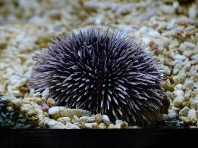
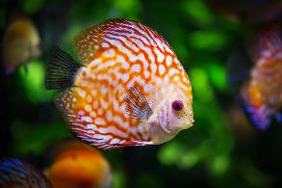
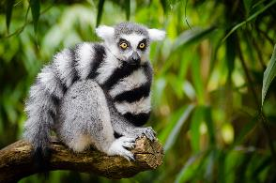
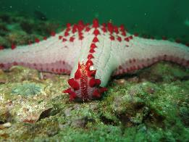
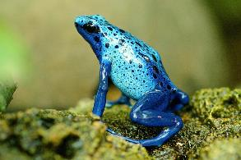
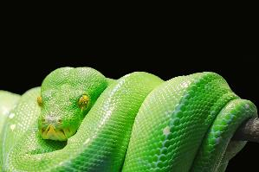
ANIMAL PHYLOGENY
Bilateria are divided into two major clades:
Deuterostomes
Echinodermata & Chordata

Slide 43
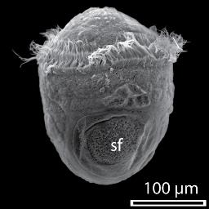
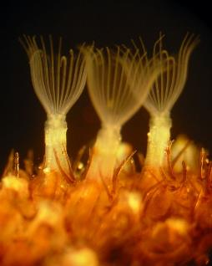
ANIMAL PHYLOGENY
Bilateria are divided into two major clades:
Protostomes
Lophotrochozoa
Either have a trochophore larva and/or a feeding structure called a lophophore
Multiple diverse groups
Ecdysozoa
Molt their exoskeleton (ecdysis)
Include Arthropoda and Nematoda
Daniel J. Jackson
https://commons.wikimedia.org
Ar rouz
https://commons.wikimedia.org

Slide 44
PUTTING IT ALL TOGETHER…

Slide 45
MODERN ADVANCES IN PHYLOGENETIC UNDERSTANDING COME FROM MOLECULAR ANALYSES
Nucleic acid and protein analyses have greatly modified and refined the modern phylogenetic animal tree
Mitochondrial DNA
Nuclear DNA
Ribosomal RNA (rRNA)
Cellular proteins

Slide 46
RECENT CHANGES TO OUR UNDERSTANDING OF ANIMAL PHYLOGENY
Lophophorates are protostomes
They are more closely related to annelids/mollusks than deuterostomes
Created the protostome clade Lophotrochozoa
Arthropods are more closely related to nematodes
Annelids and arthropods were once thought to be closely related due to their shared segmentation
Created the ecdysozoan clade
Annelids belong in the lophotrochozoan clade

Slide 47
RECENT CHANGES TO OUR UNDERSTANDING OF ANIMAL PHYLOGENY
Acoel flatworms may be more closely related to deuterostomes
Acoel flatworms were long thought to belong to Platyhelminthes because of their similar “flatworm” morphology
Ctenophores should be considered basal or as a sister group of the Porifera
Ctenophora were once considered to be a sister group of the Cnidaria based on the presence of nerve/muscle cells
BUT they lack important genes found in Cnidaria and the other animals
Specialized nerve and muscle tissue may have evolved more than once

Slide 48
GROUP DISCUSSION
List the major clades of animals and describe the major relationships between them.
Name the types of data that scientists use to construct and revise animal phylogeny.
Discuss some of the relationships within the modern phylogenetic tree that have been discovered as a result of modern molecular data.

Slide 49
ORIGIN OF ANIMALS
Animal diversity rapidly increased during the Cambrian period of the Paleozoic era (530 MYA)
Modern fossil evidence suggests primitive animal species existed much earlier

Slide 50
PRE-CAMBRIAN ANIMAL LIFE
Evidence of primitive animals before the Cambrian period has been found in the Ediacaran period
635–543 mya
Impressions of feathers or coins
No living representatives
Ediacaran biota likely evolved from protists
Download for free at http://cnx.org/contents/0a0b301a-b084-4d30-82d5-430c4d266f35@7.

Slide 51
CAMBRIAN ‘EXPLOSION’ OF ANIMAL LIFE
Cambrian period occurred 542–488 mya
Most rapid evolution of new animal phyla and animal diversity in Earth’s history
Most of today’s phyla originated
Echinoderms, mollusks, worms, arthorpods, chordates
Cambrian animals exhibited complex structures, so their ancestors must have existed much earlier
Download for free at http://cnx.org/contents/0a0b301a-b084-4d30-82d5-430c4d266f35@7.

Slide 52
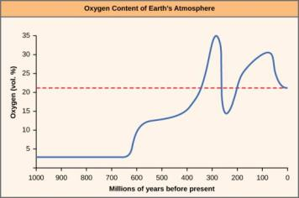
CAMBRIAN ‘EXPLOSION’ OF ANIMAL LIFE
Cause of Cambrian ‘explosion’ is debated
Preceded by rising O₂ levels and ocean calcium levels
Presence of shallow seas and lagoons, allowing for ecological variation
Changes in predator-prey relationships
Genetic innovations (via evolution of Hox genes)
Evidence for/against these hypotheses and others… probably some combination
The oxygen concentration in Earth’s atmosphere rose sharply around 300 million years ago.
Download for free at http://cnx.org/contents/0a0b301a-b084-4d30-82d5-430c4d266f35@7.

Slide 53
POST-CAMBRIAN EVOLUTION
Ordovician: plant life first appeared on land
Allowed formerly aquatic animal species to invade land
Continental plate movements in the mid to late Paleozoic Era caused changes in temperature and moisture
Encouraged new adaptations to terrestrial existence in animals, including limbs and the amniotic egg

Slide 54
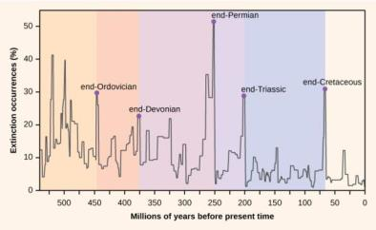
MASS EXTINCTIONS
Cataclysmic events can result in devastating losses of diversity but provide new opportunities for others to “fill in the gaps”

Slide 55
PERMIAN EXTINCTION
Permian-Triassic boundary – greatest extinction event in Earth’s history
Loss of 95 percent of extant species at that time
Disappearance of dominant species of Permian reptiles made it possible for dinosaurs to expand/diversify
Radiation of plants created complex communities of producers and consumers

Slide 56
CRETACEOUS EXTINCTION
Cretaceous-Paleogene (Tertiary) boundary (~66 mya)
Ended the Mesozoic Era
Dust from large meteorite impact near Yucatan plus volcanic activity 🡪 severe climate change
Plants, most herbivores and carnivores died, opening niches
Allowed radiation of mammals, birds and flowering plants
The radiation of flowering plants created new niches for pollinating insects, birds, and mammals

Slide 57
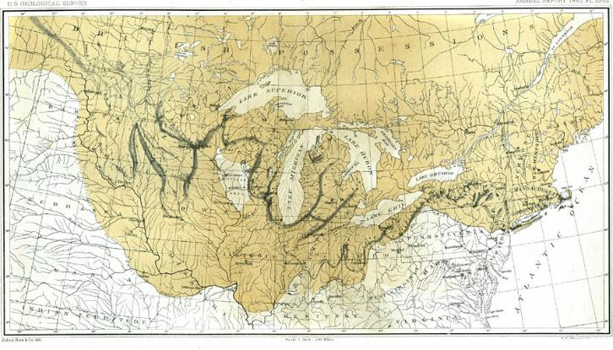
CENOZOIC ERA
Plate tectonics altered landforms and climate, causing changes in animal diversity
Evolution of grasses and coral reefs created new ecosystems
Late Cenozoic ice ages caused extinctions followed by speciation

Slide 58
POST-CAMBRIAN EVOLUTION AND MASS EXTINCTIONS
There have been five mass extinction events (MSE) after the Cambrian period
We may now be entering what appears to be the sixth MSE
Previous MSEs are likely due to drastic climate change caused by asteroids and/or tectonic events
The current MSE appears to be human-related
Current extinction rates estimated to be higher than previous MSEs over a geologically very short time span
Food for thought:
Sixth Mass Extinction (Full Documentary) – Click for YouTube Video (https://www.youtube.com/watch?v=EDQV1hiLpQQ)

Slide 59
GROUP DISCUSSION
Describe the features that characterized the earliest animals and approximately when they appeared on earth.
Explain the significance of the Cambrian Explosion for animal evolution and the possible causes.
Name two major mass extinctions and describe their effects on animal diversity.
Identify major radiations that occurred during the Cenozoic Era.

