Slide 1
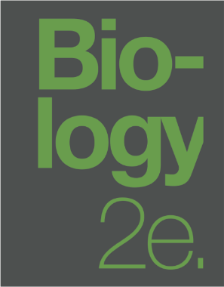
BIOLOGY 2E
Chapter 30 PLANT FORM AND PHYSIOLOGY
PowerPoint Image Slideshow
This work is licensed under a Creative Commons Attribution-NonCommercial-ShareAlike 4.0 International License.

Slide 2
INTRODUCTION
Plants provide oxygen, food, and shelter for living organisms.
Plants also provide humans medicines, oils, perfumes, and industrial products.
Plant body consists of stems, roots, and leaves.
Plant respond to environmental conditions such as light, gravity, competition, temperature, and predation.

Slide 3
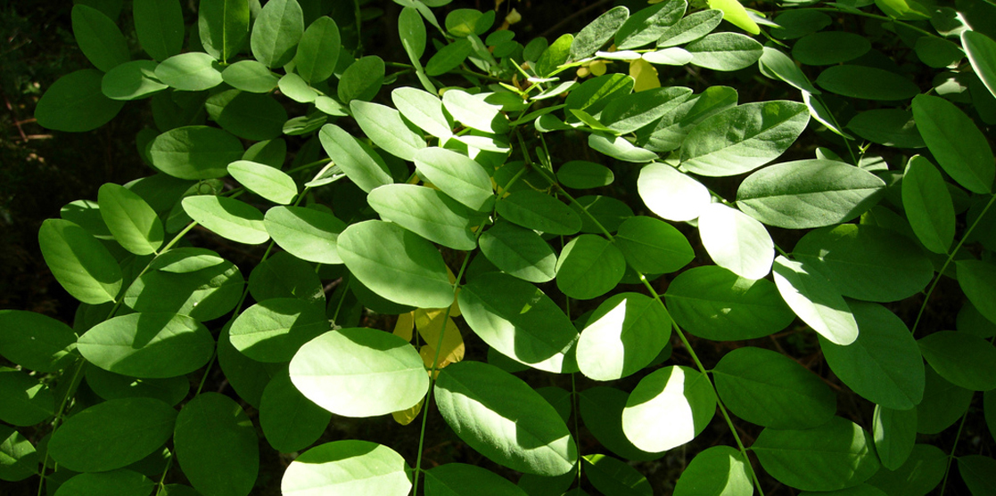
Figure 30.1 A locust leaf consists of leaflets arrayed along a central midrib. Each leaflet is a complex photosynthetic machine, exquisitely adapted to capture sunlight and carbon dioxide. An intricate vascular system supplies the leaf with water and minerals, and exports the products of photosynthesis. (credit: modification of work by Todd Petit)

Slide 4
30.1: THE PLANT BODY
Plant cells have many of the same parts as animal cells but also have chloroplast, cell walls, plastids, and a large central vacuole.
Plant Organ Systems
Group of cells 🡪 tissue
Group of tissues 🡪 organ
Group of organs 🡪 organ system

Slide 5
VASCULAR PLANT ORGAN SYSTEMS
Shoot system
Vegetative parts (non-reproductive): leaves, stems, etc.
Reproductive parts: flowers, fruits, etc.
Root system
Supports plant, absorbs water and nutrients
Usually underground

Slide 6
PLANT ORGAN SYSTEMS: Shoot and Root
Shoot system:
Vegetative (non-reproductive) parts of the plant, such as the leaves and the stems
Reproductive parts of the plant, which include flowers and fruits.
Usually grows above ground and absorbs light needed for photosynthesis.
Root system:
Supports the plants and absorbs water and minerals.
Usually underground.

Slide 7
PLANT TISSUES
Meristematic
Found in the meristem
Undifferentiated or incompletely differentiated
Continue to divide and contribute growth
Quickly differentiate (specialize) and become permanent tissue.
Three types
Apical meristems
Tips of stems on roots
Adds length

Slide 8
Meristematic
Three types (cont.)
Lateral meristems
Adds thickness (girth) to maturing plant
Intercalary meristems
Only in monocots
Base of leaf blades and nodes
Increase leaf length from base

Slide 9
Permanent (non-meristematic)
Cells that no longer actively divide.
Three main types of differentiated meristem tissue (secondary tissues)
Dermal: covers and protects
Vascular: transports water, minerals, and sugars
Ground: site of photosynthesis, supporting matrix, storage of water and sugars

Slide 10
Permanent (cont.)
Secondary tissues are either simple (similar cell types) or complex (different cell types).
Dermal = simple tissue that covers outer surface of plant
Vascular = complex tissue made of two specialized conducting systems
Xylem and phloem lie adjacent to each other
In stems: vascular bundle
In roots: vascular stele or vascular cylinder

Slide 11
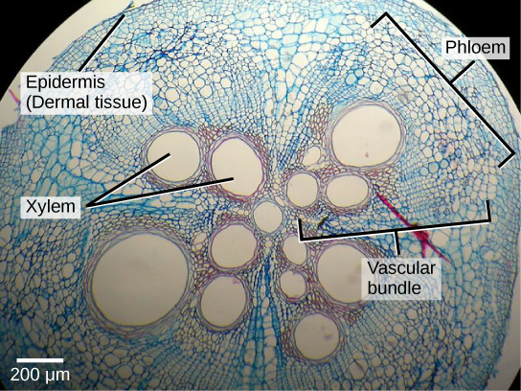
Figure 30.3 This light micrograph shows a cross section of a squash (Curcurbita maxima) stem. Each teardrop-shaped vascular bundle consists of large xylem vessels toward the inside and smaller phloem cells toward the outside. Xylem cells, which transport water and nutrients from the roots to the rest of the plant, are dead at functional maturity. Phloem cells, which transport sugars and other organic compounds from photosynthetic tissue to the rest of the plant, are living. The vascular bundles are encased in ground tissue and surrounded by dermal tissue. (credit: modification of work by "(biophotos)"/Flickr; scale-bar data from Matt Russell)

Slide 12
VASCULAR TISSUE COMPONENTS
Xylem: transport water and nutrients from roots throughout plant
Vessel elements and tracheids (conduct water)
Xylem parenchyma
Not alive at maturity
Phloem: transports organic compounds from site of photosynthesis to other parts of the plant
Sieve cells (conduct photosynthates)
Companion cells
Phloem parenchyma
Phloem fibers
Alive at maturity

Slide 13
30.2: STEMS
Main function is support but also provides storage (food) and connections (roots to leaves).
Part of the shoot system and vary between species.
Short or long
Above ground or underground
Herbaceous or woody
Unbranched or branched

Slide 14
Characterized by presence of nodes and internodes.
Nodes: points of attachment for leaves, aerial roots, and flowers
Petiole: stalk extending from the stem to base of the leaf (from nodes)
Axil: area on the petiole
Axillary bud: found on the axil and can give rise to a branch or flower
Apical bud: on the apex (tip) of the shoot and contains the apical meristem
Internodes: region between two nodes

Slide 15
STEM COMPONENTS
Leaves are attached to the plant stem at areas called nodes. An internode is the stem region between two nodes. The petiole is the stalk connecting the leaf to the stem. The leaves just above the nodes arose from axillary buds.

Slide 16
STEM ANATOMY
Arise from ground tissue.
Primarily made of simple tissues from three cell types…
Parenchyma
Most common
Found in stem, root, inside of the leaf, and pulp of fruit
Responsible for metabolic functions (photosynthesis, repair, etc.)
Some store starch

Slide 17
Primarily made of simple tissues from three cell types…(cont.)
Collenchyma
Elongated cells within uneven walls
Provide structural support (mainly stem and leaf)
Alive at maturity and usually below epidermis
Sclerenchyma
Provide support
Dead at maturity
Two types of cells: fibers (long and slender) and sclereids (smaller)
Both have secondary cell walls and deposits of lignin

Slide 18
STEM ANATOMY: Collenchyma
Collenchyma cell walls are uneven in thickness, as seen in this light micrograph. They provide support to plant structures. (credit: modification of work by Carl Szczerski; scale-bar data from Matt Russell)

Slide 19
THREE TISSUE SYSTEMS
Dermal
Primarily composed of epidermis (single layer covering)
Epidermal cells: most numerous and least differentiated
Protective and some can regulate gas exchange
Woody plants have bark (tough and waterproof layer of cork cells)

Slide 20
Dermal (cont.)
Leaf contains stomata (openings that regulate gas exchange)
Two guard cells surround the stoma (control opening and closing)
Trichomes (hair-like structures) help reduce transpiration, increase solar reflectance, and store defensive compounds.

Slide 21
DERMAL TISSUE
Openings called stomata (singular: stoma) allow a plant to take up carbon dioxide and release oxygen and water vapor. The (a) colorized scanning-electron micrograph shows a closed stoma of a dicot. Each stoma is flanked by two guard cells that regulate its (b) opening and closing. The (c) guard cells sit within the layer of epidermal cells (credit a: modification of work by Louisa Howard, Rippel Electron Microscope Facility, Dartmouth College; credit b: modification of work by June Kwak, University of Maryland; scale-bar data from Matt Russell)

Slide 22
Vascular
Composed of xylem and phloem arranged in vascular bundles.
Dicot stem: arranged in ring
In some plants bundles grow together to form growth rings.
Monocot stem: bundles are randomly scattered throughout ground tissue

Slide 23
VASCULAR TISSUE: Monocot Vs. Dicot
In (a) dicot stems, vascular bundles are arranged around the periphery of the ground tissue. The xylem tissue is located toward the interior of the vascular bundle, and phloem is located toward the exterior. Sclerenchyma fibers cap the vascular bundles. In (b) monocot stems, vascular bundles composed of xylem and phloem tissues are scattered throughout the ground tissue.

Slide 24
Vascular (cont.)
Xylem tissue cells
Xylem parenchyma
Tracheids
Conduct water and dead at maturity
Thick secondary cell walls that are lignified
Water moves through pits (on sides with no secondary walls)

Slide 25
Vascular (cont.)
Xylem tissue cells
Vessel elements
Conduct water and dead at maturity
Thinner walls and shorter
Water moves through perforation plates (on end walls)

Slide 26
Vascular (cont.)
Phloem tissue cells
Sieve-tube cells
Arranged end to end (make long sieve tube)
Transports organic substances (sugars, amino acids, etc.)
Move through perforated sieve plates (on end junctions between two cells)
Alive at maturity but many cell components disintegrated

Slide 27
Vascular (cont.)
Phloem tissue cells
Companion cells
Alongside sieve-tube cells
Provide metabolic support
Phloem parenchyma
Phloem fibers

Slide 28
STEM COMPONENTS
This light micrograph shows a cross section of a squash (Curcurbita maxima) stem. Each teardrop-shaped vascular bundle consists of large xylem vessels toward the inside and smaller phloem cells toward the outside. Xylem cells, which transport water and nutrients from the roots to the rest of the plant, are dead at functional maturity. Phloem cells, which transport sugars and other organic compounds from photosynthetic tissue to the rest of the plant, are living. The vascular bundles are encased in ground tissue and surrounded by dermal tissue. (credit: modification of work by “(biophotos)”/Flickr; scale-bar data from Matt Russell)

Slide 29
Ground Tissue
Ground
Mostly parenchyma cells but may contain collenchyma and sclerenchyma for support.
Pith: towards the interior of the vascular tissue (stem or root)
Cortex: layer between vascular tissue and the epidermis

Slide 30
STEM ANATOMY
The stem of common St John's Wort (Hypericum perforatum) is shown in cross section in this light micrograph. The central pith (greenish-blue, in the center) and peripheral cortex (narrow zone 3–5 cells thick just inside the epidermis) are composed of parenchyma cells. Vascular tissue composed of xylem (red) and phloem tissue (green, between the xylem and cortex) surrounds the pith. (credit: Rolf-Dieter Mueller)

Slide 31
GROWTH IN STEMS
Primary growth
Increases in length occur as a result of cell division in the shoot apical meristem.
Most occur at apices (tips) of stems and roots.
Result of rapidly dividing cells and their subsequent elongation.
Allows plant to continuously seek water and light.
Apical dominance: focuses growth at apical bud and diminishes growth of axillary buds
Varies according to species. (Conifers display strong dominance.)

Slide 32
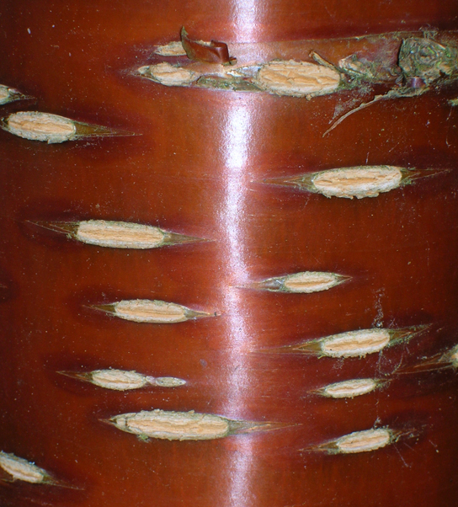
Secondary growth
Increases in thickness (girth) occur as a result of cell division in the lateral meristem.
Lateral meristems include the vascular cambium and the cork cambium (woody plants).

Slide 33
Secondary growth (cont.)
Vascular cambium
Located between primary xylem (interior) and phloem (exterior).
Divides and forms secondary xylem (tracheids and vessel elements) and phloem (sieve elements and companion cells).
Secondary xylem laid interiorly and phloem laid exteriorly of cambium.
Secondary xylem contains lignin (adds toughness)

Slide 34
Secondary growth (cont.)
Cork cambium
Outermost lateral meristem
Produces…
cork cells: contain suberin
phelloderm: layer of cells that grow inward
Periderm: cork cambium, cork cells, and phelloderm (collectively)
Will replace the epidermis in some mature plants.
Lenticels: openings in the periderm to allow for gas exchange

Slide 35
GROWTH IN STEMS: Primary Vs. Secondary Growth
In woody plants, primary growth is followed by secondary growth, which allows the plant stem to increase in thickness or girth. Secondary vascular tissue is added as the plant grows, as well as a cork layer. The bark of a tree extends from the vascular cambium to the epidermis.

Slide 36
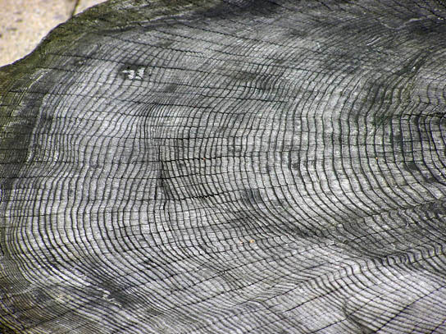
Annual rings
Formed from the activity of the vascular cambium.
Arises from seasonal decreases in vessel elements and increases in tracheids.
Early wood (spring wood)
Secondary xylem with large internal diameter and thin primary cell walls.
Late wood (autumn wood)
Secondary xylem develops thickened cell walls.

Slide 37
Herbaceous plants mostly undergo primary growth.
Woody plants undergo noticeable secondary growth (mostly in dicots).
Indeterminate growth: plant parts that grow throughout life (stems, roots, etc.)
Determinate growth: plant parts that cease growth at a certain size (leaves, flowers, etc.)

Slide 38
STEM MODIFICATIONS
Species can have modified stems to suit particular habitats and environments.
Rhizome: grows horizontally underground (Ex: ginger and ferns)
Corms: similar to rhizomes but contain stored food (allows some plants to survive winter; Ex: carrion flower)
Stolons: run almost parallel to ground and can give rise to new plants at the nodes (Ex: Rhodes grass)

Slide 39
Runners: type of stolon that runs above ground (Ex: strawberries)
Tubers: store starch (Ex: potato)
Bulb: underground storage (Ex: iris)
Tendrils: support and climbing on surfaces (Ex: buckwheat vine)
Thorns: sharp outgrowths (Ex: roses)

Slide 40
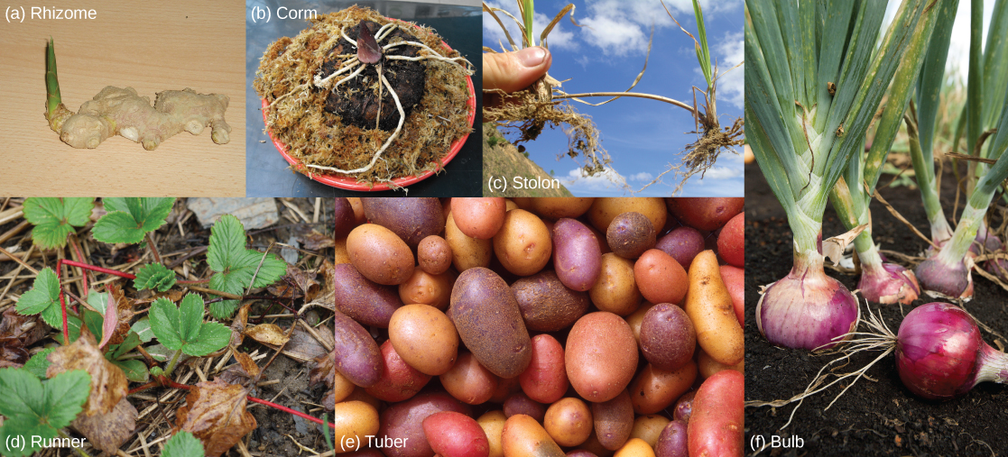
Figure 30.13 Stem modifications enable plants to thrive in a variety of environments. Shown are (a) ginger (Zingiber officinale) rhizomes, (b) a carrion flower (Amorphophallus titanum) corm, (c) Rhodes grass (Chloris gayana) stolons, (d) strawberry (Fragaria ananassa) runners, (e) potato (Solanum tuberosum) tubers, and (f) red onion (Allium) bulbs. (credit a: modification of work by Maja Dumat; credit c: modification of work by Harry Rose; credit d: modification of work by Rebecca Siegel; credit e: modification of work by Scott Bauer, USDA ARS; credit f: modification of work by Stephen Ausmus, USDA ARS)

Slide 41
30.3: ROOTS
Roots of seed plants have three major functions…
Anchor the plant to the soil
Absorb water and nutrients
Store products of photosynthesis
Some are modified and can exchange gases.
Most are underground but some emerge above the ground from the shoot (adventitious)

Slide 42
TYPES OF ROOT SYSTEMS
Tap root system
Seen in dicots.
Contains a main root that grows down vertically.
Smaller lateral roots can grow from the main root.
Penetrates deep into the soil.
Ex: dandelions

Slide 43
Fibrous root system
Seen in monocots.
Dense network of roots growing closer to the soil surface.
Helps prevent soil erosion.
Ex: lawn grasses
Some plants have a combination of the two.

Slide 44
TYPES OF ROOT SYSTEMS: Tap Vs. Fibrous
Tap root systems have a main root that grows down,
fibrous root systems consist of many small roots.
(credit b: modification of work by “Austen Squarepants”/Flickr)

Slide 45
ROOT GROWTH ANATOMY
Root growth begins with seed germination.
Radicle of the embryo forms the root system.
Root cap
Protects the tip of the root.
Continuously replaced (damaged often).

Slide 46
Root tip has three zones…
Zone of cell division
Closest to tip.
Made of actively dividing cells of root meristem.
Zone of elongation
New cells increase in length.
Zone of maturation and differentiation
Begins at first root hair.
Cells mature and specialize into distinct cell types.

Slide 47
ROOT GROWTH
A longitudinal view of the root reveals the zones of cell division, elongation, and maturation.
Cell division occurs in the apical meristem.

Slide 48
Epidermis
Surrounds ground and vascular tissue
Root hairs are extensions that increase surface area
Provides protection and helps in absorption
Inner ground tissue
Cortex (between epidermis and vascular tissue)
Pith (between vascular tissue and center)
More cortex and less pith
Both store photosynthetic products.

Slide 49
PARTS OF THE ROOT
Staining reveals different cell types in this light micrograph of a wheat (Triticum) root cross section. Sclerenchyma cells of the exodermis and xylem cells stain red, and phloem cells stain blue. Other cell types stain black. The stele, or vascular tissue, is the area inside endodermis (indicated by a green ring). Root hairs are visible outside the epidermis. (credit: scale-bar data from Matt Russell)

Slide 50
Vascular tissue
Arranged within inner portion of root (stele)
Endodermis separates stele from ground tissue.
Exclusive to roots.
Cells contain suberin.
Casparian strip (waxy region) forces water and solute to cross plasma membrane.
Acts as a filter.

Slide 51
Vascular tissue (cont.)
Outermost layer cell layer is called the pericycle.
Can give rise to lateral roots.
Arrangement of xylem and phloem within the stele.
Dicots: X shape
Monocots: Ring

Slide 52
STELE AND VASCULAR TISSUE
Vascular tissue is found inside the stele – the innermost part of the root.
In (left) typical dicots, the vascular tissue forms an X shape in the center of the root. In(right) typical monocots, the phloem cells and the larger xylem cells form a characteristic ring around the central pith.

Slide 53
ROOT MODIFICATIONS
May be modified for specific purposes.
Bulbous roots can store food. (ex: carrots and turnips)
Aerial roots and prop roots form aboveground support. (ex: banyan tree and screwpine)
Epiphytic roots allow a plant to grow on another plant. (ex: banyan tree)

Slide 54
ROOT MODIFICATIONS – STARCH STORAGE

Slide 55
ROOT MODIFICATIONS – AERIAL AND ABOVEGROUND ROOTS
The (a) banyan tree, also known as the strangler fig, begins life as an epiphyte in a host tree. Aerial roots extend to the ground and support the growing plant, which eventually strangles the host tree. The (b) screwpine develops aboveground roots that help support the plant in sandy soils. (credit a: modification of work by “psyberartist”/Flickr; credit b: modification of work by David Eikhoff)

Slide 56
30.4: LEAVES
Main site for photosynthesis.
Thickness, shape, and size are adapted to the environment.
Tropical rainforest plants have larger surface areas than plants that grow in deserts.

Slide 57
STRUCTURE OF A TYPICAL LEAF
Lamina: leaf blade
Petiole: stalk that attaches to the stem
Stipules: small green appendages at base
Sessile leaves: no petiole, directly fused to stem
Midrib: runs down center of leaf and branches to the sides (veins)

Slide 58
Margin: outer edge of leaf
Venation patterns:
Monocots: parallel venation
Dicots: reticulate venation (net-like)
Dichotomous venation (Ex: Ginkgo tree)

Slide 59
PARTS OF THE LEAF

Slide 60
VENATION
(a) Tulip (Tulipa), a monocot, has leaves with parallel venation. The netlike venation in this (b) linden (Tilia cordata) leaf distinguishes it as a dicot. The (c) Ginkgo biloba tree has dichotomous venation. (credit a photo: modification of work by “Drewboy64”/Wikimedia Commons; credit b photo: modification of work by Roger Griffith; credit c photo: modification of work by “geishaboy500”/Flickr; credit abc illustrations: modification of work by Agnieszka Kwiecień)

Slide 61
LEAF ARRANGEMENT
Phyllotaxy: arrangement of leaves on a stem
Alternate: one leaf per node, leaves alternate on each side
Spiral: one leaf per node, arrayed in a spiral along stem
Opposite: two leaves arise from same node
Whorled: three or more leaves arise from same node

Slide 62
LEAF FORM
Simple leaf
The leaf blade is completely undivided (as in banana leaves) or has lobes (as in maple tree leaves).
Separation does not reach the midrib

Slide 63
Compound leaf
The leaf blade is completely divided and forms leaflets (as in locust tree leaves).
Each leaflet attaches at the rachis.
Palmately compound: radiates outward from one point (as in buckeye tree leaves).
Pinnately compound: leaflets arranged along the midrib (as in rose leaves).

Slide 64
LEAF FORM

Slide 65
LEAF STRUCTURE AND FUNCTION
Outermost layer is the upper (adaxial) and lower (abaxial) epidermis.
Helps regulate gas exchange (stomata).
Usually one layer thick but may grow thicker to prevent water loss.
Cuticle: outer waxy layer of a plant leaf (reduces water loss)
Trichomes: small hairs (help deter herbivory and reduce water loss)

Slide 66
Figure 30.25 Trichomes give leaves a fuzzy appearance as in this (a) sundew (Drosera sp.). Leaf trichomes include (b) branched trichomes on the leaf of Arabidopsis lyrata and (c) multibranched trichomes on a mature Quercus marilandica leaf. (credit a: John Freeland; credit b, c: modification of work by Robert R. Wise; scale-bar data from Matt Russell)

Slide 67
Mesophyll lies beneath epidermis (in dicots)
Palisade parenchyma
Column shaped cells that are tightly packed.
Spongy parenchyma
Irregular shaped and loosely arranged.
Spaces allow for gas exchange and in some plants floating.
This layer contains a lot of chloroplast.

Slide 68
Vascular bundles help transport vital materials throughout the plant.
Phloem transports photosynthetic products (organic materials).
Xylem transports water and nutrients.

Slide 69
LEAF STRUCTURE
In the (a) leaf drawing, the central mesophyll is sandwiched between an upper and lower epidermis. The mesophyll has two layers: an upper palisade layer comprised of tightly packed, columnar cells, and a lower spongy layer, comprised of loosely packed, irregularly shaped cells. Stomata on the leaf underside allow gas exchange. A waxy cuticle covers all aerial surfaces of land plants to minimize water loss. These leaf layers are clearly visible in the (b) scanning electron micrograph. The numerous small bumps in the palisade parenchyma cells are chloroplasts. Chloroplasts are also present in the spongy parenchyma, but are not as obvious. The bumps protruding from the lower surface of the leave are glandular trichomes, which differ in structure from the stalked trichomes in Figure 30.25. (credit b: modification of work by Robert R. Wise)

Slide 70
LEAF ADAPTATIONS
Coniferous species that thrive in cold habitats have smaller leaf size and a needle-like appearance.
Plants like cacti that thrive in hot habitats have leaves that are reduced to spines.
Aquatic plants have leaves with wide lamina allowing them to float.

Slide 71
LEAF ADAPTATIONS – CARNIVOROUS PLANTS
The (a) Venus flytrap has modified leaves that can capture insects. When an unlucky insect touches the trigger hairs inside the leaf, the trap suddenly closes. The opening of the (b) pitcher plant is lined with a slippery wax. Insects crawling on the lip slip and fall into a pool of water in the bottom of the pitcher, where they are digested by bacteria. The plant then absorbs the smaller molecules. (credit a: modification of work by Peter Shanks; credit b: modification of work by Tim Mansfield)

Slide 72
30.5: TRANSPORT OF WATER AND SOLUTES
Phloem and xylem are the main tissues for water and solute (minerals, photosynthates, etc.) transportation.

Slide 73
WATER POTENTIAL
Measure of the potential energy in water.
The difference in potential energy between a given water sample and pure water.
Denoted by Ψ and measured in megapascals (MPa).
Potential of pure water = 0 Mpa
The water potential of a system is the sum of the solute, pressure, gravity, and matric potentials.
Ψsystem = Ψtotal = Ψs+ Ψp+ Ψg+ Ψm

Slide 74
When the water potential between two systems is unequal water moves.
Water seeks out equilibrium.
Water will move from the system with high potential to the one with low potential (high to low).
By manipulating the components of the system a plant can create differences in water potential and control movement.

Slide 75
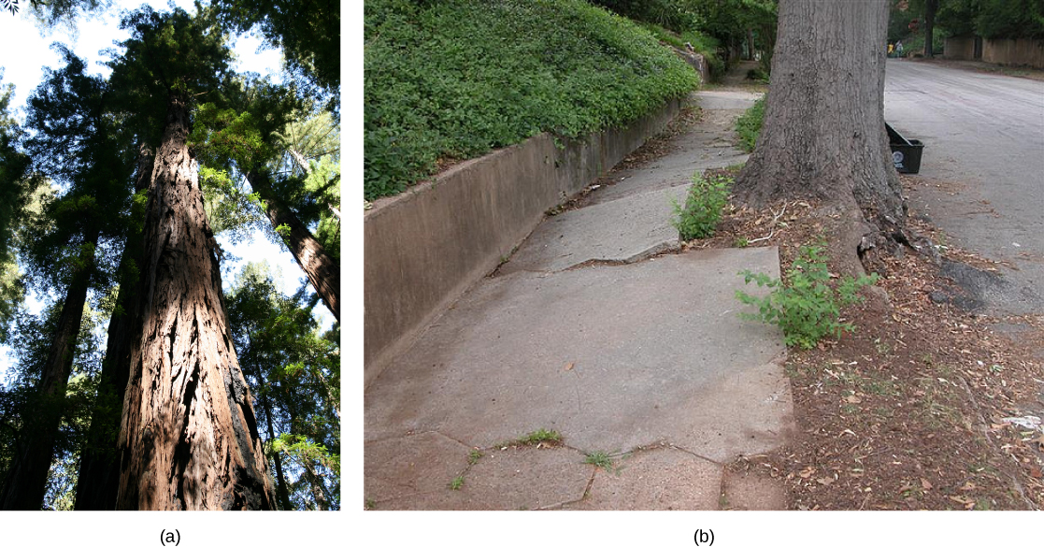
Figure 30.31 With heights nearing 116 meters, (a) coastal redwoods (Sequoia sempervirens) are the tallest trees in the world. Plant roots can easily generate enough force to (b) buckle and break concrete sidewalks, much to the dismay of homeowners and city maintenance departments. (credit a: modification of work by Bernt Rostad; credit b: modification of work by Pedestrians Educating Drivers on Safety, Inc.)

Slide 76
SOLUTE POTENTIAL (Ψ_{S})
Also called osmotic potential.
Negative in a plant cell and zero in distilled water.
Solutes reduce water potential by consuming some of the potential energy available in water.
Can occur through the creation of hydrogen bonds.

Slide 77
Internal water potential of a plant cell is more negative than pure water due to the solute concentration within the cytoplasm.
Plants cells can metabolically manipulate osmotic potential and influence the total water potential of the system.

Slide 78
SOLUTE POTENTIAL
In this example with a semipermeable membrane between two aqueous systems, water will move from a region of higher to lower water potential until equilibrium is reached. Solutes (Ψ_{s}), pressure (Ψ_{p}), and gravity (Ψ_{g}) influence total water potential for each side of the tube (Ψ_{total}^{right or left}), and therefore, the difference between Ψ_{total} on each side (ΔΨ). (Ψ_{m} , the potential due to interaction of water with solid substrates, is ignored in this example because glass is not especially hydrophilic). Water moves in response to the difference in water potential between two systems (the left and right sides of the tube).

Slide 79
PRESSURE POTENTIAL (Ψ_{P})
Also known as turgor potential.
May be positive (increasing the total potential) or negative (decreasing total potential).
Positive pressure is contained by the cell wall and produces turgor pressure.
Turgor pressure can be observed by the wilting of a plant when it does not receive sufficient water.

Slide 80
Can be manipulated by adjusting cytoplasmic solute concentration.
Increase in solute concentration will draw water into the cell increasing the pressure potential.
Can be directly manipulated by the opening or closing of stomata.

Slide 81
TURGOR PRESSURE
When (a) total water potential (Ψ_{total}) is lower outside the cells than inside, water moves out of the cells and the plant wilts. When (b) the total water potential is higher outside the plant cells than inside, water moves into the cells, resulting in turgor pressure (Ψ_{p}) and keeping the plant erect. (credit: modification of work by Victor M. Vicente Selvas)

Slide 82
GRAVITY POTENTIAL (Ψ_{G})
Negative to zero in a plant with no height.
Negligible on a cellular scale.
Increases as the height of the plant increases.
Removes potential energy from the system because gravity pulls down on water.
Plants are unable to manipulate.

Slide 83
MATRIC POTENTIAL (Ψ_{M})
Always negative to zero.
Negative in a dry system and zero in a water-saturated system.
The binding of water to a matrix consumes potential energy from the system.
Works similarly to solute potential but involves the hydrophilic (insoluble) molecules.
Cellulose in cell wall provides hydrophilic matrix for adhesion.
Plants are unable to manipulate.

Slide 84
MOVEMENT OF WATER AND MINERALS IN THE XYLEM
Water moves from area of higher total water potential (higher Gibbs free energy) to an area of lower total water potential.
Gibbs free energy = energy associated with a chemical reaction that can be used to do work (expressed as ΔΨ)

Slide 85
Transpiration is the main driver of water movement in the xylem.
Evaporation of water at the leaf-atmosphere interface creates negative pressure (tension).
This tension pulls water up from the roots.
Transpiration stops when stomata close.
Water is held in the stem and leaf by adhesion to the xylem vessels and tracheids.
Water molecules are held together by cohesion.
Called the cohesion-tension theory of sap ascent.

Slide 86
COHESION-TENSION THEORY
The cohesion–tension theory of sap ascent is shown. Evaporation from the mesophyll cells produces a negative water potential gradient that causes water to move upwards from the roots through the xylem.

Slide 87
Inside the leaf…
Surface of the cell walls within the mesophyll are saturated with water.
Water evaporates into the intercellular air spaces and creates a greater tension on the water in the mesophyll cells.
This increases the pull on water in the xylem vessels.

Slide 88
Xylem vessels and tracheids are structurally adapt to deal with large changes in pressure.
Rings in the vessels help keep their shape.
Small perforations between vessel elements reduce gas bubbles.
Cavitation: formation of gas bubbles within vessel elements.
Embolism: disruption of flow through the xylem due to gas bubbles.

Slide 89
Control of transpiration
Transpiration is a passive process (uses no ATP) and relies on energy differences.
The atmosphere drives transpiration.
Control is primarily achieved through the opening and closing of stomata.
Guard cells regulate the opening and closing.
Respond to environment cues such as light intensity and carbon dioxide concentrations.

Slide 90
Control of transpiration (cont.)
Plants must balance the need for gases and the loss of water.
Some plants have evolved mechanisms to reduce transpiration.
Increased waxy cuticle. (Ex: A. perottetii)
Leaves modified to spines (reduces surface-to-volume ratio). (Ex: prickly pear cactus)
Photosynthesis occurring in the stem. (Ex: prickly pear cactus)

Slide 91
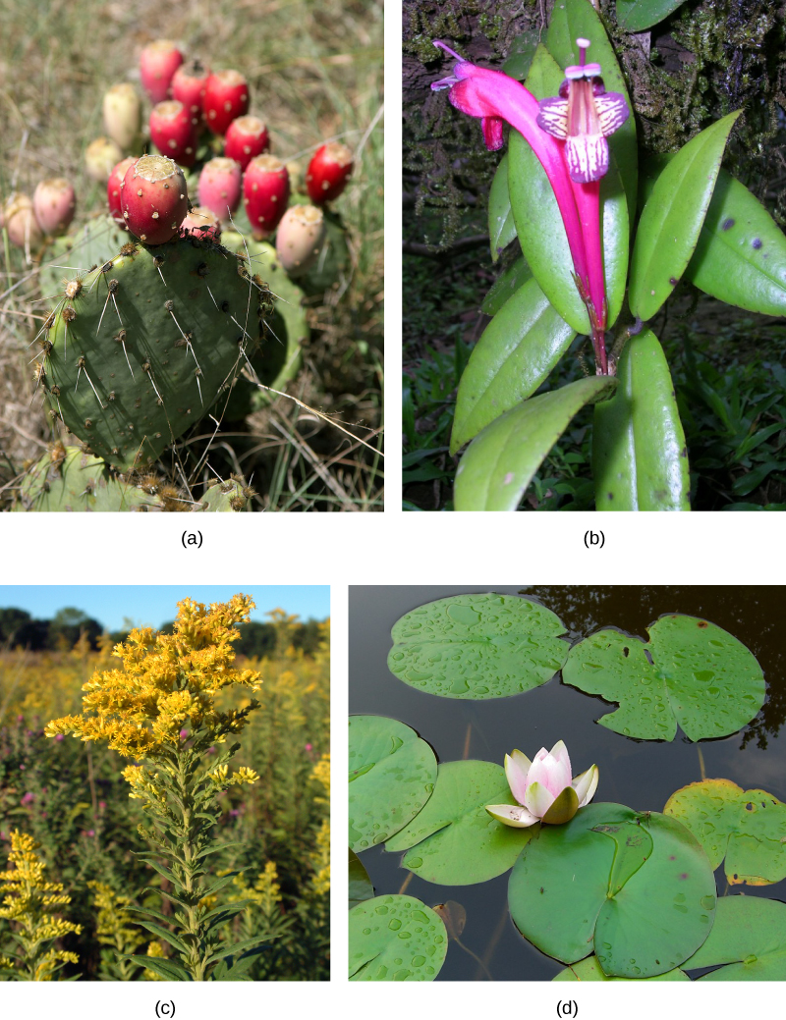
Figure 30.35 Plants are suited to their local environment. (a) Xerophytes, like this prickly pear cactus (Opuntia sp.) and (b) epiphytes such as this tropical Aeschynanthus perrottetii have adapted to very limited water resources. The leaves of a prickly pear are modified into spines, which lowers the surface-to-volume ratio and reduces water loss. Photosynthesis takes place in the stem, which also stores water. (b) A. perottetii leaves have a waxy cuticle that prevents water loss. (c) Goldenrod (Solidago sp.) is a mesophyte, well suited for moderate environments. (d) Hydrophytes, like this fragrant water lily (Nymphaea odorata), are adapted to thrive in aquatic environments. (credit a: modification of work by Jon Sullivan; credit b: modification of work by L. Shyamal/Wikimedia Commons; credit c: modification of work by Huw Williams; credit d: modification of work by Jason Hollinger)

Slide 92
TRANSPORTATION OF PHOTOSYNTHATES IN PHLOEM
Plants need an energy source (sugars) to grow.
Seeds and bulbs: stored polymers such as starch
Green shoots and leaves: photosynthates such as sucrose
Sources: structures that produce photosynthates (Ex: leaves)
Translocation: process that delivers sugars to growing parts of the plants
Occurs through the phloem

Slide 93
Sinks: points of sugar delivery (Ex: roots and young shoots)
Products from source usually translocated to the nearest sink.
Highest leaves send photosynthates upward to shoot tip.
Intermediate leaves send photosynthates upward or downwards.
Lower leaves send photosynthates downward to roots.

Slide 94
Pattern of flow changes throughout the plants life.
To roots early on.
To shoots and leaves during vegetative growth.
To seed and fruit during reproductive development.
Also directed to tubers for storage.

Slide 95
TRANSLOCATION: TRANSPORT FROM SOURCE TO SINK
Photosynthates are produced in the mesophyll of photosynthesizing leaves.
Mesophyll cells are connected by plasmodesmata (cytoplasmic channels).
Photosynthates move through plasmodesmata to reach phloem sieve-tube elements (STEs) within the vascular bundles.
Sucrose is actively transported into phloem cells with a proton. (sucrose-H⁺ symporter)
Phloem sap moves through STEs via pressure-driven bulk flow.

Slide 96
SAP THROUGH PHLOEM
Phloem is comprised of cells called sieve-tube elements. Phloem sap travels through perforations called sieve tube plates. Neighboring companion cells carry out metabolic functions for the sieve-tube elements and provide them with energy. Lateral sieve areas connect the sieve-tube elements to the companion cells.

Slide 97
Companion cells are associated with STEs.
Assist with metabolic activities and provide energy.
Phloem sap is an aqueous solution containing up to 30% sugar, amino acids, minerals, and plant growth regulators.
High percentage of sugar causes water to flow into the phloem tubes. (Water comes from adjacent xylem.)
This increases total water potential and causes the bulk flow.
Unloading of sucrose at the sink occurs by diffusion or active transport.

Slide 98
SUCROSE TRANSPORT
Sucrose is actively transported from source cells into companion cells and then into the sieve-tube elements. This reduces the water potential, which causes water to enter the phloem from the xylem. The resulting positive pressure forces the sucrose-water mixture down toward the roots, where sucrose is unloaded. Transpiration causes water to return to the leaves through the xylem vessels.

Slide 99
30.6: PLANT SENSORY SYSTEMS AND RESPONSES
Plants must respond to environmental factors just as animals do.
Receptors can sense environmental stimuli and relay the information to effector systems.

Slide 100
PLANT RESPONSES TO LIGHT
Photomorphogenesis: growth and development in response to light
Photoperiodism: using light to track time
Phototropism: grow towards or away from light

Slide 101
Plants use different photoreceptors to sense light.
Made of chromoproteins (protein covalently bonded to a chromophore that absorbs light)
Red/far-red and violet-blue light triggers structural development.
Light absorption by chlorophylls peak in the blue and red regions for land plants.
Since water absorbs red light aquatic plants must be able to detect blue light.

Slide 102
THE PHYTOCHROME SYSTEM AND THE RED/FAR-RED RESPONSE
Phytochromes: family of chromoproteins with a linear tetrapyrrole chromophore
Two photo-interconvertible forms…
Pr: absorbs red light and is immediately converted to Pfr
Pfr: absorbs far-red light and is quickly converted back to Pr.
Pfr can also revert to Pr in the dark and over time.
Together form the Phytochrome system (biological light switch).
Absorption of red or far-red light causes the chromophore to change shape.

Slide 103
RED LIGHT RESPONSE
The biologically inactive form of phytochrome (Pr) is converted to the biologically active form Pfr under illumination with red light. Far-red light and darkness convert the molecule back to the inactive form.

Slide 104
Pfr is the physiologically active form.
Red light produces more Pfr and activity.
Far-red light reduces the number of Pfr and activity.
Can activate other molecules in the cytoplasm or influence gene expression.
Plant shoots can use the system to grow away from the shade (far-red rich) and towards light (red rich).

Slide 105
In seeds the system is used to determine if there is any light at all.
Pr converted to Pfr when exposed to light and germination proceeds.
The system is also used to sense the change of season.
Uses day length as an indicator.
By sensing the Pr/Pfr ratio at dawn, a plant can determine the length of the daylight cycle.
This information can be retained for several days.
Shorter nights = springtime

Slide 106
THE BLUE LIGHT RESPONSES
Phototropism is a response to blue light.
Positive = towards a light source
Negative (skototropism) = away from a light source
Phototropins: protein-based receptors that mediate phototropic response
Chromophore is a covalently bonded flavin
Phototropins belong to the flavoproteins
Also control leaf opening and closing, chloroplast movement, and the opening of stomata.

Slide 107
Cryptochromes: set the plants’ 24-hour activity cycle (circadian rhythm)
Also contain a flavin-based chromophore
The chemical signals working in phototropism are growth stimulants.
Most phototropin activation occurs on the lit side of the stem.
Causes a buildup of indole acetic acid (IAA) on the shaded side.
Stem cells elongate under the influence of IAA.

Slide 108
BLUE-LIGHT RESPONSE
Azure bluets (Houstonia caerulea) display a phototropic response by bending toward the light. (credit: Cory Zanker)

Slide 109
PLANT RESPONSES TO GRAVITY
Negative gravitropism: the shoot apical tip grows upward
Positive gravitropism: roots grow downward
Amyloplasts (statoliths): plastids that contain starch granules and settle downward in response to gravity
Found in shoots and specialized cells of the root cap
Amyloplasts will settle to the bottom of gravity-sensing cells and contact the ER.

Slide 110
The ER will release calcium ions and cause the polar transport of IAA to the bottom of the cell.
In root: buildup of IAA inhibits cell elongation
In shoot: buildup of IAA stimulates elongation
Amyloplasts return to their normal position when vertical growth is achieved.

Slide 111
GROWTH RESPONSES
Plant’s sensory response relies on chemical messengers (hormones)
Plant hormones can be made by any plant cell and can affect any plant cell.
Plant hormones are a group of unrelated chemical substances that affect plant morphogenesis.

Slide 112
FIVE MAJOR PLANT HORMONES
Auxins
Ex: IAA
Main hormones responsible for cell elongation in phototropism and gravitropism.
Apical dominance is triggered by auxins.
Influences flowering, fruit settling and ripening, as well as inhibits abscission (leaf falling).

Slide 113
Cytokinins
Promotes cytokinesis.
Most abundant in growing tissue.
Can delay senescence in leaf tissue, promote mitosis, and stimulate differentiation of the meristem.

Slide 114
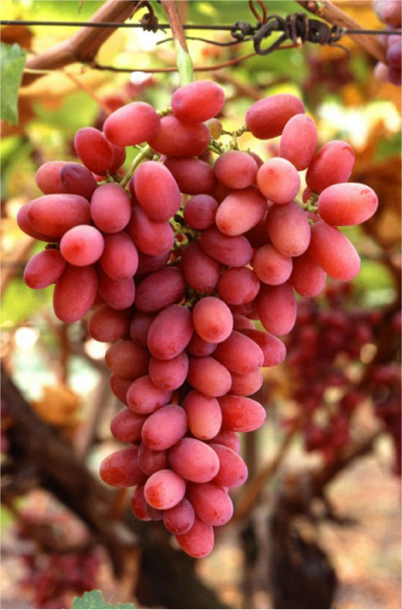
Gibberellins (GAs)
Stimulate shoot elongation, seed germination, and fruit/flower maturation.
Synthesized in root and stem apical meristems, young leaves, and seed embryos.
Abscisic acid is a strong antagonist.

Slide 115
Abscisic acid (ABA)
Accumulates as a response to stressful environmental conditions.
Counters growth-promoting effects of GAs and auxins.
Inhibits stem elongation and induces dormancy in lateral buds.
Induces dormancy in seeds by blocking germination and promoting storage.

Slide 116
Ethylene
Associate with fruit ripening, flower wilting, and leaf fall.
It is a volatile gas (C₂H₄).

Slide 117
NONTRADITIONAL HORMONES
Jasmonates
Play a major role in defense response to herbivory.
Increase when wounded which increasing toxic secondary metabolites.
Oligosaccharins
Play a role in plant defense against bacterial and fungal infection.
Strigolactones
Promote seed germination and inhibit lateral apical development for some species. (When auxin is absent.)
Play a role in the establishment of mycorrhizae

Slide 118
PLANT RESPONSE TO WIND AND TOUCH
Thigmotropism: movement of a plant subjected to constant directional pressure
Ex: tendrils
Cells that contact a support surface contract while the cells on the opposite side elongate.
Thigmonastic: touch response independent of the direction of the stimulus
Ex: Venus fly trap

Slide 119
Thigmomorphogensis: slow developmental change in the shape of a plant subjected to continuous mechanical stress
Ex: trees respond to bending in the wind

Slide 120
DEFENSE RESPONSES AGAINST HERBIVORES AND PATHOGENS
Plants face both herbivores and pathogens.
First line of defense…
Intact and impenetrable barrier.
Thick waxy cuticle, thorns, spines, etc.
If barrier is broken must really on chemical defenses.

Slide 121
Secondary metabolites (chemical defenses)
Not made by photosynthesis or needed for respiration.
Many are toxic.
The alkaloids…
Noxious odors. (Ex: oils of mint and sage)
Repellant tastes. (Ex: bitterness of quinine)
Excessive stimulation. (Ex: caffeine)
Activated by mechanical wounding and tissue damage.
Jasmonates may promote synthesis.
Plant may activate abscission of the injured tissue if damage is to great.

