Slide 1
BIOLOGY 2E
Chapter 31 SOIL AND PLANT NUTRITION
PowerPoint Image Slideshow
This work is licensed under a Creative Commons Attribution-NonCommercial-ShareAlike 4.0 International License.

Slide 2
INTRODUCTION
In order to grow and develop many requirements must be met and events must be coordinated within the plant.
Below ground…
Conditions of the soil that impact seed germination include temperature, moisture, and soil quality.
Soil quality and climate are important to plant distribution and growth.
Roots must eventually absorb nutrients and water from the soil.

Slide 3
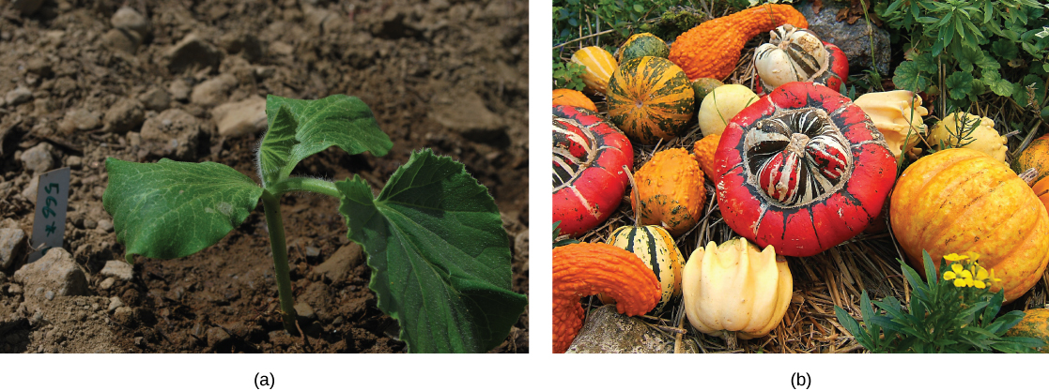
Figure 31.1 For this (a) squash seedling (Cucurbita maxima) to develop into a mature plant bearing its (b) fruit, numerous nutritional requirements must be met. (credit a: modification of work by Julian Colton; credit b: modification of work by "Wildfeuer"/Wikimedia Commons)

Slide 4
Above ground…
Absorb carbon dioxide from atmosphere.
Absorb sunlight to perform photosynthesis.

Slide 5
31.1: NUTRITIONAL REQUIREMENTS OF PLANTS
Plants are unique organisms that can absorb vital molecules from the soil and the atmosphere.
This causes soil quality and climate to be major determinants of distribution and growth.
Combination of soil nutrients, water, carbon dioxide, and sunlight allow plants to grow.

Slide 6
THE CHEMICAL COMPOSITION OF PLANTS
Majority of volume in a plant cell is water (80%-90% of total weight).
Soil is the water source for terrestrial plants.
Taken in through root hairs and transported through the xylem.
Transpiration (through leaves) and the polarity of water drives transport and the absorption of more water.
Water is needed for cell structure, metabolic functions, transport of nutrients, and photosynthesis.

Slide 7
ESSENTIAL MATERIALS
Most plans obtain water from the soil.
Water is absorbed through the root hairs and moves up the xylem to the leaves.

Slide 8
Plants also need nutrients (essential substances) to sustain life.
May be organic or inorganic.
Inorganic substances form the majority of soil solutions and are commonly called minerals.
Example: N and K are required for structure and regulation.

Slide 9
ESSENTIAL NUTRIENTS
To support their biochemical needs plants require only light, water, and about 20 elements (essential nutrients).
Three criteria for being regarded as essential…
The plant cannot complete its life cycle without the element.
No other element can perform an identical function.
The element is directly involved in the plants nutrition.

Slide 10
MACRONUTRIENTS AND MICRONUTRIENTS
Macronutrients: needed in larger amounts
About half of the essential nutrients (C, H, O, N, P, K, Ca, Mg, and S).
Carbon (C) is present in all macromolecules/biomolecules and represents about 50% of the dry weight of a plant cell.
The next most abundant is Nitrogen (N).
Found in proteins and nucleic acids.
Used to synthesize some vitamins.

Slide 11
CELLULOSE
Cellulose, the main structural component of the plant cell wall, makes up over thirty percent of plant matter. It is the most abundant organic compound on earth. Plants are able to make their own cellulose, but need carbon from the soil to do so.

Slide 12
Macronutrients (cont.)
Hydrogen (H) and Oxygen (O) are found in many organic compounds (including macromolecules/biomolecules).
O is necessary for cellular respiration.
Phosphorus (P) is needed to synthesize nucleic acids and is a component of ATP.
Light energy is converted into chemical energy through oxidative phosphorylation during photosynthesis.

Slide 13
Macronutrients (cont.)
Sulfur (S) is found in certain amino acids (such as methionine) and is present in several coenzymes.
Plays an important role in the electron transport chain (photosynthesis and aerobic respiration).
Potassium (K) plays an important role in regulating stomatal opening and closing (K ion pumps).
Calcium (Ca) helps regulate nutrient transport and supports many enzyme functions.
Magnesium (Mg) is important to the photosynthetic process.

Slide 14
Micronutrients: trace elements (found in very small quantities)
B, Cl, Mn, Fe, Zn, Cu, Mo, Ni, Si, and Na
Deficiencies in any of these nutrients can adversely affect plant growth or cause cell death.

Slide 15
ESSENTIAL NUTRIENTS
Macronutrients | Micronutrients
Carbon (C) | Iron (Fe)
Hydrogen (H) | Manganese (Mn)
Oxygen (O) | Boron (B)
Nitrogen (N) | Molybdenum (Mo)
Phosphorus (P) | Copper (Cu)
Potassium (K) | Zinc (Zn)
Calcium (Ca) | Chlorine (Cl)
Magnesium (Mg) | Nickel (Ni)
Sulfur (S) | Cobalt (Co)
 | Sodium (Na)
 | Silicon (Si)

Slide 16
HYDROPONICS
Growing a plant in a water-nutrient solution instead of soil.
Useful in studying plant nutrient deficiencies as different water-nutrient combinations are easy to create and control.
Can be used to grow flowers, vegetables, and other crops in a greenhouse environment.

Slide 17
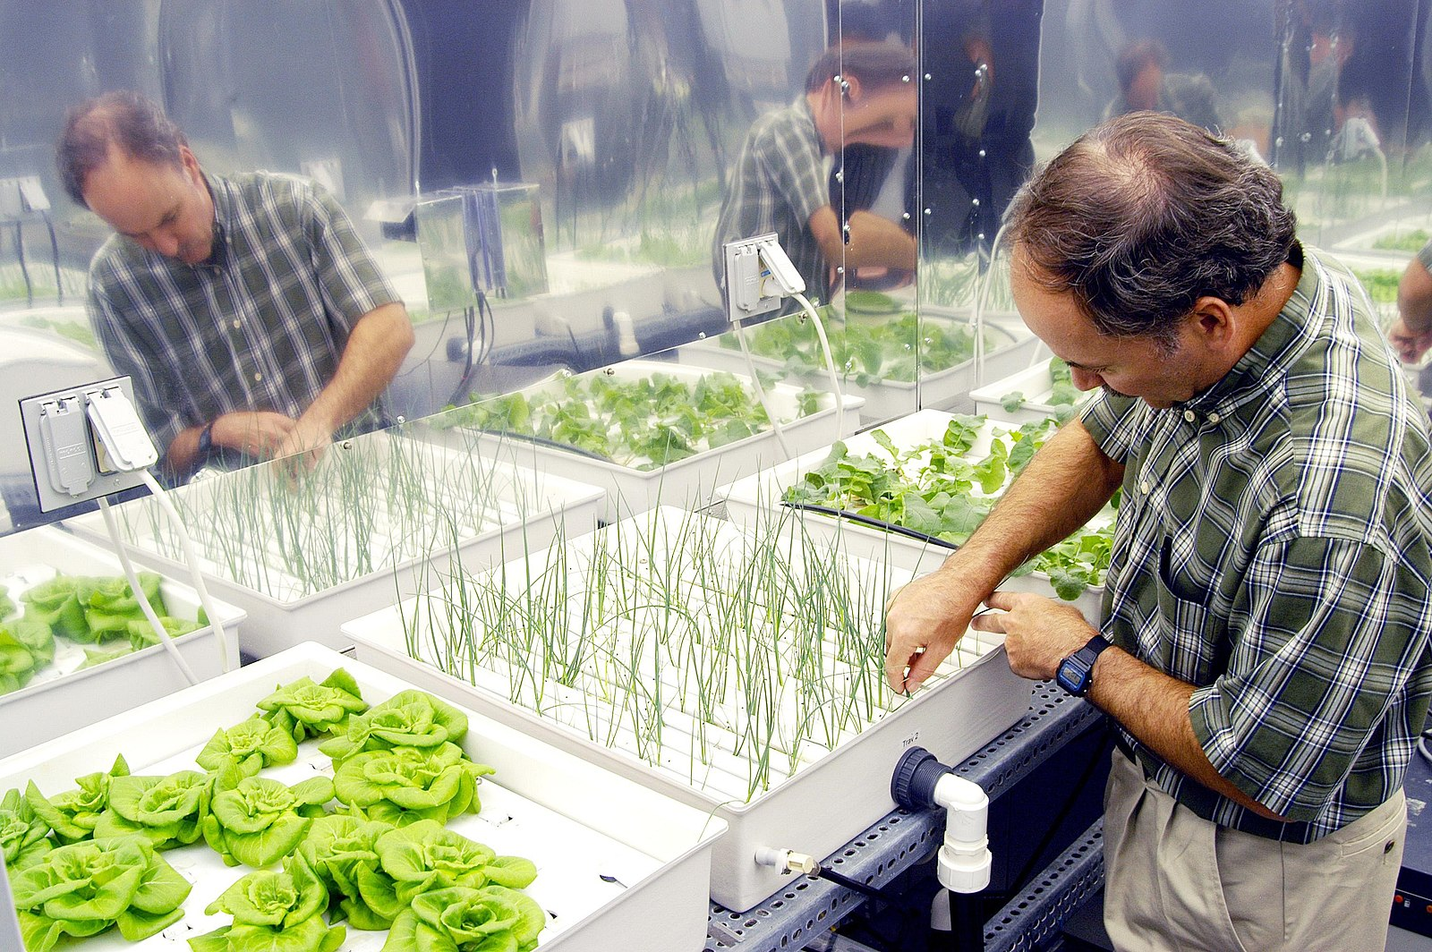
Figure 31.5 Plant physiologist Ray Wheeler checks onions being grown using hydroponic techniques. The other plants are Bibb lettuce (left) and radishes (right). Credit: NASA

Slide 18
31.2: THE SOIL
Plants obtain inorganic material from the soil.
Soil = outer loose layer that covers the earth’s surface
Soil quality depends on many factors including chemical composition, topography, and presence of living organisms.
Previous cultivating practices and crop types could also impact soil quality.

Slide 19
Soil develops very slowly over long periods of time.
Impacted by natural and environmental forces acting on mineral, rock, and organic compounds.
Organic soils: formed from sedimentation and primarily composed of organic material
Mineral soils: formed from weathered rock and primarily composed of inorganic material
Predominant in terrestrial ecosystems.

Slide 20
SOIL COMPOSITION
Major components…
Inorganic mineral matter (40%-45%)
Mostly broken down rock.
Particle size…
Sand (0.1 to 2 mm)
Silt (0.002 to 0.1 mm)
Clay (less than 0.002 mm)
Loams contain a mixture of all three without any dominant type.

Slide 21
Major components (cont.)…
Organic matter (5%)
Humus (dead and alive microorganisms as well as dead plant and animal matter)
Water and air (50%)
Exact amounts of each component depends on the amount of vegetation, soil compaction, and precipitation patterns.

Slide 22
SOIL COMPOSITION: Major Components
The four major components of soil are shown: inorganic minerals, organic matter, water, and air.

Slide 23
SOIL FORMATION
Combination of biological, physical, and chemical processes.
Would ideally contain 50% solid material and 50% pore space (half of which would be water and the other air).
Organic components serve as cementing agents, return nutrients to plants, improves water holding capacity, improves workability, and provides energy for microorganisms.

Slide 24
Most soil microorganisms will become active when moisture is available.
Soil profile = vertical section of the soil
Soil horizons = distinct layers within the profile

Slide 25
FACTORS INFLUENCING SOIL FORMATION
Parent material
Organic and inorganic material in which soils form.
Mineral soils from directly form bedrock and have similar composition to the original rock.
Other soils form from materials that came from elsewhere (glacial drift, sedimentation from rivers, etc.).

Slide 26
Climate
Temperature, moisture, and wind cause different patterns of weathering.
Moisture and nutrients from weathering will promote biological activity.
Topography
Regional surface features (“the lay of the land”).
Affects water runoff.
Steep soils are more prone to erosion and may be thinner.

Slide 27
Biological factors
Living organisms will affect both soil formation and structure.
Animals and microorganisms can create pores and crevices.
Plant roots can create additional fragmentation.
Rhizosphere = area around plant roots containing secretions that promote the development of microorganisms
Decomposing organic matter also contributes to soil composition.

Slide 28
Time
Soil formation is a dynamic process that occurs over long periods of time.
Materials are deposited, decomposed, and transformed over time.

Slide 29
PHYSICAL PROPERTIES OF THE SOIL
Soils are named and classified according to their horizons.
The soil profile has four distinct layers/horizons…
O horizon: contains humus (decomposing organic matter) at its surface and decomposed vegetation at its base
Humus adds nutrients and improved moisture retention.
The topsoil is rich in organic material, microbial processes, and is the “workhorse” of plant production.

Slide 30
SOIL PROFILE
This soil profile shows the different soil layers (O horizon, A horizon, B horizon, and C horizon) found in typical soils. (credit: modification of work by USDA)

Slide 31
The soil profile has four distinct layers/horizons (cont.)…
A horizon: contains a mixture of organic material and with inorganic products of weathering
Beginning of true mineral soil.
Layer is typically dark in color due to the organic matter.
Rainwater percolates through and carries materials from the surface.
B horizon: contains an accumulation of mostly fine material (subsoil)
Dense layer that may contain nodules or a layer of calcium carbonate.

Slide 32
SOIL PROFILE
This soil profile shows the different soil layers (O horizon, A horizon, B horizon, and C horizon) found in typical soils. (credit: modification of work by USDA)

Slide 33
The soil profile has four distinct layers/horizons (cont.)…
C horizon: contains the parent material as well as any organic and inorganic material that has been broken down (soil base)
Remember, the parent material may be from that environment or transported from another.
Beneath the C horizon is the bedrock.
The presence and depth of these layers varies from place to place.
For example, immature layers may only display O, A, and C.

Slide 34
SOIL PROFILE: Example
The San Joaquin soil profile has an O horizon, A horizon, B horizon, and C horizon. (credit: modification of work by USDA)

Slide 35
STUDYING SOIL COMPOSITION
This soil scientist is studying the horizons and composition of soil at a research site. (credit: USDA)

Slide 36
31.3: NUTRITIONAL ADAPTATIONS OF PLANTS
Plants obtain food in two different ways…
Autotrophic plants: make their own food from inorganic materials through photosynthesis (includes the green plants)
Heterotrophic plants: completely parasitic and lacking in chlorophyll (holo-parasitic plants)
Plants may also use microbial partners in nutrient acquisition.
Certain bacteria and fungi have evolved mutualistic relationships with plant roots.
Nodules in legume plants and mycorrhization are examples.

Slide 37
NITROGEN FIXATION
Atmospheric nitrogen (N₂) is the largest pool for terrestrial ecosystems.
Plants do not have the enzymes needed to change this into biologically useful forms.
Nitrogen can be fixed (converted into ammonia, NH₃) through biological, physical, or chemical processes.
Biological Nitrogen Fixation (BNF) is exclusively carried out by prokaryotes such as soil bacteria and cyanobacteria.
The ammonia can be transported into plant tissue and incorporated into amino acids.

Slide 38
Biological nitrogen fixation (BNF) is the conversion of atmospheric nitrogen (N₂) into ammonia (NH₃), exclusively carried out by prokaryotes such as soil bacteria or cyanobacteria.
Equation:
N2+16 ATP + 8 e− + 8 H+ → 2NH3 + 16 ADP + 16 Pi + H2
The most important source of BNF is the symbiotic interaction between soil bacteria and legume plants.

Slide 39
The most important source of BNF is the symbiotic interaction between soil bacteria and legume plants.
Some legume seeds serve as important sources of agricultural proteins.
Rhizobia (soil bacteria) symbiotically interact with legume roots to form nodules where nitrogen fixation takes place.
The rhizobia contain an enzyme called nitrogenase that allows the process to take place.
The plant (and soil) obtains ammonia, and the bacteria obtain organic compounds generated by photosynthesis.

Slide 40
NITROGEN FIXATION: Soybeans and Rhizobia
Soybean roots contain (a) nitrogen-fixing nodules. Cells within the nodules are infected with Bradyrhyzobium japonicum, a rhizobia or “root-loving” bacterium. The bacteria are encased in (b) vesicles inside the cell, as can be seen in this transmission electron micrograph. (credit a: modification of work by USDA; credit b: modification of work by Louisa Howard, Dartmouth Electron Microscope Facility; scale-bar data from Matt Russell)

Slide 41
MYCORRHIZAE: THE SYMBIOTIC RELATIONSHIP BETWEEN FUNGI AND ROOTS
A nutrient depletion zone can develop when there is rapid soil solution uptake, low nutrient concentration, low diffusion rate, or low soil moisture.
Many plants exhibit mycorrhization to facilitate the uptake of minerals.
Mycorrhizae = symbiotic associations between plant roots and fungi
The fungi will colonize the living root tissue during active plant growth and substantially increase the surface area of the plant root system.

Slide 42
Many plants exhibit mycorrhization to facilitate the uptake of minerals (cont.).
The plant obtains mainly phosphates and other minerals such as Zn and Cu.
The fungus obtains nutrients such as sugars.
Mycorrhizae can also function as a physical barrier to pathogens and can provide an induction of generalized host defense mechanisms.

Slide 43
Two types of mycorrhizae…
Ectomycorrhizae
Form a dense sheath around the roots (mantle).
Increases surface area for water and mineral absorption.
Often found in forest trees.
Endomycorrhizae
Also known as arbuscular mycorrhizae.
The fungal mycelium is embedded within the root tissue.
Found in more than 80% of terrestrial plants.

Slide 44
MYCORRHIZAE
Root tips proliferate in the presence of mycorrhizal infection, which appears as off-white fuzz in this image. (credit: modification of work by Nilsson et al., BMC Bioinformatics 2005)

Slide 45
NUTRIENTS FROM OTHER SOURCES
Plant parasites
Some completely depend on the host for survival (holoparasites).
Some have no leaves.
The dodder has a cylindrical stem that coils around the host and forms suckers.
Some are fully photosynthetic and only use the host for water and minerals (hemiparasites).

Slide 46
PARASITIC PLANTS (cont.)
Rely on host for nutrients, water, or food.
Over 4100 species of parasitic plants.
Some have chlorophyll, others do not.
The dodder is a holoparasite that penetrates the host’s vascular tissue and diverts nutrients for its own growth. Note that the vines of the dodder, which has white flowers, are beige. The dodder has no chlorophyll and cannot produce its own food. (credit: “Lalithamba”/Flickr)

Slide 47
Saprophytes
Plant that contains no chlorophyll and gets its food from dead matter.
Use enzymes to convert organic food materials into simpler forms from which they can absorb nutrients.
Most do not directly digest dead matter but parasitize fungi or are mycorrhizal.

Slide 48
Saprophytes (cont.)
A saprophyte is a plant that does not have chlorophyll and gets its food from dead matter, similar to bacteria and fungi.
Use enzymes to convert organic food materials into simpler forms from which they can absorb nutrients.
Often rely on fungi that directly digest the dead matter.

Slide 49
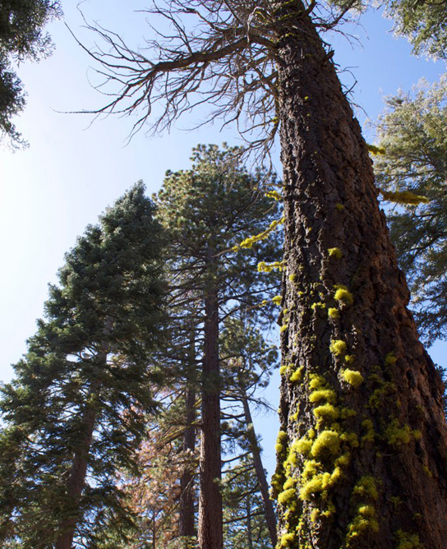
Symbionts
Plant involved in a symbiotic relationship containing special adaptations.
Such as mycorrhizae or nodule formations.
Lichens: symbiotic associations between green algae, cyanobacteria, and fungi

Slide 50
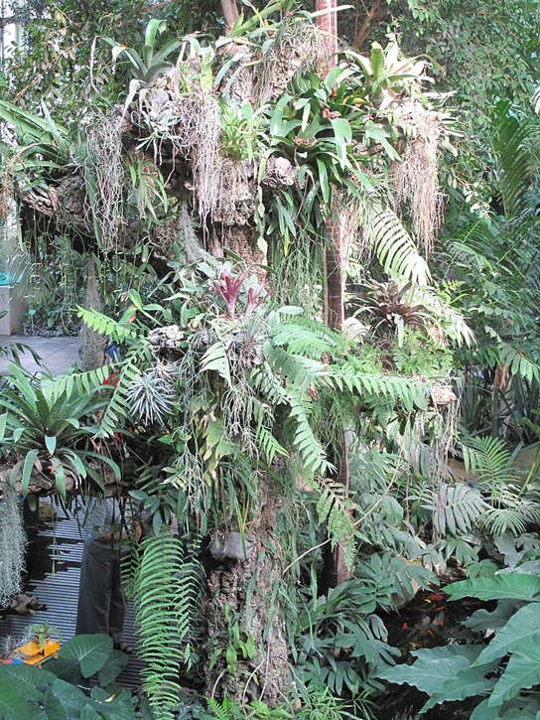
Epiphytes
Plant that grows on other plants.
Epiphytes are not dependent on the other plant for survival.
Two types of roots…
Clinging aerial roots: absorb nutrients from accumulated humus
Aerial roots: absorb moisture from the atmosphere

Slide 51
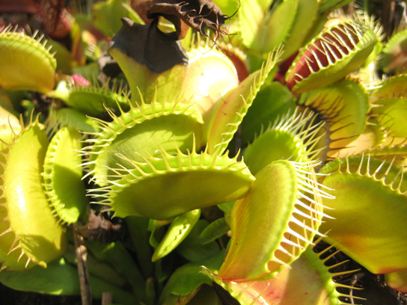
Insectivorous Plants
Plants that have specialized leaves to attract and digest insects.
The minerals obtained from the prey compensate for those lacking in their environments.
A popular example is the Venus flytrap.

