Slide 1
BIOLOGY 2E
Chapter 33 THE ANIMAL BODY PLAN: BASIC FORM AND FUNCTION
PowerPoint Image Slideshow
This work is licensed under a Creative Commons Attribution-NonCommercial-ShareAlike 4.0 International License.

Slide 2
INTRODUCTION
The structure of animals consist of primary tissues that make up more complex organs and organ systems.
Homeostasis allows an animal to maintain balance between its internal and external environments.

Slide 3
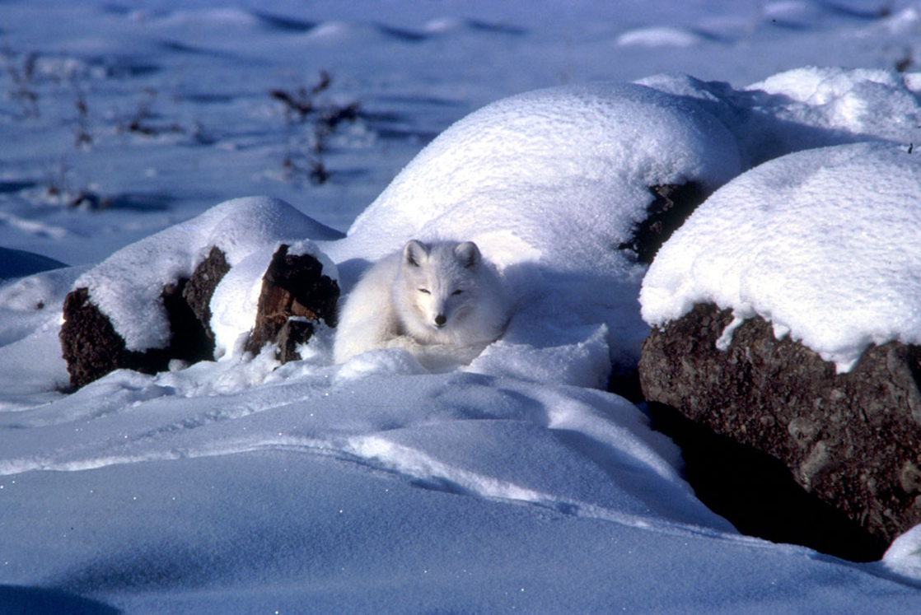
Figure 33.1 An arctic fox is a complex animal, well adapted to its environment. It changes coat color with the seasons, and has longer fur in winter to trap heat. (credit: modification of work by Keith Morehouse, USFWS)

Slide 4
ANIMAL BODY PLANS
Evolution of symmetry
Sponges do lack any definite symmetry
However, all other animals have symmetry (Eumetozoa)
Eumetazoa have a symmetry defined along an imaginary axis drawn through the animal’s body
There are two main types of symmetry:
Radial
Bilateral

Slide 5
33.1: ANIMAL FORM AND FUNCTION
Animals vary in form (anatomy) and function (physiology).
Animal’s bodies are designed to interact with their environment.
Information about the animal’s form and function can be learned by studying its environment.

Slide 6
BODY PLANS
Body plants follow set patterns related to symmetry.
Types of symmetry…
Asymmetrical
No pattern or symmetry
Example: Sponge

Slide 7
Types of symmetry…(cont.)
Radial
Up-and-down orientation
Any plane cut along the longitudinal axis would produce equal halves
No definite right or left sides
Often found in aquatic organisms, especially sessile ones.
Example: sea anemone

Slide 8
Types of symmetry…(cont.)
Bilateral
Up-and-down orientation
Left-to-right orientation
Found in aquatic and terrestrial animals
Allows for a high level of mobility
Example: goat (or any mammal)

Slide 9
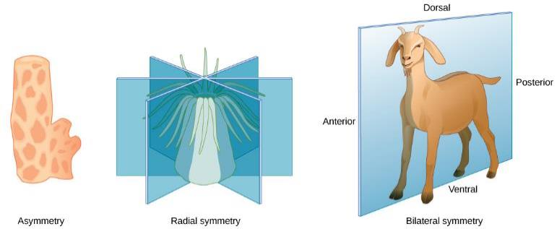
SYMMETRY
Radial symmetry
Body parts arranged around central axis
Can be bisected into two equal halves in any 2-D plane
Bilateral symmetry
Body has right and left halves that are mirror images
Only the sagittal plane bisects the animal into two equal halves

Slide 10
Other terms…
Anterior : towards front
Posterior: towards rear
Ventral: belly-side
Doral: back-side

Slide 11
LIMITS ON ANIMAL SIZE AND SHAPE
Aquatic animals that display bilateral symmetry tend to have a fusiform shape.
Tubular shape that is tapered at both ends.
Decreases drag and allows the animal to swim at high speeds.
Aquatic animals are limited by drag since the viscosity of water is higher than that of the air.
Terrestrial animals are constrained mainly by gravity.

Slide 12
Many animals have an exoskeleton.
Provides protection against physical damage and water loss.
May be constructed of tough polymers such as chitin.
May be biomineralized with salts such as calcium carbonate.
May contain apodemes (ingrowths) for muscle attachments.

Slide 13
Many animals have an exoskeleton. (cont.)
The molting process limits the ability to grow continuously.
The molting process can also limit the ability to mature.
The thickness of the exoskeleton limits most animals to a relatively small size.
Doubling of body size increases body weight by a factor of eight.
Increases in body weight must be accompanied by a significant increase in exoskeletal thickness.

Slide 14
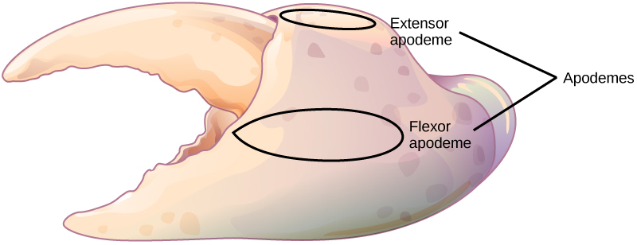
Figure 33.3 Apodemes are ingrowths on arthropod exoskeletons to which muscles attach. The apodemes on this crab leg are located above and below the fulcrum of the claw. Contraction of muscles attached to the apodemes pulls the claw close

Slide 15
Some animals have an endoskeleton.
Size determined by the amount of skeletal system needed to support tissues and muscles needed for mobility.
As body size increases, both bone and muscle mass increase.
Doubling of body size increases body weight by a factor of eight.
More efficient because muscles attach to the outside of the bones.

Slide 16
LIMITING EFFECTS OF DIFFUSION ON SIZE AND DEVELOPMENT
Exchange of nutrients and gases must occur between a cell and its watery environment.
Diffusion moves substances from an area of high concentration to an area of low concentration.
All cells are bathed in a liquid.
Diffusion is effective over a certain distance and limits cell size.

Slide 17
Surface-to-volume ratio…
Of a sphere is 3/r.
As the cell gets bigger this ratio gets smaller.
Diffusion becomes less efficient as the ratio decreases.
The solution to producing larger organisms was for them to become multicellular.
Specialization occurs in complex organisms, allowing cells to become more efficient at fewer tasks.

Slide 18
ANIMAL BODY PLANS
Evolution of tissues
Parazoa (Sponges – the simplest animals) lack defined tissues and organs
Have the ability to disaggregate and aggregate their cells
Eumetazoa (all other animals) have distinct and well-defined tissues
Have irreversible differentiation for most cell types

Slide 19
ANIMAL BIOENERGETICS
All animals obtain energy from food they digest or absorb (heterotrophic).
The energy from food is converted into ATP for short-term storage and use by cells.
Some animals can store energy for longer periods of time in glycogen or triglycerides.
Animal metabolism produces waste energy as heat.
Endotherms can conserve that heat and maintain a relatively constant body temp.
Ectotherms have less body insulation and depend on the environment to maintain their body temp.

Slide 20
Metabolic rate = the amount of energy expended over a specific time
Can be measured in joules, calories, kilocalories
Carbohydrates contain about 5 kcal/g and fats about 9kcal/g.
Estimated as the BMR in endotherms and SMR in ectotherms.
Metabolic rates of endotherms tend to be higher than those of ectotherms.
Human male BMR = 1700 kcal/day
Alligator SMR = 60 kcal/day

Slide 21
ENERGY REQUIREMENTS RELATED TO BODY SIZE
Smaller endotherms have a greater surface area for their mass compared to larger ones.
Smaller endotherms lose heat at a faster rate than larger ones.
Smaller endotherms require more energy to maintain body temp when compared to larger ones.
Smaller endotherms will have a higher BMR, per body weight, when compared to larger ones.

Slide 22
BIOENERGETICS
The mouse has a higher metabolic rate than the elephant. (credit “mouse”: modification of work by Magnus Kjaergaard; credit “elephant”: modification of work by “TheLizardQueen”/Flickr)
Smaller endothermic organisms have a higher BMR than larger ones (compensates heat lost from large surface area)
Active animals have a higher BMR than inactive ones

Slide 23
ENERGY REQUIREMENTS RELATED TO LEVELS OF ACTIVITY
A more active animal = a higher BMR
Average daily rate of energy consumption is about two to four times the BMR/SMR.
Dietary intake is determined by BMR and is influenced by the caloric value of the food.

Slide 24
ENERGY REQUIREMENTS RELATED TO ENVIRONMENT
Torpor = decreased activity and metabolic state
Allows animals to survive adverse conditions.
Hibernation = drastically reduced metabolic state (torpor) over a long period of time
Estivation = torpor that occurs in response to higher temperatures (summer months)
Torpor can occur daily.
Is able to aid smaller animals maintain their endothermy.

Slide 25
ANIMAL BODY PLANES AND CAVITIES
Planes of division…
Sagittal: divides body into right and left portions
Midsagittal: divides the body into equal right and left portions
Frontal (coronal): separates front to back
Transverse (cross section): divides into upper and lower sections
Oblique: transverse cut at an angle

Slide 26
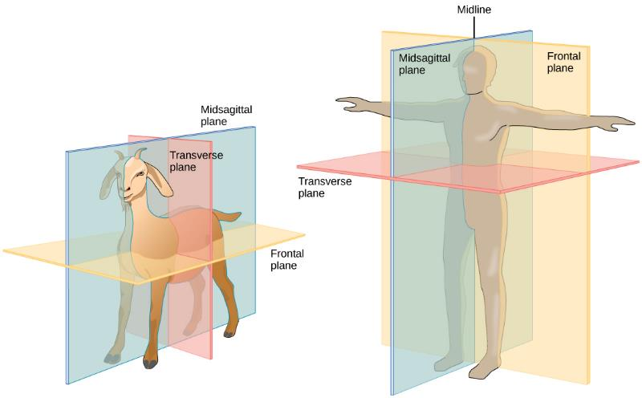
BODY PLANES

Slide 27
Vertebrate animal body cavities…
Dorsal cavity
Contains the cranial and vertebral cavities.
Ventral cavity
Contains the thoracic, abdominal, and pelvic cavities.
Abdominopelvic cavity = abdominal and pelvic cavities

Slide 28
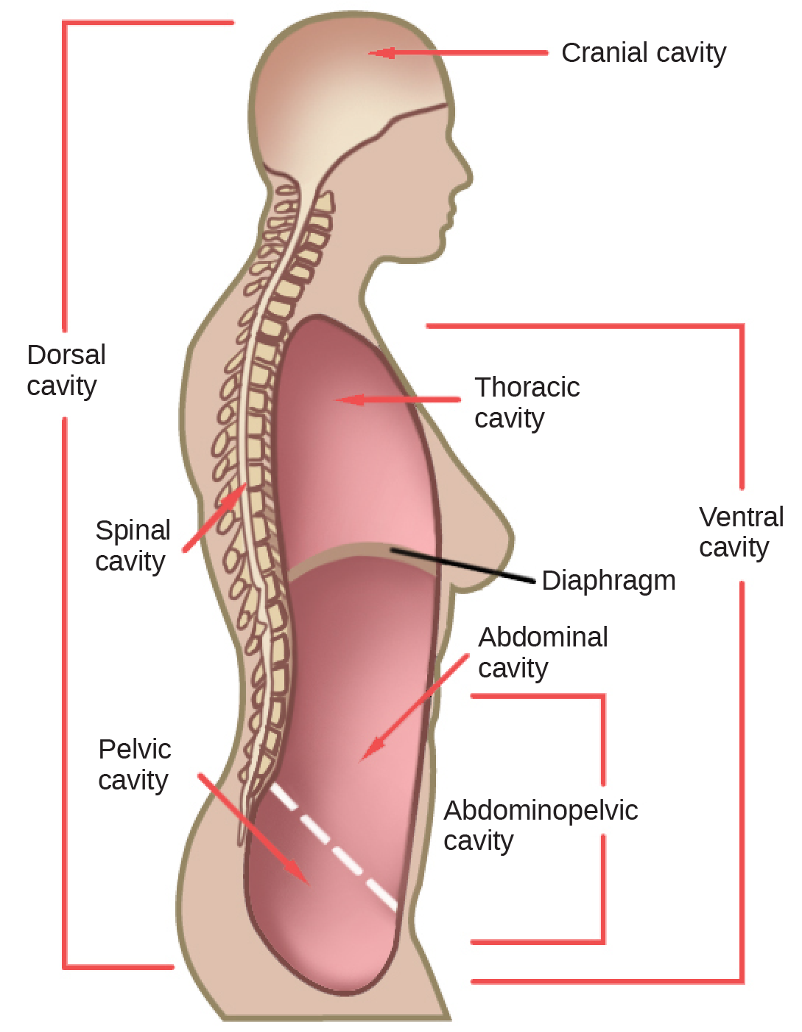
Human Body Cavities

Slide 29
33.2: ANIMAL PRIMARY TISSUES
The tissues of multicellular, complex animals come in four primary types: epithelial, connective, muscle, and nervous.
Levels of organization (review)…
Atoms/molecules
Cells
Tissues
Organs
Organ system
Organism

Slide 30
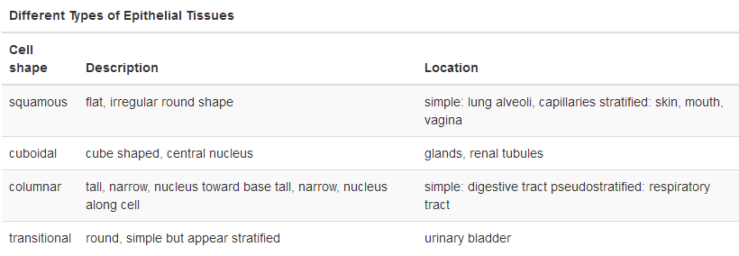
EPITHELIAL TISSUE
Covers the outside of organs and structures in the body.
Lines the lumens of organs.
Simple epithelia = single layer
Stratified epithelia = multiple layers

Slide 31
SQUAMOUS EPITHELIAL
Generally round, flat, and have a centrally located nucleus.
Cells are slightly irregular and fit together to from a lining.
Found in single and multiple layers.
Simple squamous epithelia can facilitate diffusion of gases or fluids.
Such as gas exchange in lungs.

Slide 32
SQUAMOUS EPITHELIAL
Simple Squamous
Stratified Squamous

Slide 33
CUBOIDAL EPITHELIAL
Cube-shaped with a single, central nucleus.
Commonly found in a single layer.
Simple cuboidal epithelia can be found in glandular tissue, kidney tissue, and liver tissue.

Slide 34
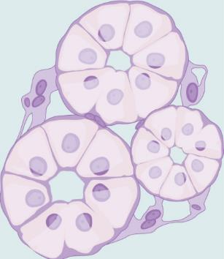
CUBOIDAL EPITHELIAL
Simple Cuboidal

Slide 35
COLUMNAR EPITHELIAL
Taller than they are wide.
Commonly found in a single layer arrangement.
Nuclei found in cells of the GI tract appear to be at the base of the cells.
These cells absorb materials from the lumen of the GI tract.

Slide 36
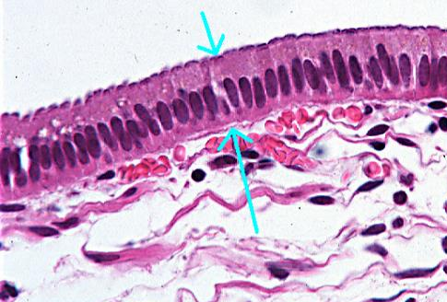
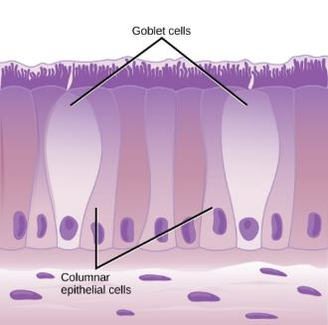
SIMPLE COLUMNAR EPITHELIAL

Slide 37
PSEUDOSTRATIFIED COLUMNAR EPITHELIAL
Pseudostratified columnar epithelia looks like multiple layers but it is only a single layer.
Nuclei arranged at different levels.
Found in the respiratory tract as ciliated epithelia.
Cilia create currents that can move fluids such as mucus.

Slide 38
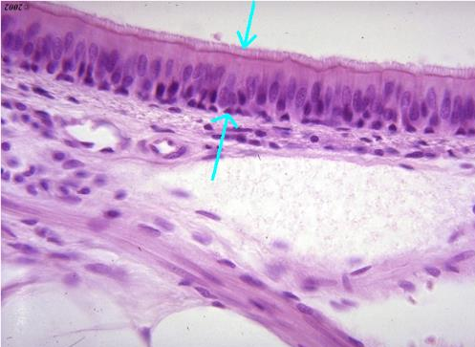
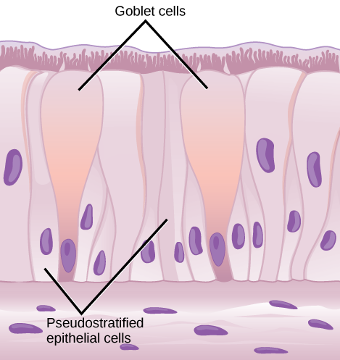
PSEUDOSTRATIFIED CILIATED COLUMNAR EPITHELIAL

Slide 39
TRANSITIONAL EPITHELIAL (UROEPITHELIAL)
Only in the urinary system (primarily the bladder and ureter).
Arranged in a stratified layer.
Tissue is able to transition from thick to thin.

Slide 40
CONNECTIVE TISSUE
Made up of a matrix composed of living cells and a ground substance (nonliving).
Ground substance is made of an organic component (typically a protein) and an inorganic component (typically a mineral or water).
The principal cell is the fibroblast.
Makes the fibers found in nearly all connective tissues.
Motile and able to carry out mitosis.
Can synthesize whatever connective tissue is needed.

Slide 41
The matrix of the connective tissue provides density.
High concentration of cells or fibers = less dense matrix
The organic portion (protein fibers) includes…
Collagen fibers: provide strength to the tissue
Elastic fibers: provide flexibility to the tissue
Made of protein elastin.
Can stretch and return to original size.
Reticular fibers: support the tissue and any organs attached to it
Made of thin strands of collagen occurring in networks.

Slide 42
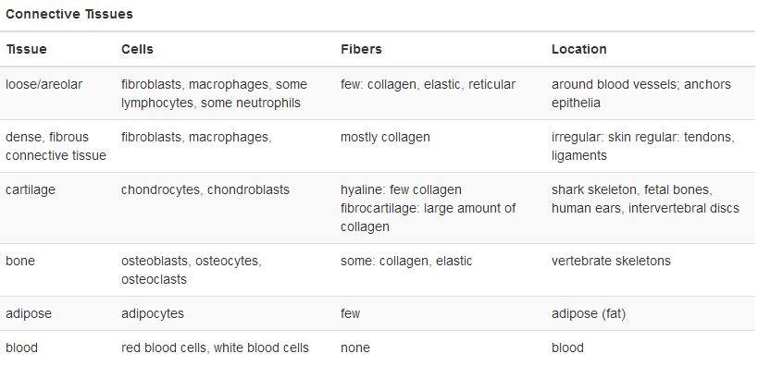
CONNECTIVE TISSUE

Slide 43
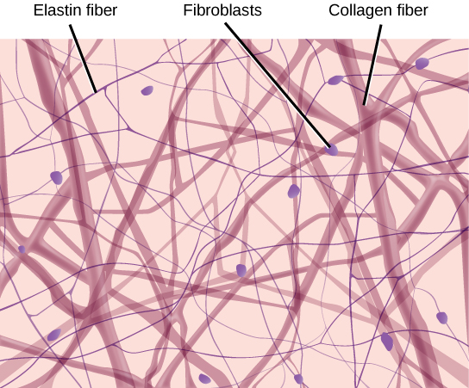
LOOSE/AREOLAR CONNECTIVE TISSUE
Has sampling of all connective tissue components.
Material gives a loose consistency similar to a cotton ball.
Found around every blood vessel and between most body organs.
Tough, yet flexible.

Slide 44
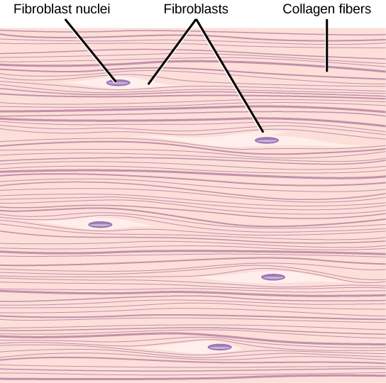
FIBROUS CONNECTIVE TISSUE
Contains a large amount of collagen fibers.
Fibers can be arranged irregularly or regularly.
Irregularly arranged fibers are found in areas where stress occurs from all directions such as the dermis.
Regularly arranged fibers can be found in tendons and ligaments.

Slide 45
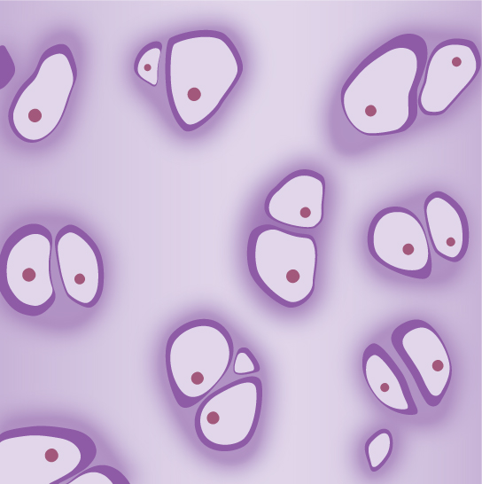
CARTILAGE
Large amount of matrix and variable amount of fibers.
Chondrocytes = cells that make the matrix and fibers of the tissue
Lacunae = spaces that house chondrocytes
Hyaline cartilage…
Few collagen and elastic fibers.
Lacunae randomly scattered.
Can be found at the end of long bones.

Slide 46
Elastic cartilage…
Large amount of elastic fibers.
Can be found in the ears.
Fibrocartilage...
Large amount of collagen fibers.
Found in the intervertebral discs.
Replaces hyaline cartilage of joints after damage.

Slide 47
BONE
Large amount of two different types of matrix material.
Organic matrix similar to others (such as collagen and elastin).
Provides flexibility.
Inorganic matrix composed of mineral salts (mostly calcium salts).
Provides harness.
Three types of bone cells…
Osteoblasts: active in making bone
Osteocytes: mature bone cells found in lacunae
Osteoclasts: active in breaking down bone

Slide 48
Can be divided into two types…
Compact
Organized into subunits called osteons.
Contain central canals (Haversian canals) that support blood vessels and neurons.
Occur in radiating circles called lamellae.
Osteocytes can be found in lacunae.
Spongy
Made of tiny plates called trabeculae and many open pores.
Blood vessels, neurons, and bone marrow can travel through pores.

Slide 49
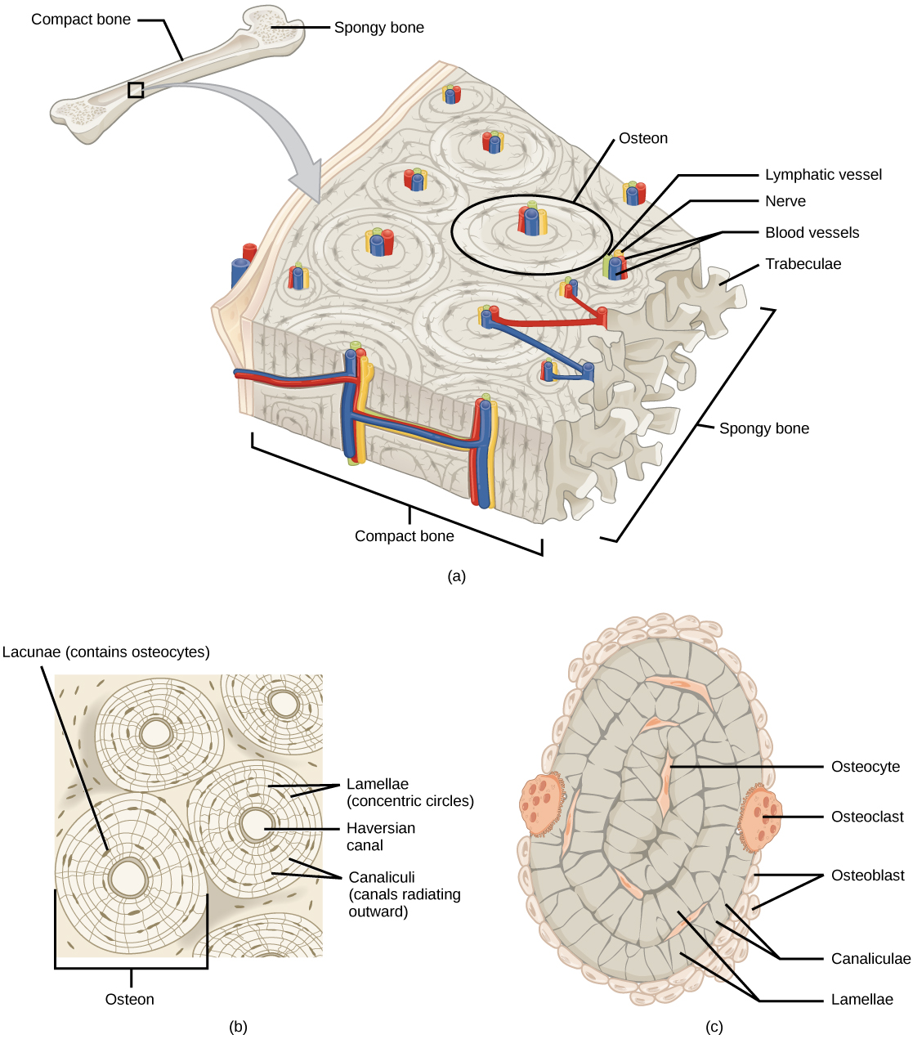
Figure 33.15 (a) Compact bone is a dense matrix on the outer surface of bone. Spongy bone, inside the compact bone, is porous with web-like trabeculae. (b) Compact bone is organized into rings called osteons. Blood vessels, nerves, and lymphatic vessels are found in the central Haversian canal. Rings of lamellae surround the Haversian canal. Between the lamellae are cavities called lacunae. Canaliculi are microchannels connecting the lacunae together. (c) Osteoblasts surround the exterior of the bone. Osteoclasts bore tunnels into the bone and osteocytes are found in the lacunae.

Slide 50
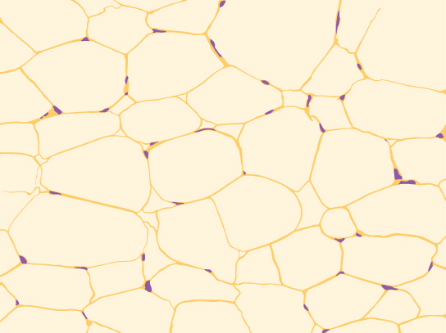
ADIPOSE TISSUE
Does not contain fibroblasts or a real matrix.
Contains limited numbers of fibers.
Made up of adipocytes.
Collect and store fat in the form of triglycerides.
Serves in energy storage, insulation, and cushioning.

Slide 51
BLOOD
Has a matrix (plasma) that composes its fluid portion.
Cell types…
Erythrocytes (RBC)
Found in greatest abundance.
Same size in a species but varies between species.
Mammalian RBC’s lose their nuclei and mitochondria during development while fish, amphibian, and avian do not.
Job is to carry and deliver oxygen.

Slide 52
Cell types…(cont.)
Leukocytes (WBC)
Carry out the immune response.
Lymphocytes respond to foreign antigens or materials.
Neutrophils are part of the early line of response against microbial invaders.
Monocytes give rise to powerful phagocytic macrophages.
Eosinophils and basophils facilitate the inflammatory response.

Slide 53
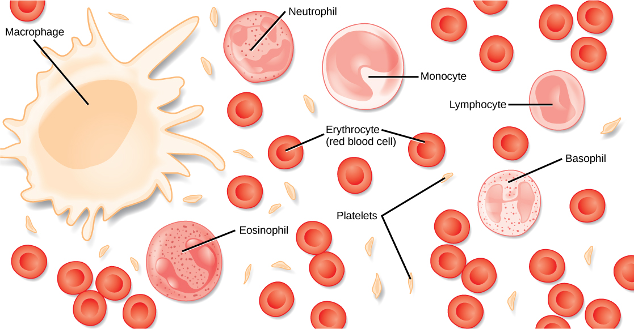
Platelets (thrombocytes) are fragments of cells that aid in blood clotting.

Slide 54
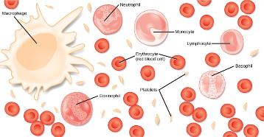
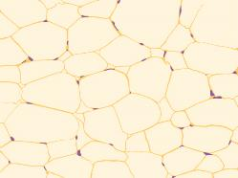
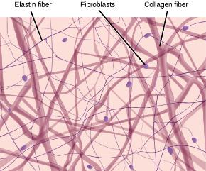
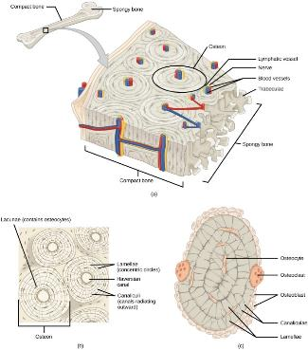
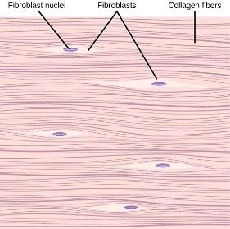
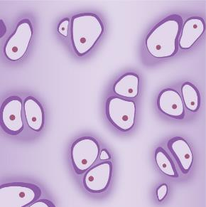
CONNECTIVE TISSUE

Slide 55
MUSCLE TISSUE
Muscle tissue differs by…
Presence of absence of striations or bands.
Number and location of nuclei.
Voluntarily or involuntarily controlled.
Location within the body.

Slide 56
MUSCLE TISSUES
Three kinds: Skeletal, Smooth, and Cardiac
Smooth – involuntary, no striations
Skeletal – voluntary, striated
Cardiac – involuntary, striated, intercalated discs

Slide 57
SMOOTH MUSCLE
No striations.
Single, centrally located nucleus.
Controlled by the autonomic nervous system (involuntary).
Responds to local conditions in the tissues.
Found in blood vessels and viscera.

Slide 58
SKELETAL MUSCLE
Has striations caused by the arrangement of contractile proteins (actin and myosin).
Long with multiple nuclei along the edges.
Controlled by the somatic nervous system (voluntary).
Muscles that move bones.

Slide 59
CARDIAC MUSCLE
Found only in the heart.
Has cross striations.
Has a single, centrally located nucleus.
Influenced by the autonomic nervous system (involuntary).
Heart has pacemaker cells that cause contraction.
Nervous system can speed up or slow down.
Cells have intercalated discs that connect them together.
Assists in spreading electrical signals.

Slide 60
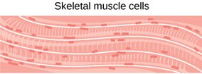
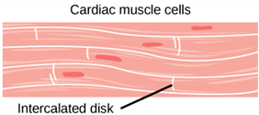
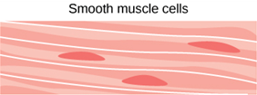
MUSCLE TISSUES

Slide 61
NERVOUS TISSUE
Cells specialized to receive and transmit electrical impulses.
Main cell of the nervous system is the neuron.
Cell body = large central region with the nucleus and other organelles.
Projections = extensions that leave the cell body
Dendrites = receive signals
Axons = transmit action potentials (impulses)

Slide 62
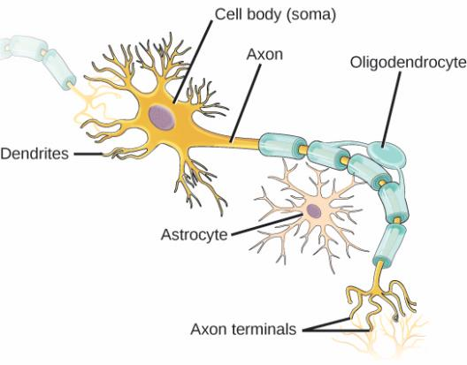
NERVOUS TISSUE
Consists of Neurons and Neuroglia
Generate and transmit electrical impulses

Slide 63
Glial cells (neuroglia) aid the neurons functioning.
Astrocytes = regulate chemical environment
Oligodendrocytes = insulate axons and speed up impulses (myelin sheath)
A nerve consists of neurons and glial cells.

Slide 64
33.3: HOMEOSTASIS
Animal organs and organ systems must constantly adjust to changing external and internal conditions.
Homeostasis = maintaining a dynamic equilibrium within the body
Usual involves ranges the body is kept within.
The goal of homeostasis is maintenance of equilibrium around a set point.
Body will undergo fluctuations but will eventually attempt to return to set point.

Slide 65
A change within the environment (internal or external) is measured by receptors.
Receptors will send this information to the control center (such as the brain or central ganglia).
The control center will then send commands to the effector (a muscle or a gland).
The effector will cause some action that either returns the body to homeostasis (negative feedback) or pushes it further out of homeostasis (positive feedback).
Homeostasis is controlled by the nervous and endocrine systems in mammals.

Slide 66
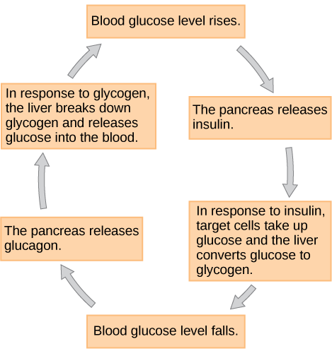
HOMEOSTASIS/THERMOREGULATION
Negative Feedback Loop – Counteracts any internal changes (reverses the direction of the change)
Most biological systems are on negative feedback
Examples
Temperature
Glucose
pH
Blood Calcium

Slide 67
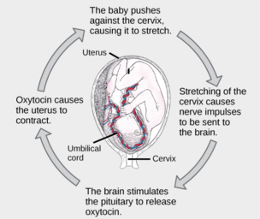
HOMEOSTASIS/THERMOREGULATION
Positive Feedback Loop – Maintains and potentially strengthens the response to a stimulus
Not many biological systems are on positive feedback
Example: Oxytocin
The birth of a human infant is the result of positive feedback.

Slide 68
SET POINT
It is possible to adjust a system’s set point through alteration.
Example…
When the body is consistently exposed to high blood pressure the set point is adjusted.
The body then recognizes the higher blood pressure as the norm.

Slide 69
It is possible for a group of body organ systems to change to maintain a set point for another system through acclimatization.
Example…
When moving to a higher altitude more red blood cells must be produced for adequate oxygen delivery.
The kidneys release EPO that stimulates more red blood cells to be created in the red bone marrow to maintain a set point for the lungs.

Slide 70
HOMEOSTASIS: THERMOREGULATION
Must maintain a relatively constant internal temperature to keep enzymes efficient and avoid denaturation
Thermoregulatory control by hypothalamus
Endotherm vs. Ectotherm
Temperature maintained in several different ways
Radiation
Convection
Conduction
Evaporation
Heat can be exchanged by four mechanisms: (a) radiation, (b) evaporation, (c) convection, or (d) conduction. (credit b: modification of work by Kullez/Flickr; credit c: modification of work by Chad Rosenthal; credit d: modification of work by “stacey.d”/Flickr)

Slide 71
BODY TEMPERATURE AFFECTS BODY CAVITIES
Enzyme activity doubles with every ten-degree centigrade rise (to a point).
Enzymes begin to denature around fifty degrees centigrade in mammals.
Enzyme activity will decrease by half with every ten-degree centigrade drop (to a point).

Slide 72
ENDOTHERMS AND ECTOTHERMS
Ectotherms = do not control their body temperatures (relies on their environment)
Poikilotherms = animals with constantly varying internal temperatures
Homeotherm = maintains constant body temperatures in the face of environmental changes

Slide 73
Endotherms = animals that rely on internal sources for body temperature
Heat can be exchanged between an animal and its environment by…
Radiation: emission of electromagnetic “heat” from some source (such as the sun or skin)
Evaporation: transition of a liquid to a gas (used in the process of sweating)
Convection: currents of air remove heat from a surface (such as skin)
Conduction: direct transfer of heat from one surface to another (such as an animal resting of a warm rock)

Slide 74
HEAT CONSERVATION AND DISSIPATION
Endothermic animals can have some form of insulation (such as fur, fat, feathers, or some combination).
Mammals have a residual effect from shivering and increased muscle activity.
Endotherms use their circulatory systems to help maintain body temperature.
More blood to the surface (vasodilation of peripheral blood vessels) = heat loss
More blood to the internal organs (vasoconstriction of peripheral blood vessels) = heat conserved
Countercurrent mechanisms can be used to transfer heat between arteries and veins (as found in dolphins, sharks, bees, etc.).

Slide 75
Some ectothermic animals can use changes in behavior to aid in regulation.
Desert ectotherms may seek cooler areas during the hottest parts of the day.
Some may seek water to aid in evaporative cooling.
The group activity of bees to warm a hive.
Many animals (especially mammals) use metabolic waste heat.

Slide 76
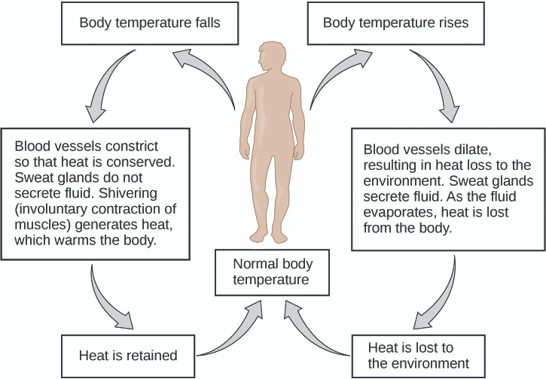
Figure 33.23 The body is able to regulate temperature in response to signals from the nervous system.

Slide 77
NEURAL CONTROL OF THERMOREGULATION
Control center is in the hypothalamus of the advanced animal brain.
The hypothalamus maintains the set point through reflexes that cause…
Vasodilation and increased sweat gland activity when the body is to warm.
Vasoconstriction and shivering when the body is to cold.
The hypothalamus can also respond to chemicals in the body.
Endogenous pyrogens will allow an increase in body temperature (fever).
Fevers are part of the bodies normal defense mechanisms.

