Slide 1
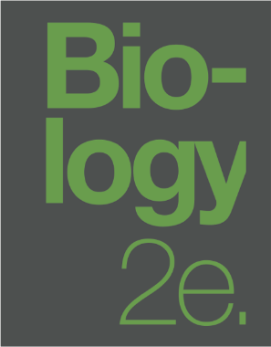
BIOLOGY 2E
Chapter 34 ANIMAL NUTRITION AND DIGESTIVE SYSTEM
PowerPoint Image Slideshow
This work is licensed under a Creative Commons Attribution-NonCommercial-ShareAlike 4.0 International License.

Slide 2
INTRODUCTION
All living organisms need nutrients to survive.
Most animals obtain their nutrients through consuming other organisms.
Biological molecules necessary for animal cell function…
Amino acids
Lipid molecules
Nucleotides
Simple sugars

Slide 3
Animal food will contain…
Proteins
Fats
Complex carbohydrates
Animals must convert macromolecules found in food into the simple molecules required for cell functioning.
Digestion = food particles are broken down
Absorption = components of digestion are taken into the blood stream or lymph
Animals must balance food intake, storage, and energy expenditure.

Slide 4
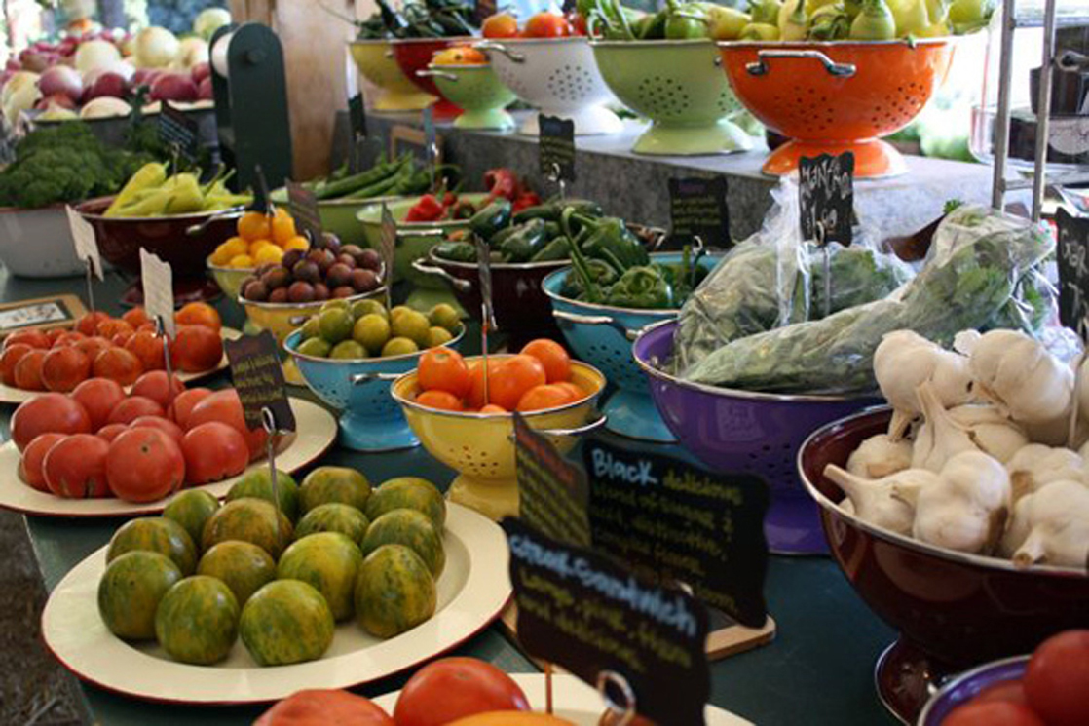
Figure 34.1 For humans, fruits and vegetables are important in maintaining a balanced diet. (credit: modification of work by Julie Rybarczyk)

Slide 5
34.1: DIGESTIVE SYSTEMS
Animals must obtain nutrients from eating plants (herbivores), meat (carnivores), or both (omnivores).
The nutrients and molecules present in food must be processed before they are accessible to cells.
Animal digestive systems have evolved to accommodate their various dietary needs.

Slide 6
HERBIVORES, OMNIVORES, AND CARNIVORES
Herbivores
Primary food source is plant-based.
Have evolved digestive systems capable of handling large amounts of plant material.
Categories…
frugivores = fruit-eaters
granivores = seed-eaters
nectivores = nectar-feeders
folivores = leaf-feeders

Slide 7
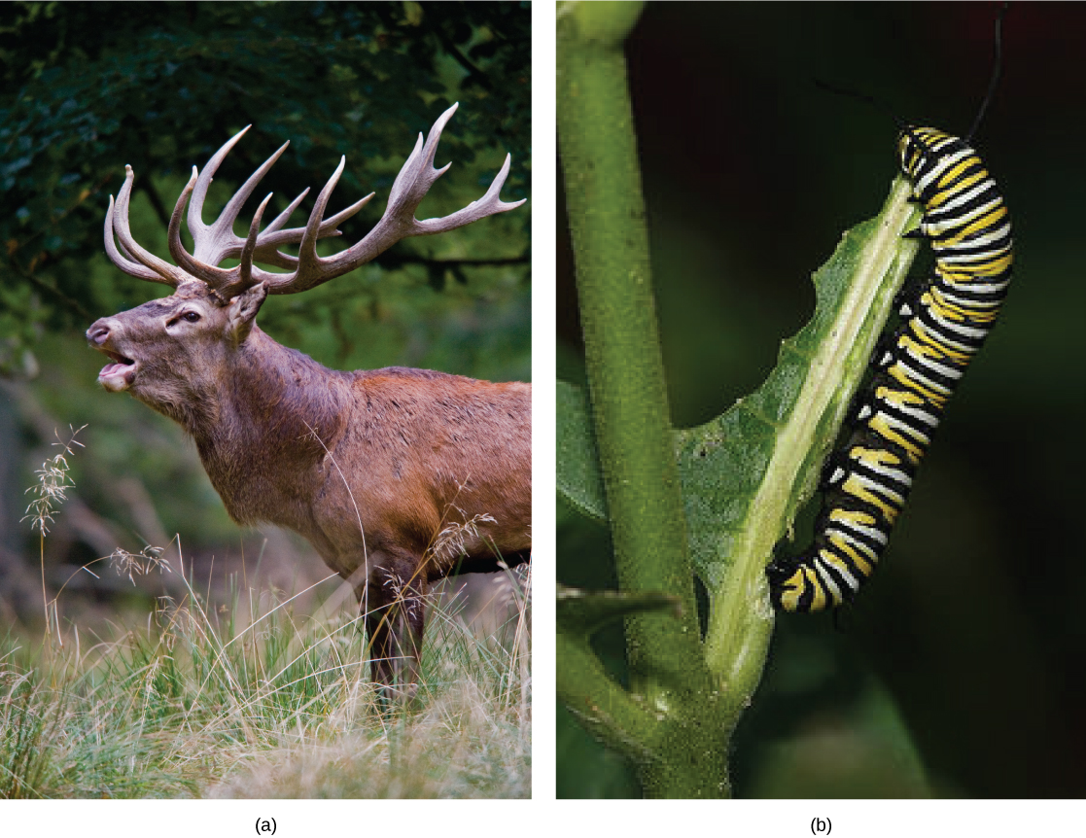
Figure 34.2 Herbivores, like this (a) mule deer and (b) monarch caterpillar, eat primarily plant material. (credit a: modification of work by Bill Ebbesen; credit b: modification of work by Doug Bowman)

Slide 8
Carnivores
Primary food source are animals.
Obligate carnivores = rely entirely on animal flesh (lions)
Facultative carnivores = also eat non-animal food (dogs)
Omnivores
Eat both plant- and animal-derived food.

Slide 9
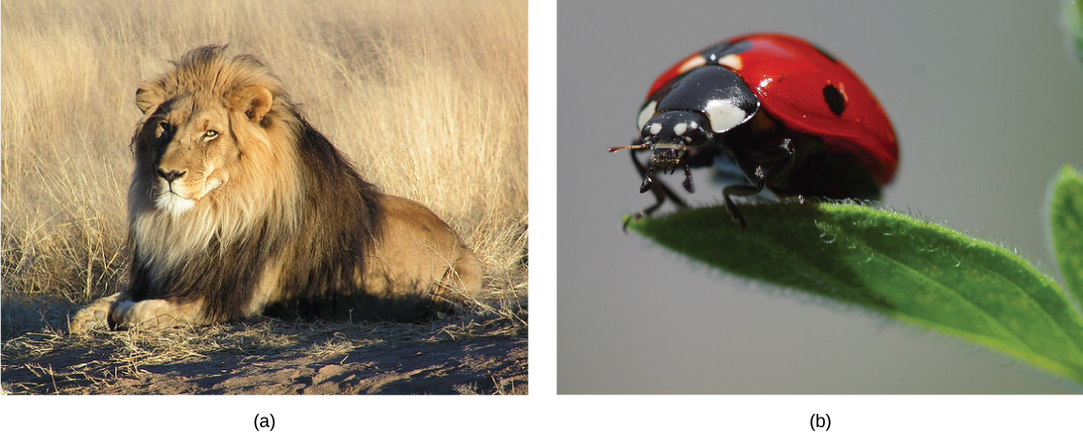
Figure 34.3 Carnivores like the (a) lion eat primarily meat. The (b) ladybug is also a carnivore that consumes small insects called aphids. (credit a: modification of work by Kevin Pluck; credit b: modification of work by Jon Sullivan)

Slide 10
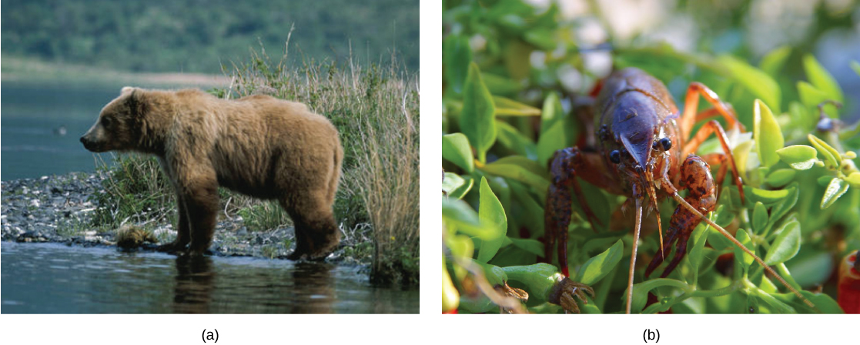
Figure 34.4 Omnivores like the (a) bear and (b) crayfish eat both plant and animal based food. (credit a: modification of work by Dave Menke; credit b: modification of work by Jon Sullivan)

Slide 11
INVERTEBRATE DIGESTIVE SYSTEMS
Simplest example of an evolved digestive system is the gastrovascular cavity.
Only has one opening for digestion.
Blind tube or cavity.
“Mouth” and “anus” are the same opening.
Cells within the cavity secrete digestive enzymes.
Food particles are engulfed by cells lining the cavity.
Examples: jellyfish and sea anemones

Slide 12
The alimentary canal is more advanced with a separate mouth and anus.
Consists of a single tube.
Food passes through mouth and is stored in the crop.
Food then passes to the gizzard where it is churned and digested.
Food particles then pass through the intestine where absorption occurs.
Feces (castings) are eliminated through the anus.
Examples: tapeworms and earthworms

Slide 13
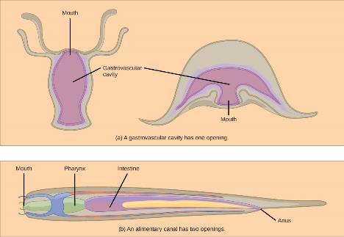
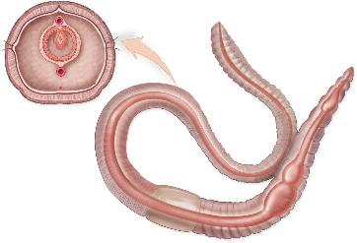
INCOMPLETE VERSUS COMPLETE DIGESTIVE TRACTS
typhlosole
anus
The castings produced by worms (or earthworm poop) is actually a very desirable natural fertilizer for plants. Some gardeners even purchase earthworm castings to mix with their soil.
mouth
pharynx
intestine
esophagus
crop
gizzard

Slide 14
VERTEBRATE DIGESTIVE SYSTEMS
Have evolved more complex digestive systems to adapt to their dietary needs.

Slide 15
MONOGASTRIC: SINGLE-CHAMBERED STOMACH
Process of digestion begins with the mouth.
Teeth play an important role in physically breaking down food (mastication).
Enzymes in saliva begin to chemically breakdown food.
The esophagus transports food to the stomach via peristalsis.
Peristalsis occurs in other GI tract organs as well.
Digestion is continued in the stomach.
Extreme acidity (pH 1.5 to 2.5) increase the rate of breakdown.
Gastric juices contribute to breakdown.

Slide 16
Further breakdown takes place in the small intestine.
Enzymes produced by the liver, pancreas, and small intestine contribute to breakdown.
Most absorption occurs in the small intestine.
Waste material travels through the large intestine and is stored until it is excreted out the rectum.
Some water is absorbed in the large intestine.
Compacts and dries waste into feces.

Slide 17
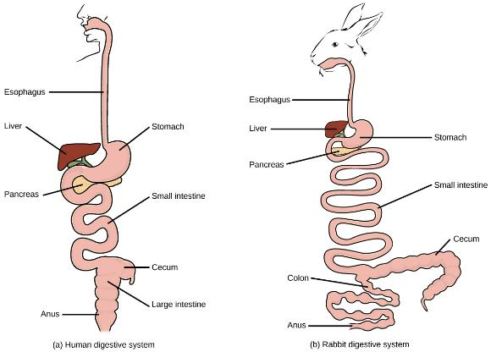
VERTEBRATE DIGESTIVE SYSTEMS
Monogastric Digestive Systems
Humans and herbivores, such as the rabbit
Note: rabbits digest their food twice: 1) Food passes through the digestive system, collects in the cecum, and then it passes as soft feces called cecotrophes. 2) The rabbit re-ingests these cecotrophes to further digest them.

Slide 18
AVIAN
Birds do not have teeth so their digestive system must be able to handle un-masticated food.
Beak type fits their diet.
Metabolic rates are high to quickly process food and keep weight down.

Slide 19
Stomach has two chambers…
Proventriculus = where gastric juices are produced
Gizzard = where food is stored, soaked, and mechanically ground
Undigested material forms pellets.
Most chemical digestion and absorption happens within the intestine.
Waste is excreted through the cloaca.

Slide 20
AVIAN ADAPTATIONS
Birds have evolved highly efficient, simplified digestive systems.
The horny beak, lack of jaws, and smaller tongues can be traced back to their dinosaur ancestors.

Slide 21
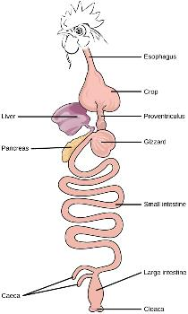
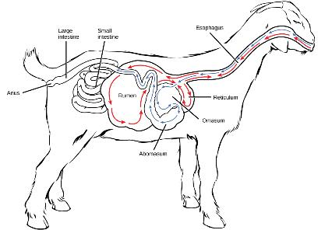
VERTEBRATE DIGESTIVE SYSTEMS
Ruminants
Four stomachs:
the rumen and the reticulum – contain prokaryotes and protists to digest cellulose fiber.
Cud is regurgitated chewed and swallowed in third stomach, the omasum – removes water.
Cud then passes onto the abomasum – enzymes produced by animal
Birds
A crop, stores food
Two stomachs: the proventriculus (enzymes) and the gizzard (grinding).
One openings to excrete urine and feces = the cloaca

Slide 22
RUMINANTS
Mainly herbivores like cows and goats.
Diets include large amounts of roughage (fiber).
Digestive systems have evolved to handle large amounts of cellulose.
Do not have upper incisor teeth.
Use lower teeth, tongue, and lips to tear and chew food.

Slide 23
Stomach is a multi-chambered organ with four compartments…
Rumen
Reticulum
Omasum
Abomasum (true stomach)
Chambers contain many microbes that breakdown cellulose and ferment food.
Space is needed to house enough bacteria to breakdown roughage.
Fermentation produces a lot of gas, such as methane.

Slide 24
Small intestine plays and important role in absorption.
Large intestine helps with the elimination of waste.

Slide 25
VERTEBRATE DIGESTIVE SYSTEMS
Ruminants
Four stomachs:
the rumen and the reticulum – contain prokaryotes and protists to digest cellulose fiber.
Cud is regurgitated chewed and swallowed in third stomach, the omasum – removes water.
Cud then passes onto the abomasum – enzymes produced by animal
Birds
A crop, stores food
Two stomachs: the proventriculus (enzymes) and the gizzard (grinding).
One openings to excrete urine and feces = the cloaca

Slide 26
PSEUDO-RUMINANTS
Includes camels and alpacas.
Have a three-chambered stomach.
Omasum
Abomasum
Reticulum
Cecum is large and contains many microorganisms that can breakdown and ferment roughage.

Slide 27
PARTS OF THE DIGESTIVE SYSTEM
Humans digestive tract is complete (alimentary canal)
Part of a tube-within-a-tube body plan
Begins with a mouth and ends in an anus
Digestion entirely extracellular
Digestive enzymes are secreted by
The wall of the digestive tract, or
By nearby glands

Slide 28
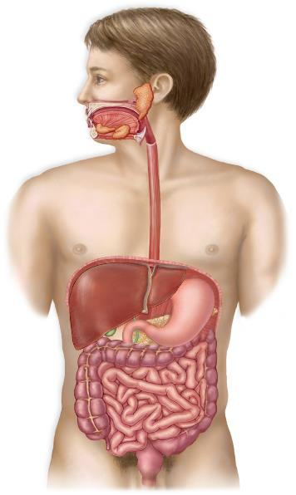
HUMAN DIGESTIVE TRACT
Accessory organs
Digestive tract organs
Salivary glands
secrete saliva: contains digestive enzyme
for carbohydrates
Mouth
teeth chew food; tongue tastes and
pushes food for chewing and swallowing
Pharynx
passageway where food is swallowed
Esophagus
passageway where peristalsis pushes
food to stomach
Liver
major metabolic organ:
processes and stores nutrients;
produces bile for emulsification of fats
Stomach
secretes acid and digestive enzyme
for protein; churns, mixing food with
secretions, and sends chyme to
small intestine
Gallbladder
stores bile from liver; sends it to
the small intestine
Pancreas
produces pancreatic juice: contains digestive
enzymes, and sends it to the small intestine;
produces insulin and secretes it into the
blood after eating
Small intestine
mixes chyme with digestive enzymes
for final breakdown; absorbs nutrient
molecules into body; secretes
digestive hormones into blood
Large intestine
absorbs water and salt to form feces
Rectum
stores and regulates elimination
of feces
Anus

Slide 29
ORAL CAVITY
Point of entry for food.
Mastication breaks food down into smaller particles.
All mammals have teeth for chewing.
Saliva begins the digestion process.
Produced by salivary glands (parotid, submandibular, sublingual).
Watery substance that contains mucous, immunoglobins, lysozymes, and salivary amylase (breaks down carbohydrates).

Slide 31
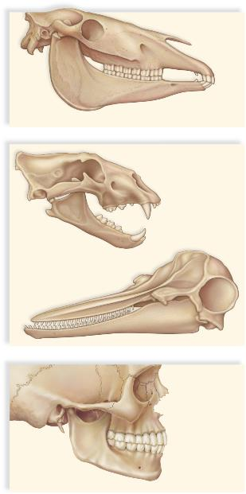
Dentition differs with mode of nutrition
Omnivores
Variety of specializations
Accommodate both vegetation and meat
Herbivores
Incisors for clipping
Premolars and molars for grinding
Carnivores
Pointed incisors and enlarged canines
Shear off pieces small enough to swallow
reduced canines
large, flat molars and premolars
sharp incisors
a. Horses are herbivores.
Lion
pointed incisors
jagged molars
and premolars
enlarged canines
similarly shaped conical teeth
Dolphin
b. Lions and dolphins are carnivores.
chisel-shaped
incisors
pointed canines
fairly flat
premolars
flat molars
c. Humans are omnivores.

Slide 32
Lipase is produced by cells in the tongue and begins the breakdown of triglycerides.
Bolus = wettened mass of food produced in the mouth
Tongue aids in swallowing, which moves the bolus to the pharynx.
Soft palate closes off nasopharynx.
In the trachea the epiglottis directs food into the esophagus.

Slide 33
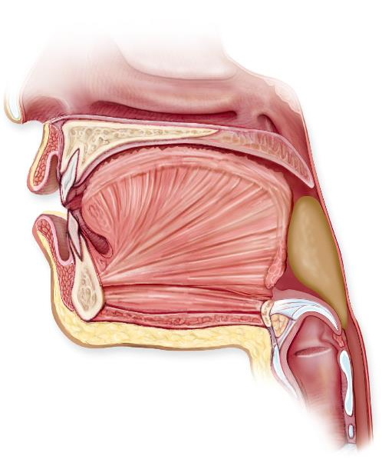
SWALLOWING
soft palate
nasopharynx
hard palate
uvula
bolus
epiglottis
covering
glottis
glottis
trachea
esophagus

Slide 34
ESOPHAGUS
Tubular organ that connects the mouth to the stomach.
Smooth muscles create a wavelike motion called peristalsis.
Involuntary response to swallowing.
Unidirectional motion that moves bolus to stomach.

Slide 35
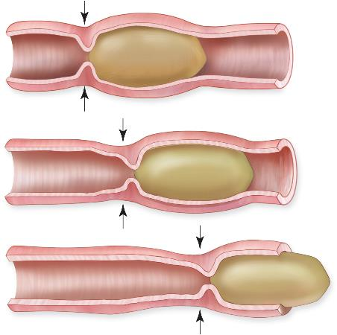
esophagus
Esophagus
Takes food to stomach by peristalsis
Peristalsis - Rhythmical contraction to move contents in tubular organs
bolus
Peristalsis in the Digestive Tract

Slide 36
Gastro-esophageal sphincter provides entry into the stomach.
Circular smooth muscles that relax in response to swallowing and pressure.
Not a true sphincter in humans. (Esophagus remains closed when there is no swallowing.)
Acid reflux occurs when stomach acids escape into the esophagus.

Slide 37
STOMACH
Saclike organ that secretes gastric digestive juices.
Highly acidic for the chemical breakdown of food and extraction of nutrients.
Can expand up to 20 times its resting size due to folds within (rugae).
A major site for protein digestion (except in ruminants).
Chief cells secrete pepsinogen, which changes into pepsin within the stomach acid.
Parietal cells secrete hydrogen and chloride, which becomes hydrochloric acid.

Slide 38
High acidity kills many microorganisms.
Chemical digestion is facilitated by churning action.
Chyme = mixture of partially digested food and gastric juices
Pyloric sphincter allows small amount of chyme to enter small intestine.
Gastric emptying takes about two to six hours.
Stomach is protected from extreme acidity by…
Thick lining of mucous containing bicarbonate.
Chief cells secrete inactive form of pepsin (pepsinogen).

Slide 39
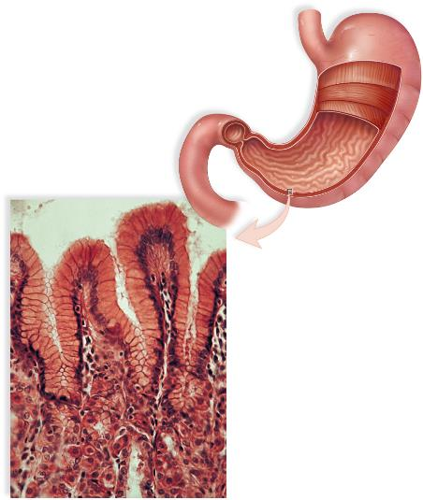
esophagus
Stomach
Stomach wall has deep folds
Folds disappear as the stomach fills to an approximate volume of one liter
Epithelial lining of the stomach has millions of gastric pits, which drain gastric glands
Pepsin is a hydrolytic enzyme that acts on protein to produce peptides
muscles of the
stomach wall
duodenum of
small intestine
a.
gastric pit
cells that
secrete mucus
cells that
secrete HCl
and enzymes
gastric gland
b.
20 μm

Slide 40
SMALL INTESTINE
Digestion of proteins, carbohydrates, and fats is competed.
Has enormous surface area because…
Long tube with many folds.
Villi = fingerlike projections on internal surface
Microvilli = fingerlike projections on apical surface of villi
Villi are lined with epithelial cells that allow for the absorption of simple food molecules.
Regions include the duodenum, jejunum, and ileum.

Slide 41
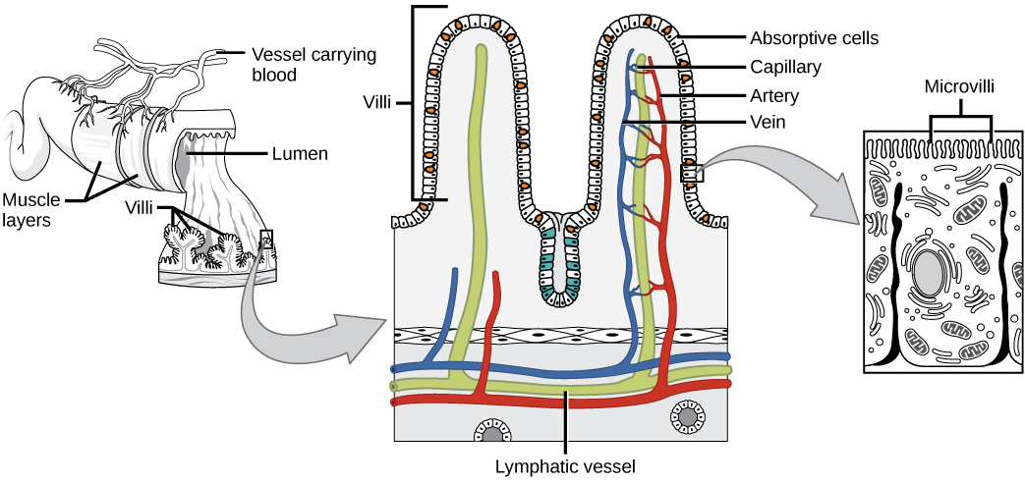
Figure 34.12 Villi are folds on the small intestine lining that increase the surface area to facilitate the absorption of nutrients.

Slide 42
HUMAN DIGESTIVE TRACT
Accessory organs
Digestive tract organs
Salivary glands
secrete saliva: contains digestive enzyme
for carbohydrates
Mouth
teeth chew food; tongue tastes and
pushes food for chewing and swallowing
Pharynx
passageway where food is swallowed
Esophagus
passageway where peristalsis pushes
food to stomach
Liver
major metabolic organ:
processes and stores nutrients;
produces bile for emulsification of fats
Stomach
secretes acid and digestive enzyme
for protein; churns, mixing food with
secretions, and sends chyme to
small intestine
Gallbladder
stores bile from liver; sends it to
the small intestine
Pancreas
produces pancreatic juice: contains digestive
enzymes, and sends it to the small intestine;
produces insulin and secretes it into the
blood after eating
Small intestine
mixes chyme with digestive enzymes
for final breakdown; absorbs nutrient
molecules into body; secretes
digestive hormones into blood
Large intestine
absorbs water and salt to form feces
Rectum
stores and regulates elimination
of feces
Anus

Slide 43
DUODENUM
Chyme mixes with bile, pancreatic juices, and intestinal juices.
Bile (Liver)
Emulsifies lipids.
Pancreatic juices (Pancreas)
Contains variety of digestive enzymes.
Intestinal juices (Small Intestine)
Adds alkalinity (bicarbonate).
Contains variety of digestive enzymes.
Absorption of fatty acids occur here.

Slide 44
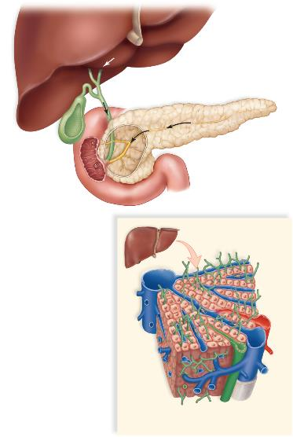
LIVER, GALLBLADDER, AND PANCREAS
bile
common hepatic duct
pancreas
pancreatic duct
pancreatic
juice
gallbladder
common bile duct
duodenum
a.
bile canals
branch of
hepatic
artery
central
vein
branch of
hepatic
portal vein
bile duct
b.

Slide 45
JEJUNUM
Hydrolysis of nutrients continues.
Most absorption of carbohydrates and amino acids.
Bulk of chemical digestion and absorption.

Slide 46
ILEUM
Bile salts and vitamins are absorbed.
Undigested foodstuff passes through the ileocecal valve into the large intestine.

Slide 47
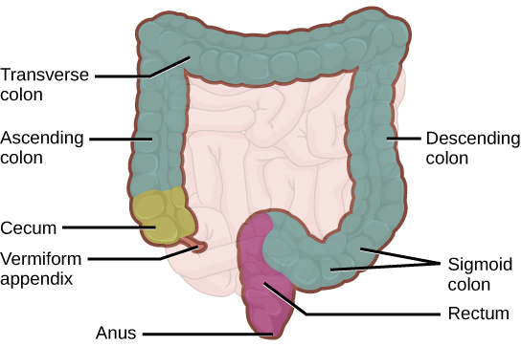
LARGE INTESTINE
Reabsorbs water and processes waste material.
Smaller in length but larger in diameter.
Regions include the cecum, colon, and rectum.

Slide 48
CECUM
Initial segment.
Receiving pouch for waste matter.
Site of attachment for appendix.

Slide 49
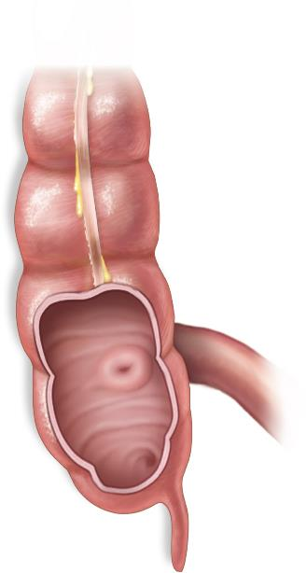
About 1/3 of the fecal matter is bacteria (live or dead)
large intestine
small intestine
cecum
Vermiform appendix

Slide 50
COLON
Houses many bacteria (intestinal flora) that aid in further digestion.
Regions include the ascending, transverse, descending, and sigmoid colon.
Main function is to extract water and mineral salts.
Carnivores have a shorter colon than herbivores.

Slide 51
RECTUM AND COLON
Terminal end of large intestine.
Rectum = store feces until defecation
Anus = exit point for feces
Has inner involuntary and outer voluntary sphincters.
Feces is propelled via peristaltic movements.

Slide 52
ACCESSORY ORGANS
Salivary glands
Produce saliva.
Liver
Produce bile.
Absorbed nutrients from small intestine are processed.
Delivered via the hepatic portal vein.
Important in detoxification.

Slide 53
Pancreatic cancer is the 4th leading cause of cancer-related death in the US. It has the highest mortality rate of all major cancers. 94% of pancreatic cancer patients will die within 5 years of diagnosis
Pancreas
Exocrine gland.
Assists in reducing the acidity of chyme.
Produces pancreatic juice and digestive enzymes.
Pancreatic amylase digests starch to maltose.
Trypsin digests protein to peptides.
Lipase digests fat droplets to glycerol and fatty acids.

Slide 54
LIVER, GALLBLADDER, AND PANCREAS
bile
common hepatic duct
pancreas
pancreatic duct
pancreatic
juice
gallbladder
common bile duct
duodenum
a.
bile canals
branch of
hepatic
artery
central
vein
branch of
hepatic
portal vein
bile duct
b.

Slide 55
34.2: NUTRITION AND ENERGY PRODUCTION
Animal diets vary substantially.
Diet is source of materials for building complex molecules needed for growth, maintenance, and reproduction (biosynthesis).
Diet is also source for ATP production (cell energy).

Slide 56
FOOD REQUIREMENTS
Diet should be well balanced.
Contain all necessary nutrients, vitamins, and minerals.

Slide 57
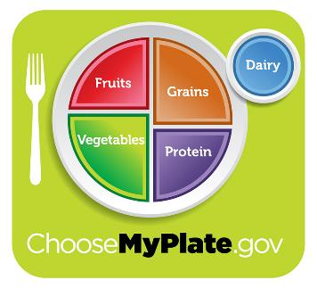
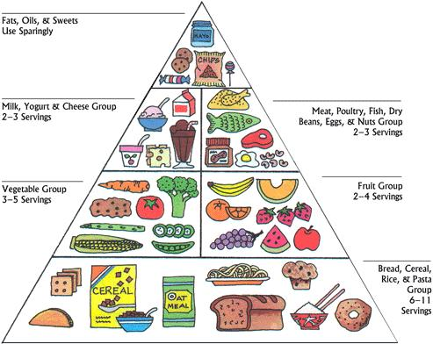
NUTRITION

Slide 58
ORGANIC PRECURSORS
Carbohydrates
Primary source of energy and organic carbon.
Carbohydrates in food are ultimately broken down into glucose.
Humans do not produce cellulase.
Cannot break down cellulose from plant matter.
Provides fiber instead.
Excess sugars are stored as glycogen or converted into fats.

Slide 59
Carbohydrates are present in food in the form of sugars, starch, and fiber.
Fruits, vegetables, milk, and honey are natural sources of sugars.
Monosaccharides:
Glucose
Fructose
Disaccharides:
Lactose (milk sugar)
Sucrose (table sugar)
After being absorbed from the digestive tract all sugars are converted to glucose.
Glucose is the preferred direct energy source in cells.
Plants store glucose as starch.
Animals store glucose as glycogen.

Slide 60
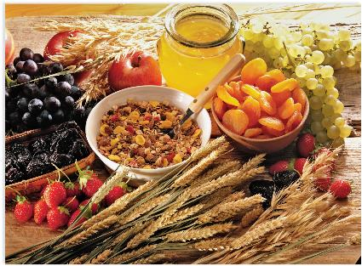
FIBER
Includes various undigestible carbohydrates derived from plants.
Food sources rich in fiber include beans, peas, nuts, fruits, and vegetables.
Technically, fiber is not a nutrient for humans.
Cannot be digested.
Soluble fiber combines with bile acids and cholesterol in the small intestine and prevents them from being absorbed.

Slide 61
Nitrogen
Protein catabolism provides a source of organic nitrogen.
Protein breakdown provides amino acids.
Carbon and nitrogen become building blocks for nucleotides, nucleic acids, proteins, cells, and tissues.
Excess nitrogen must be excreted.

Slide 62
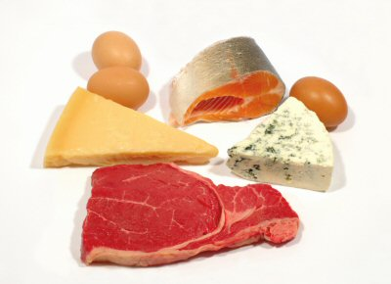
PROTEINS
Adequate protein formation requires 20 different types of amino acids
Adults require 8 from the diet, children require 9
= Essential amino acids
Some foods, such as meat, milk, and eggs, provide all 20 (complete)
Vegetables supply one or more essential amino acids, but are deficient in at least one
Vegetarians should combine plant products to provide all the essential amino acids

Slide 63
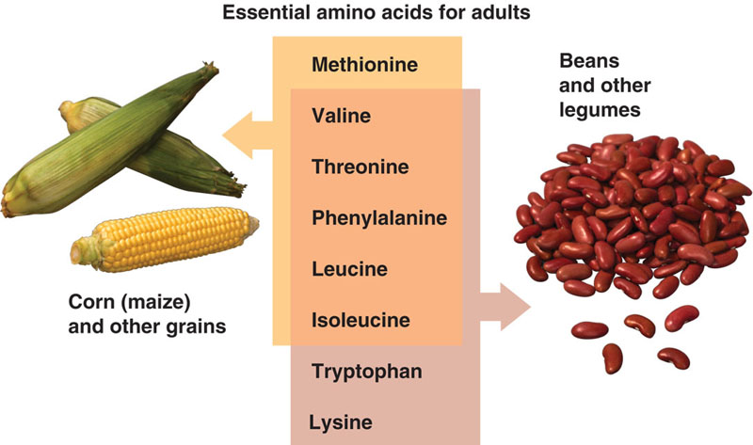
Kids also need Arginine

Slide 64
Fats/Lipids
Add flavor and a sense of satiety (fullness).
Significant source of energy.
Aid in digestion of fat-soluble vitamins and production of fat-soluble hormones.

Slide 65
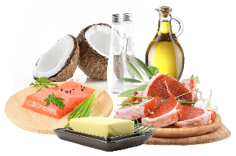
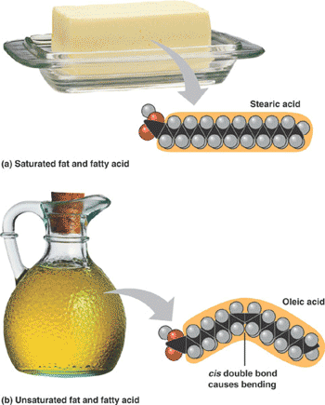
LIPIDS
Fat, oils, and cholesterol.
Essential for the storage and activity of fat-soluble vitamins A, D, and E.
Provide energy at nine calories per gram.
Fat storage is essential to protect your internal organs and to help insulate against cold temperatures.
Saturated fats (solids at room temperature) usually come from animals.
Butter and meats, such as marbled red meats and bacon, contain saturated fats.
Palm oil and coconut oil are high in saturated fats.
http://www.nature.com/nature/supplements/insights/lipids/index.html

Slide 66
ESSENTIAL NUTRIENTS
Must be eaten because the body cannot produce them.
Omega-3 alpha linolenic acid and omega-6 linoleic acid are essential fatty acids needed to make some membrane phospholipids.
Some amino acids must come from food.
Human body can only synthesize 11 of the 20 required amino acids.

Slide 67
VITAMINS
Required in small quantities for some enzymes to function (coenzymes).
Water or fat soluble.
Some vitamin deficiencies can have a dramatic effect on health.
Antioxidants
Cellular metabolism generates free radicals that carry extra electron.
Vitamins C, E, and A are believed to defend the body against free radicals.

Slide 68
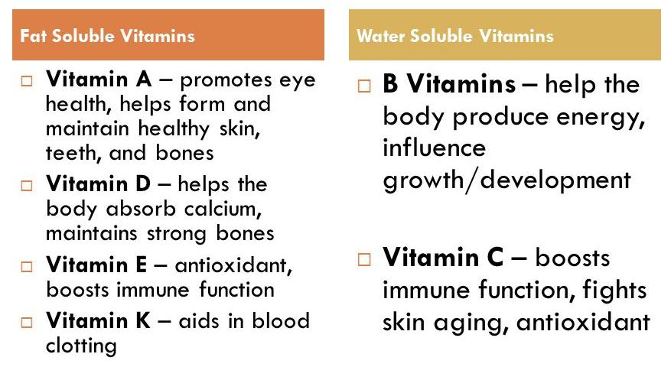
NUTRITION: VITAMINS

Slide 69
NUTRITION: MINERALS
Inorganic essential nutrients that must be obtained from food. They help in structure and regulation and are considered co-factors.

Slide 70
FOOD ENERGY AND ATP
Food is needed to obtain energy and maintain homeostasis.
Carbohydrates (mainly glucose) is the primary source of energy.
Adenosine triphosphate (ATP) is the primary energy source for cells.

Slide 71
ATP
Energy stored in phosphodiester bonds.
ADP is converted into ATP via cellular respiration.
Energy is released when phosphodiester bonds are broken (ATP to ADP).
Required for all cellular functions.
Excess ATP is used in the production of glycogen.
Glycogen is stored in the liver and skeletal muscles.
Storage of excess energy is a vital evolutionary development in helping animals deal with mobility, food shortages, and famine.

Slide 72
OBESITY
Major health concern in the United States.
May lead to other health issues such as type-2 diabetes, cardiovascular diseases, and certain cancers (colon and breast).
Calories per gram…
Carbohydrates = 4
Proteins = 4
Fats = 9
Animals tend to seek lipid-rich foods for their higher energy content.

Slide 73
Signals for hunger and satiety are controlled in the hypothalamus.
Foods that are rich in fatty acids tend to promote satiety.
Excess glucose in the body can result in excess pyruvate production.
Excess pyruvate can be converted into fatty acids that are stored in adipose tissue.
Some animals benefit from obesity, such as polar bears and seals.

Slide 74
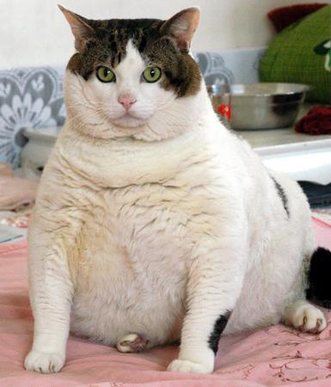
DIET AND OBESITY
Too many calories from any source contributes to body fat.
Increases risk of obesity and associated illnesses

Slide 75
34.3: DIGESTIVE SYSTEM PROCESSES
Obtaining nutrition and energy from food is a multistep process.
Ingestion and propulsion.
Digestion
Absorption
Elimination

Slide 76
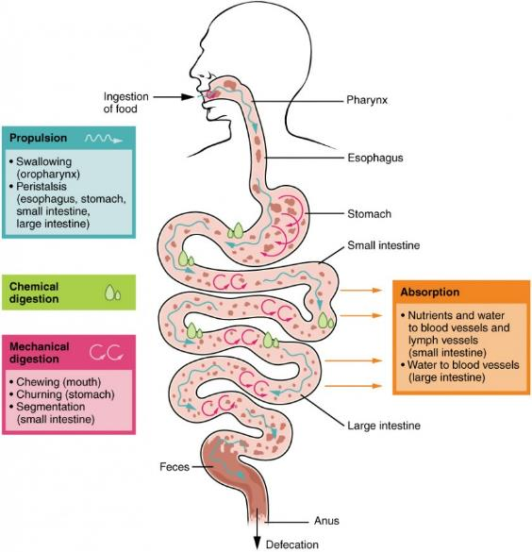
STEPS OF DIGESTION

Slide 77
INGESTION
Taking in food through the mouth.
Teeth, saliva, and tongue play an important role in vertebrates.
Food is modified into a soft mass that can be swallowed.

Slide 78
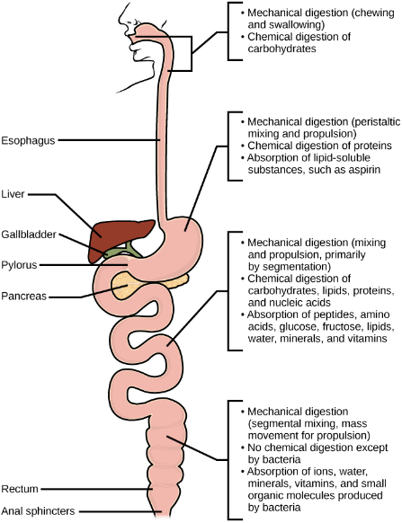
MECHANICAL AND CHEMICAL DIGESTION OF FOOD: FROM MOUTH TO RECTUM

Slide 79
DIGESTION
Food must be broken down into smaller particles to allow for absorption.
Carbohydrates
Digestion begins in mouth with salivary amylase.
Breaks down starches.
Acidic environment in stomach stops that action of amylase.
Digestion is continued in the duodenum.
Pancreatic amylase breaks down starch and glycogen.
Brush border enzymes (maltase, sucrase, and lactase) break down disaccharides into monosaccharides.
Absorption occurs across the intestinal epithelium.

Slide 80
CARBOHYDRATE DIGESTION
Digestion of carbohydrates is performed by several enzymes.
Starch and glycogen are broken down into glucose by amylase and maltase.
Sucrose (table sugar) and lactose (milk sugar) are broken down by sucrase and lactase, respectively.

Slide 81
Protein
Large amount of digestion occurs in the stomach.
Pepsin breaks down proteins into peptides (four to nine amino acids).
Digestion is continued in the duodenum.
Trypsin, elastase, and chymotrypsin reduce peptides into smaller peptides.
Peptidases (carboxypeptidase, dipeptidase, and aminopeptidase) reduce peptides to free amino acids.
Absorption occurs across the intestinal epithelium.

Slide 82
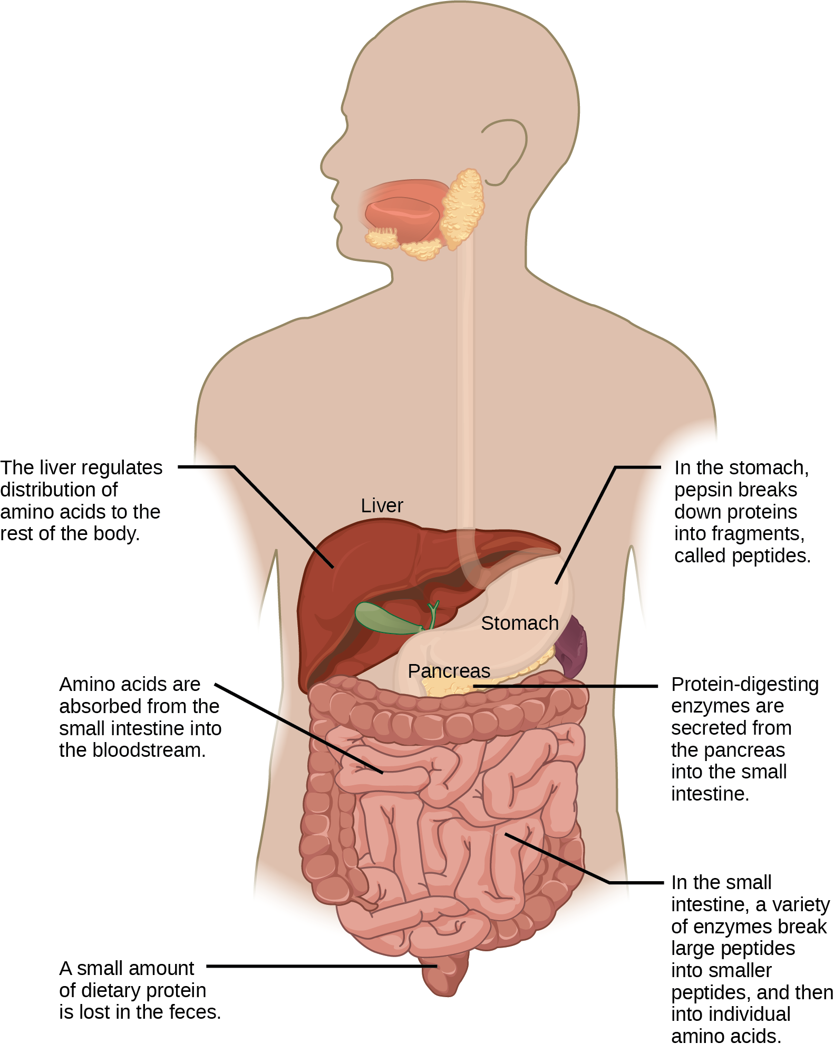
Figure 34.17 Protein digestion is a multistep process that begins in the stomach and continues through the intestines.

Slide 83
Lipids
Digestion begins in the stomach with lingual lipase and gastric lipase.
Bulk of digestion occurs in the small intestine.
Entrance of chyme triggers hormonal response to release bile.
Aids in the digestion of triglycerides.
Emulsifies large lipids globules into several small lipid globules.
Pancreatic lipase breaks down lipids into fatty acids and glycerides.

Slide 84
Lipids (cont.)
Absorption sends chylomicrons into lymphatic vessels that enter the bloodstream via the subclavian vein.
Bile salts surround long-chain fatty acids and monoglycerides forming micelles.
Micelles move into the brush border of the small intestine absorptive cells.
Fatty acids and monoglycerides enter the absorptive cells and form triglycerides.
Triglycerides aggregate and become coated with proteins to become chylomicrons.
Chylomicrons leave the absorptive cells via exocytosis.

Slide 85
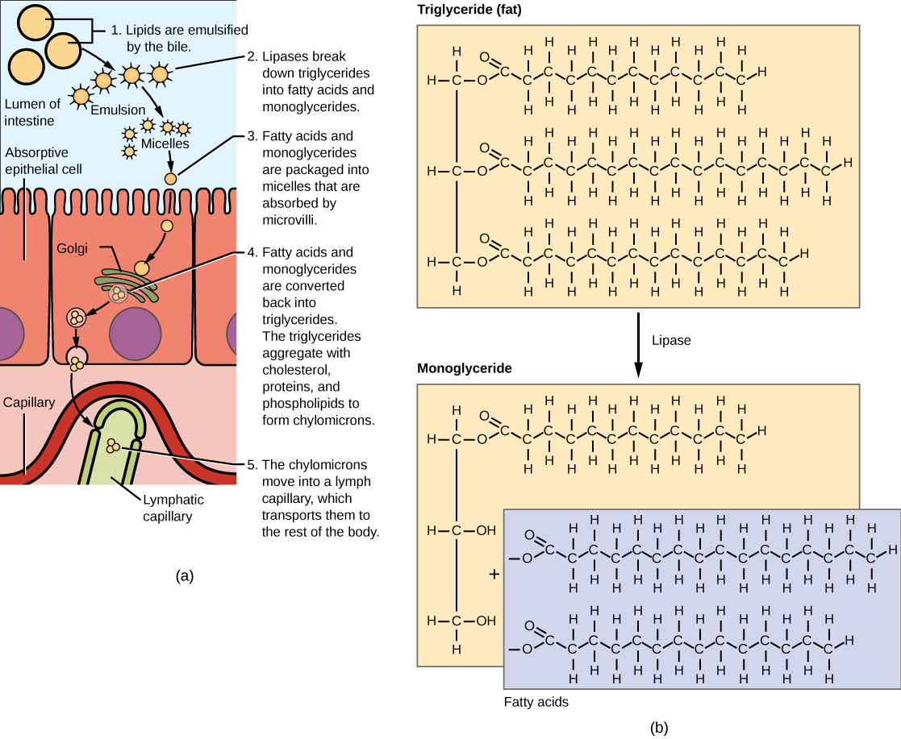
Figure 34.18 Lipids are digested and absorbed in the small intestine.

Slide 86
Vitamins
Fat-soluble vitamins are absorbed in the same manner as lipids.
Water-soluble vitamins can be directly absorbed into the bloodstream form the intestine.

Slide 87
ABSORPTION
Mucous membrane of small intestine
Has ridges and furrows that give it a corrugated surface
Villi are ridges on the surface, which contain even smaller ridges, microvilli
Greatly increase absorptive area
Each villus contains blood capillaries and a lymphatic capillary (lacteal)

Slide 88
ELIMINATION
Final step in digestion.
Removes undigested food material.
Water is reabsorbed in the colon.
Intestinal flora can perform some further digestion.
Semi-solid waste is moved via peristalsis.
As rectum expands in response to storage it triggers the neural signals required to set up the urge to eliminate.
Feces is eliminated out the anus.

Slide 89
Common Problems with Elimination
Constipation = hardened feces due to excess water removal in colon
Diarrhea = insufficient removal of water in colon
Emesis (vomiting) = elimination of food via forceful expulsion through the mouth

Slide 90
34.4: DIGESTIVE SYSTEM REGULATION
The digestive system is regulated through neural and hormonal responses.

Slide 91
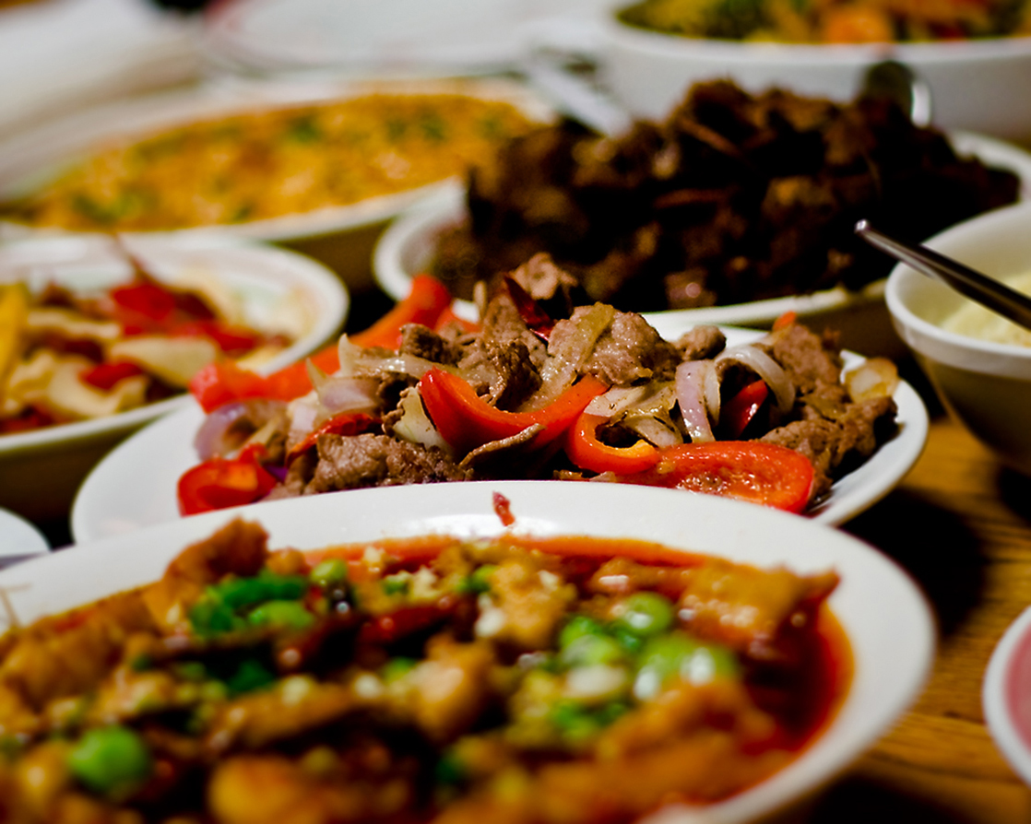
Figure 34.20 Seeing a plate of food triggers the secretion of saliva in the mouth and the production of HCL in the stomach. (credit: Kelly Bailey)

Slide 92
NEURAL RESPONSES TO FOOD
Initial responses to the smell, sight, or thought of food…
Increased salivation (autonomic nervous system).
Increased production of hydrochloric acid in the stomach.
Brain prepares smooth muscle involved in peristalsis.
When the stomach is full the brain detects satiety and signals fullness.

Slide 93
Digestive Phases
Cephalic phase
Neural response to the stimulus provided by food.
Gastric phase
Begins when the food arrives in the stomach.
Stimulated by…
Distension of stomach.
Decrease in the pH of gastric contents.
Presence of undigested material.
Consists of local, hormonal, and neural responses.

Slide 94
Digestive Phases (cont.)
Intestinal phase
Begins when chyme enters the small intestine triggering digestive secretions.
Controls the rate of gastric emptying.
Involves hormonal and neural events that coordinate the activities of the intestinal tract, pancreas, liver, and gallbladder.

Slide 95
The endocrine system controls the response of various glands and the release of hormones at the appropriate time.
Hormonal control of the stomach acid environment.
Gastrin is secreted by G cells during the gastric phase.
Stimulates the release of hydrochloric acid.
When the stomach is emptied somatostatin stops the release of hydrochloric acid.

Slide 96
Hormonal control in the duodenum.
Secretin stimulates the pancreas to produce an alkaline bicarbonate solution.
Cholecystokinin (CKK) stimulates the pancreas to produce pancreatic juices and the gallbladder to release bile.
Gastric inhibitory peptide is secreted by the small intestine in response to fatty foods.
Slows down peristaltic movements.

