Slide 1


BIOLOGY 2e
Chapter 37 ENDOCRINE SYSTEM
PowerPoint Image Slideshow
This work is licensed under a Creative Commons Attribution-NonCommercial-ShareAlike 4.0 International License.

Slide 2
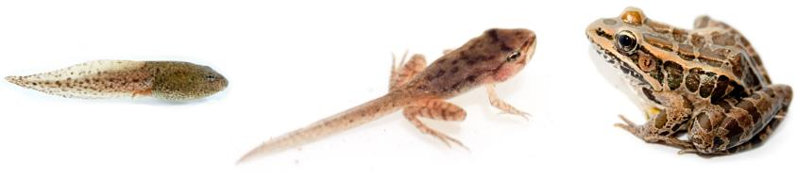
Introduction
The endocrine system is a series of organs and tissues that controls body processes by the production, secretion, and regulation of hormones.
Hormones are chemical messengers that function to maintain homeostasis.
Here is an example of what hormones can do:
The process of amphibian metamorphosis, as seen in the tadpole-to-frog stages shown here, is driven by hormones. (credit “tadpole”: modification of work by Brian Gratwicke)

Slide 3
Comparison of Nervous & Endocrine Systems
Nervous System
Controlled through nerve impulses
Responses occur within milliseconds
Relatively local, specific effects
Stops when stimulus stops, adapts quickly
Endocrine System
Controlled through hormones transported in the blood
Responses occur seconds to days
Widespread general effects
Prolonged responses that adapt slowly

Slide 4
Hormones
Hormone
  Regulatory chemical that is secreted into extracellular fluid and carried by the blood
  Can act at a distance from source
  Multicellular animals need hormones to help homeostasis
    Hormone will travel to cell that has receptor for that hormone, attachment to the receptor will induce cellular response
  Watch this video:
  https://www.youtube.com/watch?v=A0Run0HcubE

Slide 5
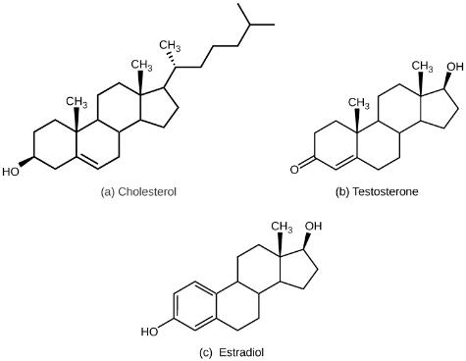
Lipid-derived hormones
The structures shown here represent (a) cholesterol, plus the steroid hormones (b) testosterone and (c) estradiol, which are derived from cholesterol. These remain active for a relatively long period of time. Steroid hormones are chemically alcohols (with -OH group and name ending in -ol) or ketones (with C=O group and name ending in -one).

Slide 6
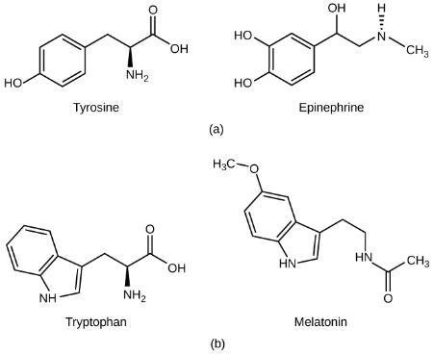
Amino Acid-derived hormones
(a) The hormone epinephrine, which triggers the fight-or-flight response, is derived from the amino acid tyrosine. (b) The hormone melatonin, which regulates circadian rhythms, is derived from the amino acid tryptophan. These hormones are only active for a short period of time.

Slide 7
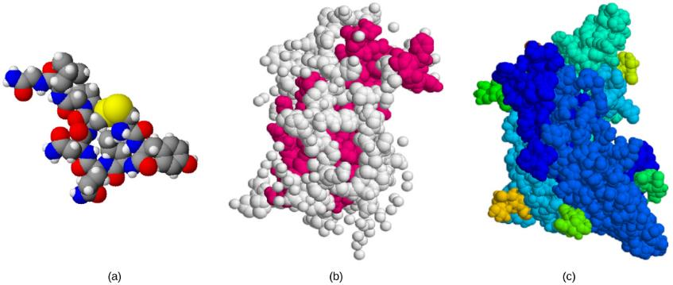
Peptide Hormones
The structures of peptide hormones (a) oxytocin, (b) growth hormone, and (c) follicle stimulating hormone are shown. These peptide hormones are much larger than those derived from cholesterol or amino acids.

Slide 8
How Hormones Work
Hormones are very specific
  A cell needs a specific receptor in order for a hormone to work
  Receptors may be found on many different cells or limited to a small number of specialized cells
  Hormone receptors may be found within the cell or on the plasma membranes
  Receptor number can change with cellular activity
      Up-regulation, there is an increase in receptor number, so the cell is more responsive
      Down-regulation, there is a decrease in receptor number, so cell activity is decreased

Slide 9
Intracellular Hormone Receptors
Lipid-derived hormones bind to transport proteins
Lipid derived hormones, due to their chemical nature, can diffuse across plasma membrane of cells.
Once they reach the target cell, they are released from their carrier protein and pass through the plasma membrane and bind to a target receptor which is intracellular.
The hormone/receptor complex regulates transcription by increasing or decreasing the synthesis of mRNA which changes the amount of a specific protein made.

Slide 10
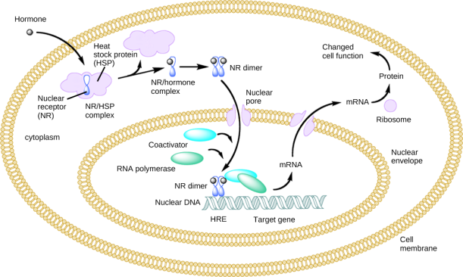
Intracellular Hormone Receptors
An intracellular nuclear receptor (NR) is located in the cytoplasm bound to a heat shock protein (HSP). Upon hormone binding, the receptor dissociates from the heat shock protein and translocates to the nucleus. In the nucleus, the hormone-receptor complex binds to a DNA sequence called a hormone response element (HRE), which triggers gene transcription and translation. The corresponding protein product can then mediate changes in cell function.

Slide 11
Plasma membrane Hormone Receptors
Non lipid-derived hormones cannot pass through the plasma membrane
Cannot directly affect the target cell since they are hydrophilic
Once they reach the target cell, they bind to a plasma membrane receptor which activates a signaling pathway.
This pathway often activates a second messenger within the cell

Slide 12
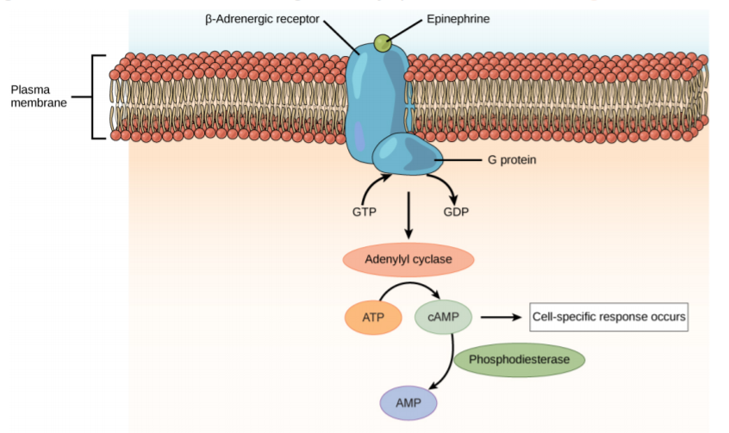
Plasma membrane receptors: Figure 37.6
The amino acid-derived hormones epinephrine and norepinephrine bind to betaadrenergic receptors on the plasma membrane of cells. Hormone binding to receptor activates a G-protein, which in turn activates adenylyl cyclase, converting ATP to cAMP. cAMP is a second messenger that mediates a cell-specific response. An enzyme called phosphodiesterase breaks down cAMP, terminating the signal.

Slide 13
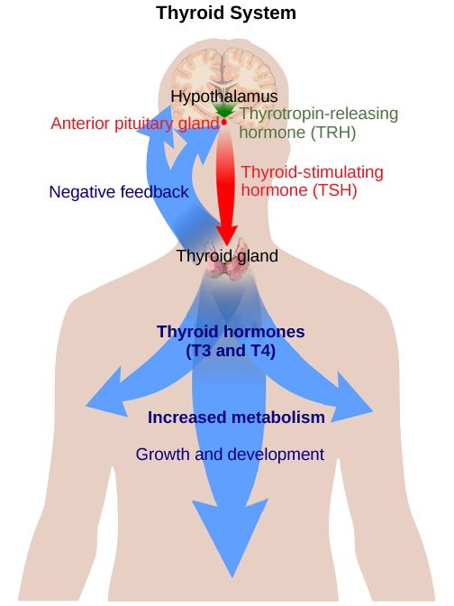
Regulation of hormone production: Figure 37.14
Most hormone levels are determined by the process of negative feedback. For example, the anterior pituitary stimulates the thyroid gland to release thyroid hormones T₃ and T₄. Increasing levels of these hormones in the blood results in feedback to the hypothalamus and anterior pituitary to inhibit further signaling to the thyroid gland. (credit: modification of work by Mikael Häggström)

Slide 14
Hormonal Regulation of Body Processes
Excretory System
Antidiuretic hormone (ADH) which is also known as vasopressin
  Produced by hypothalamus
  Regulates amount of water excreted by kidneys therefore regulating blood pressure
  Released when water levels of blood is low which is determined by osmoreceptors
  Underproduction causes diabetes insipidus (NOT mellitus!)

Slide 15
Excretory System
Aldosterone (steroid hormone)
  Produced by adrenal cortex
  Regulates the amount of water indirectly by managing electrolytes such as sodium and potassium
  Released due to the signaling of the renin angiotensin system, whereas ADH is released with the function of osmo-receptors

Slide 16
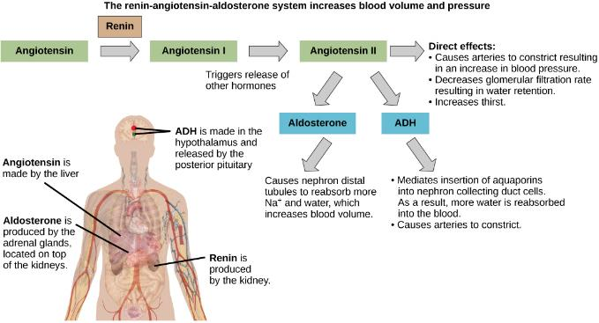
Excretory system: Figure 37.7
ADH and aldosterone increase blood pressure and volume. Angiotensin II stimulates release of these hormones. Angiotensin II, in turn, is formed when renin cleaves angiotensin. (credit: modification of work by Mikael Häggström)

Slide 17
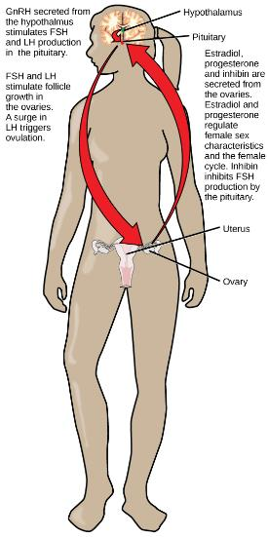
Reproductive System
Follicle Stimulating Hormone (FSH)
  Males: maturation of sperm cells
  Females: development of egg cells
Luteinizing Hormone (LH)
  Males: production of testosterone
  Females: surge causes ovulation
Oxytocin
  Stimulates uterine contraction during childbirth

Slide 18
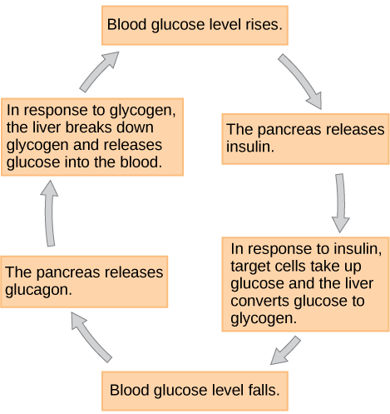
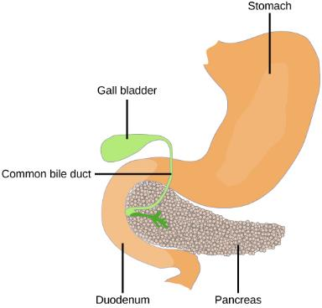
Metabolism: Pancreas
Insulin
  Produced by beta cells of pancreas
  Lowers blood sugar by
  increasing cellular uptake and utilization by cells
  Deficiency results in diabetes mellitus
Glucagon
  Antagonist to insulin
  Produced by alpha cells of pancreas
  Raises blood sugar by targeting liver to break down glycogen
glucagon
The pancreas is found underneath the stomach and points toward the spleen. (credit: modification of work by NCI)

Slide 19
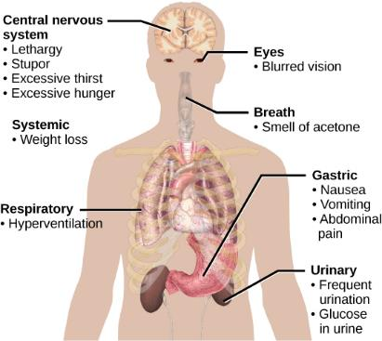
Metabolism: Figure 37.10
The main symptoms of diabetes are shown. (credit: modification of work by Mikael Häggström)

Slide 20
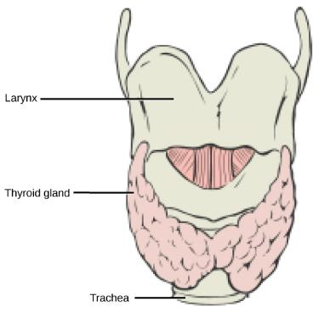
Metabolism: Thyroid
Basal metabolic rate (amount of calories required by body at rest) is determined by thyroxine (T₄) and triiodothyronine (T₃).
Released from thyroid gland in response to stimulation by TSH produced by the anterior pituitary
Hypothyroidism = low metabolic rate
  Weight gain, sensitivity to cold, lethargy
  Mistaken for depression
Hyperthyroidism = high metabolic rate
  Weight loss, irritability, increased heart rate
  Mistaken for hyperactivity

Slide 21
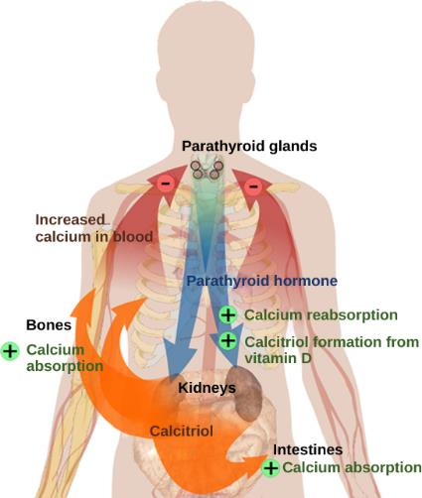
Hormonal Control of Blood Calcium
Calcium regulated by:
  PTH (produced by parathyroid glands)
    Released in response to low blood calcium levels
  Antagonist is Calcitonin (produced by thyroid gland)
    Antagonist hormone that decreases blood calcium levels

Slide 22
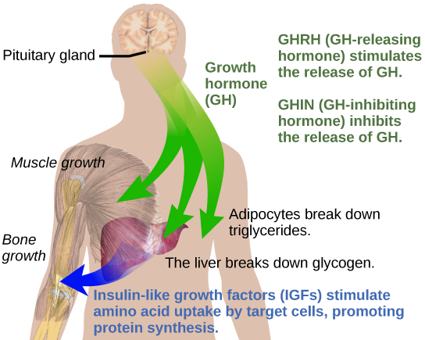
Hormonal Control of Growth
Growth and cell replication regulated by:
  GH (Growth Hormone)
    Stimulates growth, cell reproduction, and cell regeneration
      Increases rate of protein synthesis
      Is glucose sparing since causes a switch to using fatty acids for energy
    Regulated by the
    hypothalamus

Slide 23
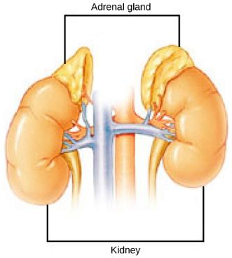
Hormonal Control of Stress
Short Term Stress
  Epinephrine for “fight or flight” from adrenal gland
Long Term (Chronic) Stress
  Cortisol from adrenal gland
    Anti-inflammatory, and also suppresses the immune system which can result in more infections and higher risk of cancer
    End result of the activation of the hypothalamus-pituitary-adrenal (HPA) axis

Slide 24
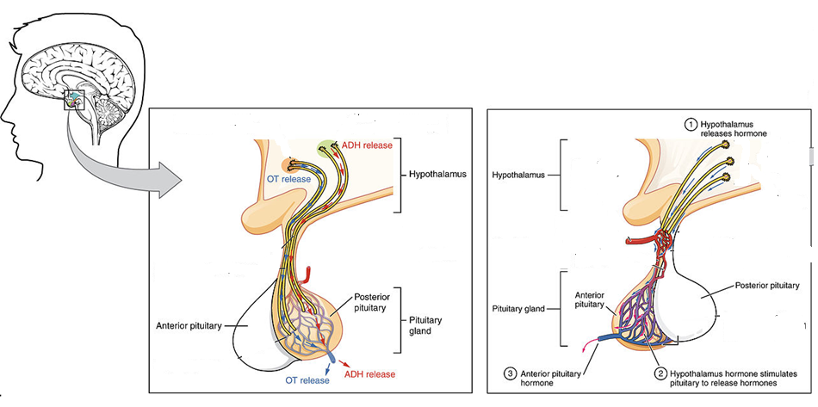
The Pituitary Gland
Also known as the hypophysis
Hangs by a stalk from the hypothalamus

Slide 25
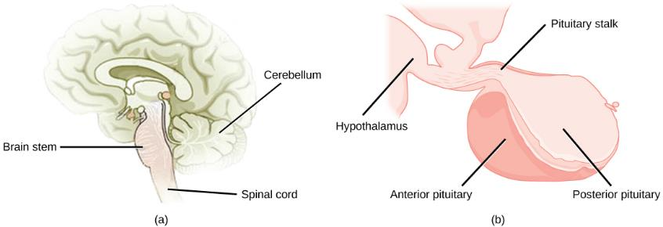
The Pituitary Gland
Consists of two parts
  Anterior pituitary (adenohypophysis)
    Appears glandular
    Not part of brain
    Hypothalamus releases neurohormones here, causing the anterior pituitary to release tropic hormones which then work on other endocrine glands
  Posterior pituitary (neurohypophysis)
    Appears fibrous
    Part of brain

Slide 26
The Anterior Pituitary
Produces at least 7 essential hormones
  Peptide Hormones
    Adrenocorticotropic hormone (ACTH) – stimulates adrenal to make cortisol
    Melanin-stimulating hormone (MSH) – stimulates dispersion of pigment
  Protein Hormones
    Growth hormone (GH)
    Prolactin (PL) – stimulate mammary glands
  Glycoprotein Hormones
    Thyroid-stimulating hormone (TSH) – acts on thyroid
    Luteinizing hormone (LH) – acts on ovaries, testes
    Follicle-stimulating hormone (FSH) – development of ovarian follicles, development of sperm

Slide 27
The Posterior Pituitary
2 hormones are produced in the hypothalamus, and stored in special cells in the posterior pituitary.
  Antidiuretic hormone (ADH)
  Oxytocin

