Slide 1
BIOLOGY 2E
Chapter 39 RESPIRATORY SYSTEM
PowerPoint Image Slideshow
This work is licensed under a Creative Commons Attribution-NonCommercial-ShareAlike 4.0 International License.

Slide 2
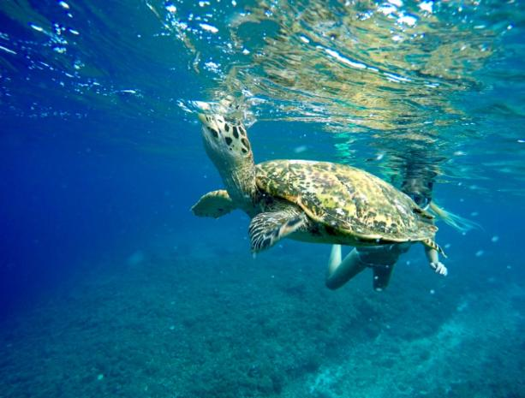
GAS EXCHANGE
All cells require oxygen for use in the efficient production of energy through cellular respiration
One of the major physiological challenges facing all multicellular animals is obtaining sufficient oxygen and disposing of excess carbon dioxide
Caption: Sea Turtle Breath Underwater © dronepicr, License

Slide 3
GAS EXCHANGE
Gases diffuse directly into unicellular organisms
Small organisms can rely on direct diffusion of gases
However, most multicellular animals require system adaptations to enhance gas exchange
Amphibians respire across their skin as well as lungs
Insects have an extensive tracheal system
Fish use gills
Mammals have a large network of alveoli in lung tissue

Slide 4
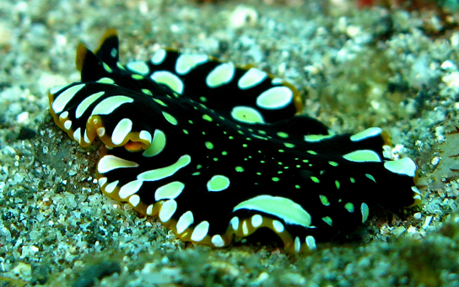
DIRECT DIFFUSION
Gas exchange by diffusion across the outer membrane
Cells are kept moist and gases diffuse down respective gradient
Flatworms, cnidarians
(credit: Stephen Childs)

Slide 5
SKIN
Dense network of capillaries lies just below skin
Facilitates gas exchange between the external environment and circulatory system
Respiratory surface must be kept moist
Earthworms, amphibians

Slide 6
GILLS
Fish and many other aquatic organisms
Thin tissue filaments that are highly branched and folded
When water passes over, the dissolved oxygen in water rapidly diffuses across the gills into the body fluids
credit: "Guitardude012"/Wikimedia Commons

Slide 7
GILLS AND DIFFUSION OF GASES
credit "fish": modification of work by Duane Raver, NOAA

Slide 8
TRACHEAL SYSTEMS
Consists of a network of small tubes that carries oxygen to the entire body
Most direct and efficient respiratory system in active animals
Air enters and exit via spiracles located along the thorax and abdomen
Insects

Slide 9
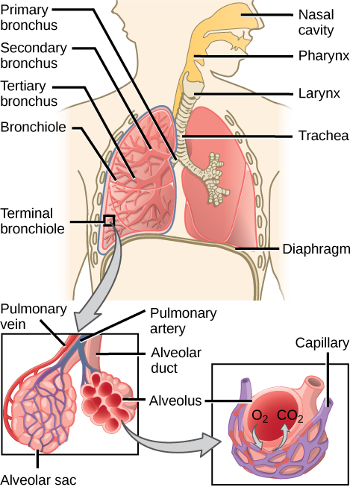
LUNGS
Lungs of mammals are packed with millions of alveoli (sites of gas exchange)
Inhaled air passes through the larynx, glottis, and trachea
Then passes into the right and left bronchi, which enter each lung and further subdivide into bronchioles
Alveoli are surrounded by an extensive capillary network

Slide 10
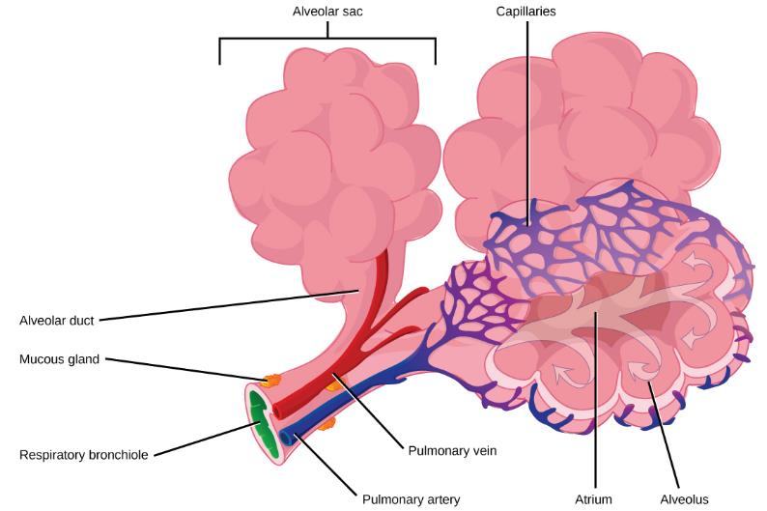
LUNGS

Slide 11
GAS EXCHANGE
Occurs primarily through diffusion
Respiratory surfaces must be kept moist in order for gases to dissolve and diffuse
Gas molecules move from area of high to low concentration
Affected by partial pressures and solubility of gases
Carbon dioxide is ~20 times more soluble than oxygen

Slide 12
AIR PRESSURE
Air exerts a pressure downward, due to gravity
A pressure of 760 mm Hg is defined as one atmosphere (1.0 atm) of pressure
Partial pressure is the pressure contributed by a gas to the total atmospheric pressure

Slide 13
Composition of Atmospheric Air and Partial Pressures at Sea Level (Total Air Pressure = 760 mmHg)
Gas | Percent of Air* | Partial Pressure (mmHg)*
Nitrogen | 78.6% | 597.36
Oxygen | 20.9% | 158.84
Water Vapor | 0.5% | 3.80
Carbon Dioxide | 0.04% | 0.304
Partial Pressure of Nitrogen: 760 X 78.6% = 597.36 mmHg
* Partial pressures calculated using percentages taken from Biology, 2e.

Slide 14
Partial Pressure at Different Altitudes
At 5364 m (17,598 ft.) the atmospheric pressure is 401 mmHg, this is the pressure at base camp 1 on Mount Everest.
PO₂ = 401 × 20.95% = 84 mmHg
Notice that the % of oxygen is the same at this altitude as it is at sea level but the partial pressure of oxygen is lower
This is why most climbers on Mount Everest use supplemental oxygen!

Slide 15
GAS EXCHANGE BETWEEN ALVEOLI AND BLOOD
In vertebrates, the gases diffuse into the aqueous layer covering the epithelial cells that line the respiratory organs
Diffusion is passive, driven only by the difference in O₂ and CO₂ concentrations on the two sides of the membranes and their relative solubility in the plasma membrane
High O₂ in alveoli results in O₂ diffusing into blood
High CO₂ in blood in CO₂ diffusing into alveoli
Opposite Occurs in the Tissue

Slide 16
GAS EXCHANGE

Slide 17
TYPES OF BREATHING
Amphibians
Tadpoles – use gills
In most amphibians – as tadpoles grow, gills disappear and lungs grow
Lack diaphragm – positive pressure breathing

Slide 18
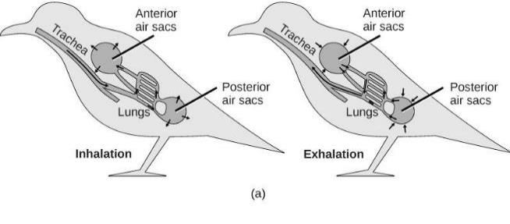
TYPES OF BREATHING - BIRDS
Lungs of birds have unidirectional flow
Watch this video: https://www.youtube.com/watch?v=kWMmyVu1ueY
Download for free at http://cnx.org/contents/185cbf87-c72e-48f5-b51e-f14f21b5eabd@10.61

Slide 19
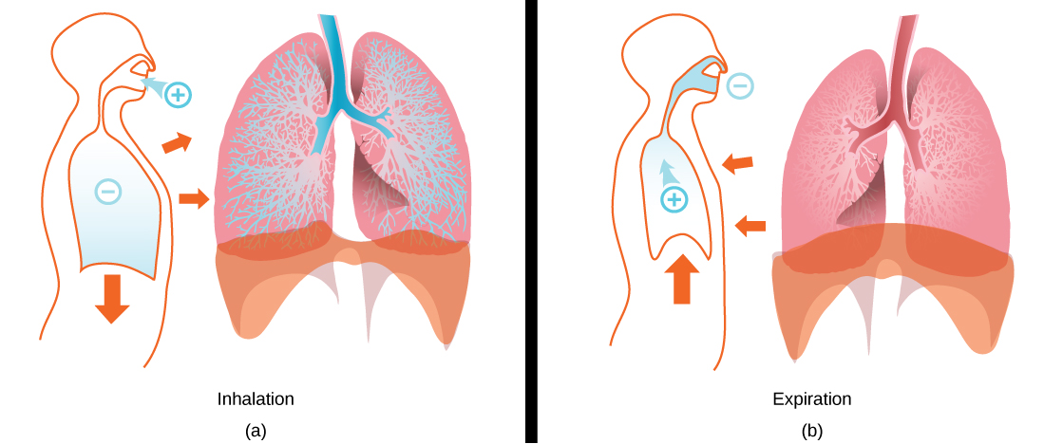
LUNG STRUCTURE AND FUNCTION
During inhalation, thoracic volume increases through contraction of two muscle sets
Contraction of the external intercostal muscles expands the rib cage
Contraction of the diaphragm expands the volume of thorax and lungs
Produces pressure gradient which draws air into the lungs
Image credit: modification of work by Mariana Ruiz Villareal

Slide 20
LUNG STRUCTURE AND FUNCTION
During exhalation, thoracic volume decreases through relaxation of diaphragm and external intercostal muscles
Produces pressure gradient which causes air movement out of lungs
Image credit: modification of work by Mariana Ruiz Villareal

Slide 21
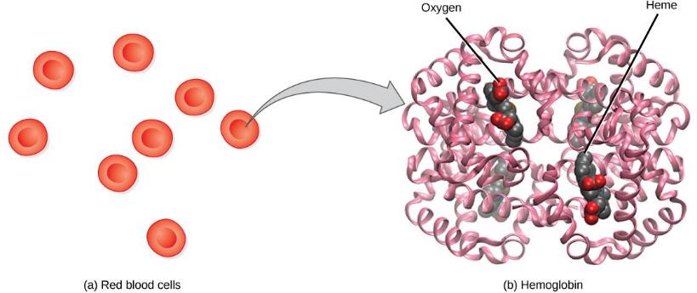
HEMOGLOBIN
Consists of four polypeptide chains: two α and two β
Each chain is associated with a heme group
Each heme group has a central iron atom that can bind a molecule of O₂
Hemoglobin loads up with oxygen in the lungs, forming oxyhemoglobin
Download for free at http://cnx.org/contents/185cbf87-c72e-48f5-b51e-f14f21b5eabd@10.61

Slide 22
HEMOGLOBIN
Hemoglobin’s affinity for O₂ is affected by pH and temperature
The pH effect is known as the Bohr shift
Increased CO₂ in blood increases H+
Lower pH reduces hemoglobin’s affinity for O₂
Facilitates oxygen unloading in the tissue
If there is high levels of CO₂, that means that oxygen is needed – the hemoglobin lets go of the oxygen
Increasing temperature has a similar effect

Slide 23
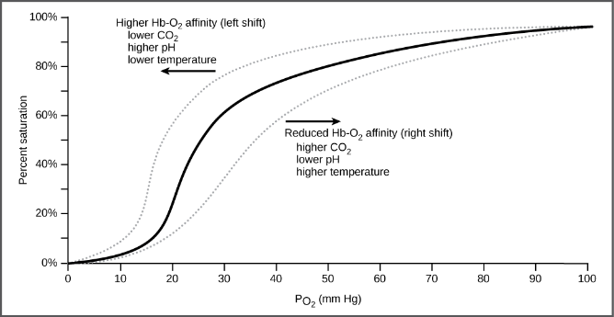
HEMOGLOBIN
The oxygen dissociation curve demonstrates that, as the partial pressure of oxygen increases, more oxygen binds hemoglobin. However, the affinity of hemoglobin for oxygen may shift to the left or the right depending on environmental conditions.
Download for free at http://cnx.org/contents/185cbf87-c72e-48f5-b51e-f14f21b5eabd@10.61

Slide 24
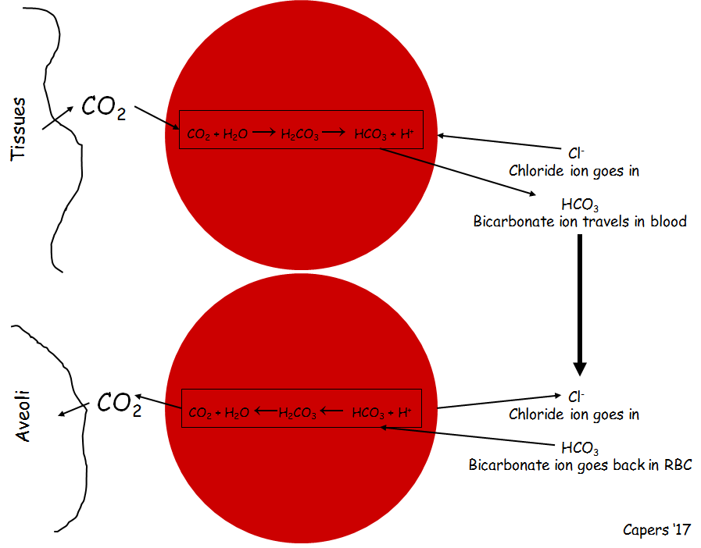
TRANSPORTATION OF CARBON DIOXIDE
Not the same as oxygen
About 8% of the CO₂ in blood is dissolved in plasma
20% of the CO₂ in blood is bound to hemoglobin
Remaining 72% diffuses into red blood cells and becomes bicarbonate

