Slide 1
BIOLOGY 2E
Chapter 41 OSMOTIC REGULATION AND EXCRETION
PowerPoint Image Slideshow
This work is licensed under a Creative Commons Attribution-NonCommercial-ShareAlike 4.0 International License.

Slide 2
OSMOREGULATION
Osmoregulation is the process of maintenance of salt and water balance (osmotic balance) across membranes within the body’s fluids.
Both electrolytes and non-electrolytes contribute to the osmotic balance.
Review osmolality and milliequivalents

Slide 3
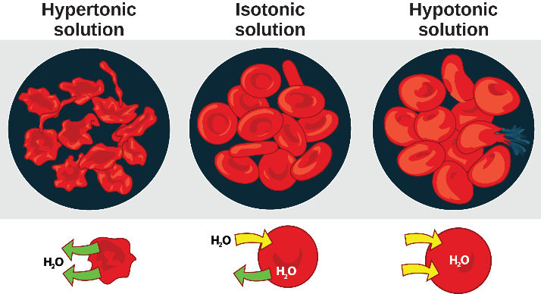
TONICITY
Cells placed in a hypertonic environment tend to shrink due to loss of water. In a hypotonic environment, cells tend to swell due to intake of water.
Image credit: Mariana Ruiz Villareal

Slide 4
OSMOREGULATORS AND OSMOCONFORMERS
Most marine organisms must live in specific environments; some, however, can live in a range.
Osmoregulators have evolved mechanisms to adapt to a variety of environments
The “cost”: Energy
Osmoconformers: Internal environment is isotonic to the external environment.
Restricted to certain environments, but expend less energy on osmoregulation.

Slide 5
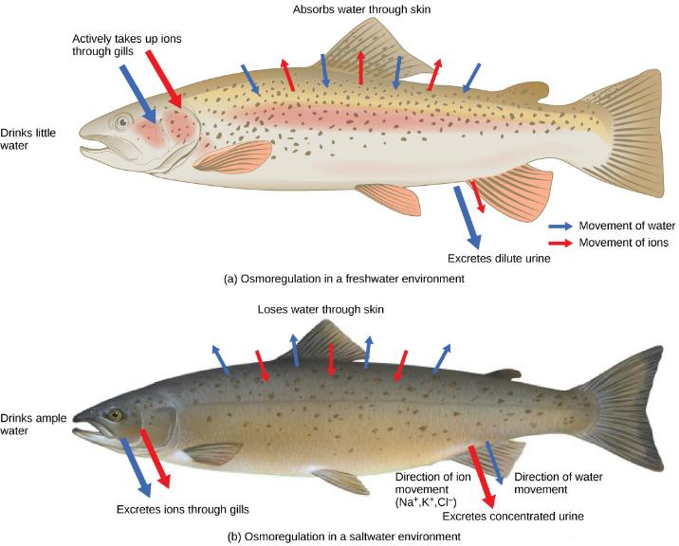
OSMOREGULATORS IN FRESHWATER VS. SALTWATER
credit: modification of work by Duane Raver, NOAA

Slide 6
AQUATIC ANIMALS
Invertebrates
Most are isotonic with water they live in
Osmoconformers
Bony Fishes
Body fluids of bony fishes with only moderate amount of salt
Osmoregulators
Some manage to adjust to both, salt and fresh water (salmon), most cannot.
Cartilaginous fishes (sharks, rays…)
Achieve isotonicity by having high concentrations of organic compounds (urea in blood)

Slide 7
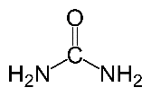
NITROGENOUS WASTE PRODUCTS
Catabolism of amino acids and nucleic acids results in ammonia
High solubility permits it to be excreted directly by many aquatic animals
Terrestrial animals must convert ammonia to urea or uric acid
Urea causes loss of much water per unit of nitrogen
Mammals and amphibians
Must drink lots of water
Uric acid requires much less water per unit of nitrogen excreted
Reptiles, birds, and arthropods
Allows invasion of drier habitats far from standing water

Slide 8
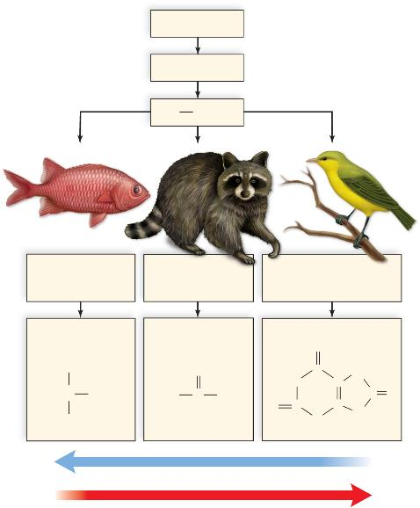
NITROGENOUS WASTES
proteins
amino acids
NH₂
most fishes and
other aquatic
animals
adult amphibians,
sharks, and
mammals
Insects, birds, and
reptiles
ammonia
urea
uric acid
O
H
O
C
H
HN
C
N
N
H
H₂N
C
NH₂
O
C
C
O
N
C
N
H
H
H
water needed to excrete
energy needed to produce

Slide 9
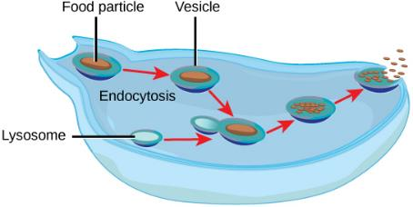
EXCRETORY ORGANS IN INVERTEBRATES
Some unicellular organisms excrete wastes by exocytosis

Slide 10
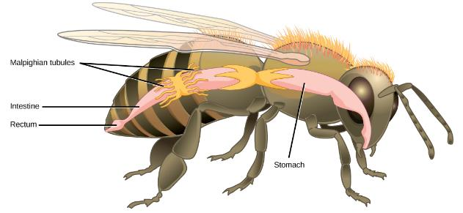
EXCRETORY ORGANS IN INVERTEBRATES
Most animals have tubular excretory organs
Regulate the water-salt balance of the body
Excrete metabolic wastes into the environment
Flame Cells in Planarians
Nephridia in Earthworms
Malpighian Tubules in Insects

Slide 11
TERRESTRIAL ANIMALS
Terrestrial animals lose water through excretion and respiration
Must drink water to make up for loss
Some reduce water loss by excreting nitrogen as relatively insoluble uric acid
Certain animals also have a highly convoluted nasal passage with a mucous membrane surface (salt excretion)
Albatross and Marine Iguana

Slide 12
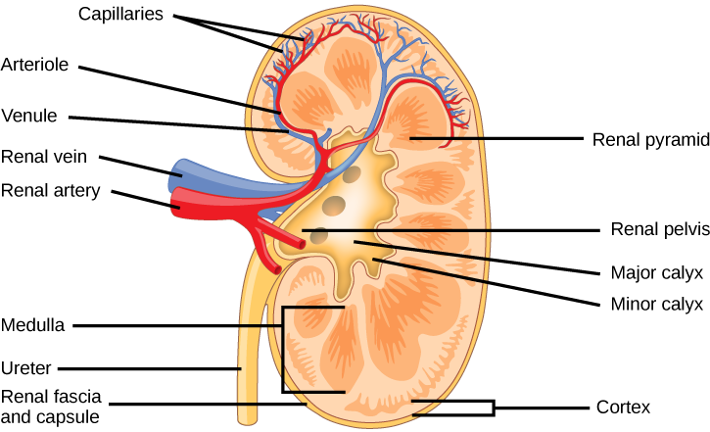
KIDNEYS

Slide 13
NEPHRONS
Each kidney composed of many tubular nephrons
Each nephron composed of several parts
Glomerular capsule
Glomerulus
Proximal convoluted tubule
Loop of the nephron
Distal convoluted tube
Collecting duct

Slide 14
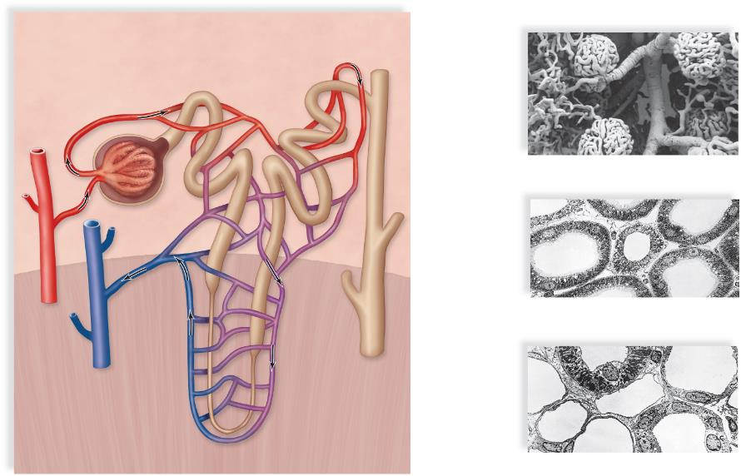
NEPHRON ANATOMY
Renal Cortex
peritubular capillary
glomerular capsule
(Bowman's capsule)
proximal
convoluted
tubule
distal
convoluted
tubule
afferent arteriole
glomerulus
efferent arteriole
efferent
arteriole
glomerulus
b. Surface view of glomerulus and its blood supply
afferent arteriole
distal
convoluted tubule
microvilli
proximal
convoluted tubule
venule
c. Cross sections of proximal and distal convoluted
tubules
20 µm
renal
artery
renal vein
peritubular
capillary
network
ascending limb
collecting duct
descending limb
Loop of the nephron (loop of Henle)
capillaries
descending limb
ascending limb
collecting duct
Renal Medulla
d. Cross sections of a loop of nephron limbs and
collecting duct. (The other cross sections are
those of capillaries.)
10 µm
a. Anephron and its blood supply

Slide 15
URINE FORMATION
Urine production requires three distinct processes:
Glomerular filtration in glomerular capsule
Tubular reabsorption at the proximal convoluted tubule
Tubular secretion at the distal convoluted tubule

Slide 16
URINE FORMATION AND HOMEOSTASIS
Excretion of hypertonic urine
Dependent upon the reabsorption of water
Absorbed from
Loop of the nephron, and
The collecting duct
Osmotic gradient within the renal medulla causes water to leave the descending limb along its entire length
Antidiuretic hormone (ADH)
Plays a role in water reabsorption
Released by the posterior lobe of the pituitary gland (brain)

Slide 17
MAINTENANCE OF BLOOD PH, OSMOLARITY, VOLUME AND PRESSURE
More than 99% of sodium filtered at glomerulus is returned to blood at the distal convoluted tubule
Reabsorption of sodium (/water) regulated by hormones
Aldosterone
Renin (made by adrenal glands when blood pressure is low)
Atrial Natriuretic Peptide Hormone (ANP) (made by heart when blood volume is high)
pH adjusted by either
The reabsorption of the bicarbonate ions, or
The secretion of hydrogen ions

Slide 18
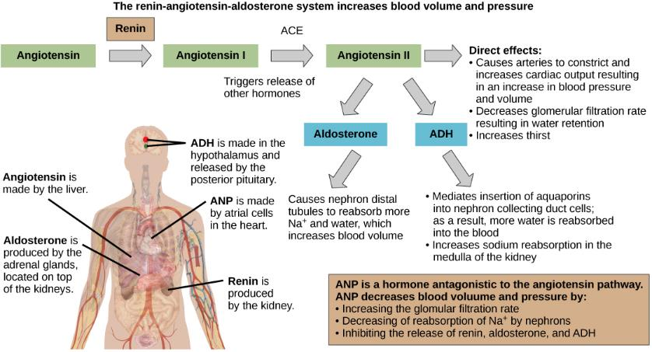
HORMONAL CONTROL

Slide 19
HORMONAL CONTROL
Hormones That Affect Osmoregulation
Hormone | Where produced | Function
Epinephrine and Norepinephrine | Adrenal medulla | Can decrease kidney function temporarily by vasoconstriction
Renin | Kidney nephrons | Increases blood pressure by acting on angiotensinogen
Angiotensin | Liver | Angiotensin II affects multiple processes and increases blood pressure
Aldosterone | Adrenal cortex | Prevents loss of sodium and water
Anti-diuretic hormone (vasopressin) | Hypothalamus (stored in the posterior pituitary) | Prevents water loss
Atrial natriuretic peptide | Heart atrium | Decreases blood pressure by acting as a vasodilator and increasing glomerular filtration rate; decreases sodium reabsorption in kidneys

