Slide 1
BIOLOGY 2E
Chapter 44 ECOLOGY AND THE BIOSPHERE
PowerPoint Image Slideshow
This work is licensed under a Creative Commons Attribution-NonCommercial-ShareAlike 4.0 International License.

Slide 2
ECOLOGY
Scientific study of the interactions between organisms
The interactions study by ecologists can be arranged into a hierarchy
Organismal Ecology: Study adaptations that enable individuals to live in specific habitats. These adaptations can be morphological, physiological, and behavioral.
Population Ecology: Focus on the number of individuals in an area and how and why population size changes.
Community Ecology: Study the processes driving interactions between species, as well as their consequences.
Ecosystem Ecology: Study the storage and movement of nutrients and energy among organisms and the surrounding atmosphere, soil, and water.

Slide 3
LEVELS OF STUDY
Ecologists study within several biological levels of organization. (credit “organisms”: modification of work by “Crystl”/Flickr; credit “ecosystems”: modification of work by Tom Carlisle, US Fish and Wildlife Service Headquarters; credit “biosphere”: NASA)

Slide 4
CLIMATE VS. WEATHER
For example, a cold week in June in Indiana may seem unusual, but it is a weather-related event rather than a climate-related one.
Climate refers to the long-term, predictable atmospheric conditions of a specific area.
Weather refers to the conditions of the atmosphere during a short period of time.

Slide 5
BIOMES
Areas characterized by vegetation type in terrestrial settings or by physical environment in aquatic settings
Life is distributed throughout these areas
Climate largely determines the terrestrial biomes
annual amount of precipitation and its fluctuations
temperature variation on a daily and seasonal basis
Physical and chemical factors determine the aquatic biomes
temperature variation, salinity, oxygen availability, etc.

Slide 6
TERRESTRIAL BIOMES
Each of the world’s major biomes is distinguished by characteristic temperatures and amounts of precipitation. Polar ice and mountains are also shown.

Slide 7
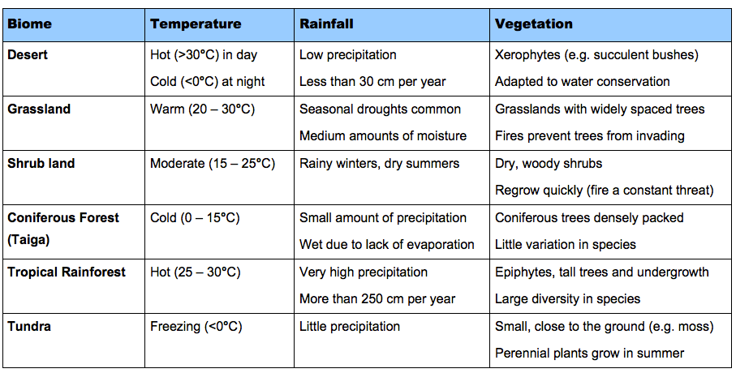
TERRESTRIAL BIOMES

Slide 8
TROPICAL FOREST
Tropical wet forests, such as these forests of Madre de Dios, Peru, near the Amazon River, have high species diversity. (credit: Roosevelt Garcia)

Slide 9
SAVANNA
Savannas, like this one in Taita Hills Wildlife Sanctuary in Kenya, are dominated by grasses. (credit: Christopher T. Cooper)

Slide 10
DESERT
To reduce water loss, many desert plants have tiny leaves or no leaves at all. The leaves of ocotillo (Fouquieria splendens), shown here in the Sonora Desert near Gila Bend, Arizona, appear only after rainfall, and then are shed.

Slide 11
CHAPARRAL – SCRUB FOREST
The chaparral is dominated by shrubs. (credit: Miguel Vieira)

Slide 12
TEMPERATE GRASSLAND
The American bison (Bison bison), more commonly called the buffalo, is a grazing mammal that once populated American prairies in huge numbers. (credit: Jack Dykinga, USDA Agricultural Research Service)

Slide 13
TEMPERATE FOREST
Deciduous trees are the dominant plant in the temperate forest. (credit: Oliver Herold)

Slide 14
BOREAL FOREST -- TAIGA
The boreal forest (taiga) has low lying plants and conifer trees. (credit: L.B. Brubaker)

Slide 15
TUNDRA
Low-growing plants such as shrub willow dominate the tundra landscape, shown here in the Arctic National Wildlife Refuge. (credit: USFWS Arctic National Wildlife Refuge)

Slide 16
AQUATIC BIOMES
The ocean is divided into different zones based on water depth and distance from the shoreline.

Slide 17
OCEAN
Intertidal zone – oceanic region closest to land
Variable environment due to tides
Neritic zone –
Intertidal zone to depts of 200 m
Continental shelf
Pelagic zone –
Open ocean
Plankton serve as base of the food chain
Photic and aphotic zone
Benthic realm –
Deep-water region beyond continental shelf
Bottom is composed of sand, silt, dead organisms
Nutrient-rich
Abyssal zone – depths 4000+ meters
Cold, high pressure, nutrient poor
Hydrothermal vents
Sea urchins, mussel shells, and starfish are often found in the intertidal zone, shown here in Kachemak Bay, Alaska. (credit: NOAA)

Slide 18
CORAL REEFS
Coral reefs are formed by the calcium carbonate skeletons of coral organisms, which are marine invertebrates in the phylum Cnidaria. (credit: Terry Hughes)

Slide 19
ESTUARIES
Occur where a source of fresh water meets the ocean
Rapid variation in salinity due to missing of fresh and salt water
Brackish water
Many estuarine plants are halophytes
Behavioral adaptations of many animals

Slide 20
LAKES
The uncontrolled growth of algae in this lake has resulted in an algal bloom. (credit: Jeremy Nettleton)

Slide 21
WETLANDS
Located in southern Florida, Everglades National Park is vast array of wetland environments, including sawgrass marshes, cypress swamps, and estuarine mangrove forests. Here, a great egret walks among cypress trees. (credit: NPS)

Slide 22
GLOBAL CLIMATE CHANGE
Global climate change is the term used to describe altered global weather patterns, including a worldwide increase in temperature, due largely to rising levels of atmospheric carbon dioxide.
Three areas of study:
• current and past global climate change
• causes of past and present-day global climate change
• ancient and current results of climate change

Slide 23
GATHERING EVIDENCE FOR CLIMATE CHANGE
Ice cores contain air bubbles and biological substances that provide important information for researchers. (credit: a: Helle Astrid Kjær; b: National Ice Core Laboratory, USGS)

Slide 24
TEMPERATURE CHANGES
Figure 44.27 Ice at the Russian Vostok station in East Antarctica was laid down over the course of 420,000 years and reached a depth of over 3,000 m. By measuring the amount of CO₂ trapped in the ice, scientists have determined past atmospheric CO₂concentrations. Temperatures relative to modern day were determined from the amount of deuterium (a nonradioactive isotope of hydrogen) present.

Slide 25
ATMOSPHERIC CO₂
The atmospheric concentration of CO₂ has risen steadily since the beginning of industrialization.

Slide 26
GLACIAL RETREAT
The effect of global warming can be seen in the continuing retreat of Grinnel Glacier. The mean annual temperature in the park has increased 1.33 °C since 1900. The loss of a glacier results in the loss of summer meltwaters, sharply reducing seasonal water supplies and severely affecting local ecosystems. (credit: modification of work by USGS)

