Slide 1
Supply and Demand

Slide 2
Key Questions
What is the Law of Demand?
How do we distinguish a change in quantity demanded from a change in demand?
What are demand shifters?
What is the Law of Supply?
How do we distinguish a change in quantity supplied from a change in supply?
What are supply shifters?
How does the market achieve equilibrium?
What do we mean by a surplus and a shortage?
How do changes in demand and supply affect market equilibrium?

Slide 3
Basics of Demand
Demand - the amount of a good or service consumers are willing and able to purchase at each price.
Price - what a buyer pays for a unit of the specific good or service.
Quantity demanded - the total number of units of a good or service consumers are willing to purchase at a given price
Law of demand - keeping all other variables that affect demand constant, an increase in price leads a decrease in quantity demanded, and a decrease in price leads to an increase in quantity demanded.

Slide 4
Demand Schedule and Curve
The demand schedule - a table that shows a range of prices for a certain good or service and the quantity demanded at each price.
The demand curve - a graphic representation of the relationship between price and quantity demanded of a certain good or service, with quantity on the horizontal axis and the price on the vertical axis.

Slide 5
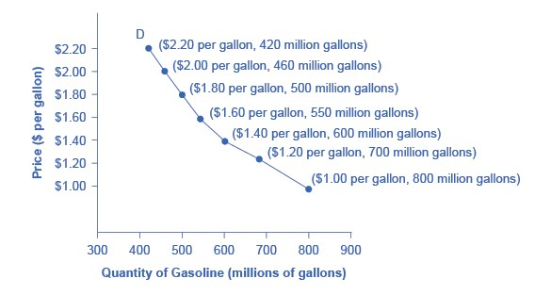
Price and Quantity Demanded Along a Demand Curve
When the points of a demand schedule are graphed, the line connecting them is the demand curve (D).
The downward slope of the demand curve illustrates the law of demand - the inverse relationship between price and quantity demanded, ceteris paribus.

Slide 6
Basics of Supply
Supply - the amount of some good or service a producer is willing to supply at each price.
Quantity supplied - the total number of units of a good or service producers are willing to sell at a given price.
Law of supply - assuming all other variables that affect supply are held constant, an increase in price leads to an increase in quantity supplied, and a decrease in price leads to a decrease in quantity supplied.

Slide 7
Define a Supply Schedule and the Supply Curve
The supply schedule - a table that shows the quantity supplied at a range of different prices.
The supply curve - a graphic illustration of the relationship between price, shown on the vertical axis, and quantity, shown on the horizontal axis.

Slide 8
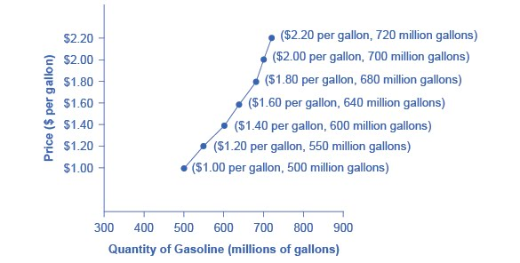
Price and Quantity Supplied Along a Supply Curve
The supply curve is created by graphing the points from a supply schedule.
The upward (positive) slope of the supply curve illustrates the law of supply - that a higher price leads to a higher quantity supplied and vice versa, ceteris paribus.

Slide 9
Market Equilibrium: Where Demand and Supply Intersect
Equilibrium - the combination of price and quantity where there is no economic pressure from surpluses or shortages that would cause price or quantity to change
quantity demanded = quantity supplied
Equilibrium price - the price where quantity demanded is equal to quantity supplied
Equilibrium quantity - the quantity at which quantity demanded and quantity supplied are equal for a certain price level.

Slide 10
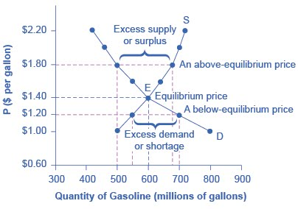
Graphing Market Equilibrium
The demand curve (D) and the supply curve (S) intersect at the equilibrium point E.
The equilibrium price is the only price at which quantity demanded = quantity supplied
At a price above equilibrium, quantity supplied > quantity demanded, so there is excess supply.
At a price below equilibrium, quantity demanded > quantity supplied, so there is excess demand.

Slide 11
Change in Quantity Demanded – Movement Along the Demand Curve
Any given demand curve is based on the ceteris paribus assumption (the assumption that all else is held equal).
A Change in Quantity Demanded - Along a demand curve, a price change, ceteris paribus, leads to a change in quantity demanded. The consumer moves from one point on a demand curve to another point on the same demand curve.

Slide 12
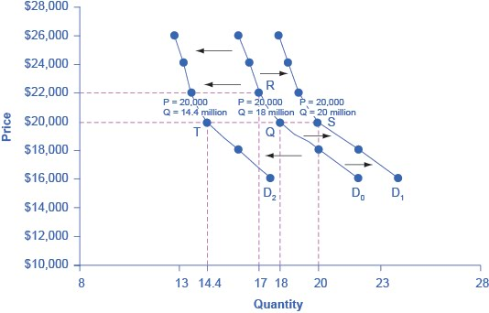
Change in Demand – A Shift in the Demand Curve
Increased demand means that at every given price, the quantity demanded is higher, so that the demand curve shifts to the right from D₀ to D₁.
Decreased demand means that at every given price, the quantity demanded is lower, so that the demand curve shifts to the left from D₀ to D₂.

Slide 13
What Factors Shift a Demand Curve?
A shift in demand happens when a change in some economic factor (other than price) causes a different quantity to be demanded at every price.
Factors that affect demand:
Income
Changing tastes or preferences
Changes in the composition of the population
Price of substitute or complement changes
Changes in expectations about future

Slide 14
How Changes in Factors Other Than Price Shift the Demand Curve
Panel (a): A list of factors that can cause an increase in demand from D₀ to D₁.
Panel (b): The same factors, if their direction is reversed, can cause a decrease in demand from D₀ to D₁.

Slide 15
Classifying Goods and Services
With respect to change in income:
Normal good - A product whose demand rises when income rises, and vice versa.
Inferior good - A product whose demand falls when income rises, rises, and vice versa.
With respect to changes in the prices of other goods:
Substitute - a good or service that we can use in place of another good or service.
Complements - goods or services that are often used together so that consumption of one good tends to enhance consumption of the other.

Slide 16
Change in Quantity Supplied – Movement Along the Supply Curve
Any given supply curve is based on the ceteris paribus assumption.
A Change in Quantity Supplied – Along a supply curve, a price change, ceteris paribus, leads to a change in quantity supplied. The seller moves from one point on a supply curve to another point on the same supply curve.

Slide 17
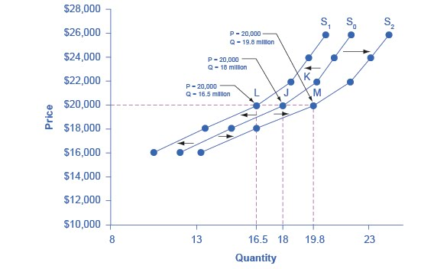
Change in Supply – A Shift in the Supply Curve
Decreased supply means that at every given price, the quantity supplied is lower, so that the supply curve shifts to the left, from S₀ to S₁.
Increased supply means that at every given price, the quantity supplied is higher, so that the supply curve shifts to the right, from S₀ to S₂.

Slide 18
What Factors Shift a Supply Curve?
A shift in supply happens when a change in some economic factor (other than price) causes a different quantity to be supplied at every price.
Inputs or factors of production - the combination of labor, materials, and machinery that is used to produce goods and services.
Factors that affect supply:
Natural conditions
Input prices
Technology
Government policies

Slide 19
How Changes in Factors Other Than Price Shift the Supply Curve
Panel (a): A list of factors that can cause an increase in supply from S₀ to S₁.
Panel (b): The same factors, if their direction is reversed, can cause a decrease in supply from S₀ to S₁.

Slide 20
Changes in Equilibrium Price and Quantity: The Four-Step Process
The four-step process to determining how an economic event affects equilibrium price and quantity:
Step 1. Draw a demand and supply model before the economic event took place.
Step 2. Decide whether the economic event affects demand or supply.
Step 3. Decide whether the event causes a curve shift to the right or to the left, and sketch the new curve on the diagram.
Step 4. Identify the new equilibrium and then compare to the original.

Slide 21
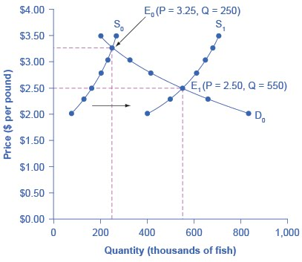
Example: Shift in Supply
Question: Using the 4-step approach, how did excellent weather conditions during the summer affect the quantity and price of salmon?

Slide 22
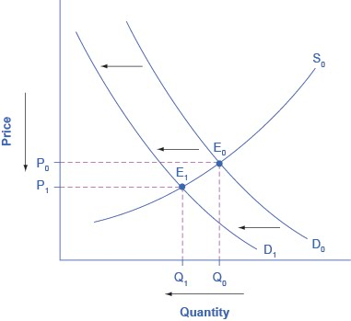
Example: Shift in Demand
Question: From 2004 to 2012, the share of Americans who reported obtaining their news from digital sources increased from 24% to 39%. Using the 4-step approach, how has this affected the consumption of traditional sources, such as print news media, and radio and television news?

Slide 23
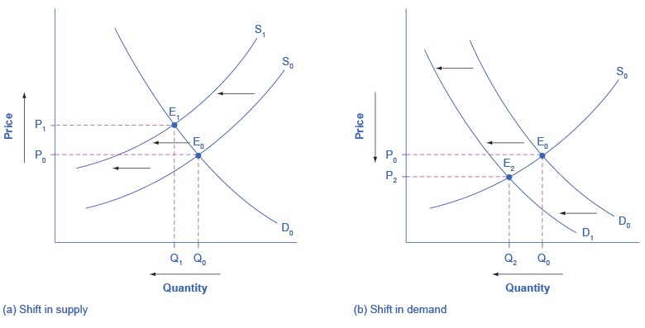
A Combined Example
Question: Using the 4-step approach, what does an increase in labor compensation, as well as an increase in digital communication suggest about the continued viability of the Postal Service?

Slide 24
Price Ceilings and Price Floors
Price controls - laws that governments enact to regulate prices.
Price ceiling
keeps a price from rising above a certain level.
a legal maximum price that one pays for some good or service.
Price floor
keeps a price from falling below a given level.
is the lowest price that one can legally pay for some good or service.

Slide 25
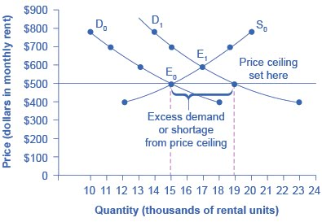
A Price Ceiling Example – Rent Control
The original intersection of demand and supply occurs at E₀.
If demand shifts from D₀ to D₁, the new equilibrium would be at E₁ - unless a price ceiling prevents the price from rising.
If the price is not permitted to rise, the quantity supplied remains at 15,000. However, after the change in demand, the quantity demanded rises to 19,000, resulting in a shortage.

Slide 26
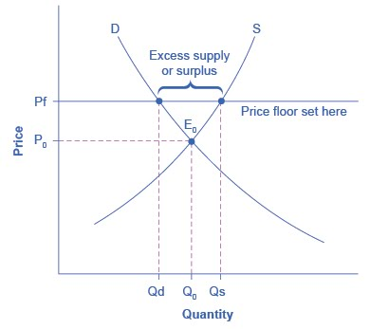
A Price Floor Example – European Wheat Prices
The intersection of demand (D) and supply (S) would be at the equilibrium point E₀.
However, a price floor set at Pf holds the price above E₀ and prevents it from falling.
The result of the price floor is that the quantity supplied Q_{s} exceeds the quantity demanded Q_{d}. There is excess supply, also called a surplus.

