Slide 1
Market Failure: Externalities and Public Goods

Slide 2
Acknowledgments
This PowerPoint presentation is based on and includes content derived from the following OER resource:
Principles of Microeconomics
An OpenStax book used for this course may be downloaded for free at:
https://openstax.org/details/books/principles-microeconomics-2e

Slide 3
Key Questions
What do we mean by market failure?
What are externalities and how do they constitute market failure?
What are prime examples of negative and positive externalities?
What are public goods and how do they constitute market failure?
What is the “tragedy of the commons” ?

Slide 4
Market Efficiency
Market efficiency means that a market is producing the quantity of a good at which the marginal social benefit of consuming the good equals the marginal social cost of producing it.
When markets are efficient, resources are being allocated in such a way as to maximize society’s well-being.

Slide 5
Market Failure
Market failure refers to the situation in which a market fails to allocate resources efficiently.
Market failure can result from noncompetitive markets or from cases in which property rights are not well defined and fully transferable.
Here’s a brief introductory video on market failure.
https://www.youtube.com/playlist?list=PL336C870BEAD3B58B

Slide 6
Externalities: An Example of Market Failure
An externality is the effect of a market exchange on a third party; that is, someone who is not party to the exchange
Also called a “spillover effect”.
Externalities can be positive or negative.
A negative externality exists when the third part bears a cost because of the exchange.
A positive externality exists when the third party benefits from the exchange.

Slide 7
Private vs. Social Costs and Benefits
Externalities arise in cases where private costs or benefits differ from social costs or benefits.
Private costs and benefits accrue to the parties to an exchange.
Social costs and benefits include the private costs and benefits plus the additional costs and benefits incurred by third parties.
When social costs > private costs, the market allocates too many resources to the production of the good or service
When social benefits > private benefits, the market allocates too few resources to the production of the good or service

Slide 8
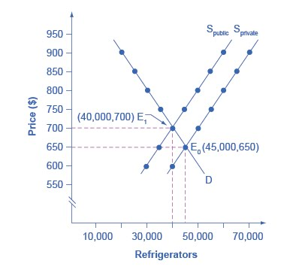
Accounting for Social Costs
In the graph, S_{private} reflects private costs only.
S_{public} reflects private and social costs.
When we account for all costs, private plus social, the new equilibrium will be at a higher price and lower quantity.
The new equilibrium is a socially-efficient equilibrium.

Slide 9
Pollution as a Negative Externality
Pollution in the form of emissions or effluent is a cost of production that is not recognized in the private transaction but is instead borne by third parties.
When pollution is not recognized as a cost of production of a good or service, the market will produce too much of that good or service.

Slide 10
Solutions to the Pollution Problem
Moral Suasion
Command-and-control
Market-oriented environmental tools
Pollution charges
Marketable permits
Better-defined property rights

Slide 11
Moral Suasion
Refers to campaigns designed to reduce pollution by encouraging voluntary change in behavior.
Moral suasion is more effective when the costs of changing behavior are small.

Slide 12
Command-and-Control
Refers to laws that regulate the amount of pollutants that can be produced or specify a pollution-control technology.
Compliance requires firms to either cut production or bear the additional cost of pollution control technology.

Slide 13
Problems with Command-and-Control
They offer no incentive to limit pollution more than the law specifically requires.
They are inflexible.
They are subject to legislative compromise which may include loopholes and exceptions, and other unforeseen consequences.

Slide 14
Market-Oriented Environmental Tools – Pollution Charges
Market-oriented solutions are intended provide incentives for firms to reduce pollution in a cost-effective way.
Pollution charges (a pollution tax) force the firm to internalize the costs of pollution.
However, the firm has an incentive to determine a cheaper way to reduce pollution and avoid the pollution charge.

Slide 15
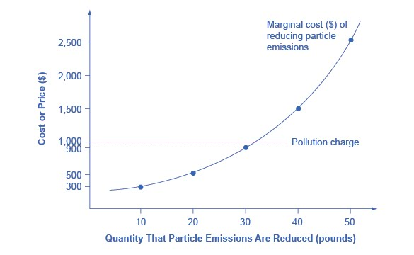
An Example of a Pollution Charge
The firm’s marginal cost of reducing emissions rises with the quantity of emissions reduced.
If the government sets the pollution charge at $1,000/lb. of emissions…
the firm will abate pollution up to 30 lbs., at a cost of $900,...
but will pay the per lb. charge for pollution beyond 30 lbs.

Slide 16
Market-Oriented Environmental Tools - Marketable Permits
Marketable permit programs (often referred to as “cap and trade”) give firms permits that allow them to emit a certain amount of pollution.
The video below describes how marketable permits work.
https://mru.org/courses/principles-economics-microeconomics/clean-air-act-pollution-control

Slide 17
Market-Oriented Environmental Tools – Better-Defined Property Rights (1 of 2)
Poorly-defined or inadequately-protected property rights are the cause of externalities.
When property rights can be established and protected, third parties become party to the transaction.
They would be compensated for what would otherwise be negative externalities…
or required to pay for what would otherwise be positive externalities.

Slide 18
Market-Oriented Environmental Tools – Better-Defined Property Rights (2 of 2)
The Coase Theorem proposes that given certain conditions, private markets can achieve social efficiency regardless of the initial definition of property rights.
These conditions include the absence of transactions costs.
Transactions costs to establish or enforce contracts can be significant and hinder the ability of individuals to solve the externality.

Slide 19
Costs and Benefits of Environmental Laws
The annual cost to U.S. firms of complying with environmental laws is roughly $200 billion.
The benefits of environmental laws include
Better health.
Higher property values.
Greater profitability for industries that rely on environmental amenities (farming, fishing, tourism).
Hard-to-value aesthetics from clearer skies and cleaner water

Slide 20
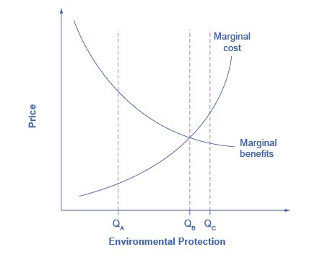
Marginal Costs and Benefits of Environmental Protection (1 of 2)
As we move from less to more environmental protection, its marginal cost rises and its marginal benefit declines.
At Q_{A} pollution is extensive and the marginal cost of mitigation is low compared to the marginal benefit.
At Q_{B} the marginal cost of mitigation just equals the marginal benefit.

Slide 21
Marginal Costs and Benefits of Environmental Protection (2 of 2)
Beyond Q_{B}, the marginal cost of environmental protection exceeds the marginal benefits.
This indicates that trying to achieve environmental protection Q_{C} would represent an inefficient use of society’s resources.
Bottom line…eliminating all pollution is not an efficient goal.

Slide 22
Economic Output vs. Environmental Protection (1 of 2)
The tradeoff between economic output and environmental protection can be depicted by the Production Possibility Frontier (PPF).
Recall the following about the PPF:
It represents efficient combinations of two goods available to a society given the society’s resources and technology.
Only combinations along the PPF are attainable and efficient.
The slope of the PPF represents the opportunity cost of one good in terms of the other.

Slide 23
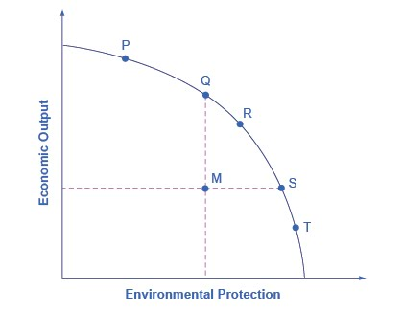
Economic Output vs. Environmental Protection (2 of 2)
Does society prefer point P, with higher output but less environmental protection or point T, with greater environmental protection but lower output?
Note that if society moves from point P to point T, the opportunity cost of more environmental protection (the economic output sacrificed) rises.

Slide 24
Positive Externalities
Positive externalities occur when third parties benefit from a transaction to which they are not a party.
When positive externalities exist the market will produce less than the socially-efficient level of output.

Slide 25
The Private vs. Social Benefits of Technology
Profit-maximizing firms in competitive markets develop new technology because it leads to the creation of new goods and services, and lowers production costs.
However, new technology also may provide valuable “spillover effects” that the originating firm is unable to profit from.
Therefore, from society’s point of view, firms in competitive markets will likely underinvest in new technology.

Slide 26
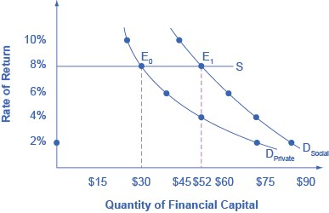
Technology and Positive Externalities (1 of 2)
If Big Drug Co. receives only the private returns on investment in drug research, their demand for financial capital is shown by D_{Private}.
If Big Drug Co. received the total social returns on investment in drug research, their demand for financial capital is D_{Social}.

Slide 27
Technology and Positive Externalities (2 of 2)
Assuming Big Drug could borrow at a rate of 8%, their private demand for financial capital would be $30 million.
If they were paid the full social benefits of drug research, their demand for financial capital would be $52 million.
The existence of positive externalities to drug research leads private firms to invest less than is socially optimal.

Slide 28
Human Capital and Positive Externalities
Similar to technology, the acquisition of human capital has both private and social benefits.
The social benefits of education may include:
Better health outcomes.
A lower crime rate.
A cleaner environment.
Better-informed and more engaged citizens.

Slide 29
Encouraging Innovation
Government policies that encourage innovation include the following:
Guaranteeing intellectual property rights.
Assisting with the costs of research and development (R&D).
Cooperative research ventures between universities and business.

Slide 30
Intellectual Property Rights
Refers to the body of law that protects the right of inventors to produce and sell their inventions.
They include:
Patents, which give the inventor the exclusive legal right to make, use or sell the inventions for a limited period of time.
Copyright laws, which give the author an exclusive legal right over works of literature, music, film/video and pictures.

Slide 31
Government Spending on R&D
Government spending can fund R&D that may be deemed too risky or not sufficiently profitable for private firms to fund.
R&D may occur at universities, nonprofits, government labs or private firms.
A complementary approach to direct funding of R&D is to provide tax breaks to private firms to encourage R&D.

Slide 32
Cooperative Research
Government can also support R&D and innovation through cooperative efforts between private firms and government research agencies such as the National Institutes for Health or the Agriculture and Food Research Initiative.

Slide 33
Public Goods
Public goods are goods that are nonexcludable and nonrival in consumption and are, therefore, unprofitable for private firms to provide.
Nonexcludable means that it is impossible or costly to exclude someone from consuming the good once it’s provided.
Nonrival means that one person’s consumption of the good doesn’t prevent the simultaneous consumption by another person.

Slide 34
Public and Private Goods…and Two More
Considering the two characterizations, rivalry and excludability, we see we actually have four categories of goods.
We’ll learn more about Common Resources in later slides.
Club goods are usually provided by the private market but at higher prices and lower output than society desires.
 | Rival | Non-rival
Excludable | Private Goods: iPhones, jeans, Big Macs | Club Goods: satellite TV, theatres, private parks
Non-excludable | Common Resources: forests, fisheries | Public Goods: air, emergency services, national defense

Slide 35
Public Goods: An Example of Market Failure
If provided by private firms, public goods are likely to be provided at less than the socially-efficient quantity.
The government may intervene to provide the public goods itself.

Slide 36
Free Riders
Free riders are those who benefit from the provision of public goods but do not pay for them.
The incentive to free ride exists when consumers can avoid the costs of consuming the good.
The existence of too many free riders will result in under-provision of the public good.

Slide 37
Solving the Free Rider Problem
The solution to free riding is to devise a way to get all consumers to pay for the good.
One way is to tax consumers, compelling everyone to pay.
In the case of traditional radio or TV broadcasts consumers “pay” by listening to or watching commercials from the private firms that support the radio or TV programming.

Slide 38
Common Resources and the “Tragedy of the Commons” (1 of 2)
Common property resources are resources for which no property rights have been established.
They are nonexcludable, like public goods but rivalrous, like private goods.
Examples include forests and fisheries, and livestock grazing lands.

Slide 39
Common Resources and the “Tragedy of the Commons” (2 of 2)
Common property resources are unlikely to be efficiently allocated by the private market.
They are more likely to be overused because users consider only the private benefits without considering the social costs.
The likelihood of common property resources being used to the point of exhaustion is call the “tragedy of the commons”.

