Slide 1
Profit Maximization in Competitive Markets

Slide 2
Acknowledgments
This PowerPoint presentation is based on and includes content derived from the following OER resource:
Principles of Microeconomics
An OpenStax book used for this course may be downloaded for free at:
https://openstax.org/details/books/principles-microeconomics-2e

Slide 3
Key Questions
What is perfect competition?
How do perfectly competitive firms make output decisions in the short run?
What do we mean by breakeven and shutdown points?
What are the conditions for entry and exit in perfectly competitive markets?
Are perfectly competitive markets efficient?

Slide 4
Perfect Competition and Why It Matters
Market structure refers to the conditions in an industry, such as number of sellers, ease of entry for new firms, and the homogeneity of goods or services sold.
Perfect competition is the market structure in which firms face many competitors that sell identical products, where entry and exit is unrestricted and buyers and sellers have all relevant information.

Slide 5
How Perfectly Competitive Firms Make Output Decisions
A perfectly competitive firm has only one major decision to make - what quantity to produce?
A perfectly competitive firm is a “price taker” and must accept the market price for its output as determined by total demand and supply.
The maximum profit will occur at the quantity where the difference between total revenue and total cost is largest.

Slide 6
Comparing Cost and Revenue at a Raspberry Farm
Total revenue for a perfectly competitive firm is a straight line sloping up; the slope is equal to the price of the good.
Total cost also slopes up, but with some curvature.
At higher levels of output, total cost begins to slope upward more steeply because of diminishing marginal returns.
The maximum profit will occur at the quantity where the difference between total revenue and total cost is largest.

Slide 7
Comparing Marginal Revenue and Marginal Cost
Marginal revenue (MR) is the additional revenue gained from selling one more unit.
$$MR=\frac{∆Total Revenue}{∆Quantity}$$
Marginal cost (MC) is the cost per additional unit sold.
$$MC=\frac{∆Total Cost}{∆Quantity}$$
The profit-maximizing output for a perfectly competitive firm will occur at the level of output where MR=MC.

Slide 8
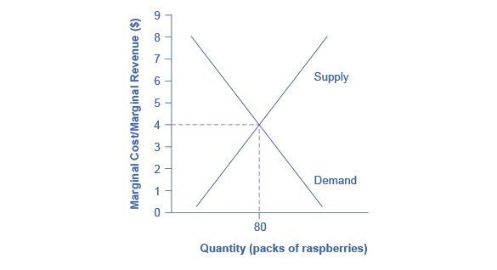
Marginal Cost and Marginal Revenue at the Raspberry Farm: Raspberry Market
The equilibrium price of raspberries is determined through the interaction of market supply and market demand at $4.00.

Slide 9
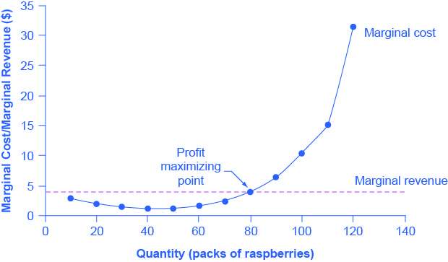
Marginal Cost and Marginal Revenue at the Raspberry Farm: Individual Farmer
For a perfectly competitive firm, the marginal revenue curve is a horizontal line equal to the market price ($4).
The marginal cost curve is assumed to be U-shaped, initially reflecting increasing marginal returns at low levels of output but eventually rising as diminishing marginal returns set in.

Slide 10
Profits and Losses With the Average Cost Curve
Does maximizing profit (producing where MR = MC) imply an economic profit?
The answer depends on the relationship between price and average total cost, which is the average profit or profit margin.

Slide 11
Profit and Loss at the Raspberry Farm
In (a), price intersects MC above the AC curve.
Price > AC, so the firm is making an economic profit.
In (b), price intersects MC at the minimum point of the AC curve.
Price = AC, so the firm is breaking even.
In (c), price intersects MC below the AC curve.
Price < average cost, so the firm is making a loss.

Slide 12
The Shutdown Point
Question: When does the firm limit its losses by “throwing in the towel” and closing its doors?
Shutdown point - the intersection of the average variable cost curve and the marginal cost curve.
If:
price < minimum AVC, then the firm shuts down
price > minimum AVC, then the firm stays in business

Slide 13
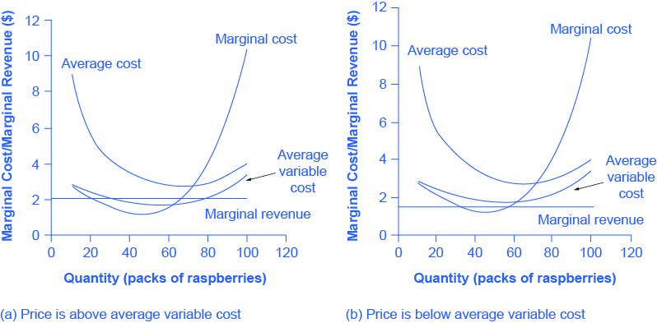
The Shutdown Point for the Raspberry Farm
Panel (a): the farm produces at a level of 65. It is incurring losses, but price > AVC, so it continues to operate.
Panel (b): the farm produces at a level of 60. Price < AVC at this level of output.
If the farmer cannot pay workers (the variable costs), then it shuts down.

Slide 14
The Breakeven Point
Question: Does breaking even mean “just getting by” or is it a worthy goal?
Break even point – the level of output where the MC intersects the AC curve at its minimum point.
If:
price > minimum AC, then the firm earns an economic profit
price = minimum AC, then the firm earns a normal profit.

Slide 15
Short-Run Outcomes for Perfectly Competitive Firms (1 of 2)
We can divide the MC curve into 3 zones, based on where it is crossed by the AC and AVC curves.
We call the point where MC crosses AC the break even point*.
If the firm is operating where price > break even point, then price > AC and the firm is earning profits.
If the price = break even point, then the firm is making zero profits.

Slide 16
Short-Run Outcomes for Perfectly Competitive Firms (2 of 2)
If shutdown point < price < break even point, the firm is making losses but will continue to operate in the short run.
It is covering its variable costs, and more if price is above AVC.
If price < shutdown point, the firm will shut down
It is not even covering its variable costs.

Slide 17
Entry and Exit Decisions in the Long Run
Entry - when new firms enter the industry in response to increased industry profits.
Exit - the long-run process of reducing production in response to a sustained pattern of losses.
Long-run equilibrium - where all firms earn zero economic profits producing the output level where P = MR = MC and P = AC.

Slide 18
Long-Run Adjustment and Industry Types
Constant cost industry - as demand increases, the cost of production for firms stays the same.
Increasing cost industry - as demand increases, the cost of production for firms increases.
Decreasing cost industry - as demand increases the costs of production for the firms decreases

Slide 19
Adjustment Process in a Constant-Cost Industry
Panel (a): Demand increased and supply met it.
In this case, the supply increase is equal to the demand increase.
The result is that the equilibrium price stays the same as quantity sold increases.

Slide 20
Adjustment Process in a Constant-Cost Industry
Panel (b): Sellers are not able to increase supply as much as demand. Some inputs were scarce, or wages were rising, so the equilibrium price rises.
Panel (c): Sellers’ increase in supply is greater than the demand increase. In this case, new technology or economies of scale caused the large increase in supply and the equilibrium price declines.

Slide 21
Efficiency in Perfectly Competitive Markets
When profit-maximizing firms in perfectly competitive markets combine with utility-maximizing consumers, the resulting output of goods and services demonstrates both productive and allocative efficiency.
Productive efficiency means that the choice is on the PPF.
In the long run in a perfectly competitive market, the price in the market is equal to the minimum of the long-run average cost curve.
In other words, firms produce and sell goods at the lowest possible average cost.

Slide 22
The Perfectly Competitive Market and Allocative Efficiency
Allocative efficiency means that among the points on the production possibility frontier, the chosen point is socially preferred.
When perfectly competitive firms produce the quantity where P = MC, which is the profit-maximizing quantity, they are ensuring that the social benefits they receive from producing a good are in line with the social costs of production.

Slide 23
Demand, Supply, and Efficiency
Consumer surplus – the amount that individuals would have been willing to pay minus the amount that they actually paid.
Graphically, it’s the area above the market price and below the demand curve.
Producer surplus – the price the producer actually received minus the price the producer would have been willing to accept.
Graphically, the area between the market price and the segment of the supply curve below the equilibrium.
Social surplus (economic surplus, total surplus) = the sum of consumer and producer surplus.
Deadweight loss - the loss in social surplus that occurs when a market produces an inefficient quantity

Slide 24
Consumer and Producer Surplus
The somewhat triangular area labeled F is consumer surplus.
It is measured as the area beneath the demand curve and above the equilibrium price.
The buyer at point J on the demand curve was willing to pay $90 but actually pays only $80.
The somewhat triangular area labeled G is producer surplus
It is measured as the area above the supply curve and beneath the equilibrium price.
The seller at point K on the supply curve was willing to sell at $40 but actually sells at $50.

Slide 25
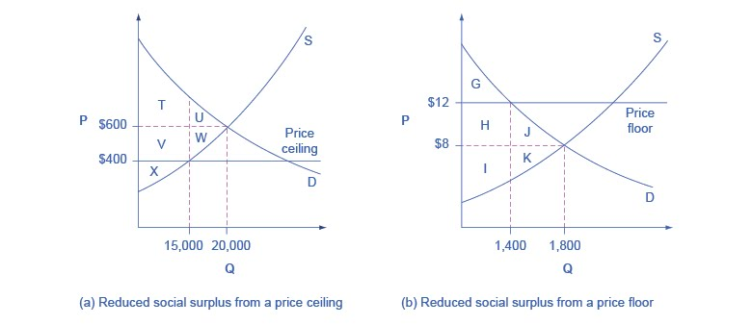
Efficiency of Price Floors and Ceilings (1 of 2)
Panel (a): The original equilibrium price is $600 with a quantity of 20,000. Consumer surplus is T + U, and producer surplus is V + W + X. A price ceiling is imposed at $400, so firms in the market now produce only a quantity of 15,000. As a result, the new consumer surplus is T + V, while the new producer surplus is X.

Slide 26
Efficiency of Price Floors and Ceilings (2 of 2)
Panel (b): The original equilibrium is $8 at a quantity of 1,800. Consumer surplus is G + H + J, and producer surplus is I + K. A price floor is imposed at $12, which means that quantity demanded falls to 1,400. As a result, the new consumer surplus is G, and the new producer surplus is H + I.

Slide 27
Comparing Perfect Competition to Real-world Markets
Perfect competition is a hypothetical benchmark for assessing real-world market performance.
Real-world markets include many issues that are assumed away in the model of perfect competition, such as:
Pollution,
Inventions of new technology
Poverty (some people are unable to pay for basic necessities)
Government programs
Discrimination in labor markets
Buyers and sellers with imperfect and unclear information.

