Slide 1
Monopoly

Slide 2
Acknowledgments
This PowerPoint presentation is based on and includes content derived from the following OER resource:
Principles of Microeconomics
An OpenStax book used for this course may be downloaded for free at:
https://openstax.org/details/books/principles-microeconomics-2e

Slide 3
Key Questions
What is a monopoly and how does it differ from perfect competition?
What are barriers to entry?
How does the monopolist make output and price decisions, and calculate profit?
What is the problem with monopoly?
What is price discrimination and why do firms do it?

Slide 4
What is a Monopoly? (1 of 2)
A monopoly is a single seller that controls the entire (or, practically speaking, almost the entire) supply of a good or service within a defined market.
Monopolies may exist at the national or international level such as Microsoft for web browsers or DeBeers for diamonds.
Or they may exist at the local or regional level like a municipal water company or a “last chance” gas station in the middle of the desert.

Slide 5
What is a Monopoly? (2 of 2)
Monopolies exist because of high barriers to entry to the market.
In some cases, these barriers are the result of anticompetitive or predatory behavior by the existing monopolist.
In other cases, they’re due production technologies that exhibit significant economies of scale or to government a license that grants monopoly rights.

Slide 6
Monopoly vs. Perfect Competition
Number of sellers - A monopolist is a single seller while a perfect competitor competes in a market with many small sellers.
Homogeneity of product - A monopolist sells a unique product while a perfect competitor sells a product that has many perfect substitutes.
Ease of entry or exit – A monopolist creates (or is created by) barriers to entry while a perfect competitor can enter or leave the market at will.

Slide 7
Barriers to Entry
Barriers to entry are essential to the existence of a monopoly.
They arise from the following sources:
Significant economies of scale (natural monopolies)
Control of a key resource
Legal monopoly status granted by government.
Patents, copyrights and other restrictions on competition.
Anticompetitive behavior by the monopolist.

Slide 8
Economies of Scale and Natural Monopolies
A natural monopoly arises when the long-run average cost of production declines throughout the quantity of output needed to serve the market’s demand.
This means that a single, larger firm has lower production costs than potential smaller competitors.

Slide 9
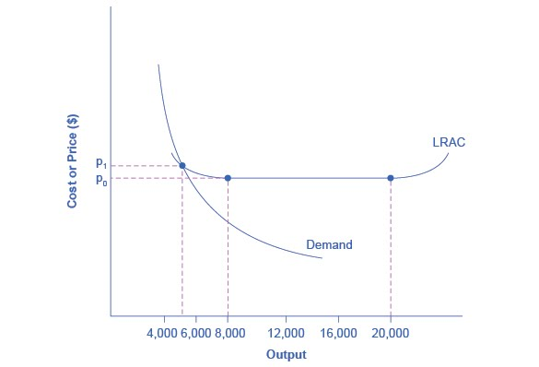
Natural Monopolies and Economies of Scale
In this market, the demand curve intersects the firm’s LRAC at its downward-sloping part.
A natural monopoly exists when the market demand occurs at a quantity less than the quantity at which the LRAC is at its minimum point.

Slide 10
Legal Monopoly
In the case of a legal monopoly, the government creates barriers to entry by limiting or prohibiting entry by competitors.
Typically, the government regulates legal monopolies to prevent exploitation.
Examples include:
The US Postal Service
Electric, gas and water utilities

Slide 11
Monopoly Rights Designed to Promote Innovation
Among the barriers to entry that government provides to promote (incentivize) innovation are:
Patents – give the inventor the exclusive right to make or sell an invention for a limited time.
Trademark – an identifying symbol or name.
Copyright – a form of legal protection to prevent copying for commercial purposes of books, films, music, etc.
Trade secrets – methods of production or ingredient lists that firms keep secret.

Slide 12
Anticompetitive Behavior by Monopolists
Monopolists may engage in predatory pricing or other anticompetitive behavior in order to keep potential competitors at bay.
Such behavior is illegal under anti-trust legislation.

Slide 13
The Monopolist’s Output and Price Decision (1 of 2)
The monopolist follows the same rule for profit maximization as the perfect competitor by producing the level of output at which marginal revenue equals marginal cost.
The difference is that the monopolist faces the downward-sloping market demand curve instead of a horizontal demand curve at the market price.
Thus, in order to sell more, the monopolist must reduce their price.

Slide 14
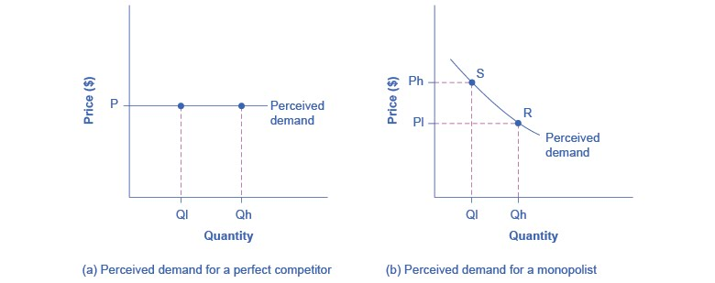
The Monopolist’s Output and Price Decision (2 of 2)
Panel (a): The perfect competitor can sell Ql or Qh at the market price, P, and has no ability to charge a higher price or incentive to charge a lower price.
Panel (b): At price Ph, the monopolist can only sell Ql. In order to sell Qh, the monopolist must lower price to Pl.

Slide 15
Cost, Revenue and Profit for HealthPill, Inc.
The next few slides will explain cost, revenue and profit concepts for a fictitious monopolist, HealthPill Inc.
Keep in mind the following:
HealthPill’s cost curves are no different than a perfect competitor’s but their revenue curves are different, reflecting the fact that HealthPill serves the entire market demand.
HealthPill’s profit-maximizing condition is identical to a perfect competitor’s but the outcome in terms of price and quantity is different.

Slide 16
Total Cost and Total Revenue for a Monopolist
The monopolist’s total cost rises as quantity increases.
The monopolist’s total revenue first rises as quantity increases but eventually falls.
Total revenue rises when the decrease in price is more than offset by the increase in quantity sold.
Total revenue then falls as further decreases in price are not offset by increases in quantity sold.

Slide 17
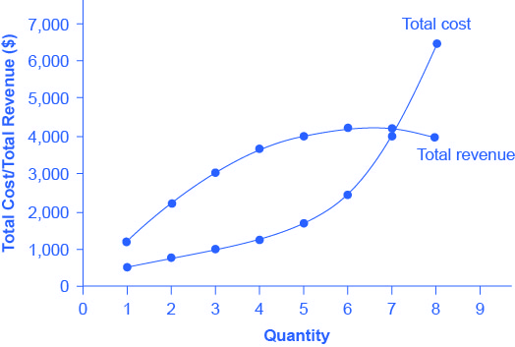
Revenue, Cost and Profit – HealthPill, Inc. (1 of 2)
HealthPill’s total revenue initially rises, peaks at Q=6 and then falls.
HealthPill’s total cost rises continuously with the increase in Q.

Slide 18
Revenue, Cost and Profit – HealthPill, Inc. (2 of 2)
HealthPill’s profit is maximized at Q=5 where the vertical distance between total revenue and total cost is greatest.
Note that the profit-maximizing quantity is less than the revenue-maximizing quantity.

Slide 19
Marginal Cost and Marginal Revenue for a Monopolist
The monopolist’s marginal cost curve is U-shaped, the same as the perfect competitor’s.
The monopolist’s marginal revenue curve is a downward-sloping curve that lies beneath the market demand curve.
Recall that the perfect competitor’s marginal revenue is a horizontal line and is equal to the market price.

Slide 20
Why Does the Monopolist’s MR Curve Lie Below the Demand Curve?
Watch and listen carefully to the video below and you’ll understand why.
https://www.youtube.com/watch?v=aboVjX-wbv4

Slide 21
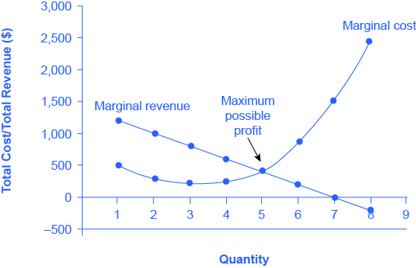
MR and MC – HealthPill, Inc. (1 of 2)
HealthPill’s MR curve is downward sloping.
HealthPill’s MC curve is upward-sloping over the relevant range of quantity.
HealthPill’s profit-maximizing quantity is 5, which is the quantity at which MR=MC (same as slide 18).

Slide 22
MR and MC – HealthPill, Inc. (1 of 2)
If HealthPill produces Q less than 5, MR > MC and HealthPill could increase profits by producing more.
If HealthPill produces Q more than 5, MR < MC and HealthPill could increase profits by producing less.

Slide 23
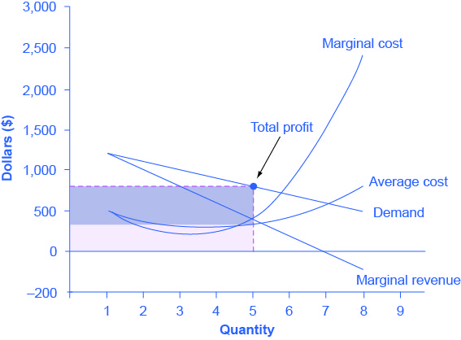
HealthPill’s Profits
This graph adds the Average Cost curve and the Demand curve to the previous graph to illustrate HealthPill’s profit.
The entire shaded area (both light- and dark-shaded areas) represents total revenue; the light-shaded area is total cost; and the dark-shaded area is profit.

Slide 24
Summarizing the Monopolist’s Output and Price Decision
Step 1: What is the profit-maximizing level of output?
Step 2: What is the price consistent with the profit-maximizing level of output?
Step 3: What are total cost, total revenue and total profit at the profit-maximizing level of output?

Slide 25
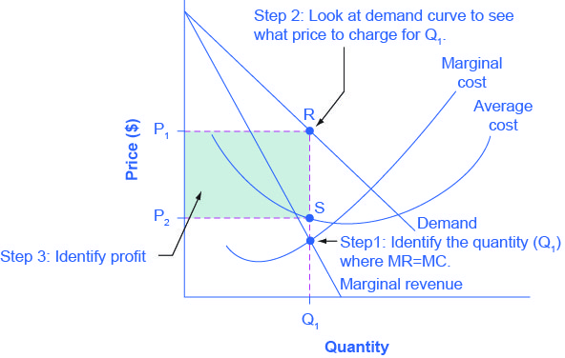
Profit-Maximizing Price and Quantity for a Monopolist (1 of 2)
Step 1: The monopolist chooses the profit-maximizing quantity by choosing the quantity at which MR=MC. That quantity equals Q₁
Step 2: The monopolist decides what price to charge by choosing the point on the demand curve that corresponds to Q₁. That price equals P₁

Slide 26
Profit-Maximizing Price and Quantity for a Monopolist (2 of 2)
Step 3: The monopolist calculates total revenue, total cost and profit.
Total revenue = P₁ x Q₁
Total cost = P₂ x Q₁
Profit = Total revenue – Total cost
Profit is shown as the shaded rectangle P₁RSP₂.

Slide 27
What’s the Problem With Monopoly?
Monopolists are often characterized as greedy, predatory and bad public citizens.
To economists, however, the fundamental problem with monopoly is that the monopolist supplies too little output at too high a price.
Technically speaking, the monopolist fails to achieve allocative efficiency.

Slide 28
Is There Anything Good About Monopoly?
As we’ve already seen, some monopolies are created by governments as a way of promoting innovation.
The video below summarizes both the bad and the good of monopoly.
https://mru.org/courses/principles-economics-microeconomics/costs-benefits-monopoly-pharmaceutical-companies

Slide 29
Price Discrimination
Price discrimination refers to the practice of sellers charging different prices for the same product when the price differences are not justified by differences in cost.
Three conditions must exist in order to price discrimination to be practiced.
The seller must face a downward-sloping demand curve.
The seller must be able to segment the market into groups willing to pay different prices.
The seller must be able to prevent sellers from engaging in arbitrage.

Slide 30
Price Discrimination and the Demand Curve
Perfect competitors, facing a horizontal demand curve, have no incentive to charge a lower price and no ability to charge a higher price.
Monopolists and other imperfect competitors who face a downward-sloping demand curve can increase their profits if they can identify what price buyers are actually willing to pay for the good.

Slide 31
Price Discrimination and Price Elasticity
Profitable segmentation of the market requires that buyers have different price elasticities of demand and that sellers be able to identify them.
Once groups are identified, sellers maximize their profits by charging a higher price to buyers with the lower price elasticity and a lower price to buyers with the higher price elasticity.

Slide 32
Price Discrimination and Arbitrage
Arbitrage refers to the ability to make a profit by buying a good at a low price in one market and reselling it at a higher price in another.
In order to profit from price discrimination, sellers must be able to prevent arbitrage by buyers.

Slide 33
Price Discrimination in Practice
Price discrimination in restraint of trade is specifically prohibited by the Robinson-Patman Act of 1936.
However, price discrimination is widely practiced as in…
Lower prices for children than adults at movie theatres.
Lower electric rates for industrial than residential customers.
Senior discounts at restaurants, hotels and car rentals.
Some economists argue that price discrimination increases allocative efficiency.

