Slide 1
Imperfect Competition

Slide 2
Acknowledgments
This PowerPoint presentation is based on and includes content derived from the following OER resource:
Principles of Microeconomics
An OpenStax book used for this course may be downloaded for free at:
https://openstax.org/details/books/principles-microeconomics-2e

Slide 3
Key Questions
What is monopolistic competition and how does it differ from perfect competition?
What do we mean by product differentiation?
How do monopolistic competitors make output and price decisions?
What is oligopoly and how does it differ from perfect competition?
What do we mean by mutual interdependence?
What is game theory and how is it used to understand the behavior of oligopolists?

Slide 4
What is Imperfect Competition? (1 of 2)
It refers to monopolistic competition and oligopoly, market structures that lie between the extremes of perfect competition and monopoly.
The vast majority of firms in the U.S. economy can be described as imperfect competitors.
Imperfect competitors engage in price and nonprice competition in order to maximize profits.

Slide 5
What is Imperfect Competition? (2 of 2)
One thing all imperfect competitors have in common is that they face a downward-sloping demand curve.
As a consequence, all imperfect competitors sell at a price that is greater than marginal cost.
Markets characterized by imperfect competition, therefore, are not allocatively efficient.

Slide 6
Monopolistic Competition vs. Perfect Competition
Monopolistic competition shares some of the characteristics of perfect competition...
It’s characterized by a relatively larger number of sellers.
Entry and exit are relatively easy.
But it differs from perfect competition in an important way.
Monopolistic competitors sell a differentiated product.
As a consequence, they face a downward-sloping demand curve.

Slide 7
Differentiated Products
A differentiated product is one that customers perceive as distinctive in some way.
Products can be differentiated in a number ways.
Their physical attributes
Their location of sale
Their intangible attributes
Customer perceptions

Slide 8
Examples of Monopolistic Competition
Most consumer businesses like barbers and hairdressers and dry cleaners.
Restaurants and coffee shops.
Retail businesses like shoe stores or boutiques.

Slide 9
Perceived Demand Curves in Different Market Structures (1 of 2)
For the perfect competitor, the demand curve is a horizontal line at the market equilibrium price.
For the monopolist, it is the downward-sloping market demand curve.
The monopolistic competitor also faces a downward-sloping demand curve but it represents demand for the firm’s differentiated product rather than the total market for all similar products, and is typically more elastic.

Slide 10
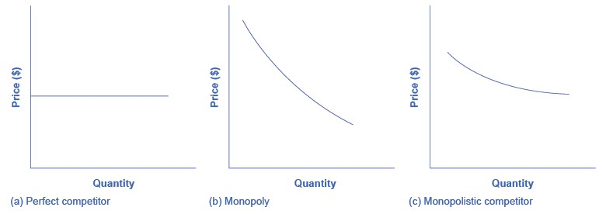
Perceived Demand for Firms in Different Market Structures (2 of 2)
Panel (a): The perfect competitor can sell any quantity at the market price.
Panel (b): The monopolist must lower his price in order to sell more.
Panel (c): The monopolistic competitor must also lower price to sell more but faces a more elastic demand curve.

Slide 11
Marginal Cost and Marginal Revenue: Perfect vs. Imperfect Competition
Let’s review marginal cost and marginal revenue under perfect and imperfect competition.
https://www.khanacademy.org/economics-finance-domain/ap-microeconomics/imperfect-competition/introduction-to-imperfect-competition/v/marginal-revenue-and-marginal-cost-in-imperfect-competition

Slide 12
Price and Output Decisions Under Monopolistic Competition
The monopolistic competitor maximizes profits by producing the output at which marginal revenue (MR) equals marginal cost (MC).
The price (P) at which this output is sold is determined by the position of the demand curve.
As in monopoly, at the profit-maximizing output, P > MR

Slide 13
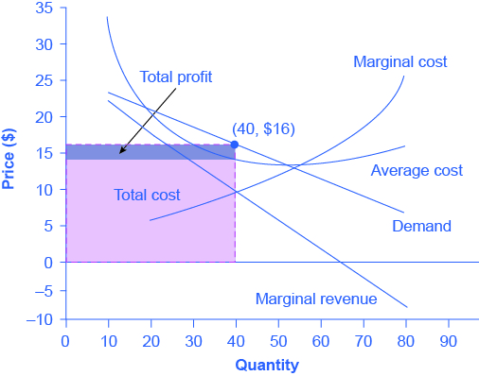
Example of Profit-Maximizing Price and Quantity
To maximize profits, the firm would choose the Q at which MR = MC.
In this example, profit-maximizing Q equals 40.
The price, which is $16, is found by the intersection of a vertical line at Q=40 and the demand curve.

Slide 14
Entry and Exit in Monopolistic Competition (1 of 3)
Due to low barriers to entry, if firms in a monopolistic competitive industry are earning an economic profit, other firms will enter the industry.
This will shift the demand curves of the original firms to the left.
Likewise, if firms are suffering an economic loss, existing firms will leave.
This will shift the demand curves of the remaining firms to the right.

Slide 15
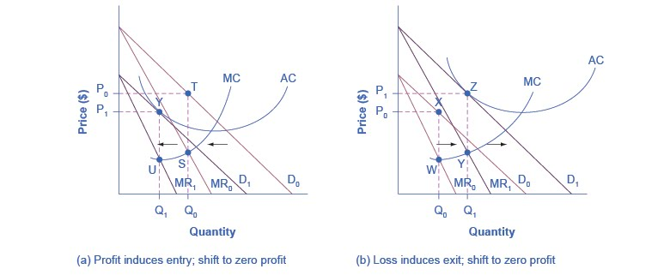
Entry and Exit in Monopolistic Competition (2 of 3)
Panel (a): Existing firm is earning an economic profit at equilibrium P₀ and Q₀ . New firms are induced to enter, shifting existing firm’s demand curve leftward from D₀ to D₁. At new equilibrium P₁ and Q₁, existing firm is earning a normal profit .

Slide 16
Entry and Exit in Monopolistic Competition (3 of 3)
Panel (b): Existing firm is suffering an economic loss at equilibrium P₀ and Q₀. Some existing firms are induced to leave, shifting remaining firm’s demand curve rightward from D₀ to D₁. At new equilibrium P₁ and Q₁, remaining firm is earning a normal profit.

Slide 17
Monopolistic Competition and Market Efficiency
As shown in panel (b) of the previous graph, the long-term equilibrium for the monopolistic competitor is on the downward-sloping portion of their AC curve.
This is in contrast to the perfect competitor whose long-term equilibrium is at the minimum point on their AC curve.
Therefore, monopolistic competition does not exhibit productive efficiency, meaning it does not result in lowest-cost production.

Slide 18
Product Differentiation and Variety
Despite not exhibiting either productive or allocative efficiency, monopolistic competition provides a benefit in the form of product differentiation and variety.
Most consumers value variety and choice in consumption decisions although economists don’t have a sense of the “optimal” amount of variety and product choice a market should provide.

Slide 19
Advertising
Advertising is a form of nonprice competition and is used to convey product differentiation to consumers.
Advertising can increase a firm’s profits…
by making their demand curve more inelastic (implying fewer good substitutes) or
by shifting it to the right (meaning more sales at any given price).

Slide 20
Is Advertising Useful or Wasteful? (1 of 2)
If advertising increases a firm’s sales, it may also allow a firm to experience economies of scale and therefore, greater production efficiency.
Critics contend, however, that most advertising is simply offsetting and doesn’t result in significant gains in production efficiency.

Slide 21
Is Advertising Useful or Wasteful? (2 of 2)
It conveys valuable information about products that allows consumers to make better-informed choices.
Critics say that it spreads misinformation through deceitful claims or emphasis on minor differences in products.
Advertising is subject to regulation by the Federal Trade Commission and must meet truth-in-advertising standards.

Slide 22
Oligopoly vs. Perfect Competition
Oligopoly means that a small number of large firms account for most of the total output and are therefore able to influence the market.
Oligopoly is characterized by significant barriers to entry that arise from economies of scale.
Oligopolists may sell differentiated products or commodity-type goods.

Slide 23
Oligopoly and Mutual Interdependence
Due to their size and ability to influence market outcomes, oligopolistic firms are said to be mutually interdependent.
Mutual interdependence means that any given firm’s behavior is influenced by competing firms’ actual or potential responses.

Slide 24
Examples of Oligopoly
Oligopoly equates to “big business” which means large firms holding significant market shares.
Prime examples include:
Automakers like GM.
Airlines such as Delta.
Food manufacturers like General Mills.
Search engines such as Google
Wireless telecommunication providers like AT&T.

Slide 25
Oligopoly: Competition and Collusion
Oligopolists may compete vigorously through price and nonprice means.
Price wars may occur as firms seek greater market shares.
Nonprice competition includes advertising and product development.
But their mutual interdependence may tempt them to collude.
Collusion allows them to act like a monopolist and enjoy monopoly profits.

Slide 26
Collusion: Explicit and Implicit
Explicit collusion refers to formal agreements among competing firms to control the market by setting price or output.
The downside…Explicit collusion is illegal!
Implicit collusion refers to informal agreements, such as price leadership, that minimize direct competition.
Implicit collusion is not illegal if it doesn’t involve private, binding agreements among firms.
The downside…informal agreements aren’t legally binding and competitors may not go along.

Slide 27
Cartels
A cartel is a formal organization of producers who agree to act as a monopolist in setting output and price.
The most notable cartel in recent history is OPEC, which controls about three-quarters of known oil reserves.
Even mighty cartels like OPEC have trouble enforcing the agreements among their members.

Slide 28
Price and Output Decisions Under Oligopoly
The presence of mutual interdependence complicates oligopolists’ price and output decisions.
Here are a few approaches to the problem:
Price leadership
The kinked demand curve
Game theory

Slide 29
Price Leadership
A dominant firm in the industry announces its prices and its competitors follow suit.
Competing carmakers’ prices for similar models are very close.
Competing airlines’ fares for the same route are identical.
Price leadership can be seen as an instance of implicit collusion but followers may not comply and price wars may ensue.

Slide 30
The Kinked Demand Curve (1 of 2)
A kinked demand curve occurs when competitors match a price cut but not a price increase.
When the firm lowers its price, competitors do the same and the firm gains little in the way of increased sales (demand is very inelastic).
When the firm raises its price, competitors hold the line on theirs and the firm loses sales (demand is very elastic).

Slide 31
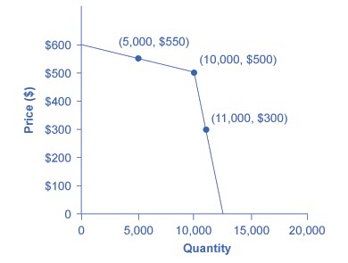
The Kinked Demand Curve (2 of 2)
Initial point is P=$500 and Q=10,000 and revenue is $5 m.
If the firm raises P to $550, Q=5,000 and revenue falls to $2.75 m.
If the firm drops P to $300, Q=11,000 and revenue falls to $3.3 m.
The firm is better off leaving P at $500.

Slide 32
Game Theory
Mutual interdependence requires that oligopolists devise strategies that take account the responses of their rivals, which they cannot know with certainty in advance.
Game theory is an analytical approach used to assess interdependent strategic choices.
A classic game theory problem is the Prisoner’s Dilemma.

Slide 33
The Prisoner’s Dilemma (1 of 3)
Here’s a short description of the Prisoner’s Dilemma:
https://www.youtube.com/watch?v=t9Lo2fgxWHw

Slide 34
The Prisoner’s Dilemma (2 of 3)
The key takeaways from the video:
The dominant strategy for a player is the strategy that yields the highest payoff (lowest loss) regardless of what the other player does.
Cooperation between the players results in best payoffs for both but cooperation is hard to achieve.
Strategies change, however, if the game is a repeated rather than one-shot game.

Slide 35
The Prisoner’s Dilemma (3 of 3)
Questions:
What is the dominant strategy in this game?
How do you know?
What is the best collective strategy?

Slide 36
The Prisoner’s Dilemma Applied to Oligopoly (1 of 2)
Because of mutual interdependence, oligopolists face their own “prisoner’s dilemma”.
Their profit-maximizing strategy is to collude (cooperate) with a competitor, but explicit collusion is illegal and implicit collusion is unreliable.
Therefore, they would typically choose the dominant strategy.

Slide 37
The Prisoner’s Dilemma Applied to Oligopoly (2 of 2)
In this game, the choice of the players is to increase output or not but each player’s payoff depends on what the other player does.
Questions:
What is the dominant strategy in this game? Why?
What is the best collective strategy (if they cooperate)?

