Slide 1
Poverty and Income Inequality

Slide 2
Acknowledgments
This PowerPoint presentation is based on and includes content derived from the following OER resource:
Principles of Microeconomics
An OpenStax book used for this course may be downloaded for free at:
https://openstax.org/details/books/principles-microeconomics-2e
Data have been updated from the U.S. Census Bureau.
Data links from The U.S. Census Bureau and The World Bank support the lesson outcomes and form the basis for updated data exercises on trends in U.S. and global poverty and income inequality.
Changes include reordering (and removing) slides, and adding/changing slides 2,3,4,5,11,12,18,21,25, and 26 to match learning outcomes.

Slide 3
Income Inequality, Poverty and Discrimination
Explain how the poverty line is determined.
Explain how income inequality is measured
Identify and discuss the causes of poverty and income inequality
Describe trends in the poverty rates and income inequality over time
Identify and explain differences in poverty rates across different populations
Identify and describe government programs to reduce poverty and income inequality
Explain the role of discrimination in poverty and income inequality
Explain the potential benefits and costs of government income redistribution and antipoverty measures
Compare poverty rates and income inequality across different countries
Identify the causes of poverty and income inequality across different countries

Slide 4
Key Questions
Explain how the poverty line is determined.
Explain how income inequality is measured
Identify and discuss the causes of poverty and income inequality
Describe trends in the poverty rates and income inequality over time
Identify and explain differences in poverty rates across different populations
Identify and describe government programs to reduce poverty and income inequality
Explain the role of discrimination in poverty and income inequality
Explain the potential benefits and costs of government income redistribution and antipoverty measures
Compare poverty rates and income inequality across different countries
Identify the causes of poverty and income inequality across different countries

Slide 5
Drawing the Poverty Line
Poverty - measured by the number of people who fall below a certain level of income, called the poverty line.
Poverty line - the specific amount of income one requires for a basic standard of living. It is three times the amount of income necessary to maintain adequate nutritional level for a family.
The poverty threshold income - $17,604 in 2000, $22,315 in 2010, and $25,094 in 2017 for a family of 4 (Source: U.S. Census Bureau).
Poverty rate - the percentage of the population below the poverty line in any given year.

Slide 6
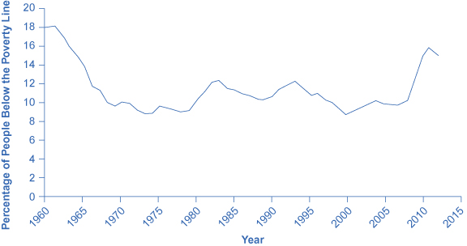
The U.S. Poverty Rate Since 1960
The poverty rate decreased from 22.2% in 1960 to 12.6% in 1970.
The poverty rose slightly in the 1970s and 1980s, and reached 11.3% in 2000.
It reached 15% in 2010-2012 and has declined since then to 12.3 % in 2017.
(Source: U.S. Census Bureau)

Slide 7
Poverty Rates by Race
Year | Blacks (alone or in combination) | Whites (alone) | Asian (alone or in combination) | Hispanic (any combination)
2005 | 24.7 | 10.6 | 10.9 | 21.8
2010 | 27.4 | 13.0 | 12.0 | 26.5
2014 | 23.9 | 11.6 | 11.1 | 21.4
2017 | 21.2 | 10.7 | 9.8 | 18.3
Source: U.S. Census Bureau

Slide 8
The Poverty Trap
Can you give people too much help, or the wrong kind of help?
When people are provided with food, shelter, healthcare, income, and other necessities, assistance may reduce their incentive to work.
Poverty trap - antipoverty programs set up so that government benefits decline substantially as people earn more income - as a result, working provides little financial gain.

Slide 9
The Safety Net
Near-poor - those who have incomes just above the poverty line.
Safety-net - the government programs that provide assistance to the poor and the near-poor.
Temporary Assistance for Needy Families (TANF) – short term cash assistance to families.
The Earned Income Tax Credit (EITC) – assistance for the working poor through the tax system.
Supplemental Nutrition Assistance Program (SNAP) – also known as “food stamps.” Provides food-purchasing assistance to eligible individuals and families.

Slide 10
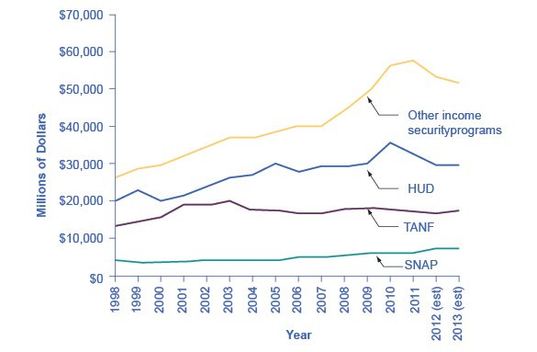
Expenditures on Income Security Programs - 1988 – 2013 (est.)
Total expenditures on income security rose between 1988 and 2010.
TANF increased from $13 billion in 1998 to $17.3 billion in 2013. SNAP has seen relatively small increments.
These two programs comprise about 30% of the estimated $106 billion dedicated to income security in 2013.
Note that “Other” programs and HUD programs increased dramatically during the 2008 and 2010 time period.
(Source: Table 12.3 Section 600 Income Security, http://www.whitehouse.gov/sites/default/files/omb/budget/fy2013/assets/hist.pdf)

Slide 11
Medicaid
A joint health insurance program between states and the federal government.
Provides medical insurance for certain low- income people, with a focus on families with children, the elderly, and the disabled.
Includes the near-poor as well as those below the poverty line.

Slide 12
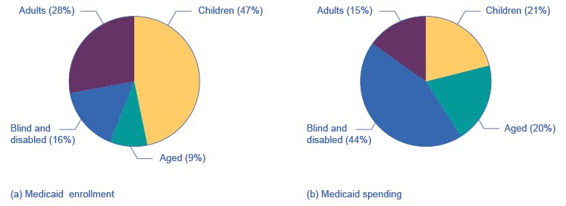
Medicaid Enrollment and Spending
Panel (a): Medicaid enrollment by different population groups. Children comprise nearly half.
Panel (b): Medicaid spending by different population groups. Children account for about a fifth.

Slide 13
Income Inequality: Measurement and Causes
Income inequality involves comparing those with high incomes, middle incomes, and low incomes - not just looking at those below or near the poverty line. It is a reference to the comparative changes in the share of the total income (or wealth) in society that different groups receive.
Quintile - dividing a group into fifths, a method economists often use to look at distribution of income.
Lorenz curve
Graph that compares the cumulative income actually received to a perfectly equal distribution of income.
Shows the cumulative share of population on the horizontal axis and the cumulative percentage of total income received on the vertical axis.

Slide 14
Data Exercise on Income Inequality
Historical data on income distribution (1967 to 2017) are provided in Tables H-2.
https://www.census.gov/data/tables/time-series/demo/income-poverty/historical-income-inequality.html
Questions:
In table H-2, what has happened to the share of aggregate income received by each quintile and the top 5 percent of households since 2000?
In what periods did each quintile experience the most significant changes?
Could you identify reasons for those changes?
Overall, would you conclude that income inequality has increased in the U.S. since 2000?

Slide 15
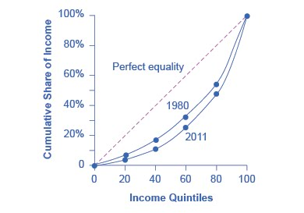
The Lorenz Curve
A Lorenz curve graphs the cumulative shares of income received by everyone up to a certain quintile.
The income distribution in 1980 was closer to the perfect equality line than the income distribution in 2011; that is, U.S. income distribution became more unequal over time.

Slide 16
Causes of Growing Income Inequality: The Changing Composition of U.S. Households
A pattern of households with two high earners (marriage of one high earner to another) tends to increase the proportion of high-earning households.
The number of single-parent households, usually headed by a single mother, has increased and the poverty rate of these households tends to be relatively high.

Slide 17
Causes of Growing Income Inequality: A Shift in the Distribution of Wages
The earnings of high-skilled labor relative to low-skilled labor have increased.
Winner-take-all labor markets result from changes in technology, which have increased global demand for “stars”.
This global demand pushes salaries far above productivity differences versus educational differences.
Argues that the salary gap between the median and the top 1 percent is not due to educational differences.

Slide 18
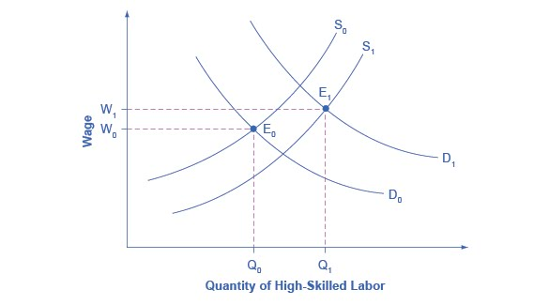
Why Would Wages Rise for Skilled Labor? (1 of 2)
The proportion of workers attending college has increased in recent decades, so the supply curve for high-skilled labor has shifted from S₀ to S₁.
If the demand for high-skilled labor had remained at D₀, then this shift in supply would have led to lower wages for high-skilled labor.

Slide 19
Why Would Wages Rise for Skilled Labor? (2 of 2)
However, the wages for high-skilled labor have increased even with the shift in supply to the right.
The explanation must lie in a shift to the right in demand for high-skilled labor, from D₀ to D₁.
The combination of the shift in supply and demand led to both an increase in the quantity of high-skilled labor hired and also to a rise in the wage for such labor, from W₀ to W₁.

Slide 20
Discrimination and Income Inequality
Discrimination - acting on the belief that members of a certain group are inferior solely because of a factor such as race, gender, or religion.
Based on wage data published by the U.S. Department of Labor, Bureau of Labor Statistics, a gap remains between the average wages of black and white workers and between the average wages of female and male workers

Slide 21
The Male/Female Earnings Gap
Gains in education and experience have reduced the female/male wage gap over time, but not eliminated it.
Concerns remain about the extent to which women have not yet assumed a substantial share of the positions at the top of the largest companies or in the U.S. Congress.
Women are likely to bear a disproportionately large share of household responsibilities and child-rearing.
This issue may primarily be rooted in America’s social patterns of discrimination, involving the roles that fathers and mothers play.

Slide 22
The Black/White Earnings Gap
Until the passage of the Civil Rights Act of 1964, it was legal in many states to refuse to hire a black worker, regardless of the credentials or experience of that worker.
Historically, blacks were often denied access to educational opportunities.
Although the gap in black/white earnings has narrowed, the remaining racial gap seems related both to continuing differences in education levels and the presence of discrimination.
There is also evidence to support that discrimination in the housing market (and thus quality education attainment) is connected to employment discrimination.

Slide 23
Government Policies to Reduce Income Inequality
If a society decides to reduce the level of economic inequality, it has a set of tools at its disposal:
Redistribution: involves taxing those with high incomes at significantly high rates than those with low incomes (income tax), and a tax on inheritance (wealth).
Ladder of Opportunity: trying to assure that a ladder of opportunity is widely available.
Antidiscrimination: trying to ensure that different population are not explicitly or implicitly targeted for discrimination.
Income - a flow of money received, often measured on a monthly or an annual basis.
Wealth - the sum of the value of all assets, including money in bank accounts, financial investments, a pension fund, and the value of a home.

Slide 24
Redistribution
Redistribution - taking income from those with higher incomes and providing income to those with lower incomes.
Progressive tax system - a tax system in which the higher earners pay a higher percentage of their income in taxes.
Effective income tax rate - total taxes paid divided by total income.

Slide 25
The Ladder of Opportunity
The Ladder of Opportunity - even though all children will never come from identical families and attend identical schools, each child has a reasonable opportunity to attain an economic niche in society.
Examples of “Ladder of Opportunity” public policy:
Improved day care
Enrichment programs for preschoolers
Improved public schools
College loans and grants for those in financial need
Opportunities for retraining and acquiring new skills
Prohibiting discrimination in job markets and housing

Slide 26
Public Policies to Reduce Discrimination
For earnings gap between blacks and whites (and also between Hispanics and whites), probably the single largest step that could be taken at this point in U.S. history to close the earnings gap would be to reduce the gap in educational achievement:
Improve the performance of schools.
Affirmative action - active efforts by government or businesses that give special rights to minorities in hiring, promotion or access to education to make up for past discrimination.

Slide 27
Data Exercise on Global Comparisons of Income Inequality
https://data.worldbank.org/topic/poverty
Data Exercise: Refer to the figure to the left in which each horizontal line represents a country. For each country click on the respective income shares to view the data.
For two countries for which data are provided, collect data on aggregate income shares of the quintiles (bottom 20% to top 20%). How does income distribution in the two countries compare to the US in 2017?
Repeat the exercise for multiple countries.

Slide 28
Causes of Poverty Across Countries
Go to the link below and examine the poverty data for two different countries. Identify the causes of poverty in those countries.
http://povertydata.worldbank.org/poverty/home/

