Slide 1
Antitrust Policy and Government Regulation of Business

Slide 2
Acknowledgments
This PowerPoint presentation is based on and includes content derived from the following OER resource:
Principles of Microeconomics
An OpenStax book used for this course may be downloaded for free at:
https://openstax.org/details/books/principles-microeconomics-2e

Slide 3
Key Questions
What are corporate mergers and acquisitions and how do they affect competition?
How do we measure monopoly power?
How has measurement of monopoly power changed over time?
How do we regulate natural monopolies?
What is deregulation and how has it affected competition and performance?

Slide 4
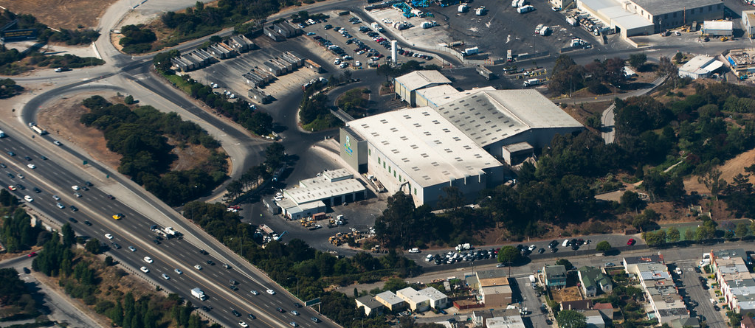
Oligopoly vs. Competitors in the Marketplace
Large corporations, such as the natural gas producer Kinder Morgan, can bring economies of scale to the marketplace.
Will that benefit consumers, or is more competition better?
(Photo credit: modification of work by Derrick Coetzee/Flickr Creative Commons)

Slide 5
Corporate Mergers and Acquisitions
Merger - when two separate firms combine to become a single firm.
Acquisition - when one firm purchases another.

Slide 6
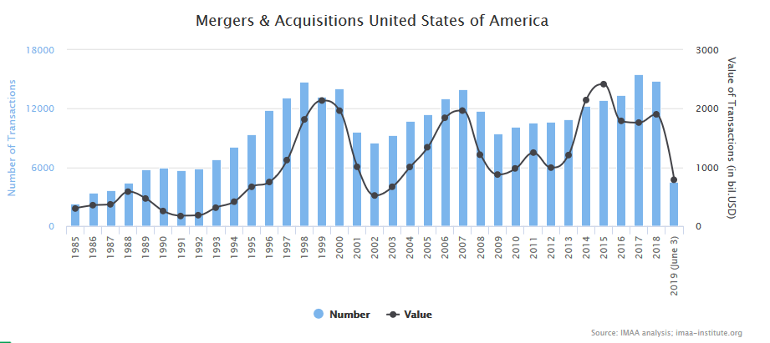
Number and Size of Mergers
The number of mergers in 1999-2000, 2006-2007, and 2014-15 were relatively high compared to the annual numbers seen at other times.
While 2001 and 2007 saw a high number of mergers, these were still only about half the number of mergers in 1999 and 2000.

Slide 7
The Traditional Way of Measuring Monopoly Power
Regulators have tried to measure the degree of monopoly power in an industry by looking at how con.
Concentration ratio – a traditional tool which measures the market share of total sales in the industry accounted for by the largest firms, typically the largest four to eight firms.
Market share - each firm’s proportion of total sales in that market.
Example: Five major publishers control 80% of the (higher education textbook) market, locking out competitors
Covering the Cost: Why We Can No Longer Afford to Ignore High Textbook Prices; Ethan Senack and Robert Donoghue, The Student PIRGs, February, 2016, p. 4

Slide 8
Measuring Monopoly Power – the Herfindahl-Hirshman Index
The Herfindahl-Hirshman Index (HHI) - measures market concentration by summing the square of the market share (s_{i}) of each firm in the industry.
$$HHI=\sum{s_{i}}$$
0 1500 2500 10,000
Competitive Moderately Highly Monopoly
Concentrated Concentrated

Slide 9
New Ideas on Defining a Market
Today, defining a market is often difficult and controversial.
For example, were Sirius and XM rivals only to each other or to every radio station in the country?
In recent decades, there have been two important shifts affecting how markets are defined:
Technology
Globalization

Slide 10
The New Way of Measuring Monopoly Power
The new approach to antitrust regulation involves detailed analysis of specific markets and companies instead of defining a market and adding up total sales.
It’s accomplished by:
Estimating the demand and supply curves that firms proposing a merger will likely face as a single firm.
Building a statistical model to estimates the likely outcome for consumers if the two firms are allowed to merge.

Slide 11
Regulating Anticompetitive Behavior
Under U.S. antitrust laws, monopoly itself is not illegal.
But, U.S. antitrust laws include rules against some restrictive practices.
Restrictive practices - practices that do not involve outright agreements to raise prices or to reduce the quantity produced, but that might have the effect of reducing competition.

Slide 12
Types of Restrictive Practices
Minimum resale price maintenance agreement - requires a dealer who buys from a manufacturer to sell for at least a certain minimum price.
Exclusive dealing - an agreement that a dealer will sell only products from one manufacturer.
Tying sales - a situation where a customer is allowed to buy one product only if the customer also buys another product.
Bundling - a situation in which multiple products are sold as one.

Slide 13
Regulating Natural Monopolies
Most true monopolies today in the U.S. are regulated, natural monopolies.
Natural monopoly - arises when average costs are declining over the range of production that satisfies market demand.
Typically happens when fixed costs are large relative to variable costs.

Slide 14
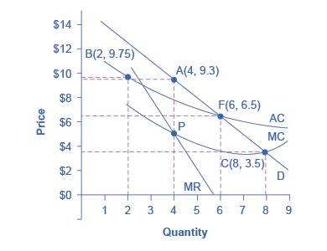
Regulatory Choices in Dealing with Natural Monopoly (1 of 3)
A natural monopoly maximizes profits by producing the quantity where MR = MC, and by then looking to the market demand curve to determine the price to charge for this quantity.
Without regulation, this firm will produce at point A, with a quantity of 4 and a price of $9.3.

Slide 15
Regulatory Choices in Dealing with Natural Monopoly (2 of 3)
If regulators chose to split this company in half then each half would produce at point B, with average costs of $9.75 and output of 2.
Note that this solution eliminates the cost efficiencies of a natural monopoly.

Slide 16
Regulatory Choices in Dealing with Natural Monopoly (3 of 3)
Regulators might require the firm to produce the output where MC=D, which is point C.
But, at point C, the firm is producing a quantity of 8 and selling at a price of $3.5, and incurring a loss.
The most likely choice by regulators is point F, a compromise where the firm produces a quantity of 6 and charge a price of $6.5.

Slide 17
Cost-Plus vs. Price Cap Regulation
Cost-plus regulation - when regulators permit a regulated firm to cover its costs and to make a normal level of profit.
Price cap regulation - when the regulator sets a price that a firm cannot exceed over the next few years.

Slide 18
The Great Deregulation Experiment
Deregulation - removing government controls over prices and quantities.
Regulatory capture – an instance of government failure in which the regulators advance the interests of the regulated industry over the interests of the public.
It is often accompanied by a “revolving door” between regulatory agencies and regulated industries.

Slide 19
The Effects of Deregulation
Sarbanes-Oxley Act - designed to increase confidence in financial information provided by public corporations to protect investors from accounting fraud.
Dodd-Frank Act - “To promote the financial stability of the United States by improving accountability and transparency in the financial system, to end “too big to fail,” to protect the American taxpayer by ending bailouts, [and] to protect consumers from abusive financial services practices…”

Slide 20
Regulation and Deregulation of U.S. Airlines (1 of 2)
1926 – First U.S. government regulation of airline industry, giving airlines permission to fly certain routes based on mail delivery needs.
1934 - Antitrust authorities charged the Postmaster General with colluding with the major airlines to monopolize the nation’s airways.
1938 - U.S. government created the Civil Aeronautics Board (CAB) to regulate airfares and routes instead.
1978 - Airline Deregulation Act took the government out of the business of determining airfares and schedules.
30 years after: greater competition from deregulation, reduced airfares, increased efficiency, offered more service, increased jobs.

Slide 21
Regulation and Deregulation of U.S. Airlines (2 of 2)
Questions:
Since deregulation, how has a string of mergers raised concerns over how competition might be compromised?
Has it affected the consumer product and demand for it?

