Slide 1
The Economics of Healthcare
An introduction to the economics of US healthcare, with a focus on the major players including consumers, providers, private insurance, and government

Slide 2
Acknowledgments
This PowerPoint presentation is based on and includes content derived from the following resources:
Creative Commons resource which may be downloaded for free at:
“A Healthy Economy”, chapter 16 from the book Theory and Applications of Economics (v. 1.0).
https://2012books.lardbucket.org/books/theory-and-applications-of-economics/s20-a-healthy-economy.html
Kaiser Family Foundation
Centers for Disease Control and Prevention
Peterson-Kaiser Health System Tracker

Slide 3
Key Questions
What are the main challenges facing healthcare and the healthcare industry in the U.S.?
What are the current trends in U.S. healthcare expenditures and why?
How and why do private consumers obtain health insurance and what are its basic features?
What important role does information play in health insurance and health service delivery?
How do changes in the demand for and supply of medical services affect healthcare spending and costs?
What are the justifications for government intervention in the health insurance markets
What are Medicare and Medicaid and how and for whom do they provide medical services?
How do healthcare spending and health outcomes differ across countries?

Slide 4
An Overview of the U.S. Healthcare System
How healthy is the population over time?
Is quality of healthcare improving?
How are healthcare costs changing?
Are healthcare services accessible to all?
Video: Health of the U.S. Healthcare System
https://www.healthsystemtracker.org/health-of-the-healthcare-system/
Source: Kaiser Family Foundation

Slide 5
Challenges for U.S. Healthcare
Increasing healthcare costs per capita.
Access to healthcare for the uninsured and populations in rural/remote communities.
Increasing healthcare spending as a percentage of GDP.
Commitment of private insurers to pay for certain care including preexisting conditions.
Commitment of medical providers to provide services given increasing costs.

Slide 6
Trends in National Health Expenditures
Year | Expenditures per Capita ($) | Expenditures as Percent of GDP
1960 | $ 146 | 5
1970 | 355 | 6.9
1980 | 1,108 | 8.9
1990 | 2,843 | 12.1
2000 | 4,856 | 13.3
2009 | 8,143 | 17.3
2015 | 9,994 | 17.7
2016 | 10,346 | 17.9
Source: Centers for Disease Control and Prevention
https://www.cdc.gov/nchs/data/hus/2017/093.pdf

Slide 7
Personal Healthcare Expenditures and Types of Expenditures
Source: Centers for Disease Control and Prevention

Slide 8
Health Insurance
Rational: Risk Sharing and Risk Aversion.
Nearly 60 percent of Americans obtain health insurance through their employer.
Employer contributions to employee health insurance are not taxable to workers
Lower average risk to underwrite a pool of employees than individually
A deductible: the amount of loss in dollars that the insured must pay before the insurer makes any payment.
A copayment: the proportion of the loss (after the deductible) that is the responsibility of the insured.

Slide 9
Informational Problems in Health Insurance
Adverse Selection: a situation in which those who buy health insurance are the ones most likely to need it.
Insurance companies may look to historical health information and employment status as signals of health risk.
Moral Hazard: a situation in which the insured may engage in more risky behavior after purchasing health insurance.
Insurance contracts contain incentives such as deductibles or copayments to minimize the insured’s risky behavior.

Slide 10
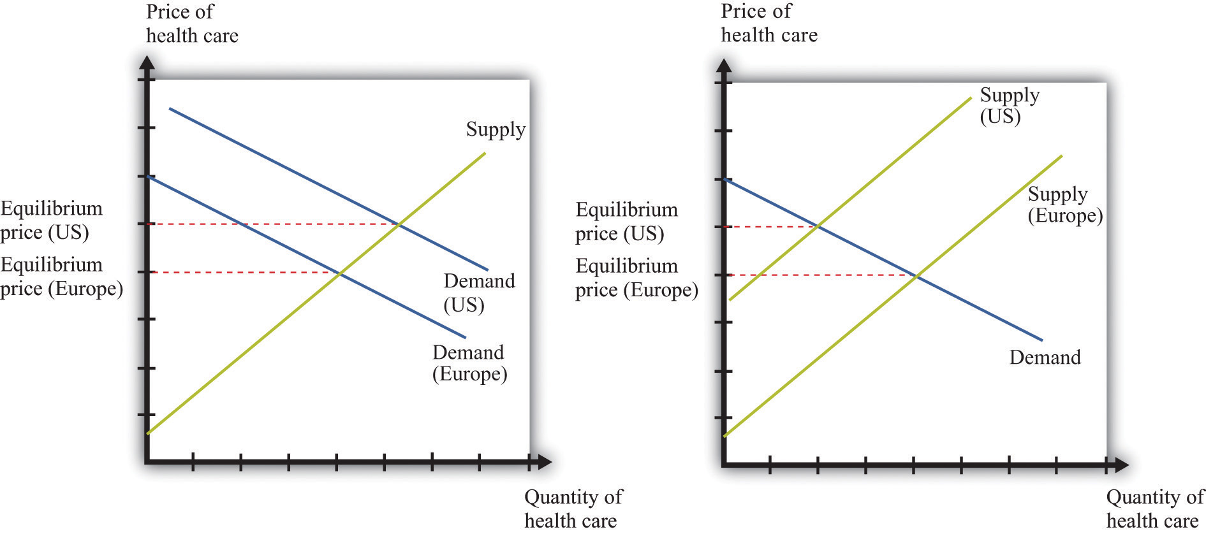
Traditional Approach: Changes in the Price of Healthcare Services
Left graph: Healthcare costs can increase due to an increase in the demand for healthcare services
Right graph: Healthcare costs can increase due to a decrease in the supply of healthcare services.

Slide 11
Demand for Healthcare Services
Determinants of the demand for healthcare services
Insurance agreements
Lack of information
Demand inelasticity
Healthcare as an investment
Heterogeneous services

Slide 12
Supply of Healthcare Services
Determinants of the supply of healthcare services
Market power of providers
Government providers
Private not-for-profit providers
Heterogeneous services
Professional barriers to entry: licensing
Technology

Slide 13
Medicaid
A joint federal and state program that provides healthcare to low-income households.
Per approval by the federal government, Medicaid is designed and run by each state and may vary by state.
For additional facts about Medicaid, refer to the following links:
http://www.cms.gov/MedicaidGenInfo
Link: https://www.kff.org/medicaid/issue-brief/10-things-to-know-about-medicaid-setting-the-facts-straight/
Source: Kaiser Family Foundation

Slide 14
Why Does Government Intervene in Healthcare?
Externalities: Benefits to others when services are provided to U.S. citizens.
The uninsured – Medicare and Medicaid.
Quality of care.
Commitment – Private insurers; Health services providers.
Availability of information – care, drugs, pricing.

Slide 15
Medicare: Facts and Figures
Medicare is a federal program that provides healthcare and services to the elderly and disabled.
The federal government sets fees for services by healthcare providers.
Refer to the following for key facts and information on Medicare spending:
http://www.medicare.gov/default.aspx
https://www.kff.org/medicare/issue-brief/the-facts-on-medicare-spending-and-financing/
Source: Kaiser Family Foundation

Slide 16
The Factors that Determine What Consumers Pay and What Providers Receive
Private Insurance
Medicaid
Medicare
Access to/availability of healthcare services

Slide 17
Healthcare Spending and Outcomes Across Countries
Growing gap in health expenditures as percent of GDP between the US and other advanced economies.
Per capita health expenditures higher in the US than in comparable advanced economies.
Decreasing growth rate in per capita health expenditures in the U.S. and other advanced economies.
The outcomes on access and quality relative to other advanced economies are mixed despite higher per capita U.S. health spending.
Source: https://www.healthsystemtracker.org/chart-collection/health-spending-u-s-compare-countries/#item-start

Slide 18
Health Consumption Expenditures Per Capita (purchasing power parity PPP adjusted)
Country | Expenditures per Capita ($)
Australia | $ 4,543
Belgium | 4,774
Canada | 4,826
Germany | 5,728
Switzerland | 8,009
United Kingdom | 4,246
United States | 10,224
Source: Peterson-Kaiser Health System Tracker
https://www.healthsystemtracker.org/chart-collection/health-spending-u-s-compare-countries/#item-start

