Slide 1
BIOLOGY 2E
Chapter 1 THE STUDY OF LIFE
PowerPoint Image Slideshow
This work is licensed under a Creative Commons Attribution-NonCommercial-ShareAlike 4.0 International License.

Slide 2
INTRODUCTION
Scientists believe the first forms of life were microorganisms, originating billions of years ago.
Our familiar mammals, birds, and flowers originated about 130 to 250 million years ago.
The genus humans belong to (Homo) originated about 2.5 million years ago.

Slide 3
Biology is the study of life, and so far, life is restricted to planet Earth.

Slide 4
1.1: THE SCIENCE OF BIOLOGY
Biology = the study of living organisms and their interactions
The discipline of Biology studies life at many different levels.
Can study life on a microscopic level (bacteria) to an entire ecosystem (impacts of deforestation on the rainforests).

Slide 5
Formerly called blue-green algae, these (a) cyanobacteria, shown here at 300x magnification under a light microscope, are some of Earth’s oldest life forms. These (b) stromatolites along the shores of Lake Thetis in Western Australia are ancient structures formed by the layering of cyanobacteria in shallow waters. (credit a: modification of work by NASA; credit b: modification of work by Ruth Ellison; scale-bar data from Matt Russell)

Slide 6
Escherichia coli (E. coli) bacteria, seen in this scanning electron micrograph, are normal residents of our digestive tracts that aid in the absorption of vitamin K and other nutrients. However, virulent strains are sometimes responsible for disease outbreaks. (credit: Eric Erbe, digital colorization by Christopher Pooley, both of USDA, ARS, EMU)

Slide 7
THE PROCESS OF SCIENCE
Science = knowledge that covers general truths or the operation of general laws, especially when acquired and tested by the scientific method
Scientific method = a method of research with defined steps that include experiments and careful observation
Hypothesis = a suggested explanation for an event, which one can test
Theory = a tested and confirmed explanation for observations or phenomena

Slide 8
NATURAL SCIENCES
Fields of study that attempt to comprehend the nature of the universe and natural phenomena.
Life sciences: studies living things
Includes general biology, cell biology, botany, zoology, etc.
Physical sciences: studies nonliving matter
Includes astronomy, geology, chemistry, and physics.
Interdisciplinary: combined studies
Includes biochemistry, biophysics, environmental science, etc.

Slide 9
SCIENTIFIC REASONING
Curiosity and inquiry are the driving forces behind science.
Methods of logical thinking…
Inductive reasoning
Uses related observations to arrive at a general conclusion.
Common in descriptive sciences.
Involves formulating generalizations inferred from careful observations and analyzing large amounts of data.
Reach a general conclusion from several specific observations.

Slide 10
Methods of logical thinking…(cont.)
Deductive reasoning
Used in hypothesis-based science.
Uses a general principle or law to forecast specific results.
Scientists can extrapolate and predict the specific results that would be valid if the general principles are valid.
Proceeds from the general to the particular.

Slide 11
SCIENTIFIC REASONING
As is the case in this example, the conclusion from inductive reasoning can often become the premise for inductive reasoning.

Slide 12
Main pathways of science…
Descriptive (or discovery) science
Usually inductive.
Aims to observe, explore, and discover.
Hypothesis-based science
Usually deductive.
Begins with a specific question or problem.
Includes a potential answer or solution that can be tested.
Scientific endeavors often involve both approaches.

Slide 13
THE SCIENTIFIC METHOD
Biologists study the living world by posing questions and seeking science-based responses.
Sir Francis Bacon first documented the scientific method.
The process typically starts with an observation that leads to a question.
Proposing a Hypothesis
Hypothesis = suggested explanation/solution that can be tested
To solve a problem, one can propose several hypotheses.
Predictions can be made from hypotheses.

Slide 14
Testing a Hypothesis
Valid hypotheses must be testable and falsifiable.
Science does not claim to “prove” anything.
Scientific understandings are always subject to modification based on incoming data.
To test the hypothesis a scientist will conduct one or more experiments designed to eliminate one or more of the hypotheses.

Slide 15
Testing a Hypothesis
Experiments will contain variables and controls.
Variable = any part of the experiment that might vary or change.
Control group = contains every feature of the experimental group except it is not given the manipulation that the researcher hypothesizes.
If results differ between the groups, then the difference must be due to the hypothesized manipulation.

Slide 16
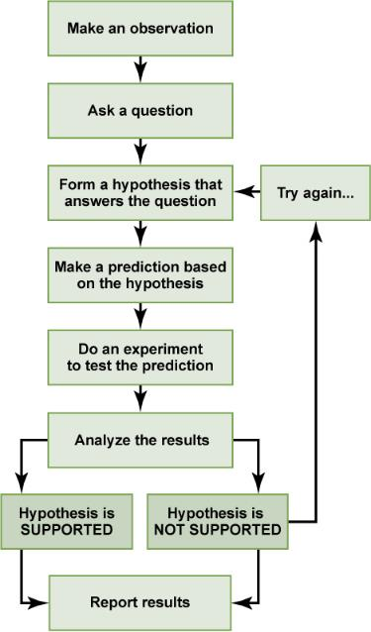
THE SCIENTIFIC METHOD
The scientific method consists of a series of well-defined steps. If a hypothesis is not supported by experimental data, a new hypothesis can be proposed.

Slide 17
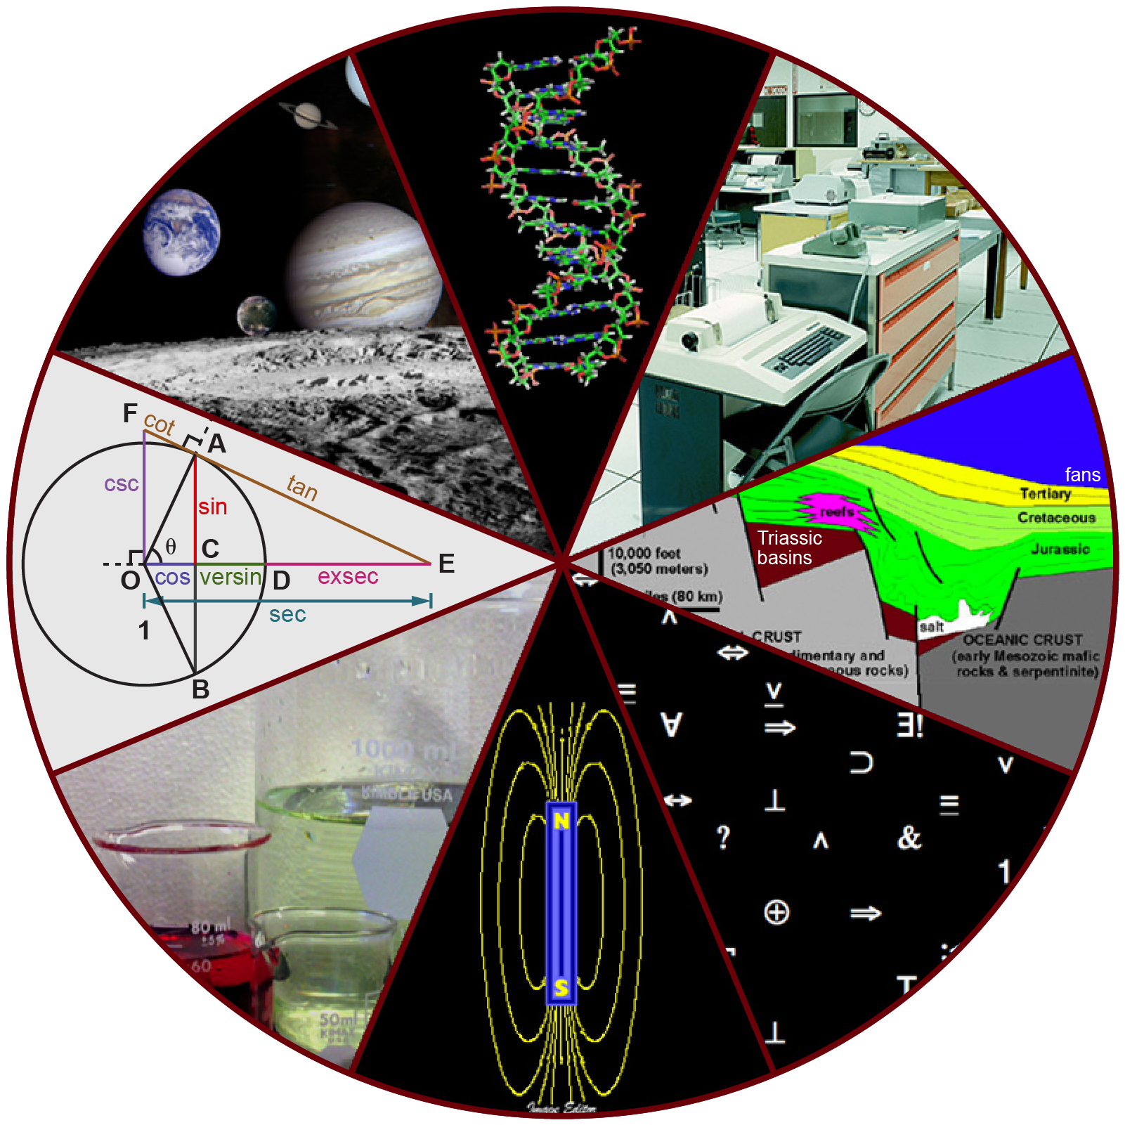
TWO TYPES OF SCIENCE: BASIC SCIENCE AND APPLIED SCIENCE
Is science valuable if it simply seeks to gain knowledge or must it solve specific problems?
Is science only valuable if it betters our lives?
Basic Science
“pure science”
Seeks to expand knowledge regardless of the short-term applications.

Slide 18
Applied Science
“technology”
Aims to use science to solve real-world problems (often defined by the researcher).
Both approaches are valid and can benefit from one another.

Slide 19
1.1
After Hurricane Ike struck the Gulf Coast in 2008, the U.S. Fish and Wildlife Service rescued this brown pelican. Thanks to applied science, scientists knew how to rehabilitate the bird. (credit: FEMA)

Slide 20
REPORTING SCIENTIFIC WORK
Scientists must share their findings for other researchers to expand and build upon their discoveries.
Communication is key in the field of science.
Peer-reviewed manuscripts = scientific papers that a scientist’s colleagues or peers review.
Publications in scientific journals and grant proposals are subject to peer reviews.

Slide 21
Scientific writings must follow strict guidelines...
Writing must be brief, concise, and accurate.
Needs to be succinct but detailed enough to allow reproduction of the experiment (reproducibility).
Often follows the “IMRaD” format.
Usually contains acknowledgements, a reference section, and an abstract.
A conclusions section will summarize the importance of the experimental findings.

Slide 22
PROCESS OF SCIENCE: PEER REVIEW
Scientific progress is typically made through the publication of peer-reviewed literature.
Peer review involves a blind process whereby scientists submit the details of their experiments, results and interpretations, and reviewers determine the veracity and merit of that work for publication.
These papers typically follow a format of
Abstract
Introduction
Methods
Results
Discussion
Literature Cited

Slide 23
1.2: THEMES AND CONCEPTS IN BIOLOGY
All living organisms share several key characteristics or functions…
Order
Response to stimuli (sensitivity)
Reproduction
Growth and development
Regulation
Homeostasis
Energy processing
Evolution

Slide 24
ORDER
Organisms are highly organized, coordinated structures.
May be unicellular or multicellular.

Slide 25
Order (cont.)
A toad represents a highly organized structure consisting of cells, tissues, organs, and organ systems. (credit: “Ivengo”/Wikimedia Commons)

Slide 26
RESPONSE TO STIMULI (SENSITIVITY)
Organisms must respond to diverse stimuli.
Response might be to internal or external stimuli.

Slide 27
Response to Stimuli (cont.)
The leaves of this sensitive plant (Mimosa pudica) will instantly droop and fold when touched. After a few minutes, the plant returns to normal. (credit: Alex Lomas)

Slide 28
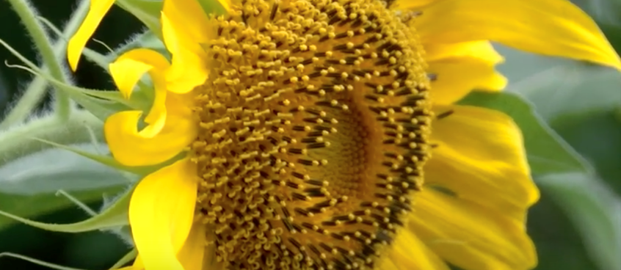
Response to Stimuli (cont.)
https://www.youtube.com/watch?v=OfBsWFfWkGE&feature=youtu.be

Slide 29
REPRODUCTION
DNA containing genes are passed along to the offspring.
Ensures the offspring will belong to the same species and will have similar (or identical) characteristics.
May be accomplished through asexual or sexual means.

Slide 30
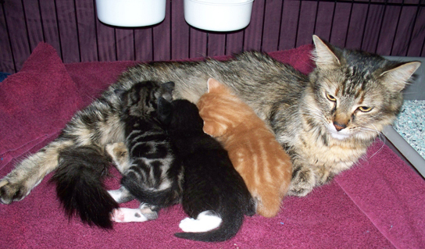
GROWTH AND DEVELOPMENT
Genes provide specific instructions for cell growth and development.

Slide 31
REGULATION
Regulatory mechanisms will coordinate internal functions, response to stimuli, and cope with environmental stresses.

Slide 32
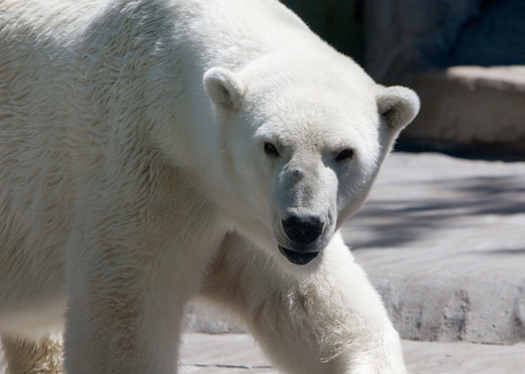
HOMEOSTASIS
Organisms can maintain internal conditions within a narrow range, despite environmental changes.

Slide 33
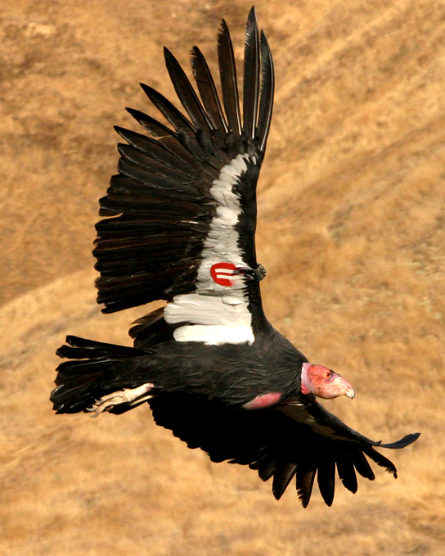
ENERGY PROCESSING
All organisms must use a source of energy for their metabolic activities.
Photosynthesis, chemosynthesis, and cellular respiration are the major processes involved.

Slide 34
LEVELS OF ORGANIZATION OF LIVING THINGS
Atom
Smallest unit of matter.
Molecule
At least two atoms held together by chemical bonds.
Macromolecules
Large molecules often formed by polymerization.
Organelles
Small structures that exist in cells.
Cell
Can be prokaryotic or eukaryotic.
Smallest fundamental unit of life.

Slide 35
Tissue
Groups of similar cells carrying out similar or related functions.
Organ
Tissues grouped together performing a common function.
Organ system
Consists of functionally related organs.
Organism
Individual living entities.

Slide 36
Population
Individuals of a species living within a specific area.
Community
Sum of all populations inhabiting an area.
Ecosystem
All the biotic (living) and abiotic (nonliving) parts of an environment.
Biosphere
Collection of all ecosystems.

Slide 37
BIOLOGICAL LEVELS OF ORGANIZATION

Slide 38
THE DIVERSITY OF LIFE
Life has a tremendous amount of diversity.
The source of this diversity is evolution.
Evolution = process of gradual change during which new species arise from older ones
Phylogenetic tree = diagram showing the evolutionary relationships among varying species

Slide 39
This phylogenetic tree was constructed by microbiologist Carl Woese using data obtained from sequencing ribosomal RNA genes. The tree shows the separation of living organisms into three domains: Bacteria, Archaea, and Eukarya. Bacteria and Archaea are prokaryotes, single-celled organisms lacking intracellular organelles. (credit: Eric Gaba; NASA Astrobiology Institute)

Slide 40
BRANCHES OF BIOLOGICAL STUDY
The scope of biology is broad and therefore contains many branches and subdisciplines.
Molecular biology and biochemistry study biological processes at the molecular and chemical level.
Microbiology studies the structure and function of single-celled organisms.
Neurobiology studies the biology of the nervous system.
Paleontology studies life’s history.
Zoology studies the form and function of animals.
Botany studies the form and function of plants.

Slide 41
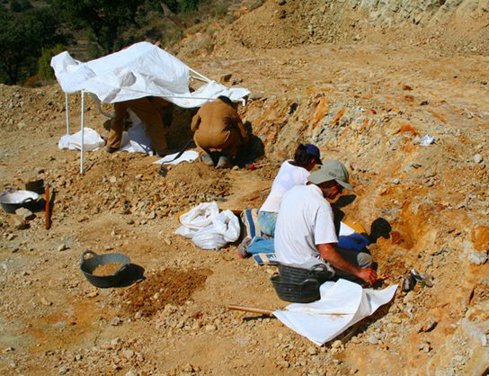
Figure 1.20 Researchers work on excavating dinosaur fossils at a site in Castellón, Spain. (credit: Mario Modesto)

