Slide 1
BIOLOGY
Chapter 2 THE CHEMICAL FOUNDATION OF LIFE
PowerPoint Image Slideshow

Slide 2
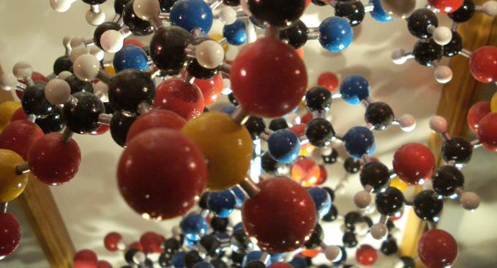
FIGURE 2.1
Atoms are the building blocks of molecules found in the universe—air, soil, water, rocks . . . and also the cells of all living organisms. In this model of an organic molecule, the atoms of carbon (black), hydrogen (white), nitrogen (blue), oxygen (red), and sulfur (yellow) are shown in proportional atomic size. The silver rods indicate chemical bonds. (credit: modification of work by Christian Guthier)
This OpenStax ancillary resource is © Rice University under a CC-BY 4.0 International license; it may be reproduced or modified but must be attributed to OpenStax, Rice University and any changes must be noted. Any images credited to other sources are similarly available for reproduction, but must be attributed to their sources.

Slide 3
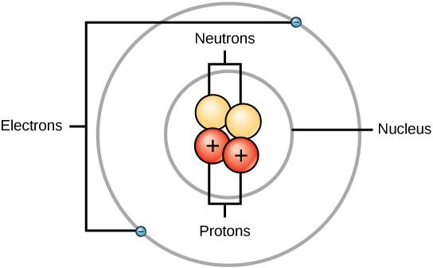
FIGURE 2.2
Elements, such as helium, depicted here, are made up of atoms. Atoms are made up of protons and neutrons located within the nucleus, with electrons in orbitals surrounding the nucleus.
This OpenStax ancillary resource is © Rice University under a CC-BY 4.0 International license; it may be reproduced or modified but must be attributed to OpenStax, Rice University and any changes must be noted. Any images credited to other sources are similarly available for reproduction, but must be attributed to their sources.

Slide 4
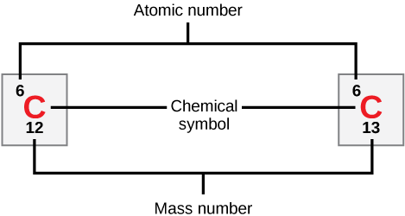
FIGURE 2.3
Carbon has an atomic number of six, and two stable isotopes with mass numbers of twelve and thirteen, respectively. Its relative atomic mass is 12.11.
This OpenStax ancillary resource is © Rice University under a CC-BY 4.0 International license; it may be reproduced or modified but must be attributed to OpenStax, Rice University and any changes must be noted. Any images credited to other sources are similarly available for reproduction, but must be attributed to their sources.

Slide 5
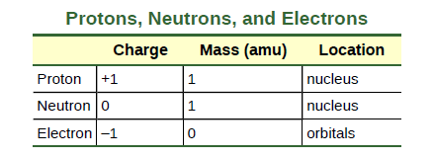
Mass, Charge and Location of subatomic particles
Although not significant contributors to mass, electrons do contribute greatly to the atom’s charge, as each electron has a negative charge equal to the proton's positive charge.
In uncharged, neutral atoms, the number of electrons orbiting the nucleus is equal to the number of protons inside the nucleus. In these atoms, the positive and negative charges cancel each other out, leading to an atom with no net charge.

Slide 6
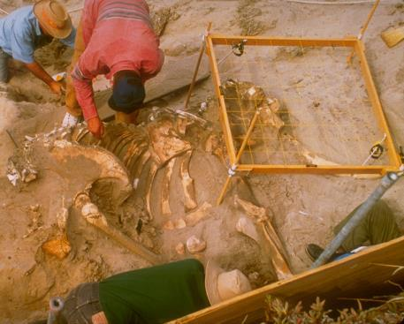
FIGURE 2.4
Scientists can determine the age of carbon-containing remains less than about 50,000 years old, such as this pygmy mammoth, using carbon dating. (credit: Bill Faulkner, NPS)
This OpenStax ancillary resource is © Rice University under a CC-BY 4.0 International license; it may be reproduced or modified but must be attributed to OpenStax, Rice University and any changes must be noted. Any images credited to other sources are similarly available for reproduction, but must be attributed to their sources.

Slide 7
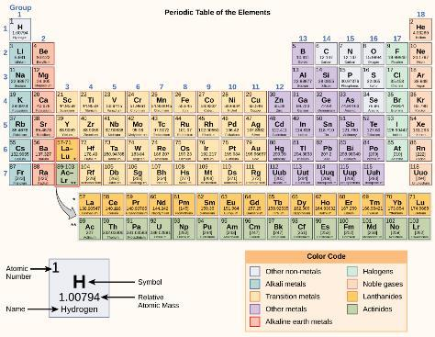
FIGURE 2.5
The periodic table shows the atomic mass and atomic number of each element. The atomic number appears above the symbol for the element and the approximate atomic mass appears below it.
This OpenStax ancillary resource is © Rice University under a CC-BY 4.0 International license; it may be reproduced or modified but must be attributed to OpenStax, Rice University and any changes must be noted. Any images credited to other sources are similarly available for reproduction, but must be attributed to their sources.

Slide 8
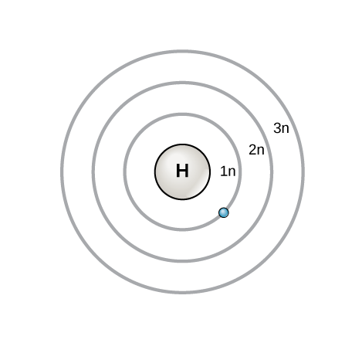
FIGURE 2.6
In 1913, Niels Bohrs developed the Bohr model in which electrons exist within principal shells. An electron normally exists in the lowest energy shell available, which is the one closest to the nucleus. Energy from a photon of light can bump it up to a higher energy shell, but this situation is unstable, and the electron quickly decays back to the ground state. In the process, it releases a photon of light.
This OpenStax ancillary resource is © Rice University under a CC-BY 4.0 International license; it may be reproduced or modified but must be attributed to OpenStax, Rice University and any changes must be noted. Any images credited to other sources are similarly available for reproduction, but must be attributed to their sources.

Slide 9
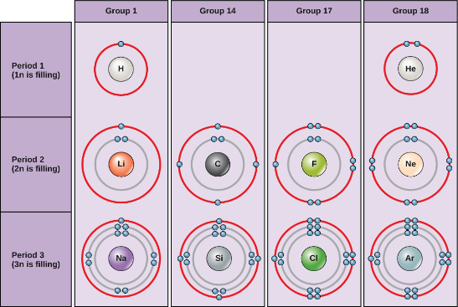
FIGURE 2.7
Bohr diagrams indicate how many electrons fill each principal shell. Group 18 elements (helium, neon, and argon are shown) have a full outer, or valence, shell. A full valence shell is the most stable electron configuration. Elements in other groups have partially filled valence shells and gain or lose electrons to achieve a stable electron configuration.
This OpenStax ancillary resource is © Rice University under a CC-BY 4.0 International license; it may be reproduced or modified but must be attributed to OpenStax, Rice University and any changes must be noted. Any images credited to other sources are similarly available for reproduction, but must be attributed to their sources.

Slide 10
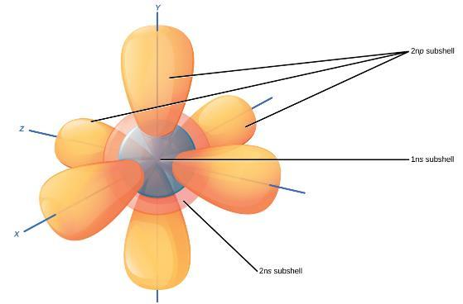
FIGURE 2.8
The s subshells are shaped like spheres. Both the 1n and 2n principal shells have an s orbital, but the size of the sphere is larger in the 2n orbital. Each sphere is a single orbital. p subshells are made up of three dumbbell-shaped orbitals. Principal shell 2n has a p subshell, but shell 1 does not.
This OpenStax ancillary resource is © Rice University under a CC-BY 4.0 International license; it may be reproduced or modified but must be attributed to OpenStax, Rice University and any changes must be noted. Any images credited to other sources are similarly available for reproduction, but must be attributed to their sources.

Slide 11
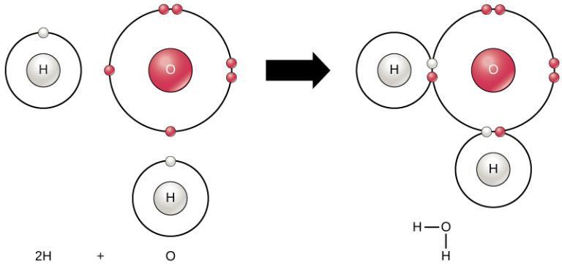
FIGURE 2.9
Two or more atoms may bond with each other to form a molecule. When two hydrogens and an oxygen share electrons via covalent bonds it forms a water molecule.
This OpenStax ancillary resource is © Rice University under a CC-BY 4.0 International license; it may be reproduced or modified but must be attributed to OpenStax, Rice University and any changes must be noted. Any images credited to other sources are similarly available for reproduction, but must be attributed to their sources.

Slide 12
FIGURE 2.10
A double bond joins the oxygen atoms in an O2 molecule.
This OpenStax ancillary resource is © Rice University under a CC-BY 4.0 International license; it may be reproduced or modified but must be attributed to OpenStax, Rice University and any changes must be noted. Any images credited to other sources are similarly available for reproduction, but must be attributed to their sources.

Slide 13
FIGURE 2.11
In the formation of an ionic compound, metals lose electrons and nonmetals gain electrons to achieve an octet.
This OpenStax ancillary resource is © Rice University under a CC-BY 4.0 International license; it may be reproduced or modified but must be attributed to OpenStax, Rice University and any changes must be noted. Any images credited to other sources are similarly available for reproduction, but must be attributed to their sources.

Slide 14
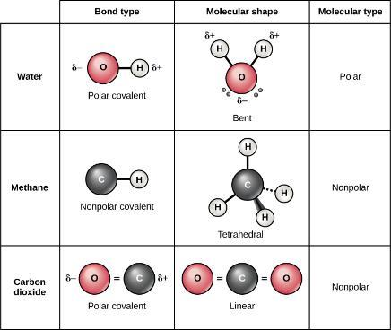
FIGURE 2.12
Whether a molecule is polar or nonpolar depends both on bond type and molecular shape. Both water and carbon dioxide have polar covalent bonds, but carbon dioxide is linear, so the partial charges on the molecule cancel each other out.
This OpenStax ancillary resource is © Rice University under a CC-BY 4.0 International license; it may be reproduced or modified but must be attributed to OpenStax, Rice University and any changes must be noted. Any images credited to other sources are similarly available for reproduction, but must be attributed to their sources.

Slide 15
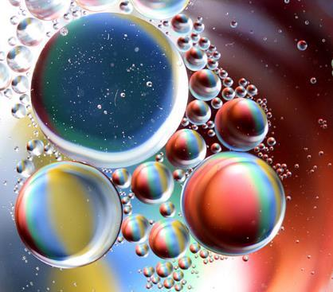
FIGURE 2.13
Oil and water do not mix. As this macro image of oil and water shows, oil does not dissolve in water but forms droplets instead. This is because it is a nonpolar compound. (credit: Gautam Dogra).
This OpenStax ancillary resource is © Rice University under a CC-BY 4.0 International license; it may be reproduced or modified but must be attributed to OpenStax, Rice University and any changes must be noted. Any images credited to other sources are similarly available for reproduction, but must be attributed to their sources.

Slide 16
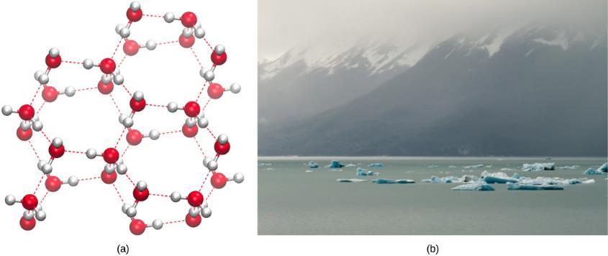
FIGURE 2.14
Hydrogen bonding makes ice less dense than liquid water. The (a) lattice structure of ice makes it less dense than the freely flowing molecules of liquid water, enabling it to (b) float on water. (credit a: modification of work by Jane Whitney, image created using Visual Molecular Dynamics (VMD) software ^{[1]}; credit b: modification of work by Carlos Ponte)
This OpenStax ancillary resource is © Rice University under a CC-BY 4.0 International license; it may be reproduced or modified but must be attributed to OpenStax, Rice University and any changes must be noted. Any images credited to other sources are similarly available for reproduction, but must be attributed to their sources.

Slide 17
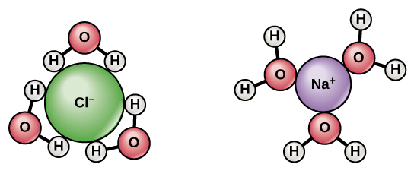
FIGURE 2.15
When we mix table salt (NaCl) in water, it forms spheres of hydration around the ions.
This OpenStax ancillary resource is © Rice University under a CC-BY 4.0 International license; it may be reproduced or modified but must be attributed to OpenStax, Rice University and any changes must be noted. Any images credited to other sources are similarly available for reproduction, but must be attributed to their sources.

Slide 18
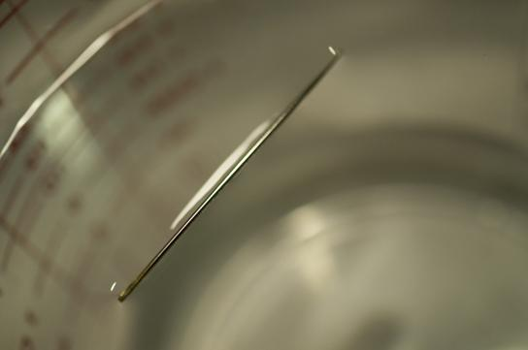
FIGURE 2.16
A needle's weight pulls the surface downward. At the same time, the surface tension pulls it up, suspending it on the water's surface preventing it from sinking. Notice the indentation in the water around the needle. (credit: Cory Zanker)
This OpenStax ancillary resource is © Rice University under a CC-BY 4.0 International license; it may be reproduced or modified but must be attributed to OpenStax, Rice University and any changes must be noted. Any images credited to other sources are similarly available for reproduction, but must be attributed to their sources.

Slide 19
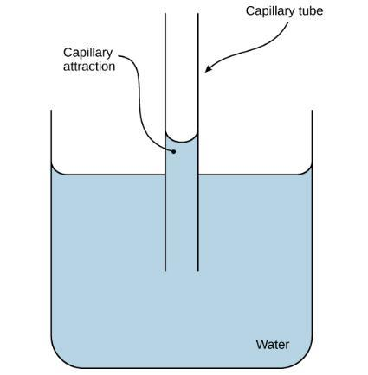
FIGURE 2.17
The adhesive forces exerted by the glass' internal surface exceeding the cohesive forces between the water molecules themselves causes capillary action in a glass tube. (credit: modification of work by Pearson-Scott Foresman, donated to the Wikimedia Foundation)
This OpenStax ancillary resource is © Rice University under a CC-BY 4.0 International license; it may be reproduced or modified but must be attributed to OpenStax, Rice University and any changes must be noted. Any images credited to other sources are similarly available for reproduction, but must be attributed to their sources.

Slide 20
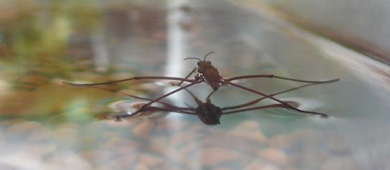
FIGURE 2.18
Water’s cohesive and adhesive properties allow this water strider (Gerris sp.) to stay afloat. (credit: Tim Vickers)
This OpenStax ancillary resource is © Rice University under a CC-BY 4.0 International license; it may be reproduced or modified but must be attributed to OpenStax, Rice University and any changes must be noted. Any images credited to other sources are similarly available for reproduction, but must be attributed to their sources.

Slide 21
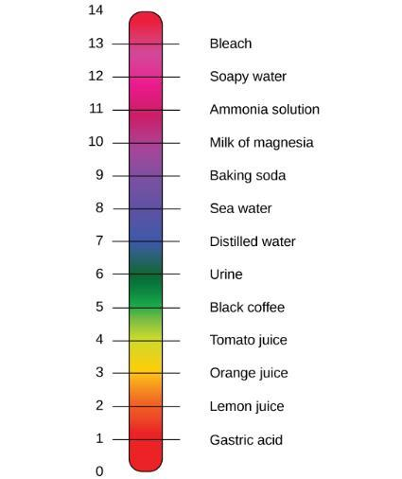
FIGURE 2.19
The pH scale measures the concentration of hydrogen ions (H⁺) in a solution. (credit: modification of work by Edward Stevens)
This OpenStax ancillary resource is © Rice University under a CC-BY 4.0 International license; it may be reproduced or modified but must be attributed to OpenStax, Rice University and any changes must be noted. Any images credited to other sources are similarly available for reproduction, but must be attributed to their sources.

Slide 22
FIGURE 2.20
This diagram shows the body’s buffering of blood pH levels. The blue arrows show the process of raising pH as more CO₂ is made. The purple arrows indicate the reverse process: the lowering of pH as more bicarbonate is created.
This OpenStax ancillary resource is © Rice University under a CC-BY 4.0 International license; it may be reproduced or modified but must be attributed to OpenStax, Rice University and any changes must be noted. Any images credited to other sources are similarly available for reproduction, but must be attributed to their sources.

Slide 23
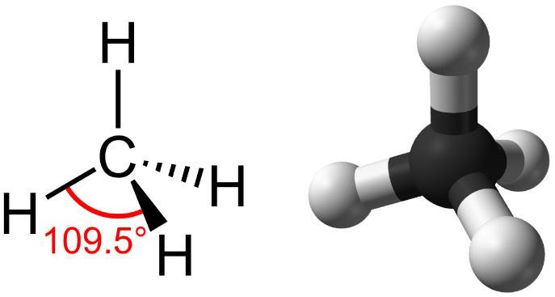
FIGURE 2.21
Methane has a tetrahedral geometry, with each of the four hydrogen atoms spaced 109.5° apart.
This OpenStax ancillary resource is © Rice University under a CC-BY 4.0 International license; it may be reproduced or modified but must be attributed to OpenStax, Rice University and any changes must be noted. Any images credited to other sources are similarly available for reproduction, but must be attributed to their sources.

Slide 24
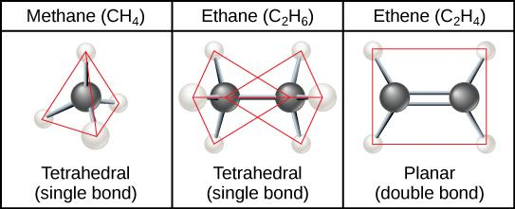
FIGURE 2.22
When carbon forms single bonds with other atoms, the shape is tetrahedral. When two carbon atoms form a double bond, the shape is planar, or flat. Single bonds, like those found in ethane, are able to rotate. Double bonds, like those found in ethane, cannot rotate, so the atoms on either side are locked in place.
This OpenStax ancillary resource is © Rice University under a CC-BY 4.0 International license; it may be reproduced or modified but must be attributed to OpenStax, Rice University and any changes must be noted. Any images credited to other sources are similarly available for reproduction, but must be attributed to their sources.

Slide 25
FIGURE 2.23
Carbon can form five-and six membered rings. Single or double bonds may connect the carbons in the ring, and nitrogen may be substituted for carbon.
This OpenStax ancillary resource is © Rice University under a CC-BY 4.0 International license; it may be reproduced or modified but must be attributed to OpenStax, Rice University and any changes must be noted. Any images credited to other sources are similarly available for reproduction, but must be attributed to their sources.

Slide 26
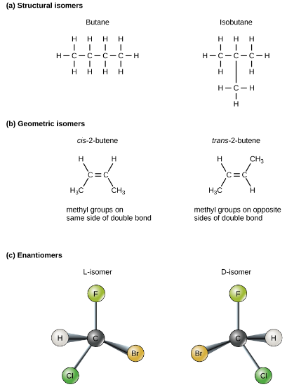
FIGURE 2.24
Molecules that have the same number and type of atoms arranged differently are called isomers.
Structural isomers have a different covalent arrangement of atoms.
Geometric isomers have a different arrangement of atoms around a double bond.
Enantiomers are mirror images of each other.
This OpenStax ancillary resource is © Rice University under a CC-BY 4.0 International license; it may be reproduced or modified but must be attributed to OpenStax, Rice University and any changes must be noted. Any images credited to other sources are similarly available for reproduction, but must be attributed to their sources.

Slide 27
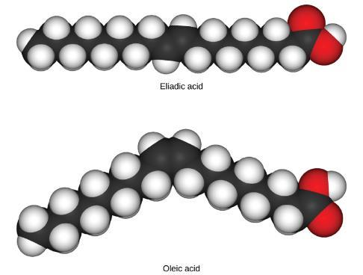
FIGURE 2.25
These space-filling models show a cis (oleic acid) and a trans (eliadic acid) fatty acid. Notice the bend in the molecule cause by the cis configuration.
This OpenStax ancillary resource is © Rice University under a CC-BY 4.0 International license; it may be reproduced or modified but must be attributed to OpenStax, Rice University and any changes must be noted. Any images credited to other sources are similarly available for reproduction, but must be attributed to their sources.

Slide 28
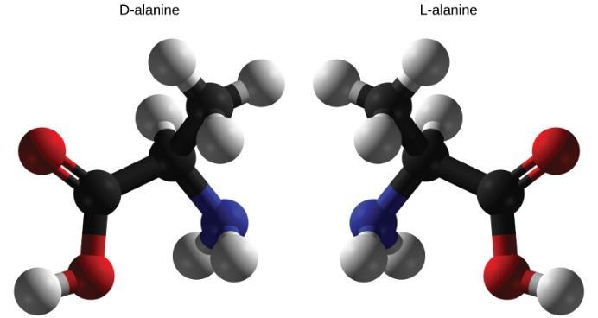
FIGURE 2.26
D-alanine and L-alanine are examples of enantiomers or mirror images. Only the L-forms of amino acids are used to make proteins.
This OpenStax ancillary resource is © Rice University under a CC-BY 4.0 International license; it may be reproduced or modified but must be attributed to OpenStax, Rice University and any changes must be noted. Any images credited to other sources are similarly available for reproduction, but must be attributed to their sources.

Slide 29
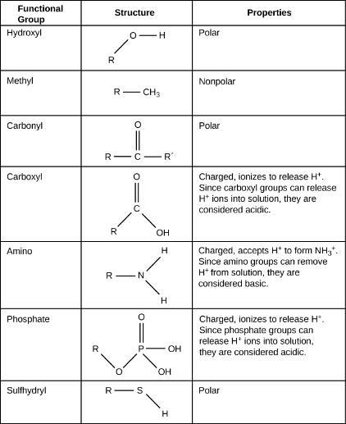
FIGURE 2.27
These functional groups are in many different biological molecules. R, also known as R-group, is an abbreviation for any group in which a carbon or hydrogen atom is attached to the rest of the molecule.
This OpenStax ancillary resource is © Rice University under a CC-BY 4.0 International license; it may be reproduced or modified but must be attributed to OpenStax, Rice University and any changes must be noted. Any images credited to other sources are similarly available for reproduction, but must be attributed to their sources.

Slide 30
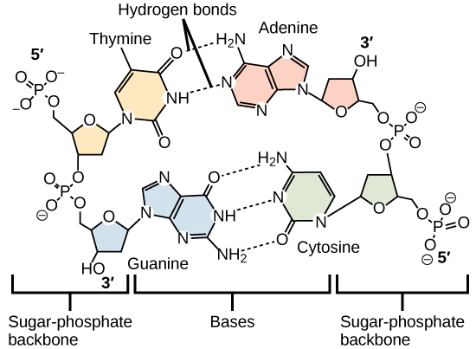
FIGURE 2.28
Hydrogen bonds connect two strands of DNA together to create the double-helix structure.
This OpenStax ancillary resource is © Rice University under a CC-BY 4.0 International license; it may be reproduced or modified but must be attributed to OpenStax, Rice University and any changes must be noted. Any images credited to other sources are similarly available for reproduction, but must be attributed to their sources.

