Slide 1




BIOLOGY 2E
Chapter 6 METABOLISM
PowerPoint Image Slideshow
This work is licensed under a Creative Commons Attribution-NonCommercial-ShareAlike 4.0 International License.

Slide 2
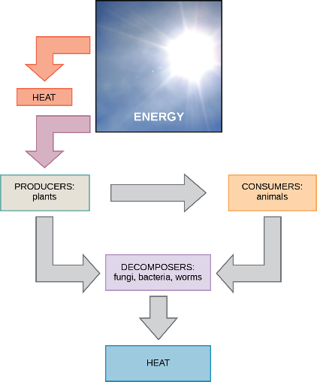
6.1 ENERGY AND METABOLISM
The energy that sustains most of the earth’s life forms comes from the sun.
Bioenergetics is the study of energy flow through a living system
Figure 6.2

Slide 3
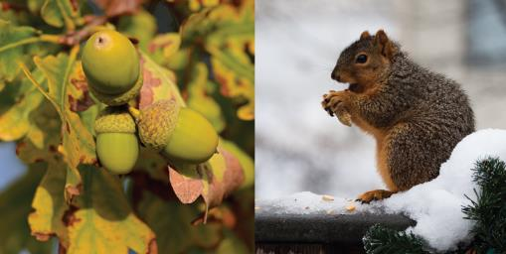
METABOLISM
Metabolism refers to all chemical reactions of a cell or organism.
A metabolic pathway is series of biochemical reactions that converts one or more substrates into a final product.
  For example, energy from the sun is captured during photosynthesis to convert CO₂ and H₂O into glucose (C₆H₁₂O₆).
  The energy stored in glucose is released during cellular respiration, regenerating CO₂ and H₂O.
(credit “acorn”: modification of work by Noel Reynolds; credit “squirrel”: modification of work by Dawn Huczek)

Slide 4
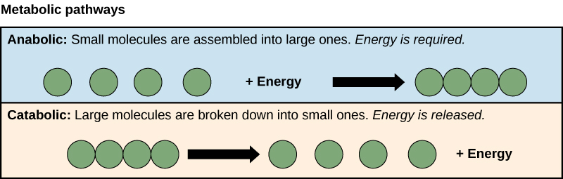
METABOLIC PATHWAYS
Two types of chemical reactions/metabolic pathways are required to maintain the cell’s energy balance.
Those that require energy and synthesize larger molecules are called anabolic.
Those that release energy and break down large molecules into smaller molecules are called catabolic.

Slide 5
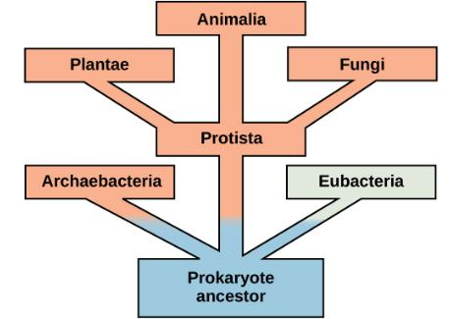
EVOLUTION OF METABOLIC PATHWAYS
All types of life share some of the same metabolic pathways.
This commonality provides more evidence that organisms evolved from common ancestors.
Over time, these pathways diverged. As organisms evolved, they developed specialized enzymes to help them adapt to their environments.

Slide 6
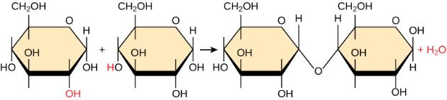
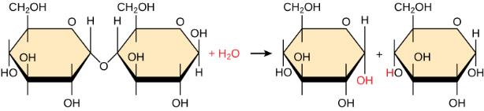
ANABOLIC AND CATABOLIC EXAMPLES

Slide 7
DISCUSSION QUESTION
Is photosynthesis an anabolic or catabolic pathway? Note: In photosynthesis energy from the sun is captured and used to convert CO₂ and H₂O into glucose (C₆H₁₂O₆).
What evidence supports your answer?

Slide 8
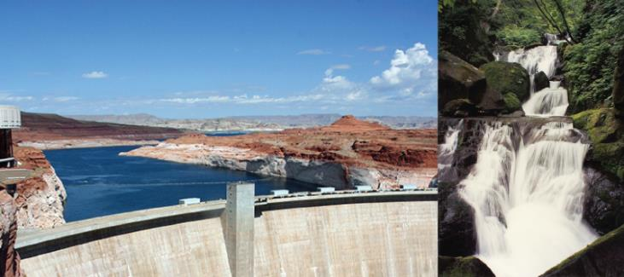
6.2 POTENTIAL AND KINETIC ENERGY
Energy is the ability to do work and is classified as kinetic or potential
(credit “dam”: modification of work by "Pascal"/Flickr; credit “waterfall”: modification of work by Frank Gualtieri)

Slide 9

KINETIC ENERGY
Kinetic energy- is energy associated with movement
  A person walking or a ball rolling
  Molecules moving
  Electromagnetic radiation (light or heat)
  Sound waves
(credit “dam”: modification of work by "Pascal"/Flickr; credit “waterfall”: modification of work by Frank Gualtieri)

Slide 10
POTENTIAL ENERGY
Potential energy- is stored energy that has the ability to do work
  Compressed spring
  Tautly pulled rubber band
  Concentration gradients
    Chemical
    Electrochemical
  Chemical energy- chemical bonds
(credit “dam”: modification of work by "Pascal"/Flickr; credit “waterfall”: modification of work by Frank Gualtieri)

Slide 11
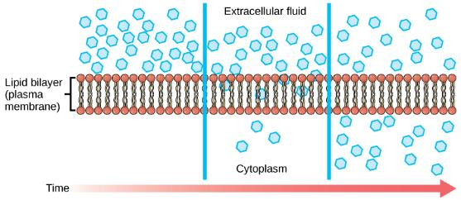


POTENTIAL ENERGY
Concentration gradient - Energy associated with chemical/ electrochemical gradients across the plasma membrane.
Chemical energy – Energy stored in chemical bonds.

Slide 12
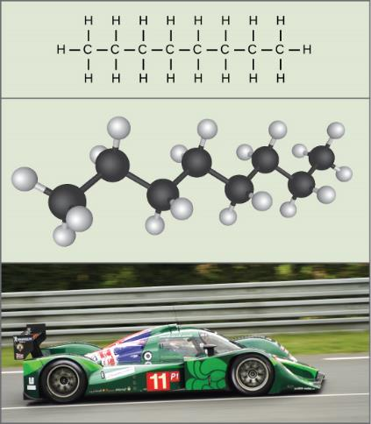
POTENTIAL AND KINETIC ENERGY
The potential energy stored in the chemical bonds of gasoline can be transformed into kinetic energy that allows a car to move on a racetrack.
(credit “car”: modification of work by Russell Trow)

Slide 13
6.2 FREE ENERGY
To explore the bioenergetics of a system, we study the amount of energy exchanged in a metabolic reaction
Gibb’s Free Energy (G) = amount of energy available to do work (aka usable energy)
All chemical reactions affect G; change in G after a reaction is abbreviated as ∆G.
ΔG = ΔH − TΔS
Where:
ΔH = change in total energy of the system (enthalpy)
T = Temperature in Kelvin
ΔS = change in entropy (energy lost to disorder)

Slide 14
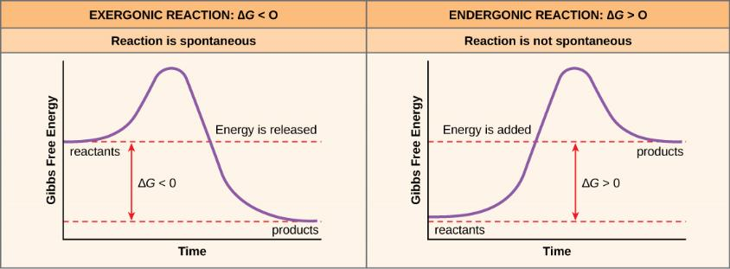
FREE ENERGY- EXERGONIC REACTIONS
If energy is released in a chemical reaction, then ΔG<0 (negative).
Products of these reactions will have less energy than the reactants
These reactions are classified as exergonic.
Exergonic reactions are spontaneous reactions because they can occur without the addition of energy.

Slide 15
FREE ENERGY

Slide 16
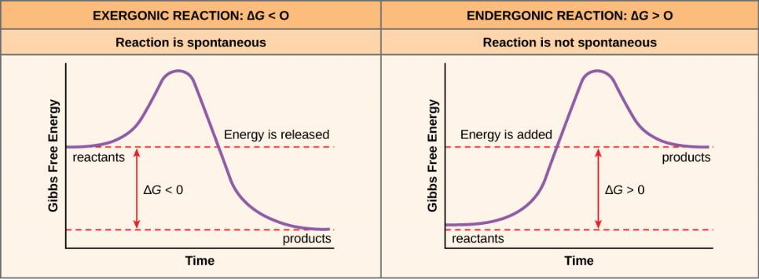
FREE ENERGY-ENDERGONIC REACTIONS
If a chemical reaction requires an input of energy, then ΔG>0 (positive).
Products of these reactions will have more energy than the reactants.
These reactions are classified as endergonic
Endergonic reactions require a net input of energy to occur.

Slide 17
FREE ENERGY

Slide 18
DISCUSSION QUESTION
Which chemical reaction is exergonic?

Slide 19
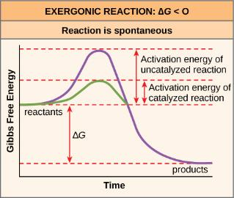
6.2 ACTIVATION ENERGY
Activation energy is the energy required for a reaction to proceed.
  It causes reactant(s) to become contorted and unstable, which allows the bond(s) to be broken or formed.
  This unstable state is called the transition state.
  Once in the transition state, the reaction occurs very quickly.

Slide 20
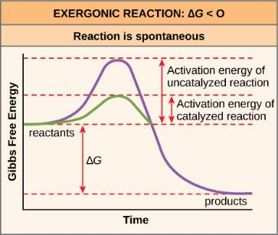
ACTIVATION ENERGY

Slide 21
ACTIVATION ENERGY
Heat energy is the main source for activation energy in a cell
Heat helps reactants reach their transition state
Activation energy is why, for example, the rusting of iron happens slowly despite being a spontaneous, exergonic reaction.

Slide 22
ACTIVATION ENERGY- CATALYSTS
A catalyst decreases the activation energy, thus speeding up the rate of a reaction.
Enzymes function as catalysts in living organisms.

Slide 23
ACTIVATION ENERGY
The breakdown of gasoline is an example of an exergonic reaction. A spark is required to provide sufficient heat (activation energy) to exceed the activation energy. Once the reaction begins, enough heat is released to drive additional reactions.

Slide 24
6.3 THE LAWS OF THERMODYNAMICS
Thermodynamics is the study of energy and energy transfer involving physical matter.
First law of thermodynamics - states that the total amount of energy in the universe if constant: energy cannot be created or destroyed.
Second law of thermodynamics - states that the transfer/conversion of energy is not completely efficient.
  With each chemical reaction, some energy is lost in a form that is unusable, such as heat energy. The result is increased entropy (disorder).

Slide 25
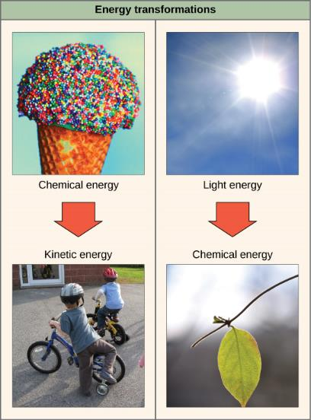
LAWS OF THERMODYNAMICS- SECOND LAW
Energy Transfer- energy is lost as heat in both examples of energy transformation.
Chemical energy (potential energy) from the molecules in the ice cream cone are converted to kinetic energy used to ride a bike.
Kinetic energy in sunlight is converted to chemical energy in molecules of glucose through photosynthesis.
(credit “ice cream”: modification of work by D. Sharon Pruitt; credit “kids on bikes”: modification of work by Michelle Riggen-Ransom)

Slide 26
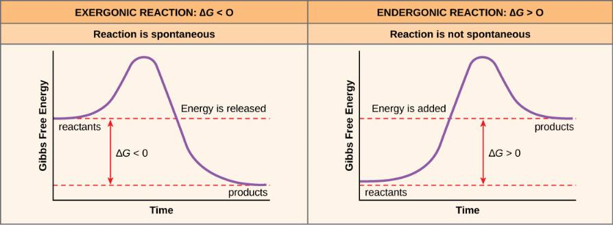
6.4 ADENOSINE TRIPHOSPHATE (ATP)
What provides the energy for a cell’s endergonic reactions?
ATP is the cell’s primary energy currency, providing energy for most endergonic reactions in a cell.

Slide 27
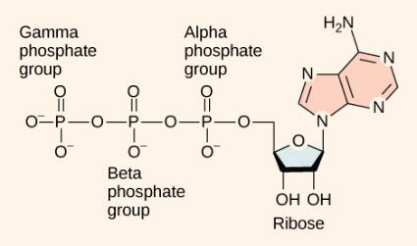
ATP STRUCTURE
ATP is composed of an adenosine backbone with three phosphate groups attached.
Adenosine is a nucleoside consisting of the nitrogenous base adenine and a five-carbon sugar, ribose.
The three phosphate groups, in order of closest to furthest from the ribose sugar, are alpha, beta, and gamma.
The bonds that link the phosphate groups are high-energy bonds: When the bonds are broken, the products have lower free energy than the reactants.

Slide 28
ATP HYDROLYSIS
ATP + H₂O 🡪 ADP + P_{i} + free energy
ΔG = -7.3 kcal/mol
ATP is an unstable molecule and will hydrolyze quickly.
If it is not coupled with an endergonic reaction this energy is lost as heat.
If it is coupled with an endergonic reaction, much of the energy can be transferred to drive that reaction.
ATP Hydrolysis is reversible

Slide 29
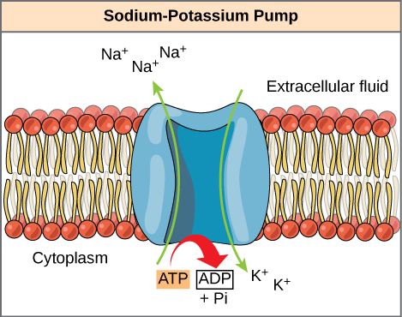
ATP HYDROLYSIS
The sodium-potassium pump is an example of energy coupling. The energy derived from exergonic ATP hydrolysis is used by the integral protein to pump 3 sodium ions out of the cell and 2 potassium ions into the cell.

Slide 30
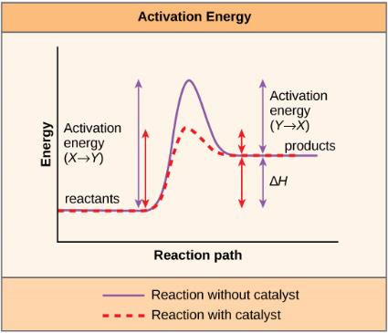
6.5 ENZYMES
Enzymes are protein* catalysts that speed up reactions by lowering the required activation energy.
Enzymes bind with reactant molecules promoting bond-breaking and bond-forming processes.
Enzymes are very specific, catalyzing a single reaction.
* While the overwhelming majority of biological enzymes are proteins, some non-protein enzymes exist, including ribozymes.

Slide 31
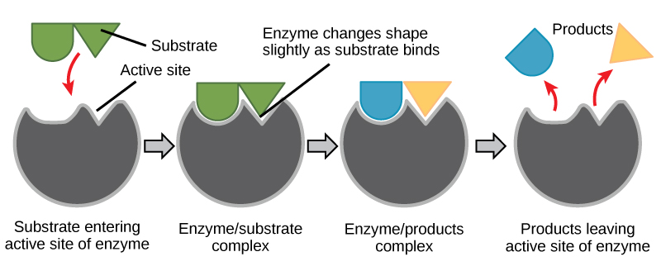
ENZYME FUNCTION
Substrate specificity - The shape of the enzyme and reactants (substrates) determines this specificity.
Substrate molecules interact at the enzyme’s active site.
Forming the enzyme/substrate complex (bonds are broken or formed)
Products are released and the enzyme is unchanged.

Slide 32
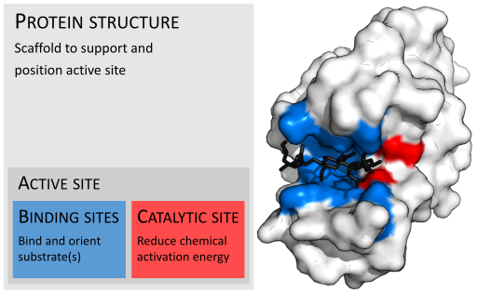
ENZYMES - ACTIVE SITE
Credit: Thomas Shafee [CC BY 4.0 (https://creativecommons.org/licenses/by/4.0)], from Wikimedia Commons

Slide 33
ENZYMES- INDUCED FIT
At the active site, there is a mild shift in shape that optimizes reactions. This is called induced fit.
The slight changes at the active site maximizes the catalysis.
Induced fit is a relatively recent discovery. It is viewed as an expansion of the previously held “lock-and-key” model.

Slide 34
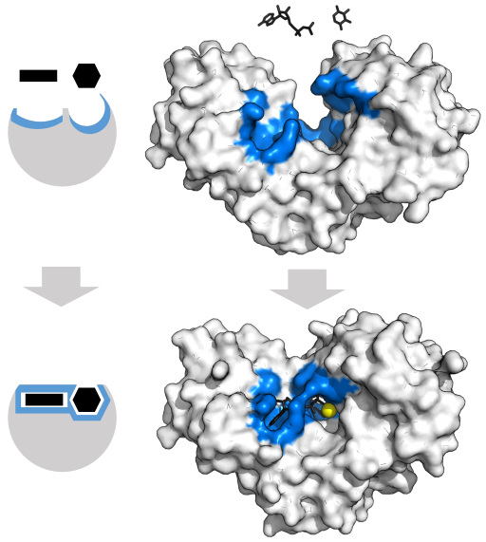
ENZYMES - INDUCED FIT
By Thomas Shafee [CC BY 4.0 (https://creativecommons.org/licenses/by/4.0)], from Wikimedia Commons

Slide 35
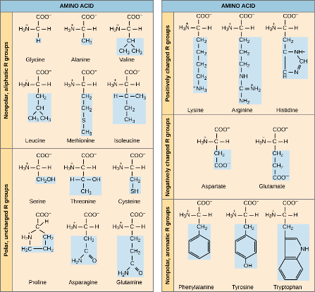
ENZYME STRUCTURE
REVIEW: PROTEIN STRUCTURE REVISITED
Reminder, the 3-D shape of a protein is determined by the amino acid sequence of the polypeptide.
The AAs of the active site are particularly important for the enzyme’s function – allow binding with unique substrate(s)
The cellular environment is also important for enzyme function:
  Suboptimal temperatures can denature the enzyme (loss of shape)
  Suboptimal pHs can reduce substrate-enzyme binding
Figure 3.23.
Refer back to Chapter 3 for more information.

Slide 36
ENZYMES- ACTIVATION ENERGY
The enzyme can help the substrate reach its transition state, lowering activation energy, in one of the following ways:
  position two substrates so they align perfectly for the reaction
  provide an optimal environment, i.e. acidic or polar, within the active site for the reaction
  contort/stress the substrate so it is less stable and more likely to react
  temporarily react with the substrate (chemically change it) making the substrate less stable and more likely to react.

Slide 37
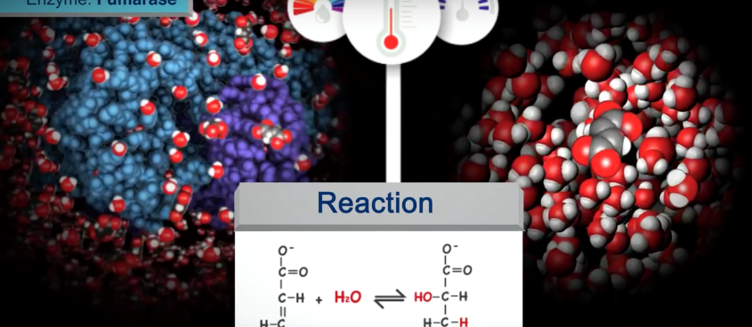
ENZYME FUNCTION - OVERVIEW
https://pdb101.rcsb.org/learn/videos/how-enzymes-work

Slide 38
ENZYME REGULATION
Regulation of enzyme activity helps cells control their environment to meet their specific needs.
  For example, digestive cells in your stomach work harder after a meal than when you sleep.
Enzymes can be regulated by
  Modifications to temperature and/or pH
  Production of molecules that inhibit or promote enzyme function
  Availability of coenzymes or cofactors

Slide 39
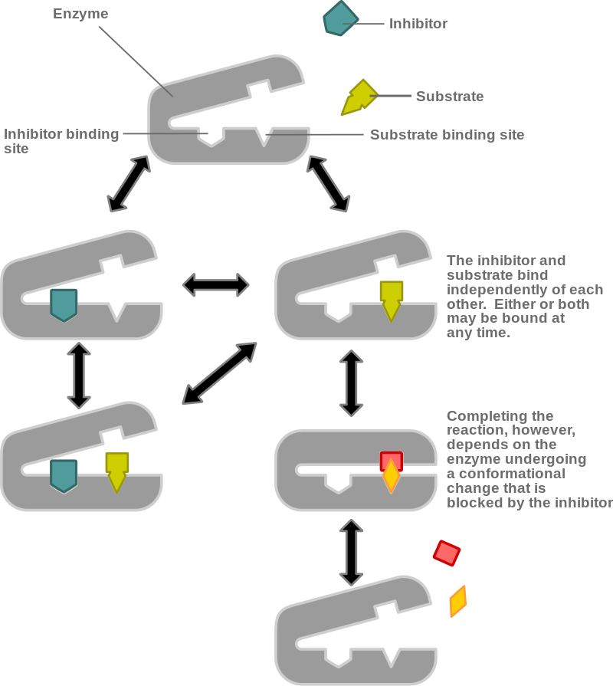
ENZYME REGULATION - INHIBITION
Competitive inhibitors have a similar shape to the substrate, competing with the substrate for the active site.
Noncompetitive inhibitors bind to the enzyme at a different location, causing a slower reaction rate
https://en.wikipedia.org/wiki/Non-competitive_inhibition

Slide 40
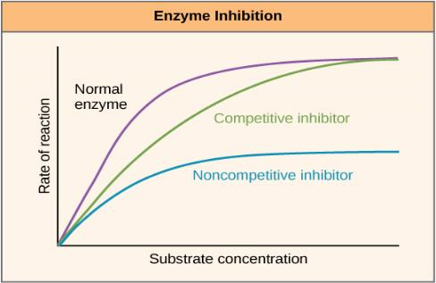
ENZYMES REGULATION - INHIBITION (FIGURE 6.17)
Competitive inhibitors slow reaction rates but do not affect the maximal rate.
Noncompetitive inhibitors slow rates and reduce the maximal rate.
Maximal rate – speed of a reaction when substrate is not limited.

Slide 41
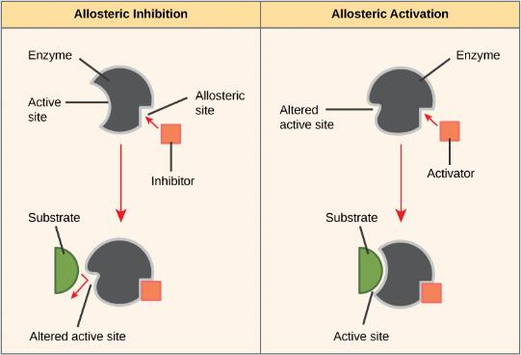
ENZYME REGULATION (FIGURE 6.18)
Allosteric inhibitors modify the active site of the enzyme so that substrate binding is reduced or prevented.
Allosteric activators modify the active site of the enzyme so that the affinity for the substrate increases.

Slide 42
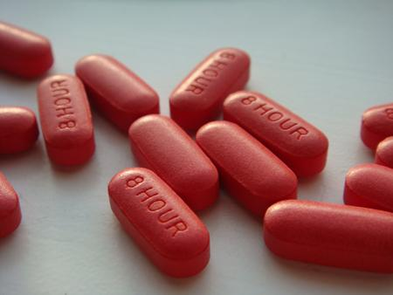
ENZYMES
EVERY DAY CONNECTION - DRUG DISCOVERY (FIGURE 6.19)
Have you ever wondered how pharmaceutical drugs are developed?
Look for inhibitors to enzymes in specific pathways

Slide 43
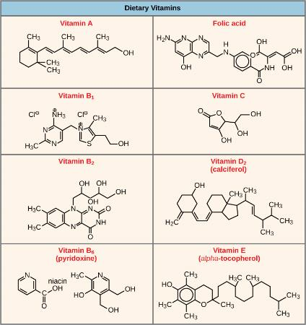
ENZYME COFACTORS
Some enzymes require one or more cofactors or coenzymes to function.
These molecules are provided primarily from the diet.
Cofactors are inorganic ions (Fe²⁺, Mg²⁺, Zn²⁺)
  DNA polymerase requires Zn²⁺
Coenzymes are organic molecules, including ATP, NADH⁺, and vitamins

Slide 44
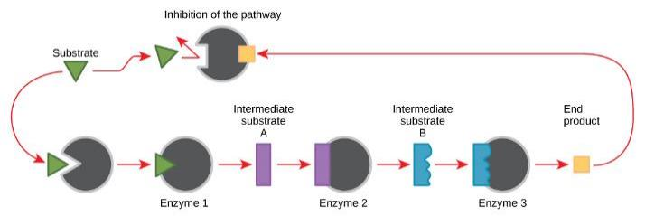
ENZYME REGULATION- FEEDBACK INHIBITION (FIGURE 6.21)
Metabolic pathways are a series of reactions catalyzed by multiple enzymes.
Feedback inhibition, where the end product of the pathway inhibits an upstream step, is an important regulatory mechanism in cells.
  Ex. ATP is an allosteric inhibitor for some enzymes involved in cellular respiration

Slide 45
COPYRIGHT AND CREDITS
This PowerPoint file is copyright Rice University. All Rights Reserved.
Modified by E.G. Cantonwine, Valdosta State University.
Updated for Biology 2e by OpenStax.

