Slide 1
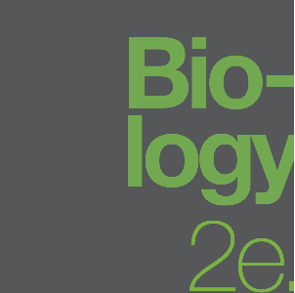
BIOLOGY 2E
Chapter 8 PHOTOSYNTHESIS
PowerPoint Image Slideshow
This work is licensed under a Creative Commons Attribution-NonCommercial-ShareAlike 4.0 International License.

Slide 2
8.1 OVERVIEW OF PHOTOSYNTHESIS
Autotroph
means “self-feeders”
Organisms that use a source of energy to from organic molecules from small inorganic molecules (CO₂).
Include plants (a), algae (b), cyanobacteria (c) and some thermophilic bacteria (d and e.)

Slide 3
8.1 OVERVIEW OF PHOTOSYNTHESIS
Types of autotrophs
Photoautotrophs use sunlight as the source of energy.
Plants (a)
algae (b)
cyanobacteria (c)

Slide 4
8.1 OVERVIEW OF PHOTOSYNTHESIS
Types of autotrophs
Chemoautotrophs use inorganic compounds as a source of energy
thermophilic bacteria (d and e)

Slide 5
8.1 OVERVIEW OF PHOTOSYNTHESIS
Heterotrophs,
means “other-feeder”
Require organic molecules from other living organisms.
Include animals, fungi, and most bacteria.

Slide 6
8.1 OVERVIEW OF PHOTOSYNTHESIS
Photosynthesis uses energy in sunlight to produce organic molecules such as glucose from carbon dioxide and water. Oxygen is a waste product.

Slide 7
8.1 OVERVIEW OF PHOTOSYNTHESIS
Basic Photosynthetic Structures
https://www.youtube.com/watch?v=Bf-RFPaZeAM
Animation from California Academy of Sciences

Slide 8
8.1 OVERVIEW OF PHOTOSYNTHESIS
Basic Photosynthetic Structures
Chloroplasts
Double membrane (outer & inner)
Stroma (not to be confused with stoma)
Grana (stacks of thylakoids)
Lumen is inside the thylakoid

Slide 9
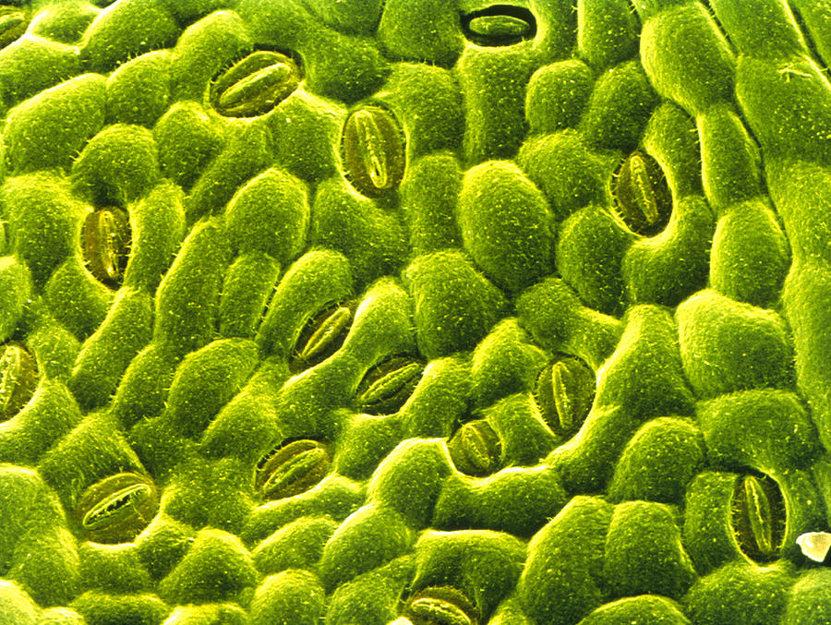
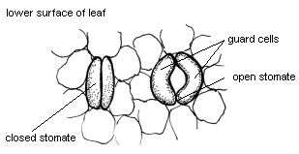
8.1 OVERVIEW OF PHOTOSYNTHESIS
Overall Reaction:
6 CO₂ + 6 H₂O 🡪 C₆H₁₂O₆ + 6 O₂
CO₂ is acquired from the air as a result of gas exchange through the stomata (small pores on the leaf underside).
H₂O is absorbed by the roots from the soil.
O₂ waste product exits through the stomata.
Stoma (singular)
Guard cells

Slide 10
8.1 OVERVIEW OF PHOTOSYNTHESIS
https://www.youtube.com/watch?v=gz5L1GUaaXA

Slide 11
8.1 OVERVIEW OF PHOTOSYNTHESIS
The two metabolic pathways of photosynthesis are:
The Light-dependent reaction
The Calvin cycle

Slide 12
8.1 OVERVIEW OF PHOTOSYNTHESIS

Slide 13
8.1 OVERVIEW OF PHOTOSYNTHESIS
The light-dependent reactions
convert energy in sunlight to chemical energy in ATP and NADPH (an e⁻ carrier).
occurs in the thylakoid membranes of chloroplasts.

Slide 14
8.1 OVERVIEW OF PHOTOSYNTHESIS
The Calvin cycle
uses the ATP and NADPH (produced in the light reactions) to make organic molecules such as glucose.
occurs in the stroma of chloroplasts.

Slide 15
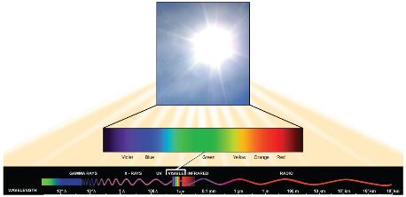
8.2 THE LIGHT-DEPENDENT REACTIONS
Sunlight is electromagnetic energy, composed of photons that travel as waves.
Longer wavelengths (crests farther apart) carry less energy than shorter wavelengths
Plants use wavelengths in the visible portion of the electromagnetic spectrum.

Slide 16
8.2 THE LIGHT-DEPENDENT REACTIONS
The Electromagnetic Spectrum
Wavelengths are measured in nm (nanometers).
In the visible range (700-400nm), the violets have the shortest wavelengths (and most energy) and the reds have the longest.

Slide 17
8.2 THE LIGHT-DEPENDENT REACTIONS

Slide 18
8.2 THE LIGHT-DEPENDENT REACTIONS
Pigments
absorb specific wavelengths of light;
absorbance spectrum.
Located in thylakoid membranes
chlorophyll a (a)
chlorophyll b (b)
β-carotene (c), a type of carotinoid.

Slide 19
8.2 THE LIGHT-DEPENDENT REACTIONS
Chlorophyll a (a) and b (b) capture light for photosynthesis; reason leaves are green (green wavelengths are reflected).
β-carotene (c) helps to protect photosystems by dissipating excess energy; also found in cells of carrots & oranges
Other carotenoids include lycopene (red color of tomato) and zeaxanthin (yellow of corn seeds)

Slide 20
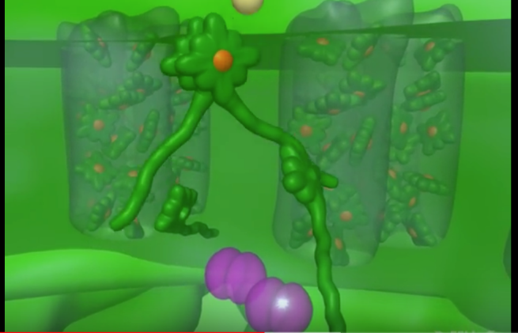
8.2 THE LIGHT-DEPENDENT REACTIONS
https://www.youtube.com/watch?v=hj_WKgnL6MI&t=72s

Slide 21
8.2 LIGHT-DEPENDENT REACTIONS

Slide 22
8.2 LIGHT-DEPENDENT REACTIONS
Thylakoid membranes
Photosystems II and I; sites of light absorption
Molecules that make up an Electron Transport Chain (ETC)
Two enzyme complexes, NADP reductase and ATP synthase

Slide 23
8.2 THE LIGHT-DEPENDENT REACTIONS
Photosystem II and I consists of a light-harvesting complex and a reaction center.
Pigments in the light-harvesting complex pass light energy to two special chlorophyll a molecules in the reaction center.

Slide 24
8.2 THE LIGHT-DEPENDENT REACTIONS
In the reaction center, the light excites an e⁻ from the chlorophyll a pair, passing it to the first electron acceptor of the ETC.
This is a light driven redox reaction
The lost electron is then replaced.
In photosystem II (a), the e⁻ comes from the splitting of water, which releases oxygen as a waste product
In photosystem I (b), the e⁻ comes from the ETC

Slide 25
8.2 THE LIGHT-DEPENDENT REACTIONS

Slide 26
8.2 THE LIGHT-DEPENDENT REACTIONS

Slide 27
8.2 THE LIGHT-DEPENDENT REACTIONS
Electron Transport Chains
There are two parts of the ETC in the light reaction
The final e- acceptor of the light reaction is NADP+ 🡪 yielding NADPH

Slide 28
8.2 THE LIGHT-DEPENDENT REACTIONS
Electron Transport Chains
The first part transports e- from PSII to PSI via
Plastoquinone Qb
Cytochrome b₆f
Plastocyanin
The second transports e- from PSI to NADP reductase via
Ferredoxin

Slide 29
8.2 THE LIGHT-DEPENDENT REACTIONS
Just like the ETC of cellular respiration:
a H+ gradient is created as e- are passed through the electron transport chain
pumped into the lumen space
ATP synthase uses the gradient to generate ATP (chemiosmosis)

Slide 30
8.3 USING LIGHT ENERGY TO MAKE ORGANIC MOLECULES
The ATP and NADPH from the Light-Dependent Reaction are used in the Calvin Cycle.

Slide 31
8.3 USING LIGHT ENERGY TO MAKE ORGANIC MOLECULES

Slide 32
8.3 USING LIGHT ENERGY TO MAKE ORGANIC MOLECULES
Three stages to the Calvin Cycle:
Fixation: CO2 added to RuBP by enzyme Rubisco to generate 2 3-PGA molecules
Reduction: ATP and NADPH used to add e⁻ and make sugar (GA3P)
Note 2 GA3P 🡪 glucose
Regeneration: of RuBP from GA3P
Three turns of the cycle are required to make one GA3P.

Slide 33
8.3 USING LIGHT ENERGY TO MAKE ORGANIC MOLECULES
RuBisCO
ribulose bisphosphate carboxylase oxygenase
Two functions:
carboxylase (Calvin cycle)
oxygenase (photorespiration – which does not result in sugar production).
Some plants (CAM), like this cactus, have evolved mechanisms to reduce the chances of photorespiration.

Slide 34
8.1 OVERVIEW OF PHOTOSYNTHESIS
https://www.youtube.com/watch?v=gz5L1GUaaXA

Slide 35
This PowerPoint file is copyright Rice University.
Modified and improved by E.G Cantonwine, Valdosta State University.
Revised for OpenStax Biology 2e by OpenStax.

