Slide 1
BIOLOGY 2E
Chapter 10 CELL REPRODUCTION
PowerPoint Image Slideshow
This work is licensed under a Creative Commons Attribution-NonCommercial-ShareAlike 4.0 International License.

Slide 2
10.1 Overview of Cell Division
Cell Cycle (includes mitosis)
In multicellular organisms
for growth, maintenance and repair of cells and tissues
occurs throughout the body
one cell divides into two identical cells
In single-celled organisms
for reproduction (clones)
Meiosis (Chapter 11)
In multicellular organisms
produces haploid gametes (egg and sperm)
occurs in reproductive tissues
one cell divides twice forming four non-identical cells

Slide 3
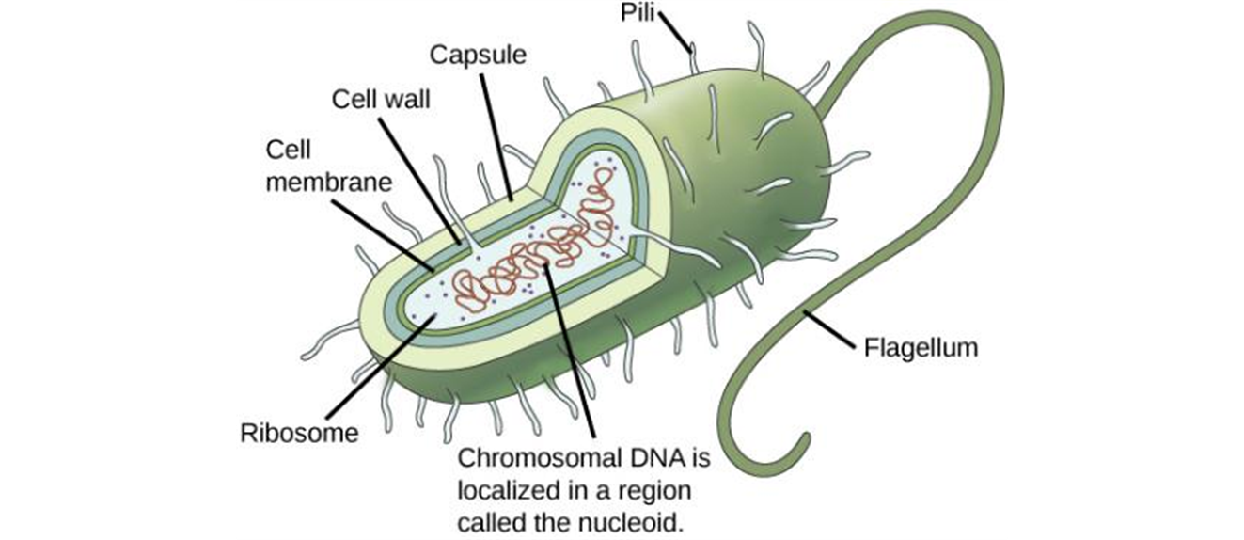
10.1 Genomic DNA
Prokaryotes
Consists of one double-stranded circular DNA molecule
Nucleoid region
Additional smaller loops of DNA called plasmids may be present
These are not necessary for normal growth but may have important info
Exchange of plasmids with other cells allows gene transfer in prokaryotes

Slide 4
10.1 Genomic DNA

Slide 5
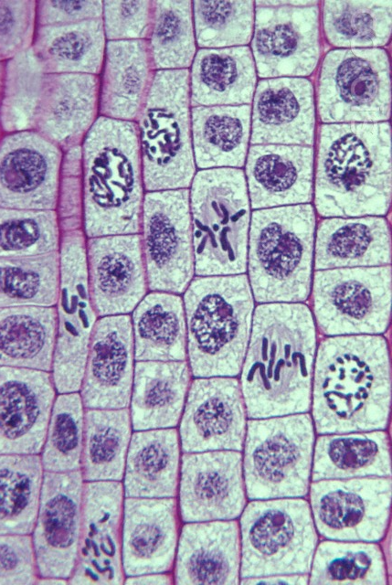
10.1 Genomic DNA
Eukaryotes
Consists of several double-stranded linear DNA molecules
Chromosomes
Within the nucleus
Number of chromosomes vary among different species

Slide 6
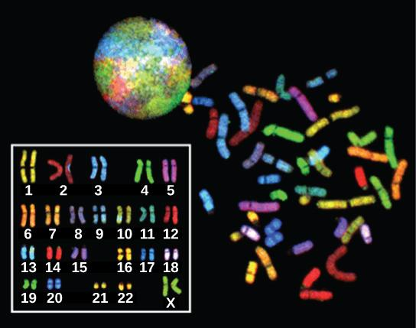
10.1 Genomic DNA
Eukaryotes
Karyotype
Arrangement of chromosomes according to size
Within the nucleus
Somatic cells (body cells)
Two sets of chromosomes
Diploid
Gametes (egg and sperm)
One set of chromosomes
Haploid

Slide 7
10.1 Genomic DNA
Eukaryotes- Humans
Autosomal Chromosomes
Chromosome pairs # 1-22
Homologous Chromosomes
Same size/length
Same centromere position
Genes for the same characters
Sex Chromosomes
Chromosome pair # 23
Determines sex
XX-female
XY- male (heterologous pair)

Slide 8
10.1 Genomic DNA

Slide 9
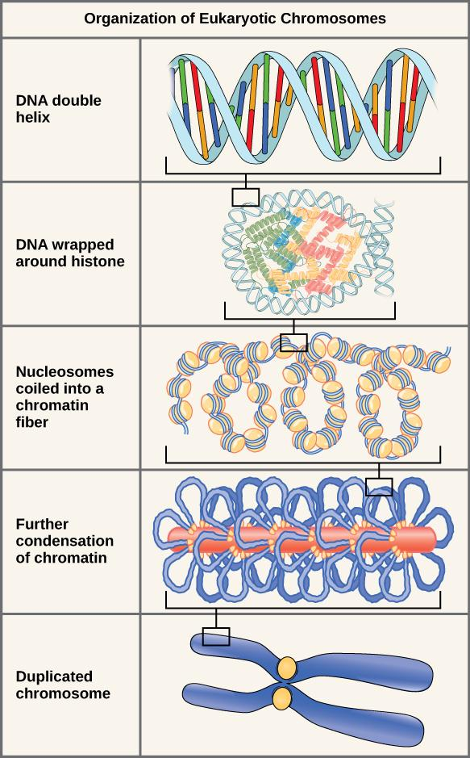
10.1 Chromosome Structure and Compaction
Eukaryotes
Histones
DNA organizing proteins
8 histones form a spool that DNA wraps around
Nucleosome
Chromatin
DNA and organizing proteins
Coiled
Condensed chromosomes
Prior to mitosis
Prevent damage or tangling

Slide 11
10.1 CHROMOSOME STRUCTURE AND COMPACTION
https://youtu.be/gbSIBhFwQ4

Slide 12
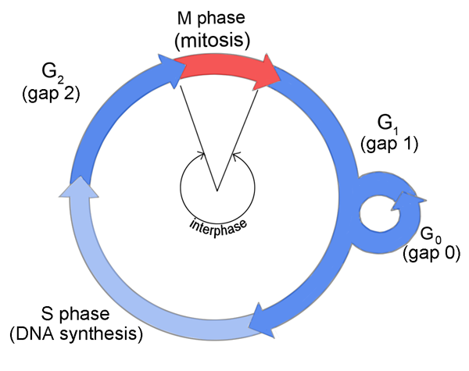
10.2 The Cell Cycle
An ordered series of events in the life of a cell
Interphase (blue)
normal growth and preparation for cell division
G₁, S phase, G₂
M or Mitotic phase (red)
Mitosis
Division of the nucleus
Cytokinesis
Division of the cytoplasm/cell

Slide 13
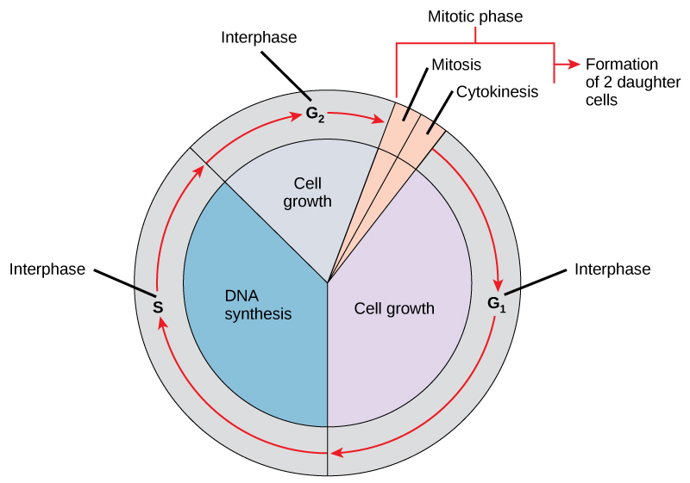
10.2 The Cell Cycle

Slide 14
10.2 The Cell Cycle
Interphase
G₁ Phase (first gap)
Change is not evident (“gap”) but the cell is biochemically active
S Phase is when DNA synthesis occurs
Identical copies of the DNA molecules (sister chromatids) are joined at the centromere
Centrosomes produce the mitotic spindles to move the chromosomes
In animal cells, centrosomes are associated with centrioles which help organize cell division
G₂ Phase (second gap)
Energy is replenished, organelles reproduce and cytoskeleton breaks down

Slide 15
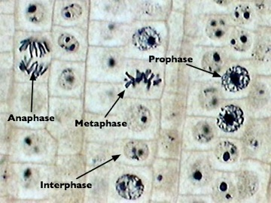
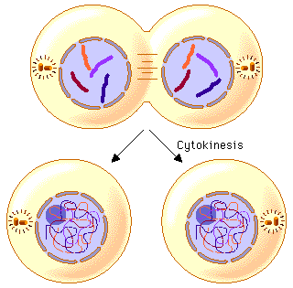
10.2 The Cell Cycle
M or Mitotic Phase
Mitosis
Prophase
Prometaphase
Metaphase
Anaphase
Telophase
Cytokinesis
Animal Cells
Contractile ring forms a cleavage furrow
Plant Cells
Cell plate

Slide 17
10.2 The Cell Cycle
Mitosis
Prophase
Nuclear envelope breaks down
The nucleolus disappears
Membranous organelles (eg. Golgi complex, endoplasmic reticulum) disperse toward edges of the cell
Centrosomes begin migration to poles
Spindle fibers emerge from poles
Microtubule
Chromosome condense and become visible
Sister chromatids coil tighter (aided by condensin proteins)

Slide 18
10.2 The Cell Cycle
Mitosis
Prophase

Slide 19
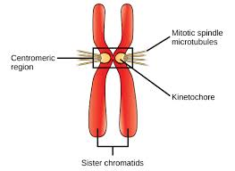
10.2 The Cell Cycle
Mitosis
Prometaphase
Sister chromatids develop a protein kinetochore in the centromere region which attaches the chromatids to the spindle microtubules

Slide 20
10.2 The Cell Cycle
Mitosis
Prometaphase
Chromosomes continue to condense
Mitotic spindles attach to the kinetochore
Centrosomes arrive at opposite poles

Slide 21
10.2 The Cell Cycle
Mitosis
Prometaphase

Slide 22
10.2 The Cell Cycle
Mitosis
Metaphase
Chromosomes line up along metaphase plate
Sister chromatids remain attached by cohesion proteins

Slide 23
10.2 The Cell Cycle
Mitosis
Anaphase
Cohesin proteins degenerate allowing chromatids to separate
Separated sister chromatids move in opposite directions toward the centrosomes to which their kinetochore microtubules are attached
The cell elongates through lengthening of non-kinetochore microtubules

Slide 24
10.2 The Cell Cycle
Mitosis
Telophase
Chromosomes reach opposite poles and begin to decondense (unravel)
Spindles depolymerize into tubulin monomers that will form cytoskeletal components for the daughter cells
Nuclear envelopes form around the chromosomes, and nucleosomes appear within the nuclear area

Slide 25
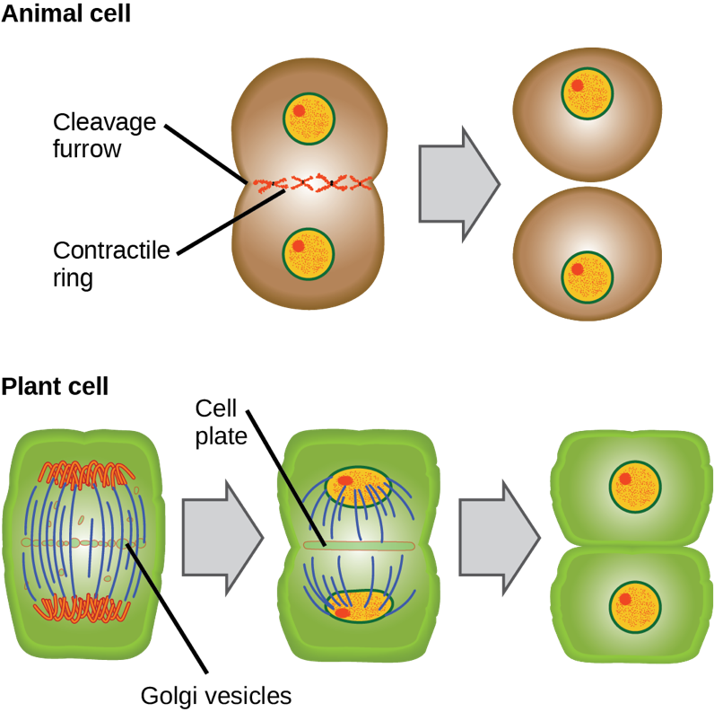
10.2 The Cell Cycle
Cytokinesis

Slide 26
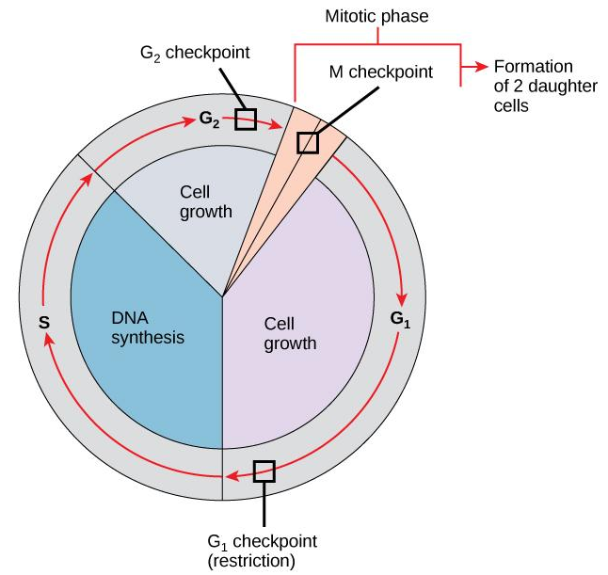
10.3 Control of the Cell Cycle
Regulation by external events
can initiate or inhibit the cell cycle
Death of nearby cells
Release of growth hormones
Cell crowding
Cell size
Attachment to an underlying surface

Slide 27
10.3 Control of the Cell Cycle
Regulation at internal checkpoints
Mistakes affecting function (such as mutated chromosomes or the wrong number of chromosomes) are regulated at 3 checkpoints in the cell cycle
(1) Near the end of G₁
(2) At the G₂ mitosis transition
(3) In metaphase of mitosis

Slide 28
10.3 Control of Cell Division
G₁ Checkpoint
determines whether all conditions are favorable for cell division
External factors- cell reserves and size
Check for genomic DNA damage
A cell that does not meet all the requirements will not be allowed to enter the S phase
The cell has 2 options if conditions aren’t met:
Stop the cycle and try to fix the problem
Enter G₀ and wait for signs that conditions are more favorable

Slide 29
10.3 Control of Cell Division

Slide 30
10.3 Control of Cell Division
G₂ Checkpoint
prevents entry into the mitotic phase if certain conditions are not met
Cell size and protein reserves are checked again
Most important role of this checkpoint is to ensure that all chromosomes have been replicated and that the replicated DNA is not damaged
If any problems are detected, the cell cycle is halted while the cell attempts to either complete DNA replication or repair the damaged DNA

Slide 31
10.3 Control of Cell Division

Slide 32
10.3 Control of Cell Division
M Checkpoint
Occurs near the end of metaphase
Determines whether all sister chromatids are correctly attached to the spindle microtubules
Also known as “spindle checkpoint”
The cycle will not proceed until kinetochores of each pair of sister chromatids are firmly anchored to at least two spindle fibers
Failure to correct this could lead to non-disjunction of chromatids

Slide 33
10.3 Control of Cell Division

Slide 34
10.3 Control of Cell Division
Regulator Molecules of the Cell Cycle
Two groups of intracellular molecules regulate the cell cycle
Positive Regulators- promote movement to next step of the cell cycle
Negative Regulators- stop advancement of the cell cycle

Slide 35
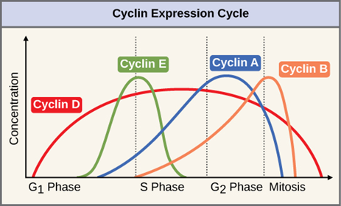
10.3 Control of Cell Division
Positive Regulators
Cyclins and cyclin-dependent kinases (Cdks)
Levels of these proteins fluctuate predictably over the cell cycle
Internal and external signals can trigger increases in cyclin protein levels

Slide 36
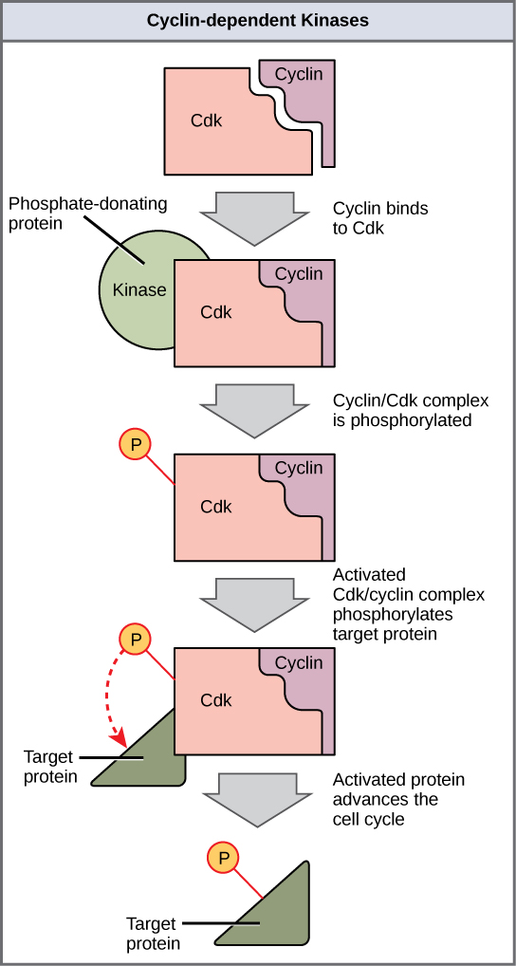
10.3 Control of Cell Division
Positive Regulators

Slide 38
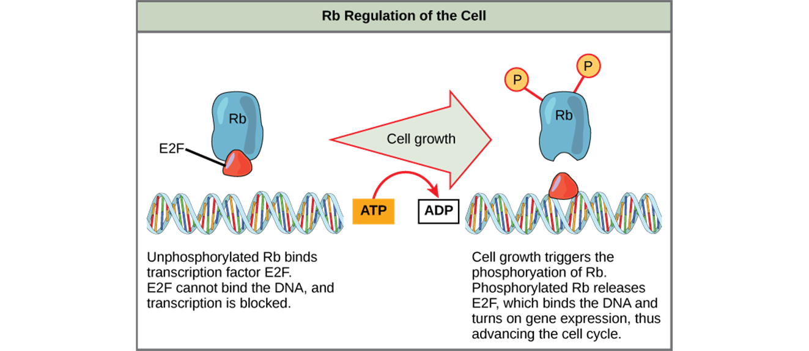
10.3 Control of Cell Division
Negative Regulators
The best understood are retinoblastoma protein (Rb), p53, and p21
These act primarily at the G₁ checkpoint

Slide 39
10.4 Cancer and the Cell Cycle
Cancer includes many different diseases characterized by uncontrolled cell growth
Begins with a gene mutation that results in a faulty protein that regulates cell reproduction
Proto-oncogenes are normal genes that code for positive regulators
Specific mutations in these gene disrupt regulation of the cell cycle
Oncogenes
Tumors result when reproduction of mutated cells surpasses growth of normal cells

Slide 40
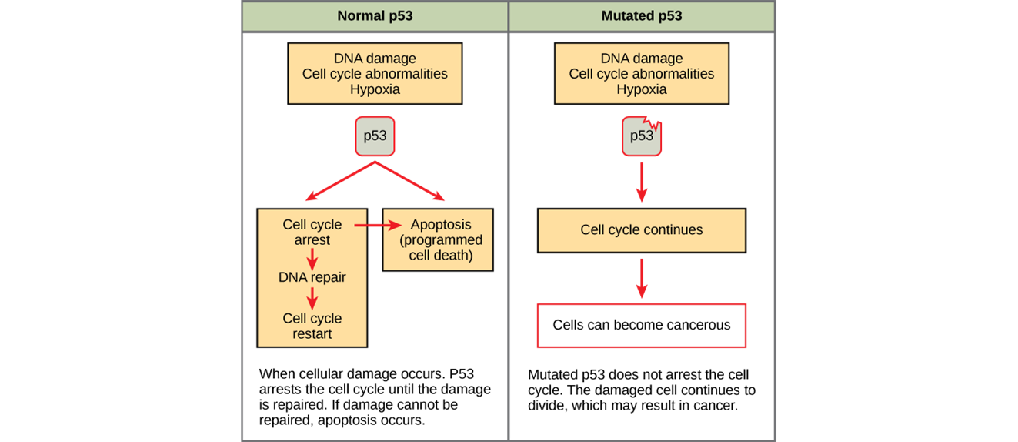
10.4 Cancer and the Cell Cycle

Slide 41
10.4 Cancer and the Cell Cycle
Tumor suppressor genes
segments of DNA that code for negative regulator proteins
When activated, these can prevent uncontrolled division
Cells with a mutated form of a negative regulator might not be able to stop the cell cycle if there is a problem

Slide 42
10.5 Prokaryotic Cell Division
Binary fission
Prokaryotes (Bacteria and Archaea)
Produces daughter cells
Genetically identical
Includes:
Replication of DNA
Allocation of DNA and division of cytoplasmic contents to daughter cells

