Slide 1
BIOLOGY 2E
Chapter 12 MENDEL’S EXPERIMENTS AND HEREDITY
This work is licensed under a Creative Commons Attribution-NonCommercial-ShareAlike 4.0 International License.

Slide 2
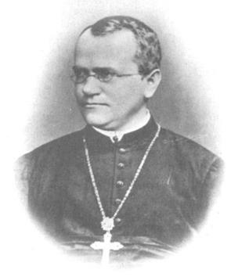
INTRODUCTION
Johann Gregor Mendel is considered the “father of genetics”
Genetics is the study of heredity
Used a simple biological system
Conducted quantitative analyses using large sample sizes (thousands!)

Slide 3
Historical misconceptions about heredity
Hippocrates: Pangenesis
Particles from every part of the parent’s body collects in the gonads
16th century: Homunculus
Sperm contained fully formed microscopic person
Darwin: Pangenesis revisited
Each part of the body emits “gemmules”
Lamarck: Inheritance of acquired traits
Changes happening to parents could be passed on to offspring
Altered parts = altered “gemmules”

Slide 4
Example: Homunculus
Homunculus from a 1640 Swedish text
Note the “little man”.
Some earlier editions even clothed little men and women in the fashions of their day!

Slide 5
POPULAR BELIEF
Inheritance involves a “blending” of parental traits that produces an intermediate physical appearance in offspring
Blending theory of inheritance: original parental traits are lost or absorbed by blending them together
Appeared to be correct because of continuous variation
Variation in a characteristic which results from the interaction of many genes
https://www.youtube.com/watch?v=E0Aeks_id6c&feature=share

Slide 6
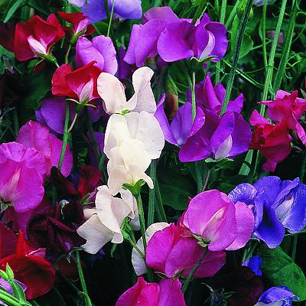
MENDEL’S MODEL SYSTEM- THE GARDEN PEA PLANT
True-breeding
Avoided the appearance of unexpected traits in offspring
Grows to maturity within one season
Several generations could be grown over a short time
Large quantities could be grown simultaneously
Allowed Mendel to conclude that his results were not simply by chance
Exhibits discontinuous variation
Traits are inherited in distinct classes
Allowed him to see whether traits blended together or remained distinct
Cheap
Readily available

Slide 7
Mendel’s Method for Monohybrid Cross
Step 1: Select trait with two different forms
variation in the physical appearance of a heritable characteristic
Plant height, seed texture, seed color, flower color, pea pod size, pea pod color, and flower position
Step 2: Confirm true-breeding parents
Step 3: Perform hybridizations of the P generation
Cross of true-breeding parents
Step 4: Collect and grow seeds from P generation to produce F₁ generation
First filial generation
Step 5: Collect and grow seeds from F₁ generation to produce F₂ generation
Second filial generation

Slide 8
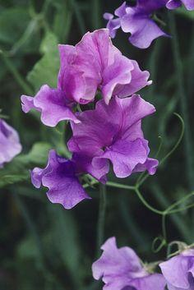
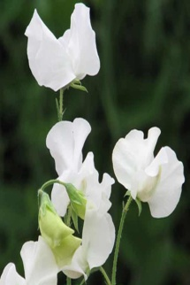
Results
True-breeding purple
True-breeding white
X
P
All purple
White disappeared
No blending!
F₁
X
3:1 purple to white
Always!
F₂

Slide 10
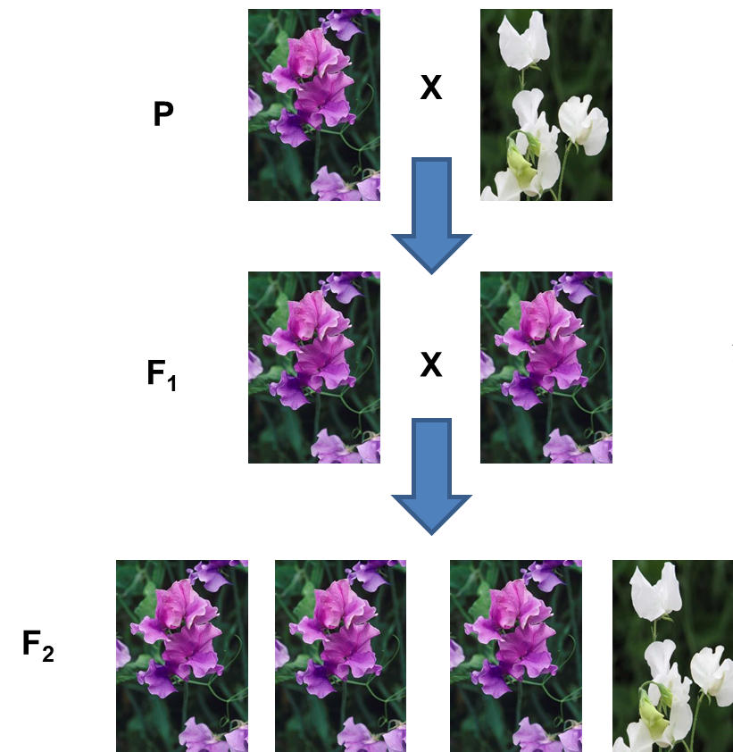
CONCLUSIONS FROM MONOHYBRID CROSSES:
Blending inheritance was not possible

Slide 11
CONCLUSIONS FROM MONOHYBRID CROSSES:
Particulate inheritance most likely
Offspring inherit discrete ‘particle’ from each parent
Genotype = the specific combination of “particles” inherited from the parents
Dominant particle hides the recessive particle
Dominant particle determines the phenotype
The version of the trait actually seen
Recessive particle is passed unchanged

Slide 12
CONCLUSIONS FROM MONOHYBRID CROSSES:
Implications of the 3:1 ratio
F1 monohybrids carry one particle for each trait
Parents are identical except for one characteristic
Particles segregate into gametes and come back together at fertilization
Genotypes and phenotypes can be predicted by a Punnett Square

Slide 13
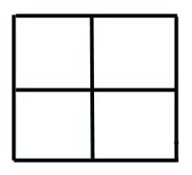
Punnett Squares
P generation (purple) homozygote PP
P generation (white) homozygote pp
F₁ Heterozygotes
X
Pp
X
Pp
Parental gametes
P
P
P
p
p
Pp
Pp
P
p
Pp
Pp
p
F₁ generation genotypes
F₂ generation genotypes

Slide 14
PUNNETT SQUARES CAN PREDICT MENDELIAN CROSS OUTCOMES

Slide 15
MENDEL’S PROBLEM
How to tell a heterozygote from homozygote?

Slide 16
A Formal Test Cross
Begin with true-breeding parents
P
X
Cross the F₁
monohybrid with a recessive homozygote
F₁
X
F₂
What do these results indicate?

Slide 17
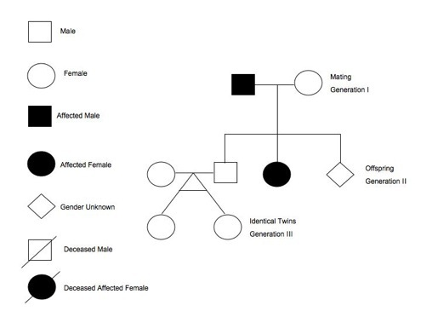
AN ALTERNATIVE TO THE TEST CROSS
Many human diseases can be passed from parent to offspring BUT unethical to perform a test cross on humans!
Probability can be used with pedigrees to make genetic inferences about individual risk

Slide 18
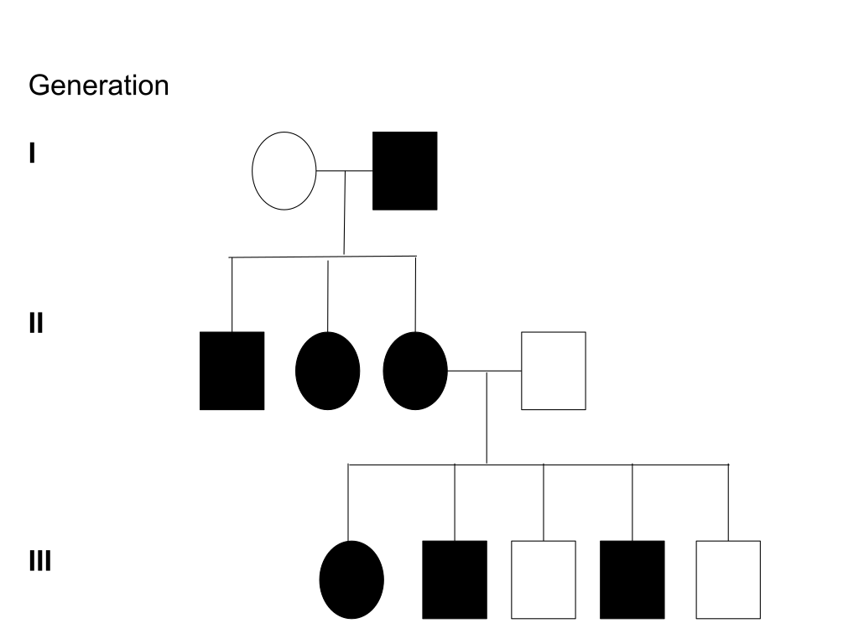
AUTOSOMAL DOMINANT DISORDER
By Hydra2114 at https://en.wikipedia.org/wiki/Pedigree_chart
It never skips a generation and there are no unaffected carriers. Affected children must have affected parents. When one parent possesses the trait and is heterozygous approximately half of the children will possess the dominant disorder.

Slide 19
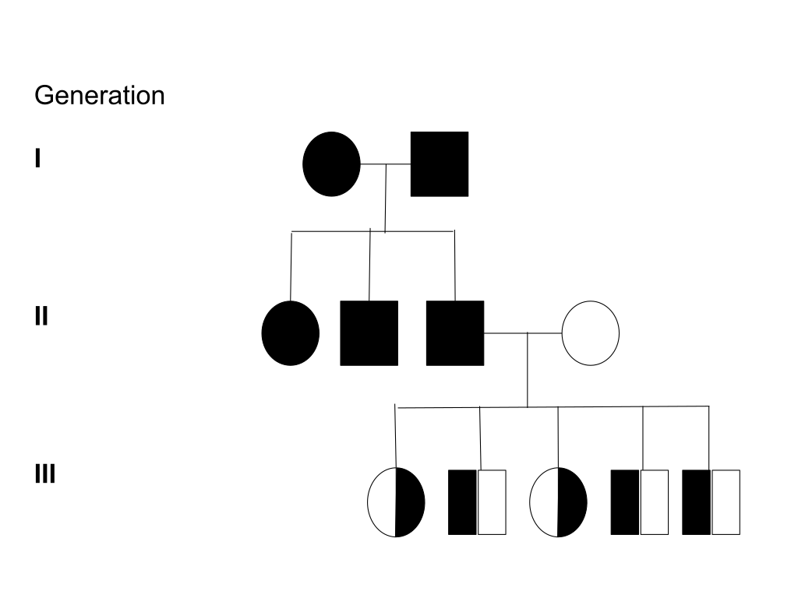
AUTOSOMAL RECESSIVE DISORDER
By Hydra2114 at https://en.wikipedia.org/wiki/Pedigree_chart
It skips generations with none of generation 3 actually displaying the trait. When both parents display the disorder all of their kids have to display the disorder, but when only one parent displays the disorder all of the kids will be carriers but unaffected by the trait.

Slide 20
GROUP DISCUSSION
Describe the scientific reasons for the success of Mendel’s experimental work.
How did Mendel know that each individual must have two particles?
What are the expected genotype and phenotype ratios for crossing a female chocolate lab with a male heterozygous black lab?
Explain the purpose and methods of a test cross.

Slide 21
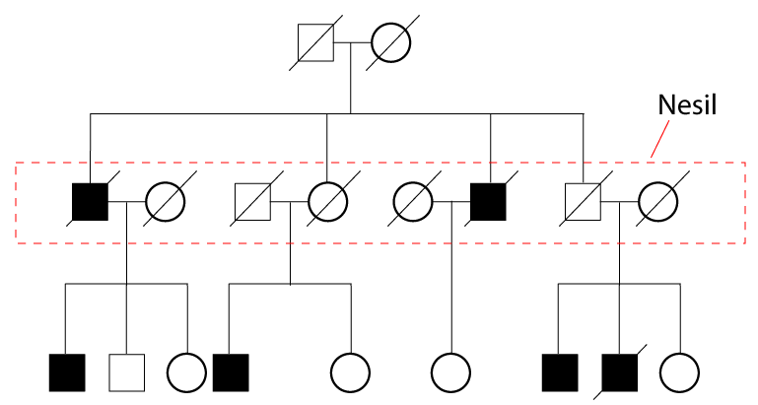
GROUP DISCUSSION
Identify the type of inheritance shown in the pedigree, and identify the genotype(s) of each individual.

Slide 22
Postulate #1
Hereditary particles inherited as discrete units
Not lost or blended
Each true-breeding parent carries 2 hereditary particles for each characteristic
Come apart during gamete formation such that each parent passes only one particle into each gametes
Hereditary particles recombine randomly during fertilization to produce offspring

Slide 23
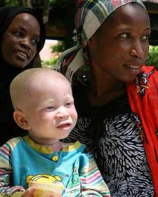
Postulate #2: Law of Dominance
In a heterozygote, dominant trait conceals the recessive trait
Recessive trait will remain “latent” but will still be transmitted to offspring
Only expressed by offspring that have two copies
These offspring breed true when self-crossed
NOW: law of dominance does not always hold true
Several different patterns exist
Notes:
Information about ear wax and implications for human health: http://udel.edu/~mcdonald/mythearwax.html
Albinism results from inheritance of recessive gene alleles and is known to affect all vertebrates, including humans. It is due to absence or defect of tyrosinase, a copper-containing enzyme involved in the production of melanin. It is the opposite of melanism.

Slide 24
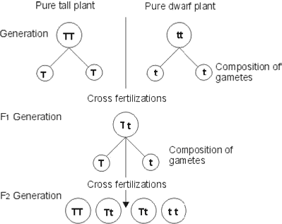
Postulate #3: Law of Segregation
Paired hereditary particles must segregate equally into gametes such that offspring have an equal likelihood of inheriting either factor
Supports Mendel’s observed 3:1 phenotypic ratio in the F2 generation
Getpractice.com

Slide 25
CHROMOSOMES AND THE LAW OF SEGREGATION
Mendel’s “particle” is a gene
portion of a DNA molecule that encodes for a trait
Locus = location of a gene on a chromosome
Alleles = specific versions of a gene that code for each trait
The physical basis of the Law of Segregation is anaphase I of meiosis
Homologous chromosomes, each with a different allele for each gene, are segregated into daughter nuclei

Slide 26
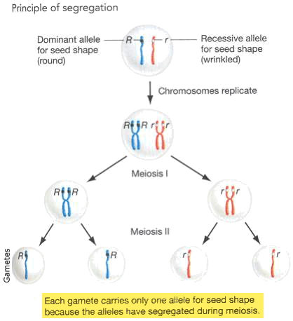
Slideplayer.com

Slide 27
Postulate #4: Law of Independent Assortment
Genes do not influence each other with regard to the sorting of alleles into gametes
Every possible combination of alleles for every gene is equally likely to occur
Segregation and recombination of alleles for one trait has no effect on segregation and recombination of alleles for other traits

Slide 28
Postulate #4: Law of Independent Assortment
Independent assortment occurs during metaphase I of meiosis

Slide 29
Postulate #4: Law of Independent Assortment
Mendel deduced the law of independent assortment of genes from dihybrid crosses
Cross between two true-breeding parents that express different traits for two characteristics

Slide 30
If you count each trait individually, you will see each still gives a 3:1 ratio as in monohybrid crosses. This led Mendel to conclude that traits were inherited independently from one another.
Dihybrid Crosses

Slide 31
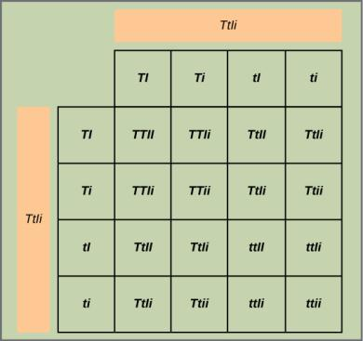
HOW TO COMPLETE A DIHYBRID CROSS
This figure shows all possible combinations of offspring resulting from a dihybrid cross of pea plants that are heterozygous for the tall/dwarf and inflated/constricted alleles.

Slide 32
LINKED GENES
Genes located on separate, non-homologous chromosomes always follow the Law of Independent Assortment
However, each chromosome contains hundreds or thousands of genes which by definition are “linked” together
Linkage: genes that are located physically close to each other on the same chromosome are more likely to be inherited as a pair
Recombination allows two genes on the same chromosome to behave independently
Crossing over during metaphase I of meiosis
The farther apart two genes are located, the more likely recombination is

Slide 33
RECOMBINATION
The process of crossover occurs when two homologous chromosomes align during metaphase I of meiosis and exchange a segment of genetic material
Here, the alleles for gene C were exchanged. Result:
Two recombinant chromosomes
Two non-recombinant chromosomes

Slide 34
WHAT ABOUT MORE THAN 2 CHARACTERISTICS?
Use the probability method
Use the product rule and sum rule and consider the alleles for each gene separately

Slide 35
Probability Basics
Probabilities are mathematical measures of likelihood
The probability of an event = the number of times the event occurs divided by the total number of opportunities for the event to occur
Given as a fraction equivalent (or decimal or %) over a range of zero to one
A probability of 1 means it is guaranteed to occur
A probability of 0 means it is guaranteed not to occur
Anything that is chance is between 0 and 1
Example: the chance of a flipped coin landing with heads up is ½ ( or 0.5 or 50%)

Slide 36
PRODUCT RULE
The probability of two or more independent random events occurring in an exact order is equal to the product of their individual probabilities
Example:
The chance of rolling exactly a five on a die is 1/6,
The chance of rolling exactly a four on a die is 1/6,
So, the overall chance of rolling a five on the first die and a four on the second die is:
1/6 X 1/6 = 1/36
Practice
What is the probability of drawing 4 of a kind in poker?
What is the probability of a family having 3 boys?

Slide 37
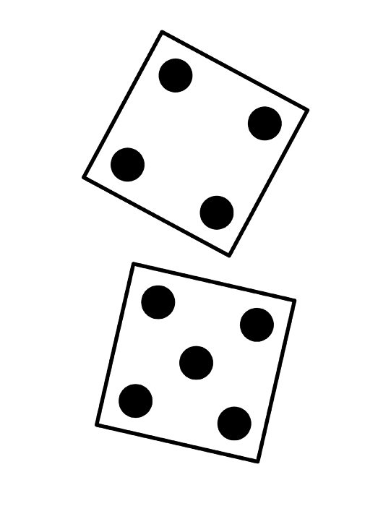
SUM RULE
When there are multiple ways for an outcome to occur, the overall probability is the sum of the individual events
Example:
If one can win by rolling a 4 or a 5 with one die, then the overall chance of winning is:
The chance of rolling a four is 1/6
The chance of rolling a five is also 1/6
So, the overall chance is 1/6 +1/6 = 2/6 = 1/3
OR

Slide 38
BOTH LAWS CAN BE COMBINED FOR COMPLEX RANDOM EVENTS
Practice:
What is the chance of rolling a 5 and a 4 in any order?
There are 5 parents, 3 students and 2 teachers in a room. If a person is selected at random, what is the chance it is 2 parents or 2 teachers?

Slide 39
PROBABILITY METHOD
Consider the following cross: AABBCc x AabbCc. What is the probability of finding an offspring whose genotype is either AaBbCC or AaBbcc?

Slide 40
GROUP DISCUSSION
Explain Mendel’s law of segregation and independent assortment in terms of genetics and the events of meiosis
Explain the effect of linkage and recombination on gamete genotypes
In pea plants, purple flowers (P) are dominant to white flowers (p) and yellow peas (Y) are dominant to green peas (y). What are the possible genotypes and phenotypes for a cross between PpYY and ppYy pea plants?

Slide 41
BEYOND MEDELIAN INHERITANCE
Incomplete dominance
Codominance
Multiple alleles
X-linked traits
Lethality
Epistasis

Slide 42
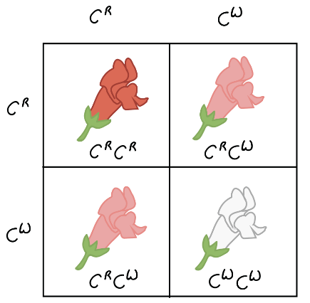
INCOMPLETE DOMINANCE
The interaction of two contrasting alleles creating an intermediate phenotype.
How do the genotype and phenotype ratios compare to ratios resulting from complete dominance?
www.khanacademy.org

Slide 43
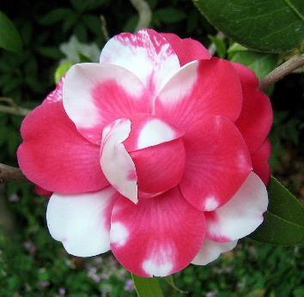
CODOMINANCE
Both alleles for the same characteristic are simultaneously expressed in the heterozygote
Darwin Cruz

Slide 44
MULTIPLE ALLELES
More than 2 alleles may be present in the population
The most common form is the wild type
Considered the normal form
All other forms are variants or mutants
May be recessive or dominant to the wild-type
Four different alleles for the rabbit coat color (C) gene.
Dominance of each individual allele over a second allele varies from completely dominant to incompletely dominant.

Slide 45
X-LINKED TRAITS
Genes located on the X chromosome do not have a match on the Y chromosome
Females may be homozygous or heterozygous
Males are hemizygous
Contain only one allele for the characteristic
Thomas Hunt Morgan discovered the first x-linked characteristic in 1910
Eye color
Red is wild-type and dominant to white

Slide 46
Inheritance of X-linked traits
Punnett square analysis is used to determine the ratio of male and female offspring

Slide 47
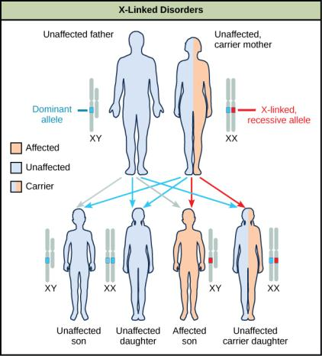
Inheritance of X-linked traits
What is the probability that the son of a colorblind father and carrier mother will be colorblind?
What is the probability of a colorblind daughter?

Slide 48
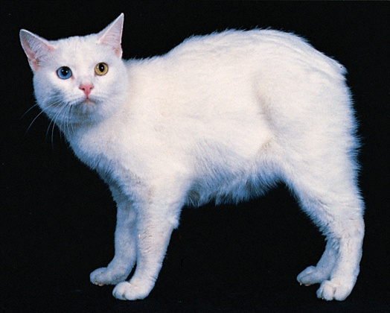
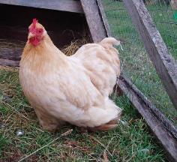
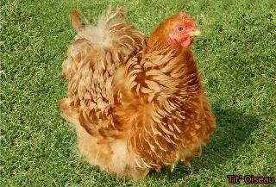
LETHALITY
Some alleles are so non-functional as to kill the individual inheriting it. Lethal alleles can be dominant or recessive.
MM are normal cats
MM^{L} are Manx
M^{L}M^{L} all die
Frizzle chicken x smooth chicken = 50% of each type of chick
Frizzle x frizzle = dead chicks
Is frizzle dominant or recessive?
What is the genotype of a frizzle chicken?
Michael Romanov
Notes:
Frizzle x smooth = 50% of each type in chicks so a frizzle must be heterozygous
The frizzle allele must be recessive, otherwise the heterozygotes would die

Slide 49
EPISTASIS
Mendel only investigated characteristics controlled by one gene
In some cases, several genes can contribute to phenotype
Epistasis = the antagonistic interaction between genes where one gene masks or interferes with the expression of another
The alleles that are being masked or silenced are hypostatic to the epistatic alleles that are doing the masking

Slide 50
EPISTASIS
The mottled agouti coat color (A) is dominant to a solid color (a)
A second gene at locus C is responsible for pigment production
The recessive c allele does not produce pigment
The homozygous recessive cc genotype is albino regardless of the allele present at the A locus
Thus, the C gene is epistatic to the A gene

Slide 51
GROUP DISCUSSION
Describe non-Mendelian inheritance patterns such as incomplete dominance, codominance, recessive lethal alleles, multiple alleles, and x-linkage.
Explain the phenotypic outcomes of epistatic effects between genes.

